Slide 1

FOR THE LOVE OF THE OUTDOORS I 2024
Notes:
Welcome to Leave No Trace. Introduce yourselves and your role with Leave No Trace. Include a land acknowledgment if applicable.

Slide 2
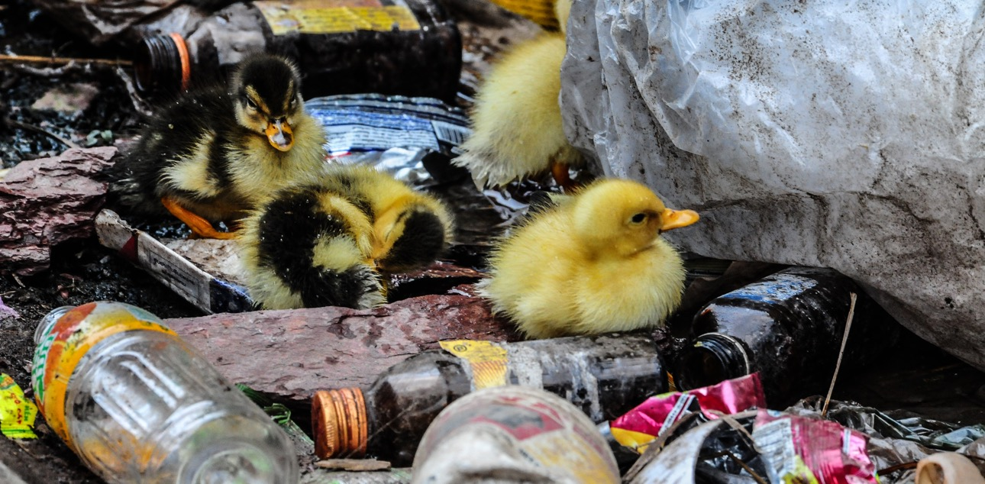
We love nature, yet we all have an impact.
FOR THE LOVE OF THE OUTDOORS I 2024
Notes:
We love nature, yet we all have an impact. More use, trash, compromised wildlife, fire and climate change. The nature we love is at risk.

Slide 3
Leave No Trace is one of the world’s leading organizations devoted to teaching people how to protect the natural world.
People trained in Leave No Trace are 5 times more likely to take actions that protect nature.
FOR THE LOVE OF THE OUTDOORS I 2024
Notes:
Leave No Trace is one of the world’s leading organizations that addresses these risks by teaching people how to take action to care for the outdoors. When we Leave No Trace, we keep forests healthy, protect our parks, keep wildlife strong, prevent wildfires, and ensure everyone is welcome to enjoy these remarkable places together.
The research tells us that people trained in Leave No Trace are 5 times more likely to protect nature, yet 9 out of 10 people still don’t have that critical, basic education that they need. Leave No Trace exists to change that.

Slide 4
How:
1
2
3
Expanding Training for All People
Increasing
Stewardship
Advancing Science
and Research
FOR THE LOVE OF THE OUTDOORS I 2024
Notes:
At Leave No Trace we empower people to be the solution to conservation. To do it, we:
We are advancing the science and research to support the health of the outdoors
We are leading the way with Leave No Trace education and training for all people to ensure they have the tools they need.
Build sustaining partnerships and activate communities through critical education and restoration programs.
Because when we Leave No Trace, we keep forests healthy, protect our parks, keep
wildlife strong, prevent wildfires and ensure everyone is welcomed to enjoy these remarkable places together.

Slide 5
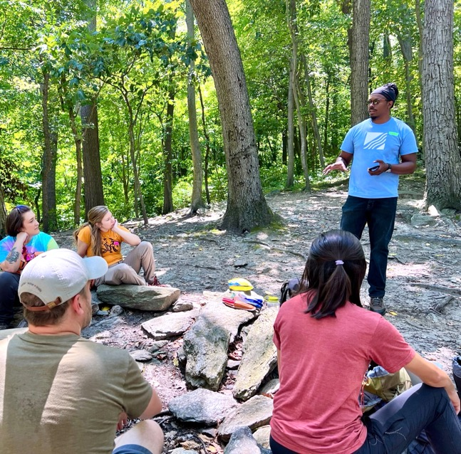
1
Expanding Training for All People
Our training structure creates a world of Leave No Trace advocates, practitioners and stewards.
FOR THE LOVE OF THE OUTDOORS I 2024
Notes:
At Leave No Trace, we empower people to be the solution to conservation.
To do it, we are leading the way with Leave No Trace education and training for all people to ensure everyone has the tools they need. Our comprehensive training programs and education are designed to ensure that not just outdoor professionals, land managers and rangers know and teach Leave No Trace, but also that anyone who gets out on the trail or enjoys their local park with family and friends has what they need to protect nature. We are designing new programs every day to make Leave No Trace accessible to everyone.

Slide 6
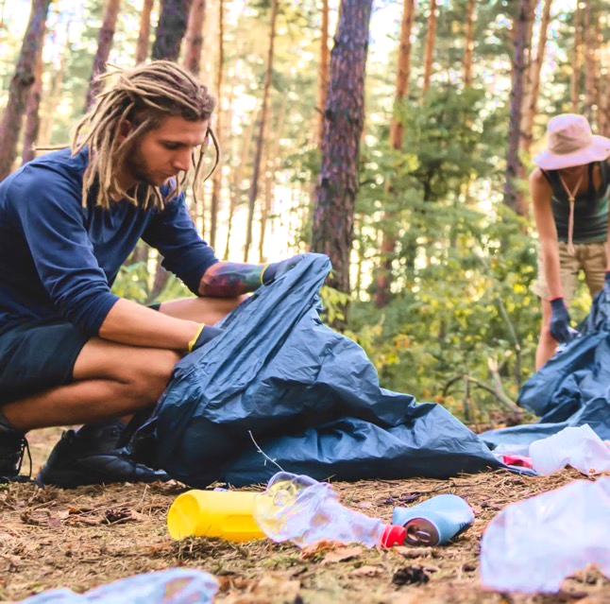
2
Increasing Stewardship
We are building a global community of people who care about and are engaged with putting Leave No Trace into action.
FOR THE LOVE OF THE OUTDOORS I 2024
Notes:
Environmental stewardship is at the core of what we do. Leave No Trace builds sustaining partnerships and activates communities through on-the-ground training and restoration programs in communities around the United States. We work with the international community to help them do the same.

Slide 7
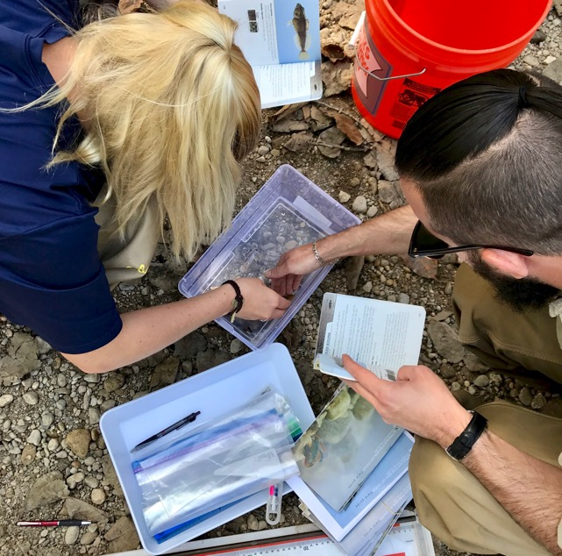
3
Expanding Science and Research
We are constantly enhancing and elevating the science behind Leave No Trace.
FOR THE LOVE OF THE OUTDOORS I 2024
Notes:
Leave No Trace’s foundation, our education system, and our recommendations are based on the best science we do and have available to us. We work with the scientific community to conduct research that informs what we teach, what people respond to, and what will help our land, water, and wildlife thrive.

Slide 8

ICON STYLE
THE LEAVE NO TRACE SPECTRUM
Few Impacts
Significant Impacts
Notes:
Think of Leave No Trace and our personal outdoor ethic as a spectrum: On one end there are many impacts. On the other end, few impacts. Find your place on the spectrum. Everyone has a unique relationship with nature and their place on this spectrum may be different, and that's okay.

Slide 9
ICON STYLE
PUBLIC LAND USE
Visits per Year
(Hundreds of Millions)
Notes:
As you can see from this graph, the number of visitors to protected areas is high, and continues to increase.
While it's wonderful that so many people are enjoying our federal lands, increased visitation can lead to significant environmental impacts. More foot traffic means more wear and tear on trails, greater potential for litter, and increased risk of disturbing wildlife.
This is why the Leave No Trace principles are more important than ever. They provide a framework for minimizing our impact and ensuring that these lands remain pristine for future generations. By educating visitors and practicing Leave No Trace, we can help mitigate the negative effects of high visitation.

Slide 10
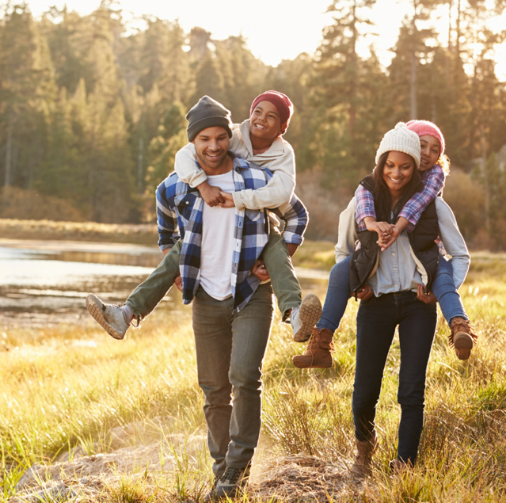
THE 7 PRINCIPLES
Plan Ahead and Prepare
Travel and Camp on Durable Surfaces
Dispose of Waste Properly
Leave What You Find
Minimize Campfire Impacts
Respect Wildlife
Be Considerate of Others
FOR THE LOVE OF THE OUTDOORS I 2024
Notes:
These principles provide a simple yet effective framework for minimizing our impact on the natural environment.
Whether you're hiking, camping, or enjoying any outdoor activity, these principles help ensure that our beautiful natural spaces remain unspoiled for future generations.
By following these guidelines, we can all contribute to the preservation of our wild places.

Slide 11
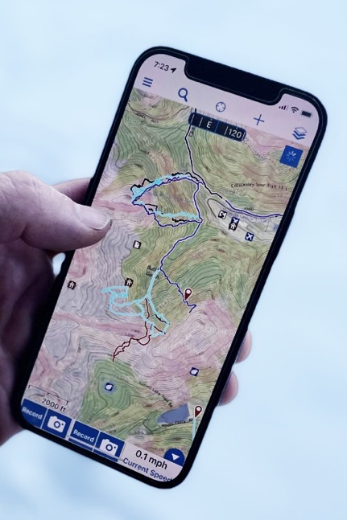

PRINCIPLE 1
PLAN AHEAD AND PREPARE
Be prepared! Remember to bring enough food and water, and clothes to protect you from cold, heat and rain.
Use maps to plan where you’re going and consult them often on the trails. Check the forecast before you leave, and be aware of changing conditions.
Remember to bring a leash for your pet and plastic bags to pick up your pet’s waste.
Learn about the areas you plan to visit. Read guidebooks, check online sources and talk to experienced people before you go. The more you know, the more fun you’ll have.
FOR THE LOVE OF THE OUTDOORS I 2024
Notes:
Effective planning not only ensures your safety but also minimizes your impact on the environment. Mention the advantages of non-digital and offline info sources like paper maps.
Research the Area you plan to visit:
Begin by researching your destination. Know the terrain, weather conditions, and the types of activities allowed in the area.
Check for any specific regulations or guidelines provided by park services or managing authorities. This could include information about camping zones, fire restrictions, or sensitive habitats.
Prepare for Weather:
Weather can change rapidly, especially in mountainous or remote areas. Check the forecast before your trip and be prepared for unexpected changes.
Pack clothing and gear that can handle the worst possible conditions you might encounter.
Pack Appropriately:
Your gear should be suitable for the environment and duration of your trip. This includes navigation tools, sufficient food and water, and a first aid kit.
Make a checklist to ensure you don’t forget any essential items. Remember, it’s better to have it and not need it than need it and not have it.
Know the Regulations:
Familiarize yourself with the rules and regulations of the area you're visiting. This could involve permits, fire regulations, wildlife guidelines, and restrictions on where you can camp or hike.
Following these regulations helps protect the environment and ensures you have a safe and enjoyable trip.
By planning ahead and preparing thoroughly, you reduce the likelihood of emergencies and help protect the environment. You also enhance your overall outdoor experience by being ready for whatever comes your way. Remember, good planning leads to great adventures.

Slide 12
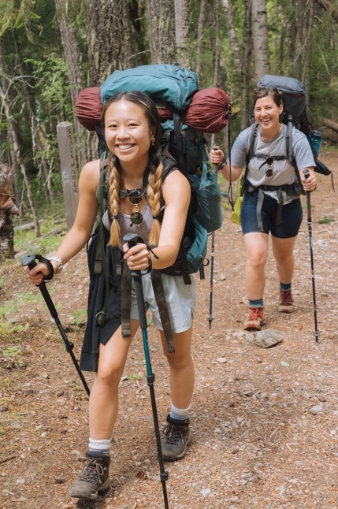

PRINCIPLE 1
TRAVEL AND CAMP ON DURABLE SURFACES
Walk and ride on designated trails to protect trailside plants.
Do not step on flowers or small trees. Once damaged, they may not grow back.
Respect private property by staying on designated trails.
Camp on existing or designated campsites to avoid damaging vegetation and to minimize your impacts.
Good campsites are found, not made. Don’t dig trenches or build structures in your campsite.
FOR THE LOVE OF THE OUTDOORS I 2024
Notes:
The surfaces and living organisms we step on and interact with are susceptible to cumulative impacts from humans. Not only can we directly trample and kill vegetation, lichen, mosses, flowers, or other living things, but we can compact soil and make areas unsightly.
It’s always best to stick to designated trails and campsites when they are available to us. These were put in place to concentrate the damage from a high amount of humans in an area. It can take as few as 12 passes, or 25 nights of camping, to impact the surfaces of an area enough to where it won’t recover. If we are in an area without trails or campsites, or are doing an activity that doesn’t utilize them, we want to disperse our impact to wider area (or spread out in a group) to improve the chances that spot will recover and dissuade others from following our exact track.

Slide 13
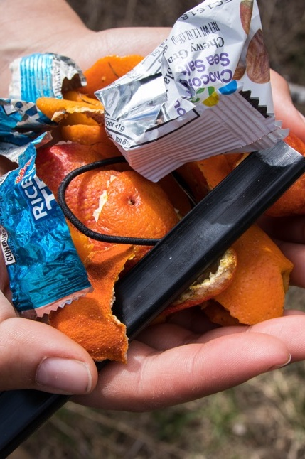

PRINCIPLE 1
DISPOSE OF WASTE PROPERLY
Pack it in, Pack it out. Put litter–even crumbs, peels and cores–in garbage bags and carry it home.
Use bathrooms or outhouses when available. If not available, bury human waste in a small hole 6-8 inches deep and 200 feet or 70 big steps from water.
Use a plastic bag to pack out your pet’s poop to a garbage can.
Keep water clean. Do not put soap, food, or human or pet waste in lakes or streams.
FOR THE LOVE OF THE OUTDOORS I 2024
Notes:
The waste we create when spending time outdoors can have negative effects on the environment. This includes litter, including food scraps, human waste, pet waste and dirty water from washing dishes or ourselves.
The number one guideline is pack it in, pack it out. Trash and litter left behind is not only unsightly but pollutes water and is dangerous for wildlife. Food waste such as orange peels, pistachio shells and apple cores can take up to two years to decompose. They are also unhealthy sources of food to wildlife. Bring a bag so you can take your trash, and maybe others litter, home with you.
For human waste disposal, do your best to plan ahead and use bathrooms where they are available. If nature calls and there are no bathrooms nearby walk 70 big steps from trails, water and camp and dig a hole that is 6-8 inches deep. Do your business and use a stick to cover the hole with the dirt you removed. Toilet paper can be buried with your waste in the hole unless packing it out is required by local land managers.
In some areas, such as those above the tree line or in desert environments where decomposition is much slower, may require that you pack out solid human waste. In these situations, use a WAG bag, that can be found at most outdoor stores and even some ranger stations, to pack out your waste.
Pet waste carries disease that can spread to wildlife and pollute water sources. Pack a bag to pick up pet waste and carry it out with you. Bags left on the side of the trail are often forgotten and turn into litter.

Slide 14
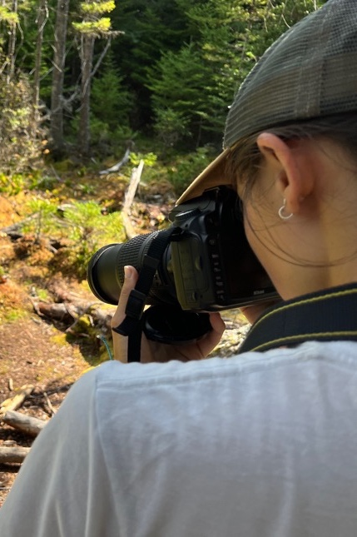

PRINCIPLE 1
LEAVE WHAT YOU FIND
Leave plants, rocks and historical items as you find them so others can enjoy them.
Photographs allow you to share the interesting things you find while leaving them undisturbed.
Treat living plants with respect. Carving, hacking or peeling plants may kill them.
Foraging for small quantities of wild food items is allowed in some places but be sure to consult with land managers first.
FOR THE LOVE OF THE OUTDOORS I 2024
Notes:
Everything we find in nature plays a role in that environment or tells a story of past people and current cultures.
Protect living plants and trees by not carving into them. Carving into trees breaks their protective barrier making them more susceptible to disease. While picking a flower may not seem like it has a big impact, but imagine everyone who spends time outside took a few flowers. Pollinators may depend on just a few species in a small range to survive.
Leave other natural items such as antlers and bones for other visitors to enjoy. These items may also provide important nutrients to local critters. Don’t stack rocks or create your own cairns. Moving rocks may disturb the ecosystem and in areas where cairns are used for directions could cause other visitors to be lost.
While enjoying the outdoors you may come across objects such as structures, arrowheads, clay pots, old tin cans, and other evidence of past peoples. Leave these items as you found them for future visitors to enjoy and protect the cultural or spiritual connections tied to these items and places. Observe but do not touch any structures, rock imagery or historic inscriptions you might find.
Finally, invasive species can have damaging impacts on ecosystem. You can help minimize the spread of these specifies by brushing off boots and bike tires and cleaning, draining and drying water crafts before and after every outing.

Slide 15
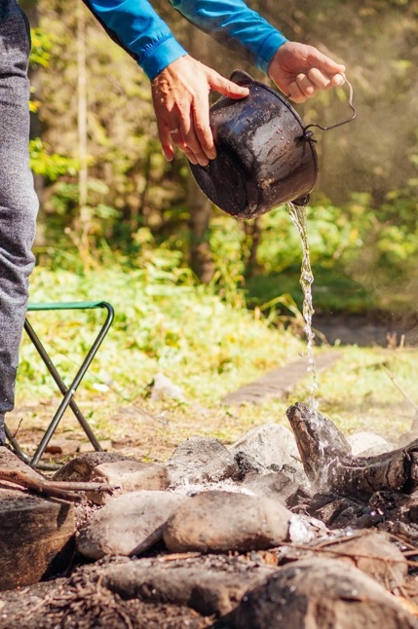

PRINCIPLE 1
MINIMIZE CAMPFIRE IMPACTS
Consider a camp stove—stoves are easier to cook with and create less impact than campfires.
If you want to have a campfire, be sure it’s permitted and safe to build a fire in the area you’re visiting. Use only existing fire rings to protect the ground from heat. Keep your fire small.
A campfire isn’t a garbage can. Pack out all trash and food.
Firewood should be either bought from a local vendor or gathered on site if allowed. Do not bring firewood from home—it can harbor tree-killing insects and diseases. Many states regulate the movement of untreated firewood.
Before gathering any firewood on site, check local regulations.
Burn all wood to ash and be sure the fire is completely cold before you leave.
FOR THE LOVE OF THE OUTDOORS I 2024
Notes:
Campfires are an important part of many peoples experience in the outdoors and Leave No Trace is pro campfire when allowed. However, it is critical we do everything we can to have a safe and responsible fire.
Use a camp stove for cooking. Camp stoves comes in all shapes and sizes and are much quicker and easier for cooking than a fire. They also create far less impact.
Before having a fire, always check local fire restrictions and make sure you understand what is allowed under each level of restrictions. Keep in mind in dry and windy conditions it may not be safe to have a fire even if there are no restrictions in place.
If campfires are allowed always use a designated or existing fire ring. This reduces the footprint of the damage the heat of the fire has on soils and vegetation.
For firewood, purchase wood locally to avoid introducing invasive, tree-killing species to an area. If gathering firewood is allowed, gather only wood that is dead, down, distant from camp and smaller than your wrist. Dead and down wood burns quickly, is easy to collect and does not disturb the ecosystem.
Never leave your fire unattended. This is how many wildfires are started. When you are done with your fire burn all the wood to ash and drown your fire with water. Stir and dowse it with more water until it is cool to the touch. Fires that are not put out completely can reignite easily with wind and can start a wildfire.
Don’t burn trash or food scraps. Burning trash releases harmful chemicals including some that cause cancer and burning food may attract unwanted visitors to your campsite.

Slide 16
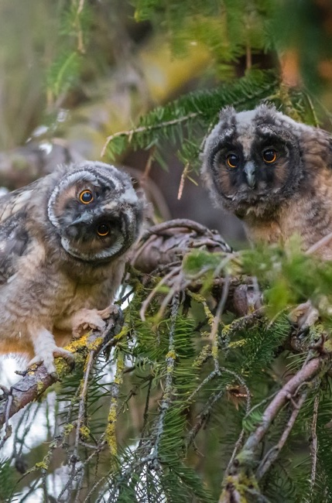

PRINCIPLE 1
RESPECT WILDLIFE
Observe wildlife from a safe distance and never approach, feed or follow wild animals. If you are unsure whether you are far enough away you are likely too close.
Human food is unhealthy for all wildlife and feeding them starts bad habits.
When wild animals associate humans with food they develop unsafe and unhealthy behaviors.
Protect wildlife and your food by securely storing your meals and trash. If bear-proof storage units are available in your campsite be sure to use them.
FOR THE LOVE OF THE OUTDOORS I 2024
Notes:
The sixth principle of Leave No Trace is Respect Wildlife.
Whenever you are in an outdoor space, you are in the natural habitat of many wild animals and it is imperative to minimize your impact on them. Human impacts on wildlife can result in negative human-wildlife interactions, aggressive animals, a decline in the ecosystem’s health and relocated or euthanized animals. All these impacts can be avoided if we respect wildlife on all outdoor trips.
Remember:
Observe wildlife from a distance. Do not follow or approach them.
Never feed animals. Feeding wildlife damages their health, alters natural behaviors, and exposes them to predators and other dangers. In order to keep our food and trash away from wildlife, we need to secure these items and follow food storage regulations for the area we are visiting.
Control pets at all times, or leave them at home.
Avoid wildlife during sensitive times: mating, nesting, raising young or winter.

Slide 17
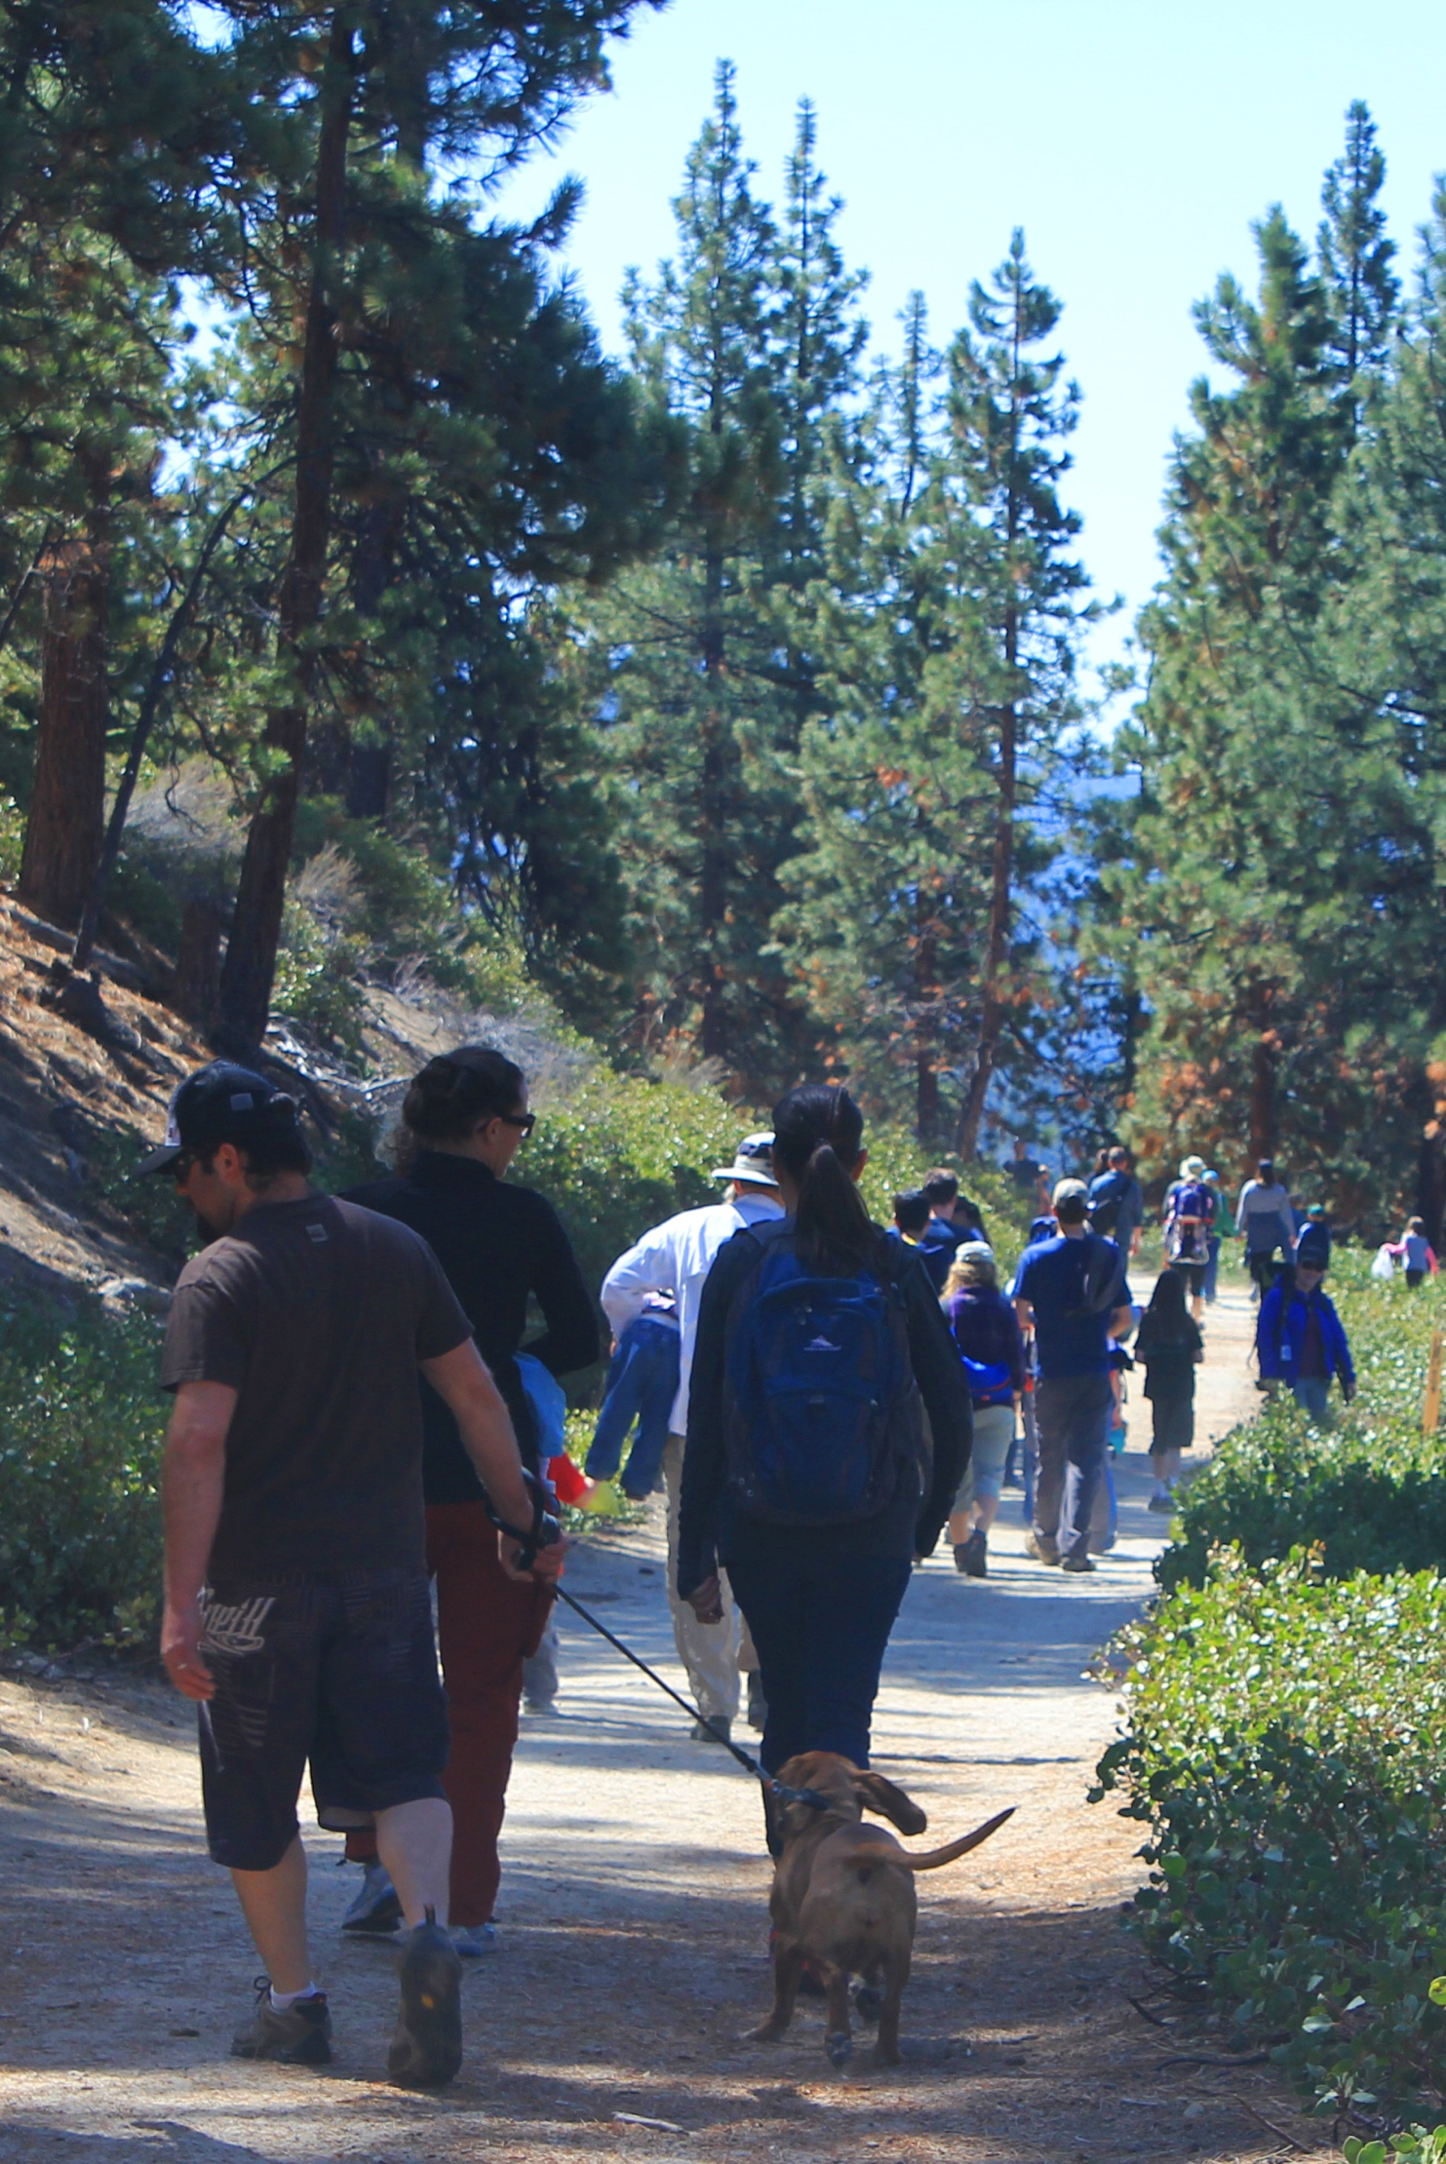

PRINCIPLE 1
BE CONSIDERATE OF OTHERS
Be considerate and friendly when encountering others on the trail.
Keep your pet under control to protect it, other visitors and wildlife.
Listen to nature. Avoid making loud noises or yelling. You will see more wildlife if you are quiet.
Be sure the fun you have outdoors does not bother anyone else. Remember, other visitors are there to enjoy the outdoors too.
FOR THE LOVE OF THE OUTDOORS I 2024
Notes:
The seventh principle of Leave No Trace is to Be Considerate of Others.
The outdoors belong to all of us, and it is important that we are mindful of how our actions can impact the experience and enjoyment of others. One of the most important components of outdoor ethics is to maintain courtesy toward others. It helps everyone enjoy their outdoor experience. Excessive noise, uncontrolled pets, and damaged surroundings detract from the natural appeal of the outdoors. Being considerate of others ensures everyone can enjoy nature no matter how they interact with it.
Respect others and protect the quality of their experience.
Be courteous. Yield to other users on the trail.
Keep pets under control
Let nature’s sounds prevail. Be mindful of how the noise you make impacts other people and wildlife.

Slide 18
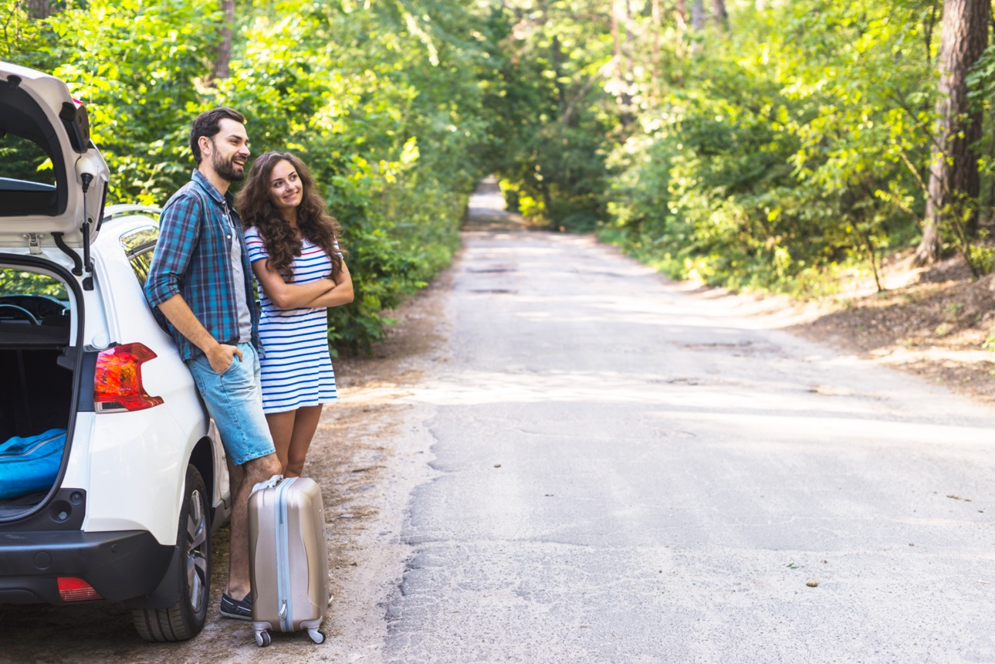
1
ANTICIPATION
Planning for the outing
2
TRAVEL TO
Getting to where you’re going
3
ONSITE
Immersed in the experience
5
STEPS OF
RECREATIONAL
EXPERIENCE
4
TRAVEL BACK
Experience is over, headed home
5
REFLECTION
Taking it all in
FOR THE LOVE OF THE OUTDOORS I 2024
Notes:
When talking about recreation we often talk about the five steps of the recreation experience.
The first stage is the planning stage where you are decide what trail to hike or ride or what park to visit.
Next is the travel to in which you are in a car, on a plane or on a bus on you way to your outing.
Then you arrive, you get to the trailhead or natural area and start to enjoy your activity.
Then experience is over and your headed home. Maybe you’re thinking about work the next day or the errands you need to run later.
Finally there is the reflection stage in during which you are thinking about your trip, how pretty it was, how much you enjoyed your time with family and friends and maybe even considering going back again.
Traditionally, the opportunities for Leave No Trace education have only been available in the anticipation phase, through the land manager websites, and the on-site experience through things like signage and the occasional conversation with a local ranger.
However, we know that the most critical time to reach people with Leave No Trace is doing the anticipation and planning stage. If you show up to the trailhead and didn’t know that there was steep terrain and it had recently rained, there is not much you can do about not having your hiking boots.
Our work within the Tourism Industry has allowed Leave No Trace to expand its reach within this phase as well as incorporate Leave No Trace into the other phases of the visitor experience such as travel to and reflection.

Slide 19


Start With Your Park
Minimize Single Use Items
Properly Dispose of Household Waste
Reuse Before Recycle
Consider Alternative Transportation
Minimize Energy Consumption
Support Local Businesses & Farmers Markets
Consider the Impact of Your Pet
Use Social Media to Educate, Not Degrade
Educate With Kindness
FOR THE LOVE OF THE OUTDOORS I 2024
Notes:
Leaving No Trace extends beyond merely practicing and incorporating the Seven Principles into your outdoor adventures. In 2022, we introduced Leave No Trace in Daily Life because we know that leaving no trace begins not only before you are out in nature but is a way of living. The science tells us that. We also know that everyone has a distinct and unique relationship with what we consider nature and the natural world. Now, we have basic guidance about being a better environmental steward closer to home and in your community, with recommendations about how to reuse and recycle, minimize energy consumption, and even how to use social media to Leave No Trace.

Slide 20
1960s
Originated in backcountry and wilderness areas during a rapid expansion of outdoor recreation.
1970s
Federal Land Managers developed basic Leave No Trace concepts. The “No Trace” program is first established.
1980s
The Foundation for the Leave No Trace program is built through a partnership between government land agencies and the National Outdoor Leadership School.
HISTORY OF LEAVE NO TRACE
1990s
Independent Leave No Trace organization established as a nonprofit entity.
2000s
Leave No Trace expands its scope to address issues in the backcountry, frontcountry and urban environments
2010s
The science of Leave No Trace grows into a distinct academic field and new research partners are established.
2020s
New training tracks for both outdoor professionals and the general public are introduced, and the international program expands around the globe.
FOR THE LOVE OF THE OUTDOORS I 2024
Notes:
While Indigenous people have been incorporating land stewardship concepts for centuries, “Leave No Trace” as a framework for education has been around since the 1960s, and the Leave No Trace organization was formed 30 years ago to put a single structure in place, initially for public lands in the United States. From there, the science and training programs have developed to ensure that everyone who loves nature has access to consistent and informed messages and education.

Slide 21
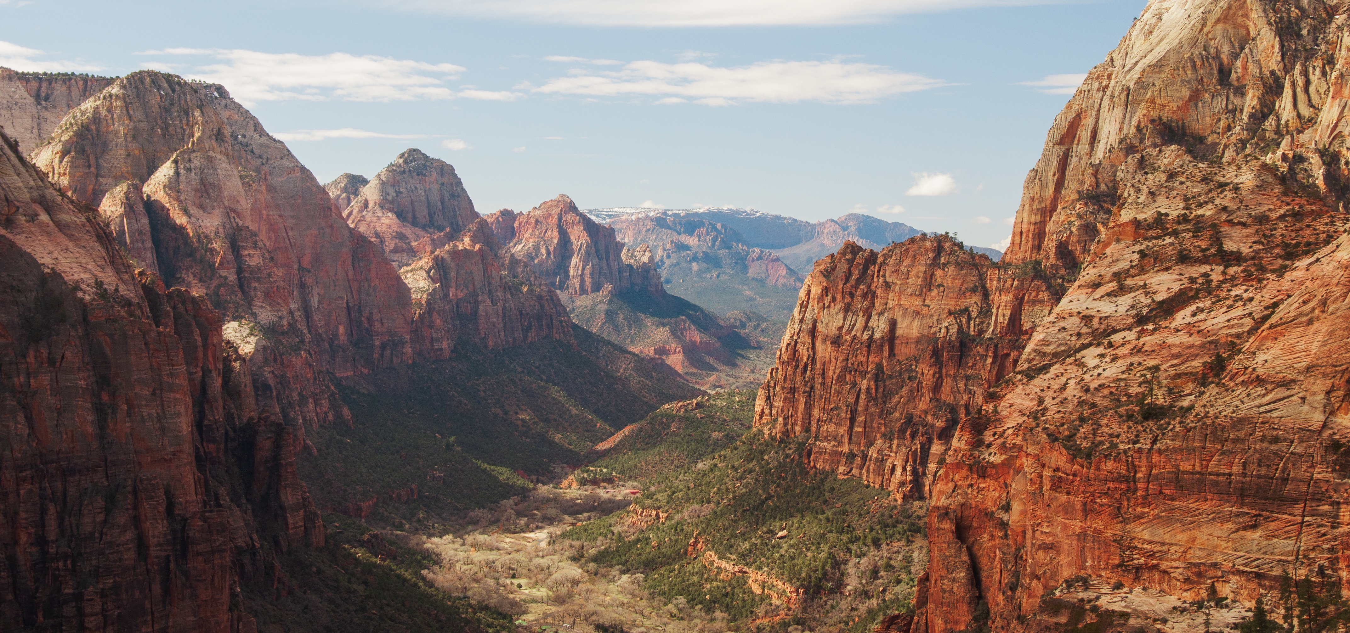

LEAVE NO TRACE TODAY
FOR THE LOVE OF THE OUTDOORS I 2024
Notes:
Which brings us to the Leave No Trace organization today. The organization is made up of a vast network of advocates and volunteers from all walks of life, scientists, partner organizations and companies, groups from around the world, as well as agencies that manage lands that all come together with the shared belief that empowering people is the best way to protect nature. Here is a snapshot of that network.

Slide 22
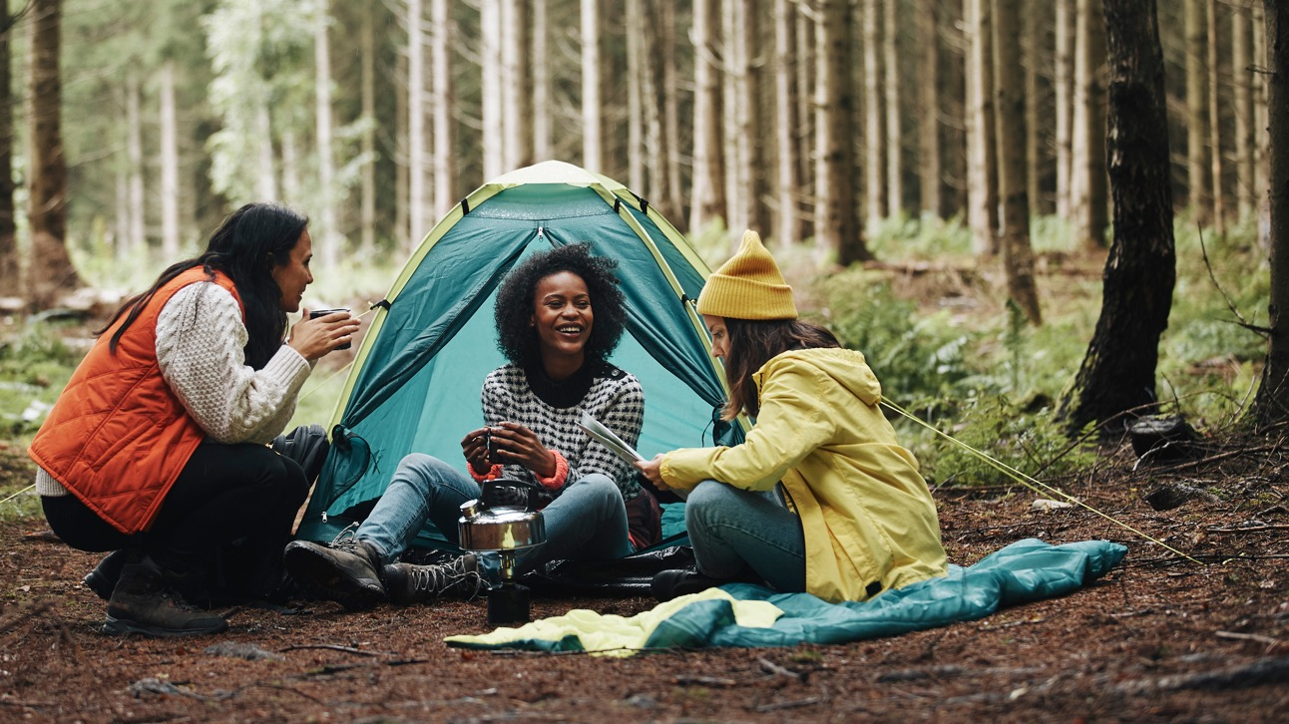

COMMITMENT TO DIVERSITY, EQUITY AND INCLUSION
FOR THE LOVE OF THE OUTDOORS I 2024
Notes:
Leave No Trace is committed to fostering diversity, equity, inclusion, and accessibility (DEIA) within our organization and across the outdoor community. We recognize that all individuals should have equal opportunities to experience and enjoy the outdoors, regardless of background or identity.
Through intentional efforts to promote diversity and inclusion in our programs, policies, and partnerships, we strive to create a welcoming and equitable outdoor environment for everyone. Our commitment to DEIA is integral to our mission of protecting outdoor spaces and promoting responsible recreation practices for all.
Some examples include offering the website in multiple languages, working to provide more and more materials in Spanish, and updating training guidelines to improve accessibility opportunities.
We continue to update Leave No Trace curriculum materials to more clearly outline inclusive practices within outdoor ethics, and to evaluate and eliminate problematic/outdated terminology used in our publications.
Working to make outdoor spaces inclusive and accessible is fundamental to the core mission of Leave No Trace – to ensure a sustainable future for the outdoors and the planet for all people, present and future.

Slide 23
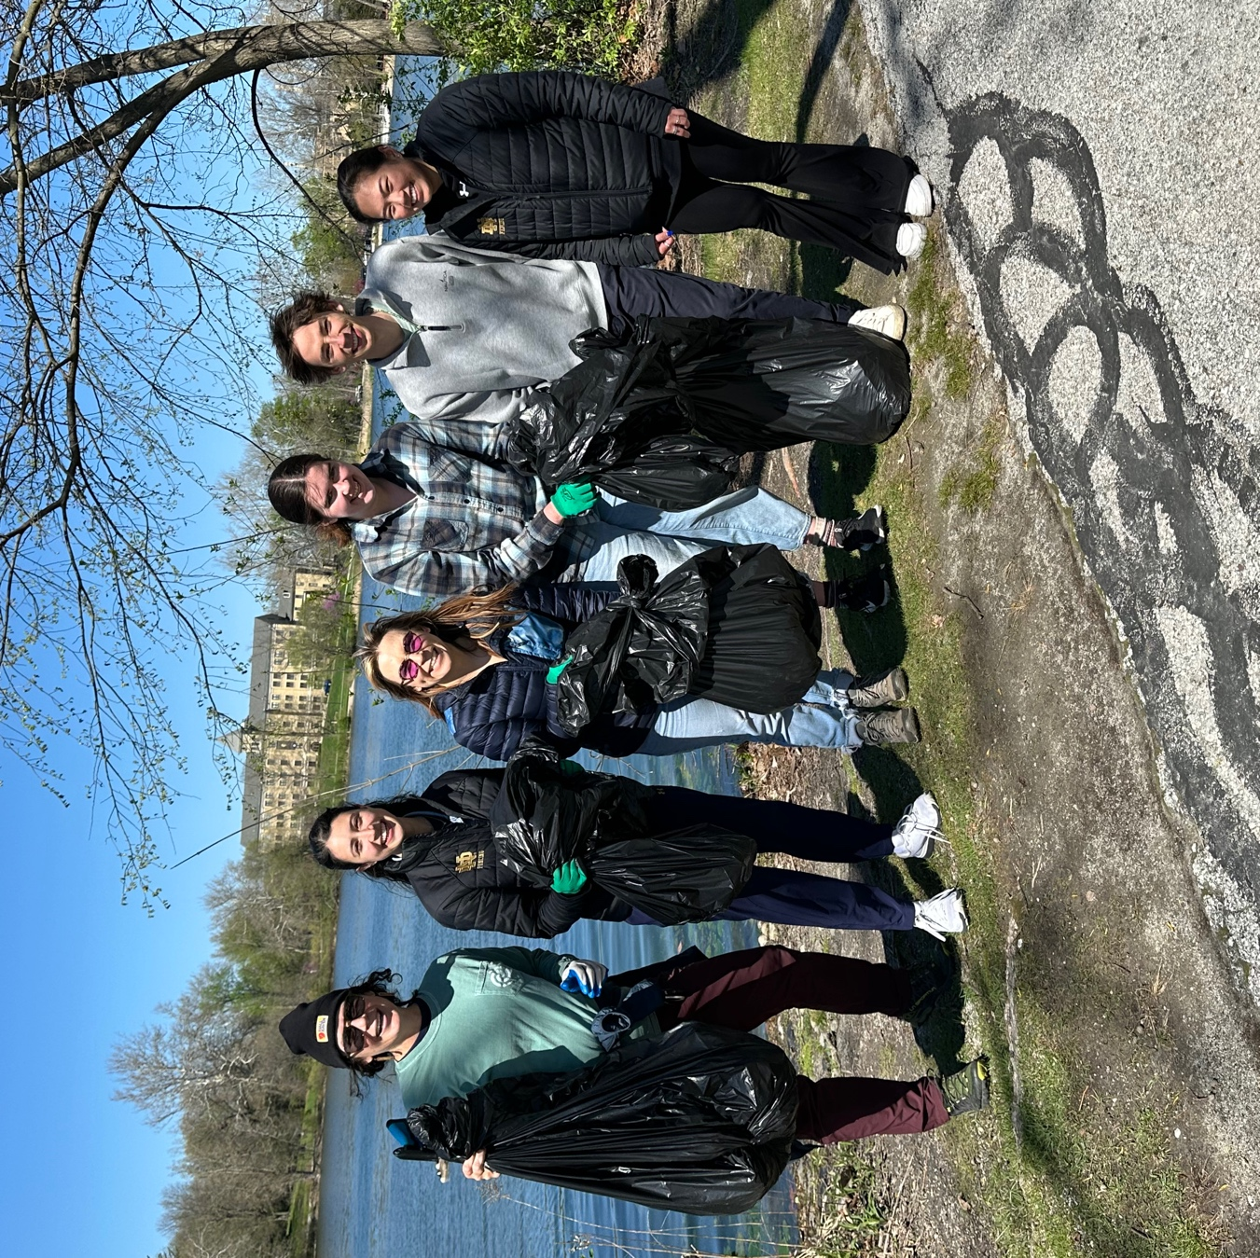
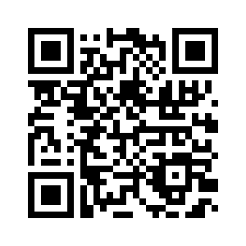
LNT.org/get-involved/volunteer/registry
THE POWER OF PEOPLE
Members, Instructors, State Advocates and Volunteers
FOR THE LOVE OF THE OUTDOORS I 2024
Notes:
The people of Leave No Trace make a tremendous impact. Leave No Trace members who have joined the movement provide support and resources to ensure the program is getting into the hands of those who need it most. State-by-state advocates and other key volunteers are on the ground to organize workshops and education events, and almost 75,000 instructors have been trained to bring Leave No Trace to life in their communities.

Slide 24


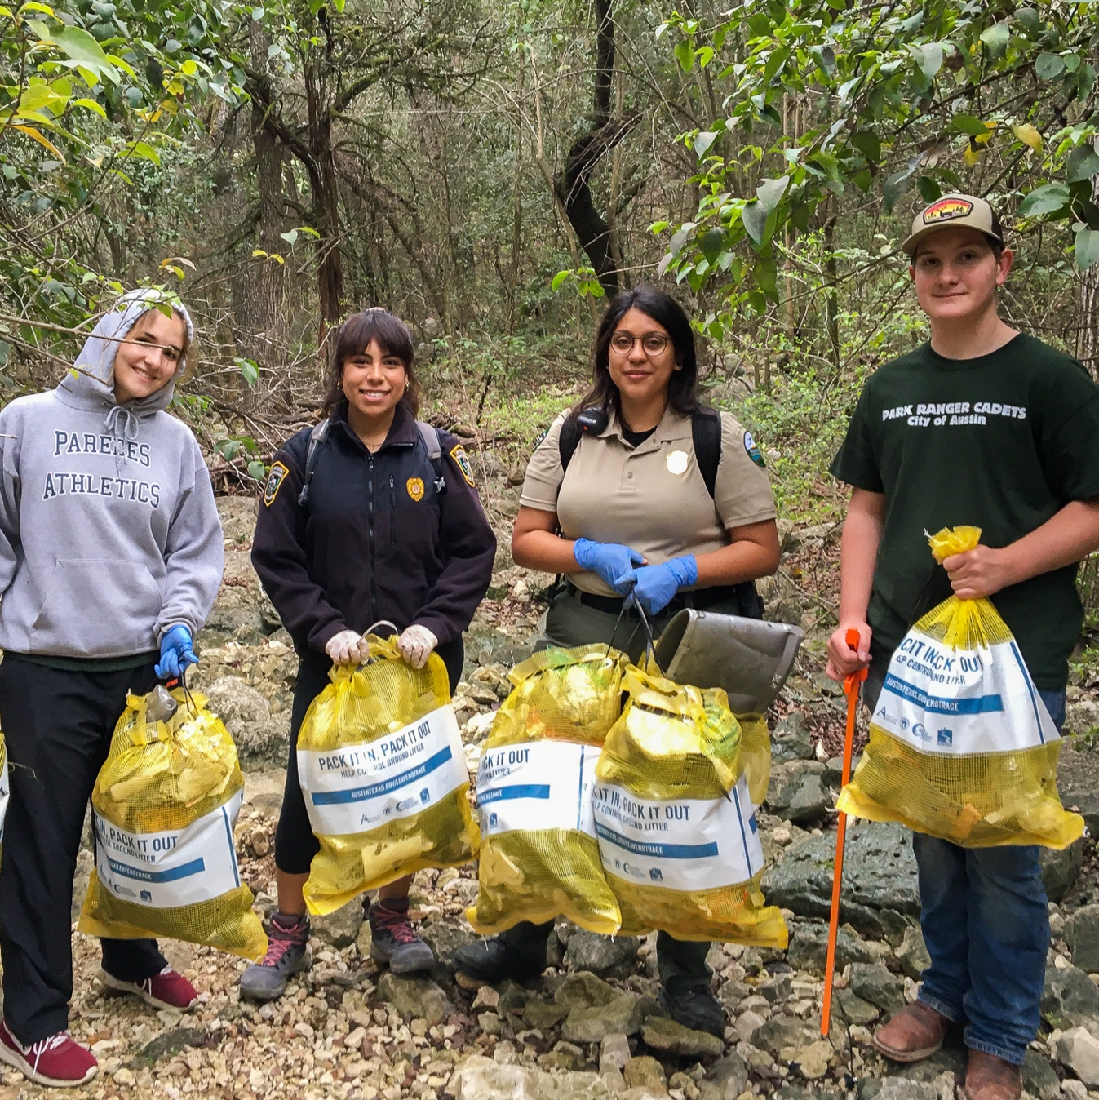





THE POWER OF PARTNERSHIPS
Land Agencies: Federal, State & Local Partners
FOR THE LOVE OF THE OUTDOORS I 2024
Notes:
Leave No Trace has formal partnerships with major federal land management agencies like the National Park Service, the US Forest Service, and so many more, provide education and tools that are specific to the lands and populations they serve. We’ve worked with Grand Canyon National Park in Arizona, in Acadia National Park in Maine and along the Appalachian Trail on visitor education: in Yosemite, Denali and in the Tetons on research to help them reduce waste. Then we’ve done programs in city parks and state parks in Florida, Ohio and Minnesota on Leave No Trace programs for the unique issues they are facing in their communities.

Slide 25
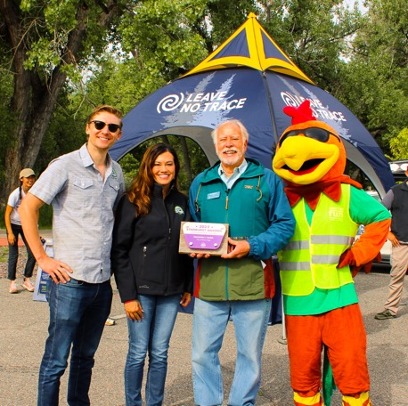
THE POWER OF PARTNERSHIPS
Leave No Trace works with partners in tourism, corporate, small businesses, education and NGOs to further its impact.
FOR THE LOVE OF THE OUTDOORS I 2024
Notes:
Then, through the power of 600+ partnerships with companies, local nonprofits, tourism offices, outfitters and guide services, Leave No Trace can extend our reach even further with their distinct constituents and customers who all seek experiences in the outdoors and who need Leave No Trace education.

Slide 26
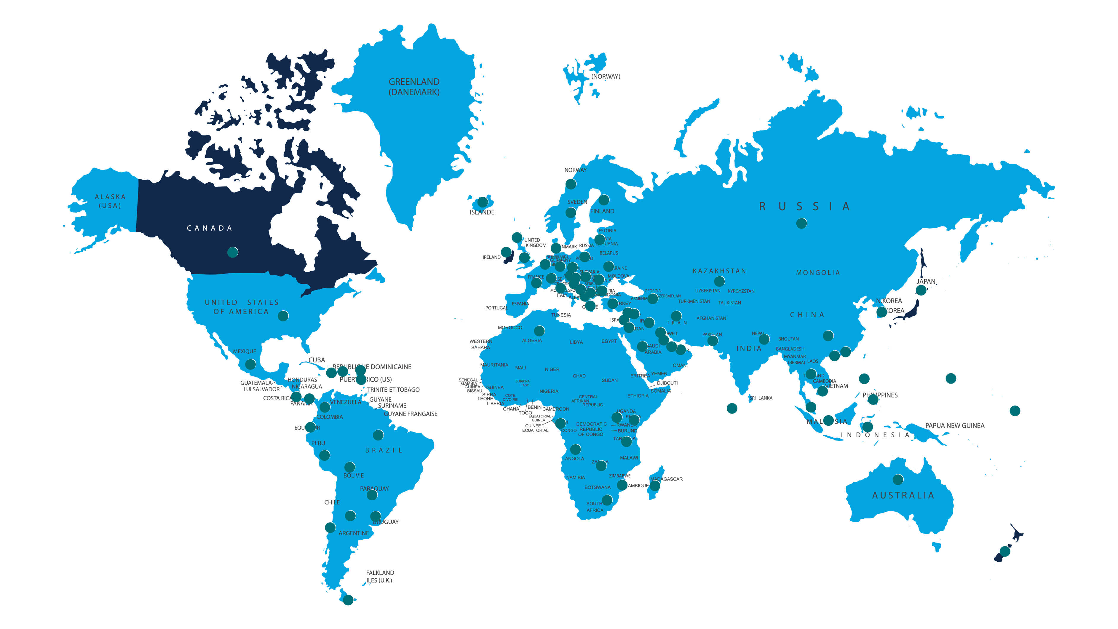

INTERNATIONAL BRANCHES:
Canada, Ireland, New Zealand, Japan
INTERNATIONAL PARTNERS
FOR THE LOVE OF THE OUTDOORS I 2024
Notes:
Imagine a world where all people know and practice Leave No Trace: The movement is growing every day. One-fifth of our 75,000 trainers are from the international community, and 96 countries have formed partnerships, have passionate educators teaching Leave No Trace in their communities or have government engagement with the program. Leave No Trace organizations in Ireland, Japan, Canada and New Zealand will be joined by Leave No Trace Korea this year, and more are to come, supporting our vision for the world for a global citizenry committed to Leave No Trace education.

Slide 27
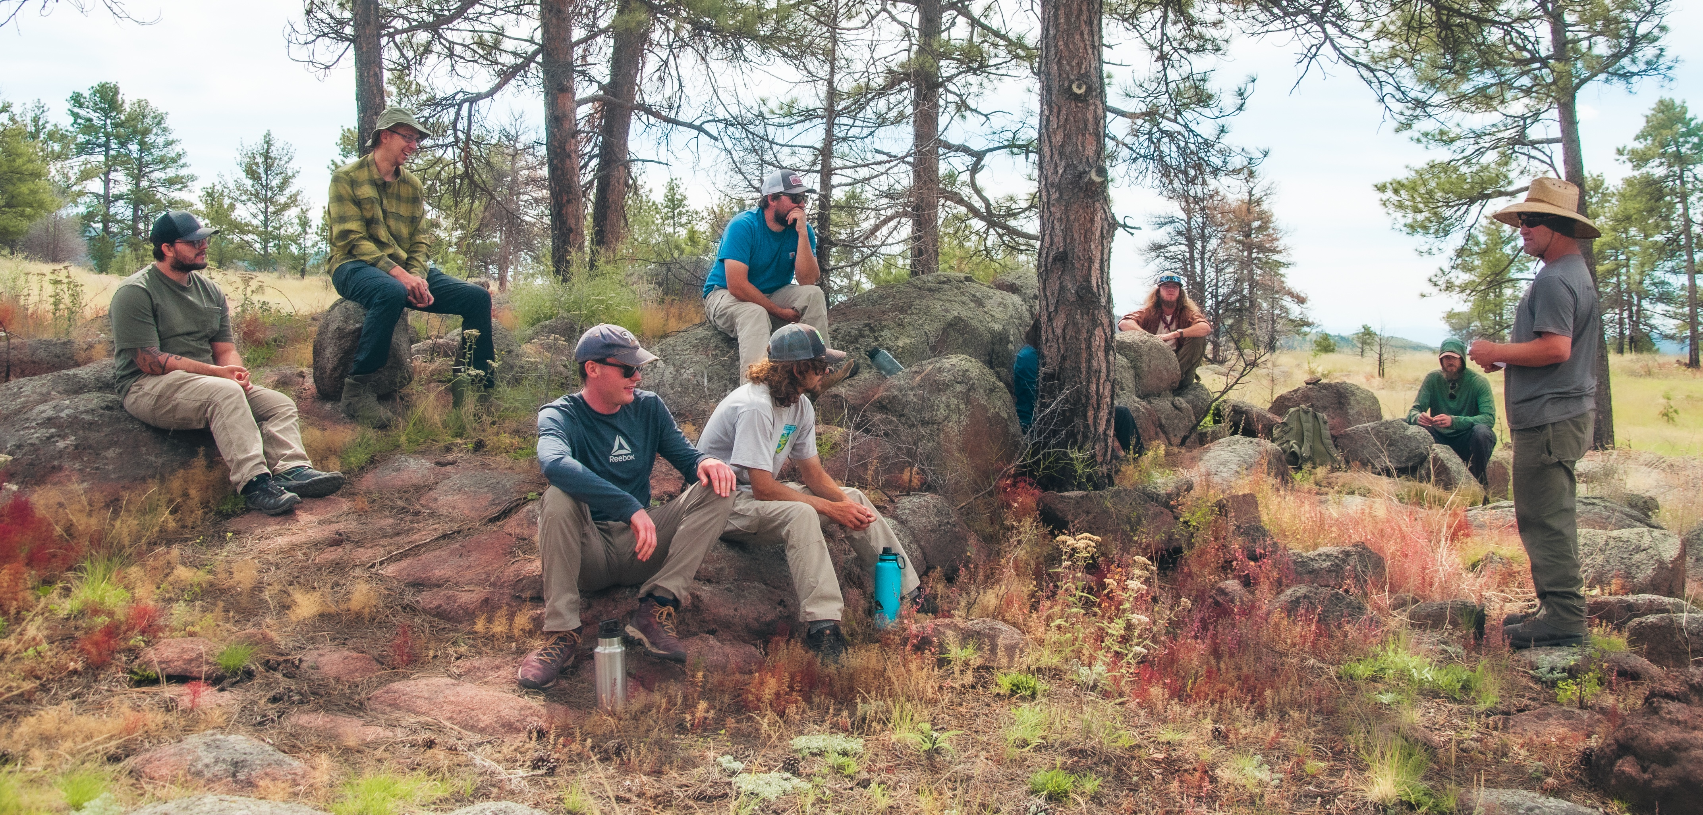

THE POWER OF PROGRAMS
FOR THE LOVE OF THE OUTDOORS I 2024
Notes:
Leave No Trace focuses our programs around two major initiatives: Leave No Trace in Every Park and Protected Area and Leave No Trace for Every Kid. The goal of these programs is to bring Leave No Trace education to communities and provide on the ground opportunities for everyone to take on an active stewardship role.
These programs take many forms including service work, research, interpretive materials, staff and volunteer training, public education initiatives, onsite signage, Leave No Trace Spotlights, Leave No Trace Hot Spots, Leave No Trace Gold Standard Sites, Citizen Science Projects, working with government agencies, state and local tourism entities and more.
In a typical year, the Leave No Trace organization:
Conducts over 600 education events in most of the lower 48 states, reaching over 15.5 million people
Works with partners and volunteers on in-person workshops to train over 500 advanced educators. The organizations online learning programs reaches over 40 thousand people
Works with parks and protected areas, programs, and organizations to achieve Leave No Trace Gold Standard Designation

Slide 28

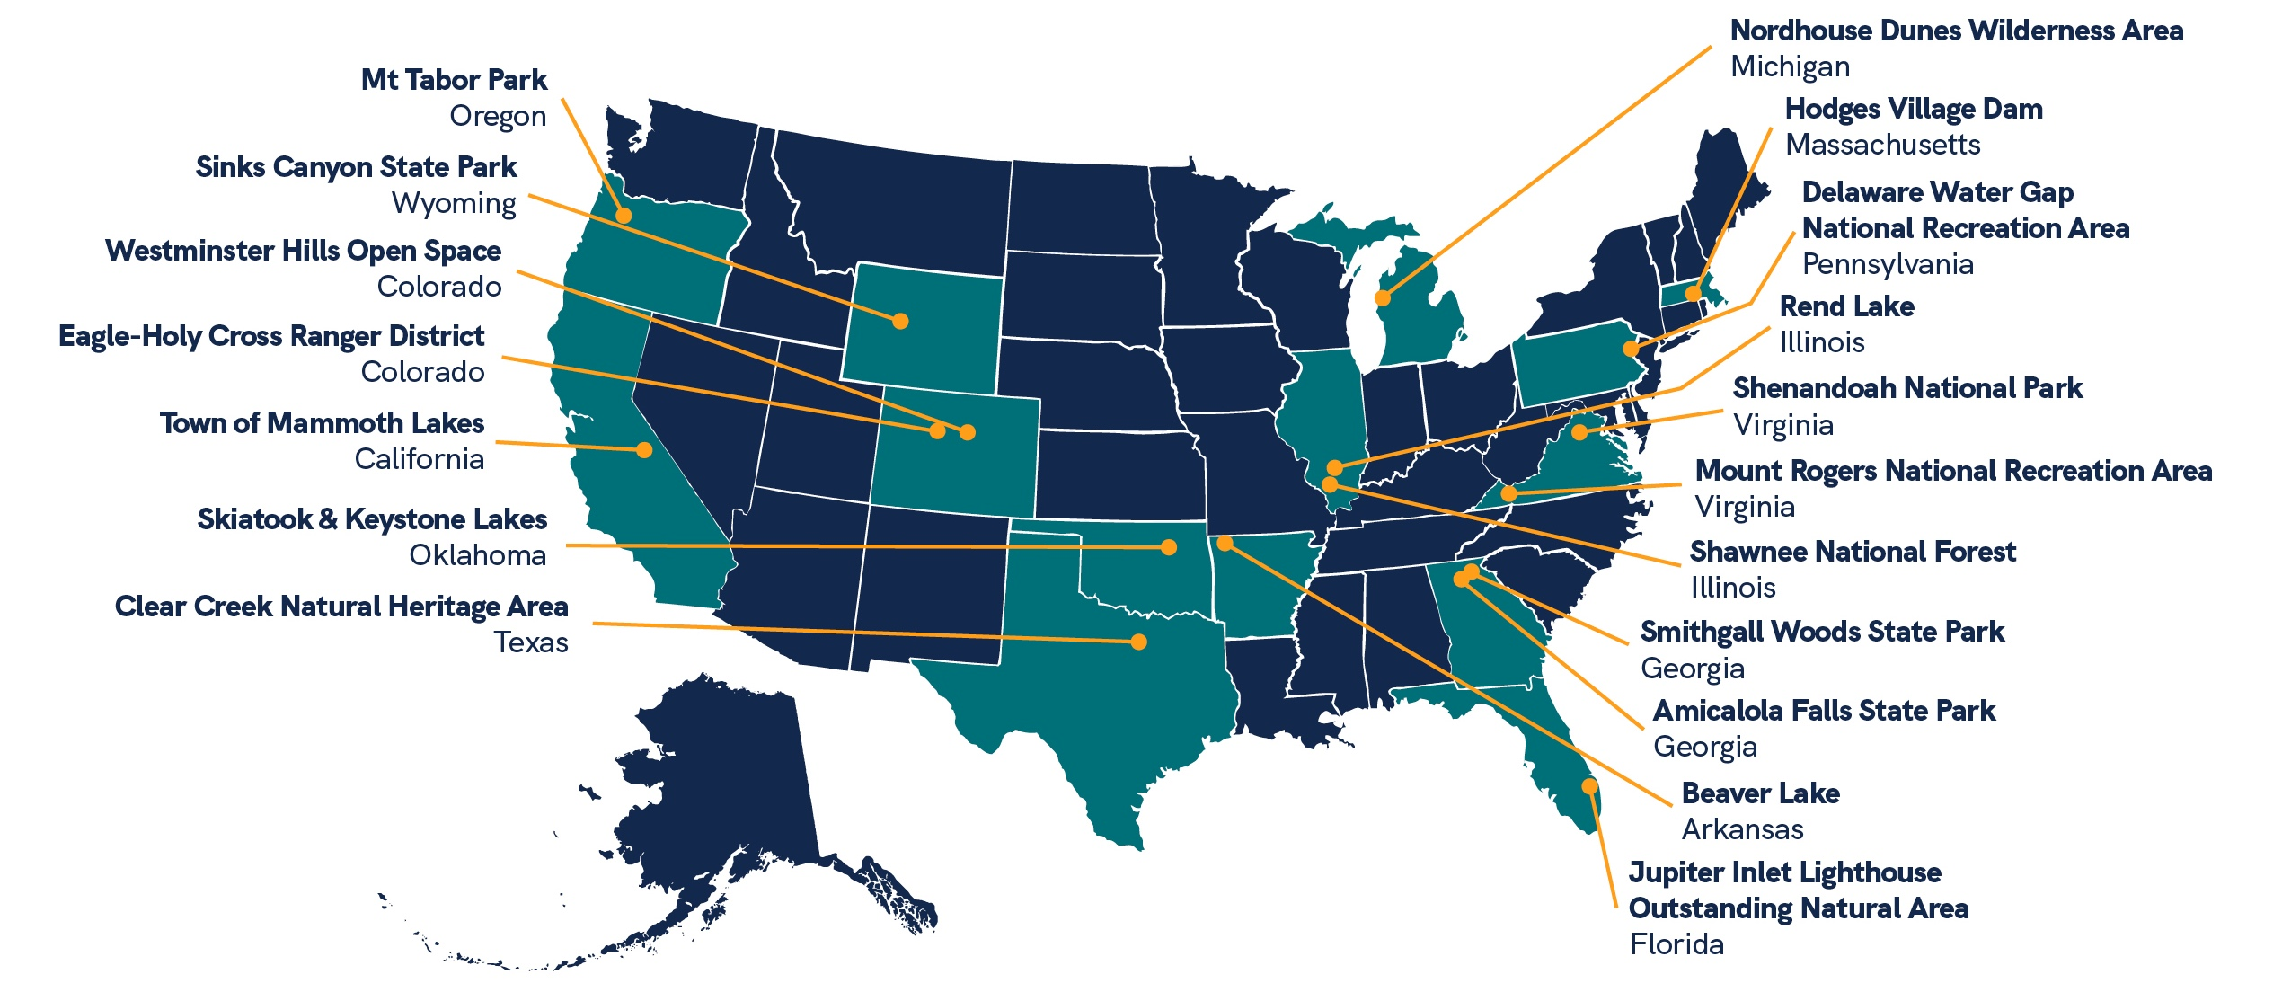
2024
FOR THE LOVE OF THE OUTDOORS I 2024
Notes:
The Leave No Trace Spotlight program brings together our shared love for the outdoors with a dedication to preserving its well-being and beauty.
We hand-select nominated outdoor spaces that need our collective care and attention. By designating them as Spotlights, we’re rallying the local community to step up, join forces with Leave No Trace, and make a meaningful impact that can revitalize and protect these special places where we recreate, enjoy one another’s company, and elevate our health physically, mentally and emotionally. Sites receive 3 days of activation put on by the Subaru/Leave No Trace Traveling Teams that can include service projects, staff and community training, community outreach, and youth programs.

Slide 29
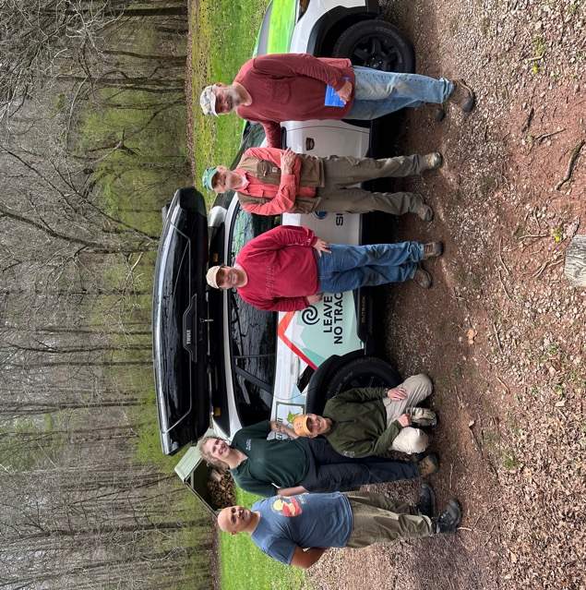

FOR THE LOVE OF THE OUTDOORS I 2024
Notes:
Hot Spots are areas around the country facing the threat of irreversible impacts and sometimes closure that can recover and return to their healthy states through long-term and targeted Leave No Trace recommendations.
The Hot Spot program features 5 days of in-person education programming that aim to guide land managers through a comprehensive education and messaging audit. These programs are successful because Leave No Trace involves stakeholder and partner organizations from the beginning and encourages a community wide approach to impact reduction.
To date, Leave No Trace has conducted over 110 Hot Spots around the country–these 5-day site specific activations are a blend of educational programs, stewardship projects, community engagement, public lands workshops and more.
Learn more at LNT.org/our-work/protecting-parks/hot-spots

Slide 30
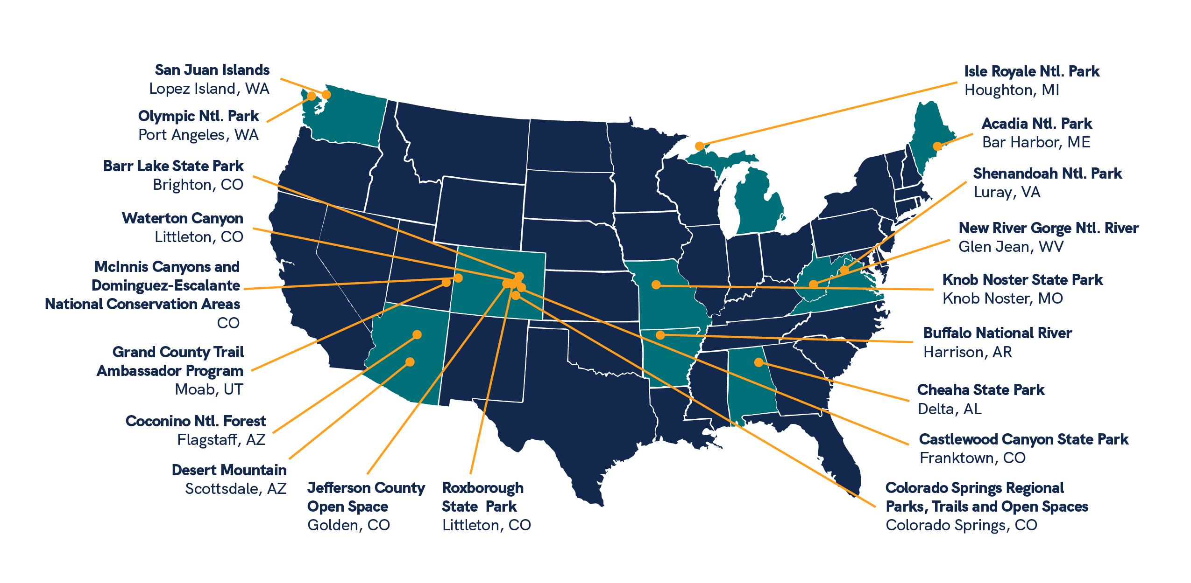

FOR THE LOVE OF THE OUTDOORS I 2024
Notes:
Gold Standard is Leave No Trace’s highest form of recognition. Sites, organizations, and programs that achieve Gold Standard designation are recognized nationally for their implementation of Leave No Trace. The designation process provides a framework for building a well developed Leave No Trace educational program that can result in more informed visitors and less recreation related impacts.
Based on the Leave No Trace Assessment, Gold Standard provides a framework for developing in depth Leave No Trace programming and education. Completing the work required to achieve the designation builds a well developed Leave No Trace educational program that can result in more informed visitors, less recreation related impacts, reduced search and rescue needs, and more resilient parks and protected areas.

Slide 31
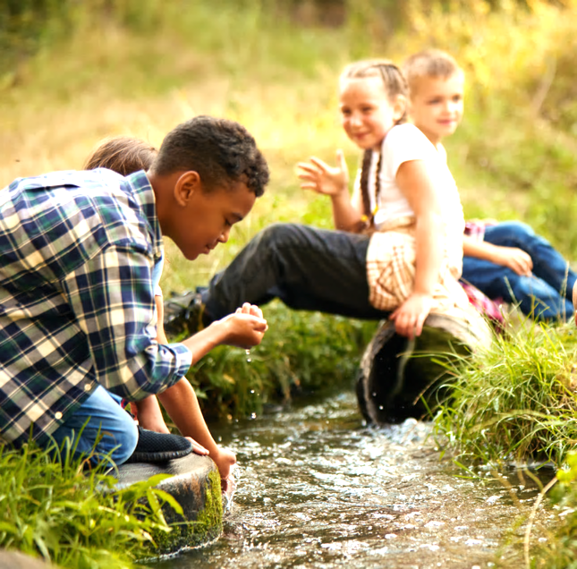

FOR THE LOVE OF THE OUTDOORS I 2024
Notes:
Leave No Trace for Every Kid is a program that helps young people learn how responsible actions can help protect the outdoors. The initiative is shaped and inspired by the rich diversity of young people and their communities that have found joy, discovery and learning through the outdoors.

Slide 32
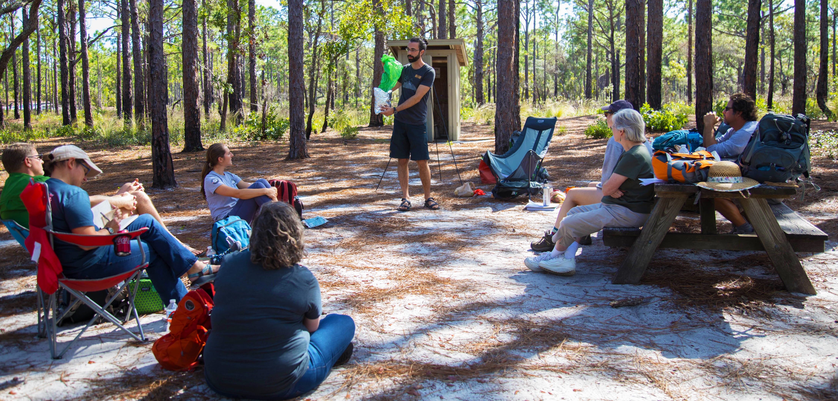

TRAINING & EDUCATION
FOR THE LOVE OF THE OUTDOORS I 2024
Notes:
Being equipped with leave No Trace training makes our communities and outdoor spaces healthier. Practicing Leave No Trace is something we can all do when we interact with nature and a skill we can pass down to the next generation. 85% of people believe Leave No Trace effectively protects the environment for future generations.

Slide 33

ICON STYLE
TRAINING FOR ALL
INSTRUCTOR TRAINING
(REQUIRES RECERTIFICATION EVERY TWO YEARS)
RECREATIONAL TRAINING
Certified Level 1 Instructor
A two-day virtual or in-person certification
Certified Level 2 Instructor
A five-day in-person certification resulting in the ability to instruct Level 1 courses
Certified Level 3 Instructor
This certification is held by Course Provider instructors only
Leave No Trace Skills Course
A two-day course resulting in a Certificate of Completion
Leave No Trace Workshops
30-minute to full day online or in-person courses
FOR THE LOVE OF THE OUTDOORS I 2024
Notes:
Leave No Trace Training is broken up into two tracks; and Instructor track and a Recreational track.
The Instructor Training track is designed for those in a role to actively teach Leave No Trace and provides a 2 year certification to those who complete courses. Level 1 Instructor Courses are held in-person, virtually or as a hybrid for 2 days or a total of 16 hours. Level 1 Instructors are certified to co-instruct Level 1 Instructor Courses and teach Skills Courses and Workshops. Level 2 Instructor Courses are 5 days and in-person. Level 2 Instructors are certified to teach Level 1 Instructor Courses, Skills Courses and Workshops.
The Recreational Training track is designed for those who have a desire to learn the skills and information of Leave No Trace to apply in their own outdoor pursuits. Skills Courses are a two-day course and Workshops range from 30 minutes to a full day. Participants in Recreational Training courses are able to receive Certificates of Completion.

Slide 34












ICON STYLE
LEVEL 2 INSTRUCTOR COURSE PROVIDERS
FOR THE LOVE OF THE OUTDOORS I 2024
Notes:
Course Providers are organizations authorized to teach Level 2 Instructor Courses.

Slide 35
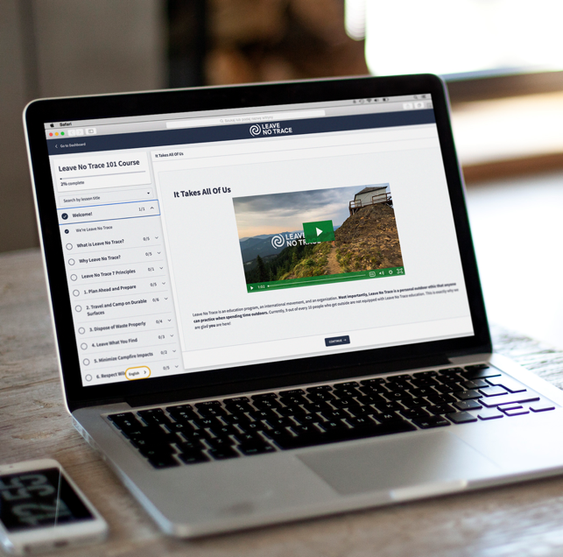
LEAVE NO TRACE 101
Free 45 Minute Online Course Available to Everyone
Learn.LNT.org/courses/101
Notes:
The Leave No Trace 101 Course is just one example of our online course/training offerings and is a great introduction to Leave No Trace and the actions we can collectively take to protect our planet. In the course we have helpful information with a simple framework of minimum impact practices to apply when spending time outdoors. There are other free online courses for specific types of recreation and we are continuing to create more online courses.

Slide 36
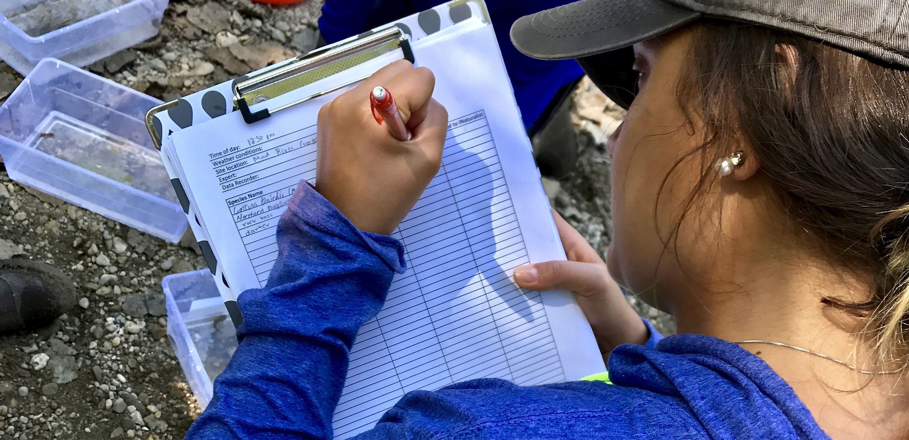

RESEARCH
FOR THE LOVE OF THE OUTDOORS I 2024
Notes:
The Leave No Trace organization funds, develops and undertakes research designed to inform new, effective ways to provide education about protecting our shared public lands. We create ground-breaking research projects, and utilize state-of-the-art methods to fuel the development of specific education, messaging, and innovative programming.
Some past Leave No Trace-focused studies used minimum-impact practices as a measure of Leave No Trace effectiveness. In other words, the more you know about Leave No Trace, the more likely you are to put it into action. While knowledge of Leave No Trace is important, there isn’t a perfect relationship between knowledge and behavior. Put another way, increasing knowledge about environmental impacts does not necessarily guarantee a change in a person’s Leave No Trace behavior. The Leave No Trace organization is continually looking for new and effective ways to influence stewardship of our shared lands.

Slide 37
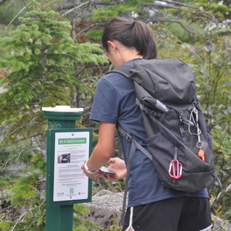
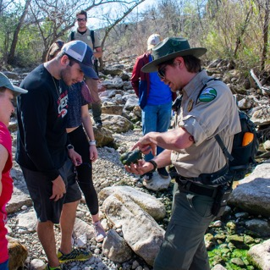
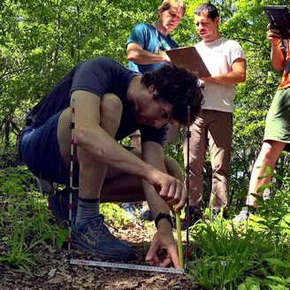
5-YEAR RESEARCH AGENDA
Recreation Ecology, Human Dimensions, Citizen Science and more
FOR THE LOVE OF THE OUTDOORS I 2024
Notes:
The Leave No Trace Research Strategic Research Agenda serves as a strategic framework for advancing our mission through evidence-based practices and informed decision-making. This agenda outlines key research priorities and focus areas aimed at addressing critical knowledge gaps in outdoor ethics and conservation.
By leveraging research methodologies such as quantitative studies, qualitative research, experimental designs, and collaborative partnerships, we aim to generate empirical evidence to continue supporting the effectiveness of Leave No Trace principles, practices, and educational programs and trainings. Engaging with stakeholders across academia, government agencies, nonprofit organizations, and the outdoor industry, we seek to foster a culture of research collaboration and knowledge exchange to inform policy, education, and advocacy efforts.

Slide 38
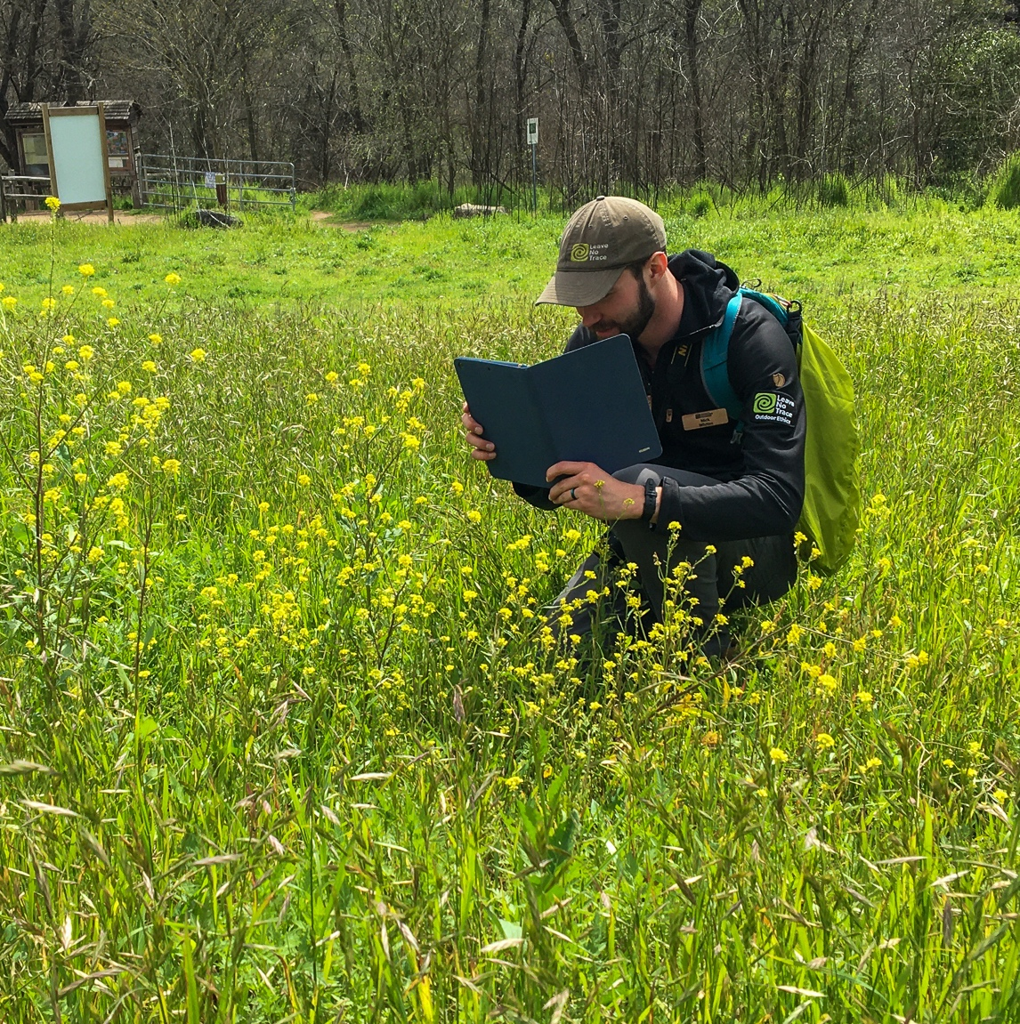
LEAVE NO TRACE SCIENCE TEAM
Leave No Trace has built a team of 20+ scientists to study, assess, and understand more about Leave No Trace behaviors, ideology, messaging and more.
FOR THE LOVE OF THE OUTDOORS I 2024
Notes:
The Leave No Trace Science Team comprises a diverse group of experts and researchers dedicated to advancing our understanding of outdoor ethics and conservation. This interdisciplinary team works with the Leave No Trace organization to collaborate on research projects, data collection efforts, and knowledge dissemination initiatives to inform evidence-based decision-making and best practices in outdoor recreation. Through their expertise and contributions, the Science Team plays a vital role in supporting the mission and impact of Leave No Trace.
Learn more about the research studies conducted and future research at LNT.org/out-work/research

Slide 39

ICON STYLE
FOR THE LOVE OF THE OUTDOORS
Join the Movement
LNT.org/give/join
FOR THE LOVE OF THE OUTDOORS I 2024
Notes:
You can protect nature for future generations by renewing your membership or joining the movement today. Together, we can create a greener, more sustainable future for all.

Slide 40
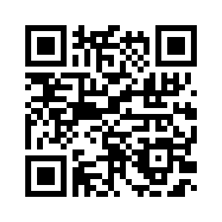
ICON STYLE
FOR THE LOVE OF THE OUTDOORS
Get Trained
LNT.org/get-involved/training-courses
FOR THE LOVE OF THE OUTDOORS I 2024
Notes:
One person trained in Leave No Trace goes on to education 256 additional people. Sign up for a course today.

Slide 41
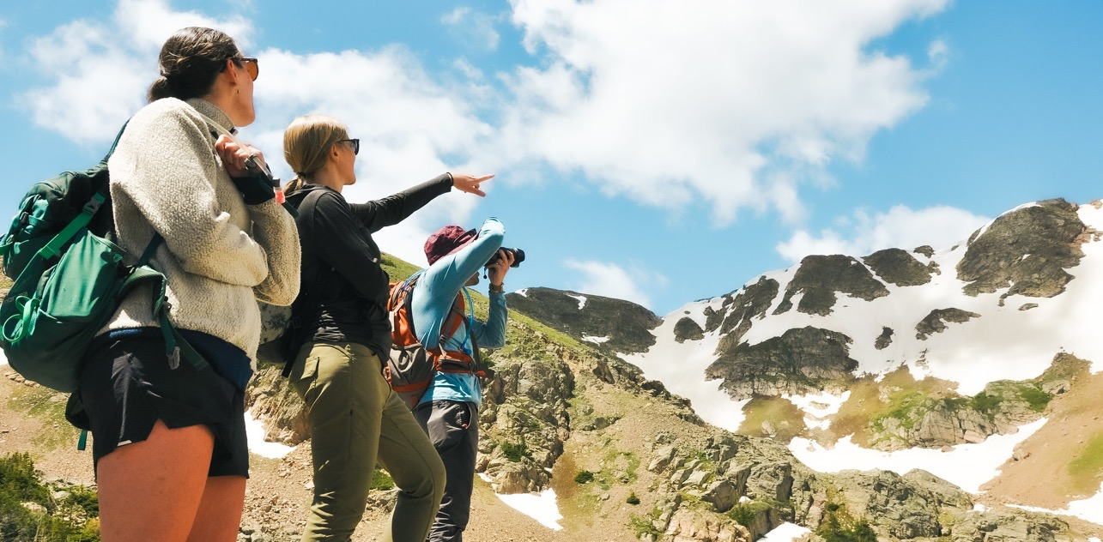
It’s going to take all of us.
FOR THE LOVE OF THE OUTDOORS I 2024
Notes:
Everyone here has a role to play. Leave No Trace works—we protect our world—when people like you learn it, practice it, live it and share it.

