Slide 1
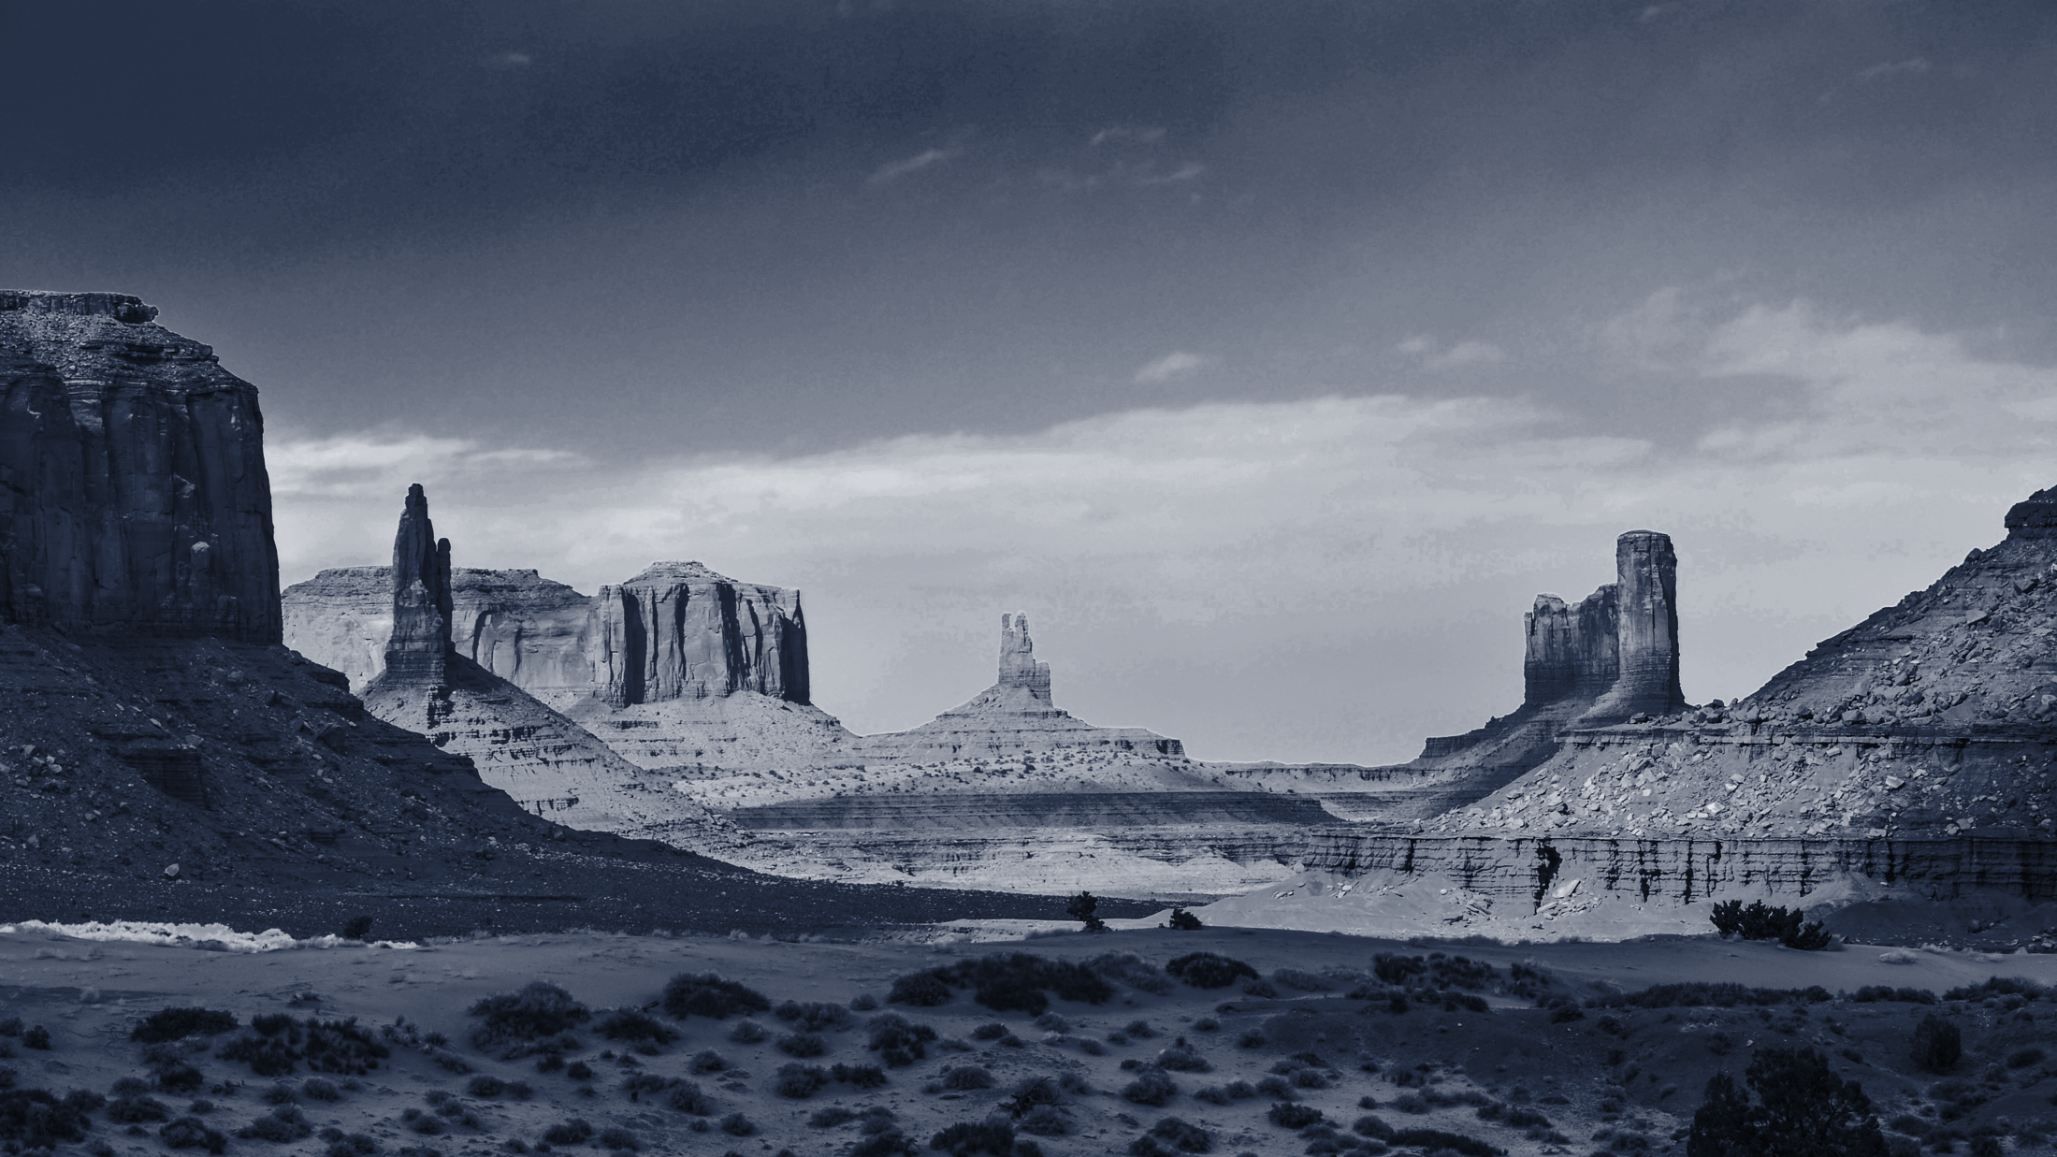
©Leave No Trace | www.LNT.org

Slide 2
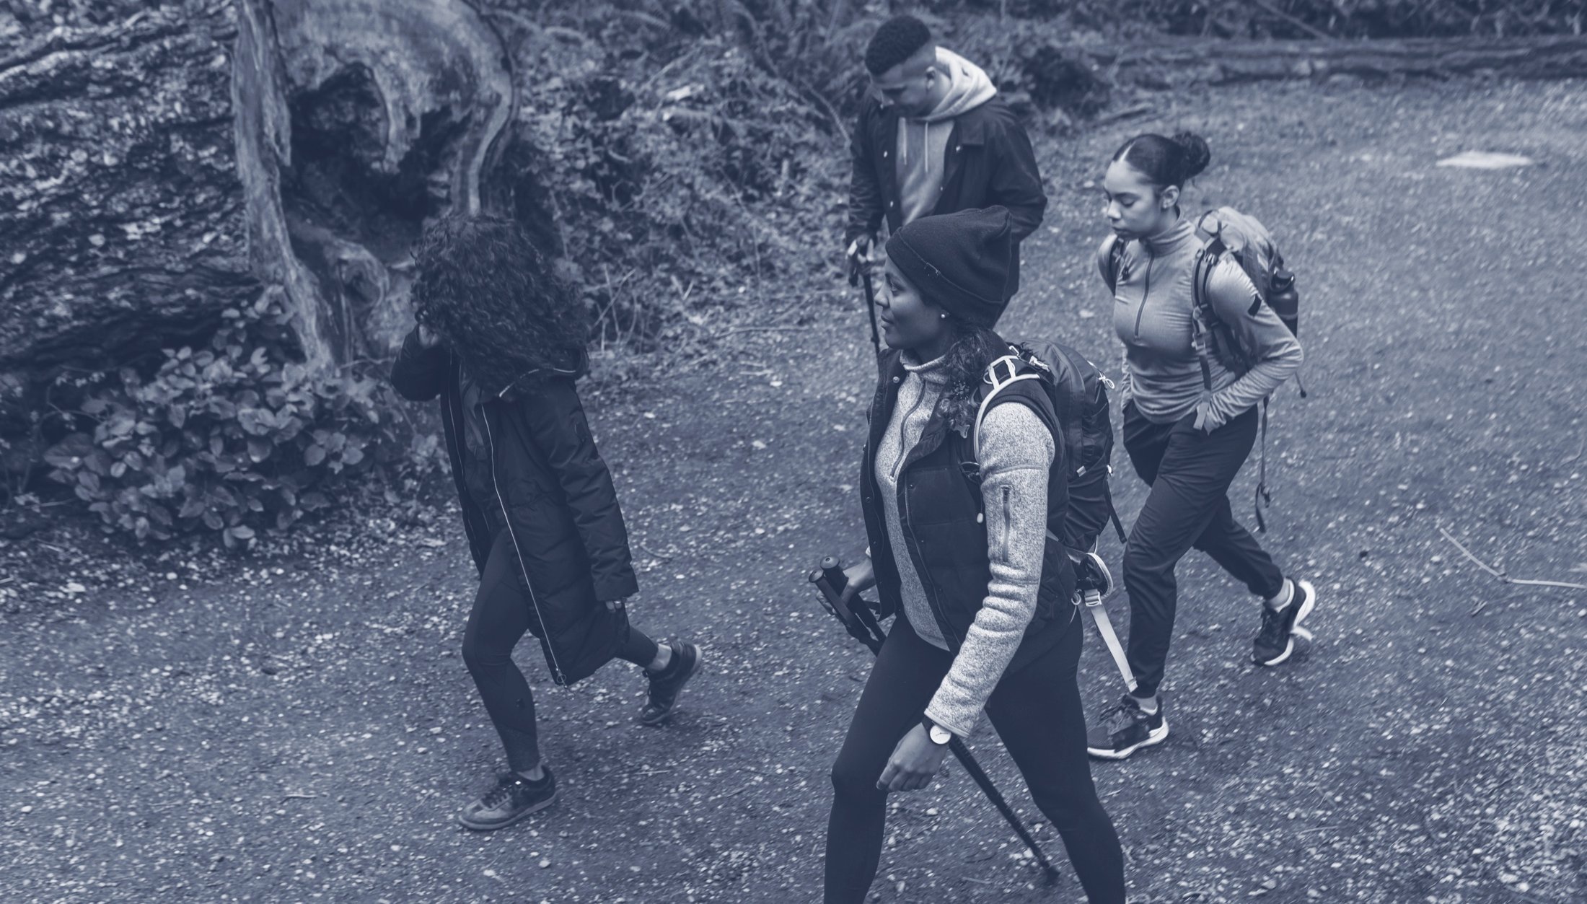
THERE’S
FOR NATURE
Notes:
At Leave No Trace we believe there is no substitute for nature, and the outdoors are meant to be enjoyed by everyone.

Slide 3
IMPACTS ARE ON THE
It’s time to reimagine how we get outdoors.
Notes:
The nature we love is at risk. With over 13 billion trips into the outdoors in the U.S. alone every year, people are causing preventable impacts, and those impacts are adding up.
A goal of Leave No Trace is to change the relationship between use and impacts. By putting Leave No Trace into action, use of our share lands can increase without a continued rise in impacts to these places.
Optional Narrative: Have you ever seen a trashed area? Scars from fire? Severely damaged trails? Other impacts? Would you believe (use any of stats that may resonate):
Americans pay $3 billion to fight fires in parks and forests, nearly 85% of which are caused by campfires left unattended, the burning of debris, or negligently discarded cigarettes (According to the National Park Service: 2018).
Recovery rates for areas impacted by recreation are often very slow, with restoration to natural conditions often requiring a minimum of 10-30 years.
Trash lasts a very long time: plastic grocery bags can last up to 20 years; aluminum cans up to 100 years; fishing line up to 600 years.
Each year, tons of petrified wood are removed illegally from Arizona’s Petrified Forest National Park.
Wildlife in our parks are routinely relocated and, in some cases euthanized, due to conflicts with humans. The National Park Service cites human garbage as the origin of many of these unfortunate and unnecessary conflicts.
Wildlife that obtain human food can lose their fear of humans and develop attraction behaviors to trails, picnic areas, campsites and visitors, turning wild animals into aggressive and potentially dangerous. Such animals may ultimately have to be euthanized by land managers because of the risks they present to people.
Invasive species are being spread nationwide due to moving firewood from one area to the next by campers. Many new infestations of non-native tree-killing insects and disease are often first found in campgrounds. The specific insects and diseases vary by region, but some have already killed millions of trees over thousands of acres.
According to the U.S. Centers for Disease Control (CDC), one day’s worth of pet waste can contain several billion fecal coliform bacteria, along with Giardia and the eggs of roundworms, hookworms, and tapeworms.
Studies have attributed pet waste to instances of water pollution sufficient enough to exceed water quality standards, close beaches, and harm wildlife.
The good news: Leave No Trace is the best way to minimize these and other types of impacts we see on natural lands today.

Slide 4
LEAVE NO TRACE
We make people the solution to conservation challenges.
Notes:
People enjoy the outdoors in more ways than ever before. We explore on foot, by boat, on bikes, on handcycles, with our friends, with kids and more. We explore in places that range from city parks to national parks and even our own backyards.
Leave No Trace is a national as well as international organization. Using the power of science, education and people, Leave No Trace is a nonprofit organization on a mission to ensure a sustainable future for the outdoors and the planet.
Leave No Trace accomplishes this mission by delivering cutting-edge education, and training programs to millions of people across the country every year.
Then introduce yourselves:
If Traveling Teams—we are a Subaru/Leave No Trace Traveling Team, a mobile education team that is part of the Leave No Trace organization.
If Staff/State Advocate/Volunteer: Introduce yourself and your role with the organization
“Leave No Trace knows that everyone’s relationship to the outdoors is personal and unique. We believe Leave No Trace and the outdoors are for all, and in order for these truly to be spaces for all, we are committed to diversity, equity, and inclusion as core values.”
Land Acknowledgment statement: We want to acknowledge the indigenous communities and tribes whose ancestral land we recreate on. This area is the ancestral land of the ______, ______, ______, and _______ Nations. Our intention in this acknowledgement is to honor cultural ways of stewarding the land, practiced from immemorial to this day.”
We like to tell everyone: IT’S YOUR NATURE. The natural world is for all of us, and it it up to us, collectively to protect it.

Slide 5
WHEN YOU DO YOUR PART,
Notes:
You can be on the forefront of changing this (the impacts)—the trashed parks and damaged trails, the impacts of fire, polluted waterways and serious wildlife issues. Now, more than ever, your role is critical.
Leave No Trace provides the foundation and framework necessary for making good decisions when you’re outside, now and well into the future.

Slide 6
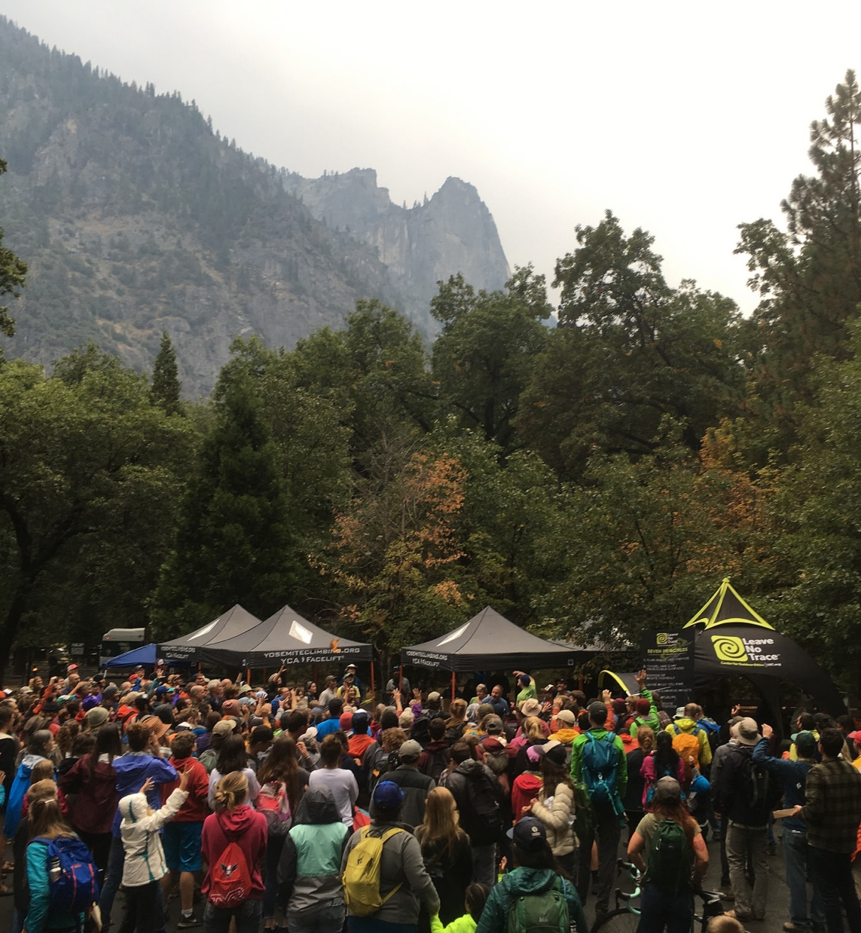
THE OF LEAVE NO TRACE
01
Science & Research
Training for All
Stewardship
02
03
Notes:
What began as a call to preserve wilderness areas has evolved into a global, daily commitment for all people to embrace a Leave No Trace ethic. We accomplish this work using three pillars:
1. Science & Research which serves as the foundation for all of our education and messaging
2. Training for all that includes in person and online training options
3. Deploying an extensive network of volunteers and educators that teach others about Leave No Trace and give back to the lands we all love.
The environmental stewardship promoted by the Leave No Trace organization extends beyond outdoor enthusiasts to include ANYONE who enjoys the outdoors and is concerned with people’s relationship with nature.

Slide 7
IMPACTS FROM OUTDOOR RECREATION AFFECT:
WILDLIFE
SOILS
VEGETATION
CULTURAL HERITAGE
WATER RESOURCES
OTHER PEOPLE
Notes:
When venturing in the outdoors, humans generally impact the environment in six broad areas:
Wildlife Impacts: disturbance, altered behavior, intentional or inadvertent feeding, or reduced health and reproduction of animals.
Soil Impacts: loss of organic litter, soil compaction, or soil erosion
Vegetation Impacts: vegetation loss, the introduction of invasive species, and tree or plant damage
Cultural Resource Impacts: theft or damage to cultural and historic features and artifacts
Water Resource Impacts: siltation, sedimentation, trash, soap, or fecal waste
Social Impacts from Others: crowding, conflicts between various user groups, and diminished outdoor experience

Slide 8
PUBLIC LAND USE
Visits per Year
(Hundreds of Millions)
Notes:
Public lands use continues to rise, and with the pandemic, even more people are seeking recreation, health, fellowship, solitude and more in the outdoors. While this is an excellent opportunity to create more Leave No Trace stewards, the need to provide education is greater than ever. Outdoor impacts to public lands are individual but they’re cumulative over time. It’s not the one time someone cuts a switchback, leaves trash, poorly disposes of human waste, or tosses an apple core off the trail, it’s when these actions are repeated hundreds, thousands, or millions of times.
The environmental implications of outdoor use can be staggering, especially given the popularity of outdoor recreation on federal and state lands.

Slide 9
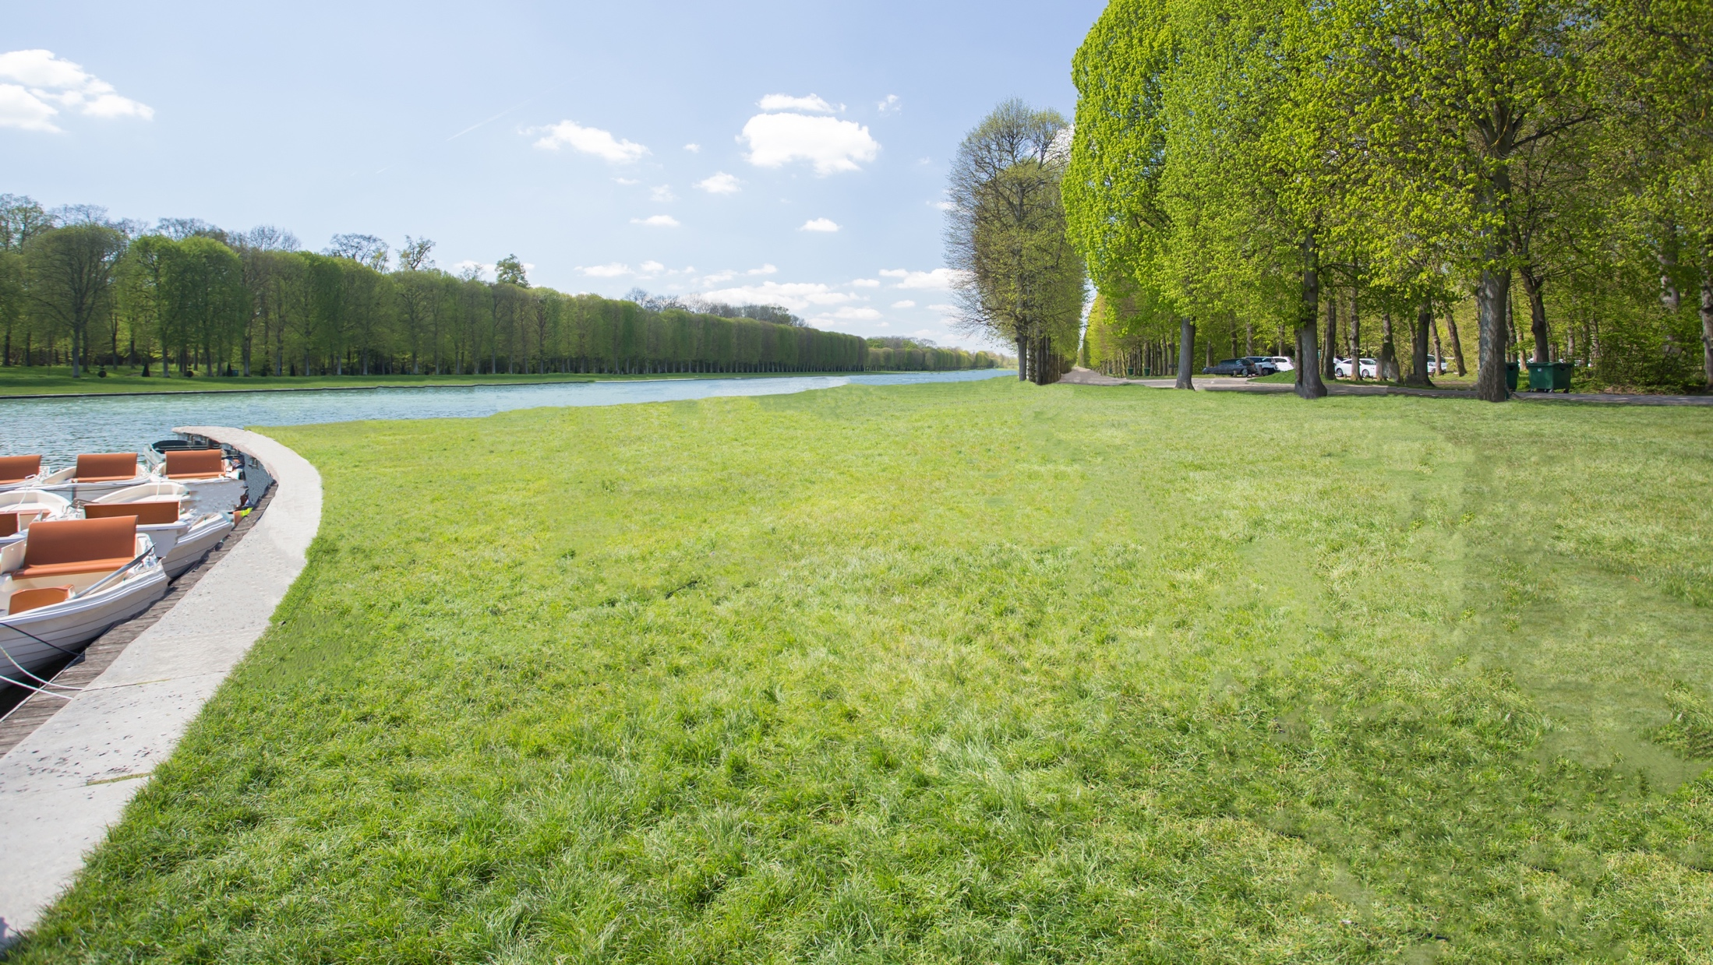
Notes:
Think about what happens to a park when Leave No Trace education is not widely known. The potential for recreation-related impacts can increase significantly.

Slide 10
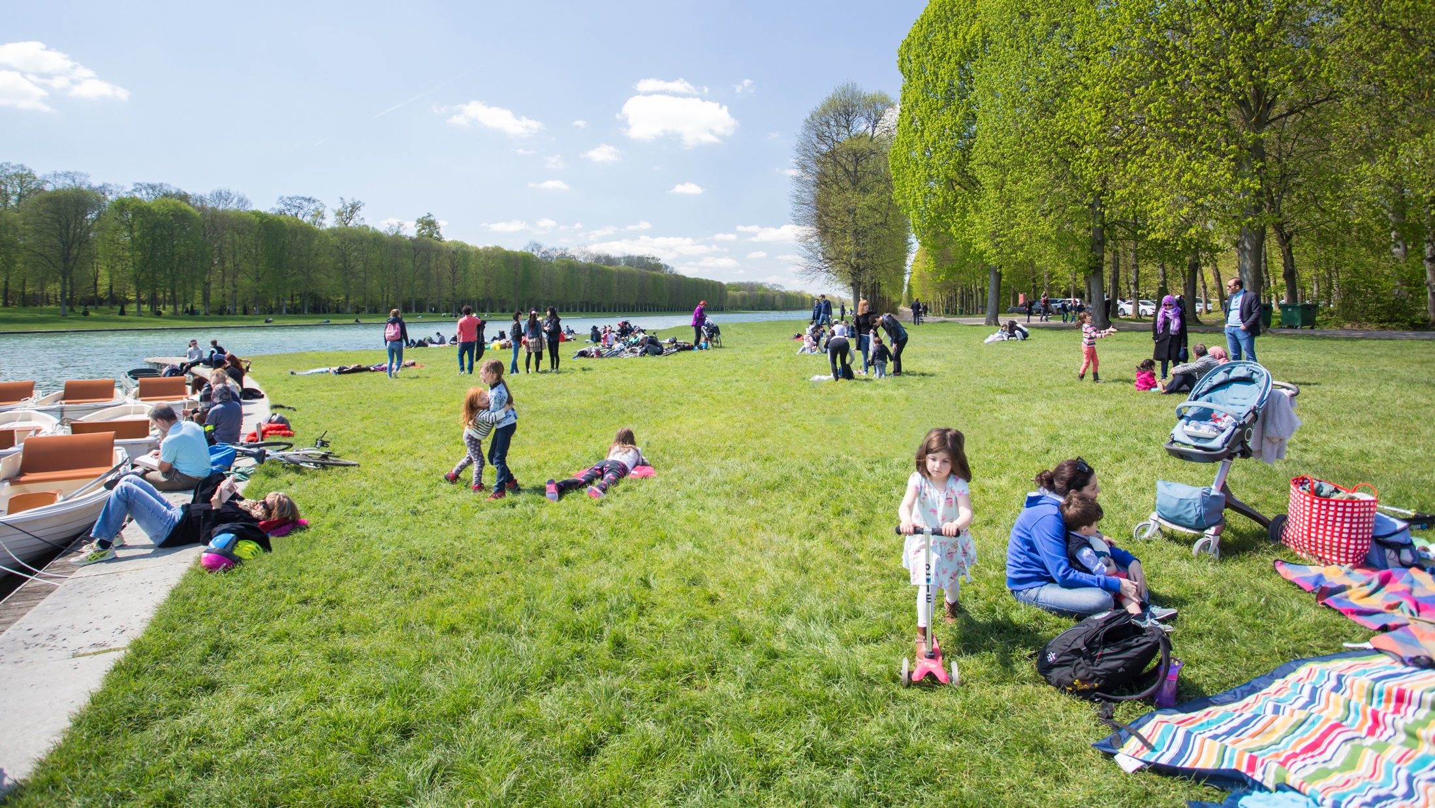
Notes:
Here is a typical park scene. A nice park with grassy fields, a hardened parking area, and easy access to the water.

Slide 11
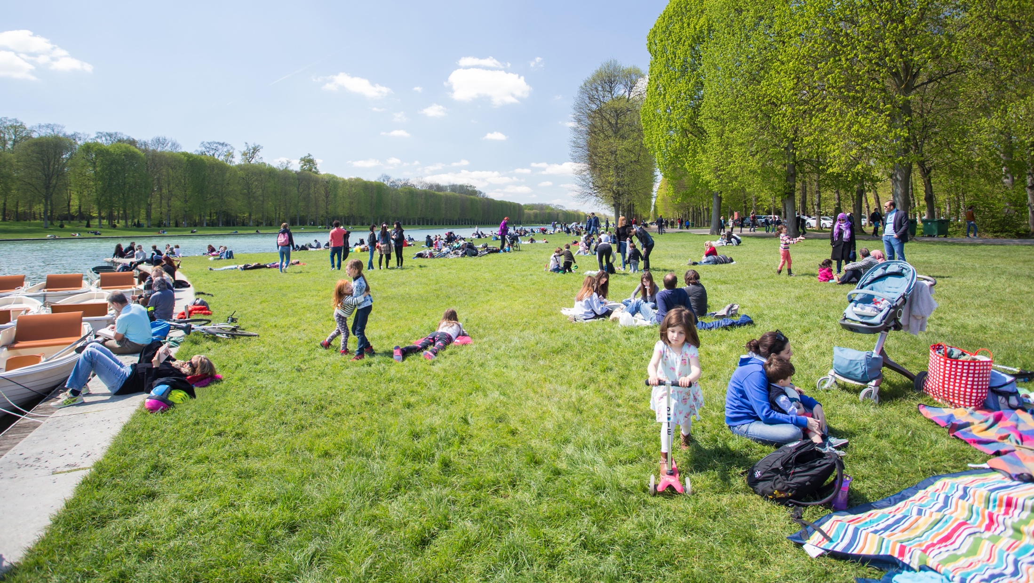
Notes:
What happens when people show up and Leave No Trace is not practiced? What kinds of impacts can occur?

Slide 12
THE LEAVE NO TRACE SPECTRUM
FEW IMPACTS
SIGNIFICANT IMPACTS
Notes:
Think of Leave No Trace as a spectrum: On one end: many impacts. On the other: few impacts
Find your place on the spectrum: by doing ANYTHING to minimize your impact and practice Leave No Trace you are helping to protect the outdoors.
If you pack out your trash, you’ve left no trace. If you’ve picked up after your pet, you’ve left no trace. If you’ve done both, even better. The cumulative effect of all those good stewardship actions is how we can collectively protect our shared lands.
Think of the difference for our shared lands if everyone put Leave No Trace into action!

Slide 13
OF LEAVE NO TRACE
Plan Ahead and Prepare
Travel and Camp on Durable Surfaces
Dispose of Waste Properly
Leave What You Find
Minimize Campfire Impacts
Respect Wildlife
Be Considerate of Others
Notes:
Our ultimate goal: which is Leave No Trace education for everyone who loves the outdoors, is enormous. The fastest way to get there, we believe, is to focus on engaging as many people and partners as possible to get the work done. We are currently employing new strategies and focusing on Leave No Trace close to home and even in the home to connect people to the education and mission.

Slide 14
OF RECREATIONAL EXPERIENCE
ANTICIPATION
Planning for the outing.
TRAVEL TO
Getting to where you’re going.
ON-SITE
Immersed in the Experience
TRAVEL BACK
Experience is over, headed home.
REFLECTION
Taking it all in.
Notes:
There are 5 steps to any recreational experience. Most people first learn about Leave No Trace in the “on site” phase. While good that they’re learning about Leave No Trace, it’s often too late to make a difference for that particular outdoor experience.
The best place to reach people is in the first stage: Anticipation. Reaching them while they’re trip planning can ensure they’re prepared to put Leave No Trace into action. With our tourism partners, we have emphasized work in the early stages of the recreational experience. Working within the tourism industry also allows Leave No Trace to reach travelers throughout their experience in a destination. This includes having minimum impact messaging everywhere from in hotels, restaurants and breweries to at trailheads and in visitor and welcome centers. These repetitive Leave No Trace messages help to instill these important practices in residents and visitors, turning them into stewards of the outdoors.

Slide 15
LEAVE NO TRACE
1960s
Originated in backcountry and wilderness areas.
1970s
Federal Land Managers developed basic Leave No Trace concepts. “No Trace” program was established.
1980s
Federal land managers developed basic Leave No Trace concepts with support from National Outdoor Leadership School.
1990s
Independent Leave No Trace organization established.
2000s
Nonprofit expands the Leave No Trace scope to address issues in the Backcountry, Frontcountry and Urban Environments.
2010s
The science of Leave No Trace is expanded and new research partners are established.
Notes:
What began as a wilderness education program is now relevant from backcountry to urban parks and protected areas—anywhere people live and enjoy the outdoors.
Established in 1994 as an independent, national nonprofit to lead development, education, partnerships, research and expand public awareness.

Slide 16
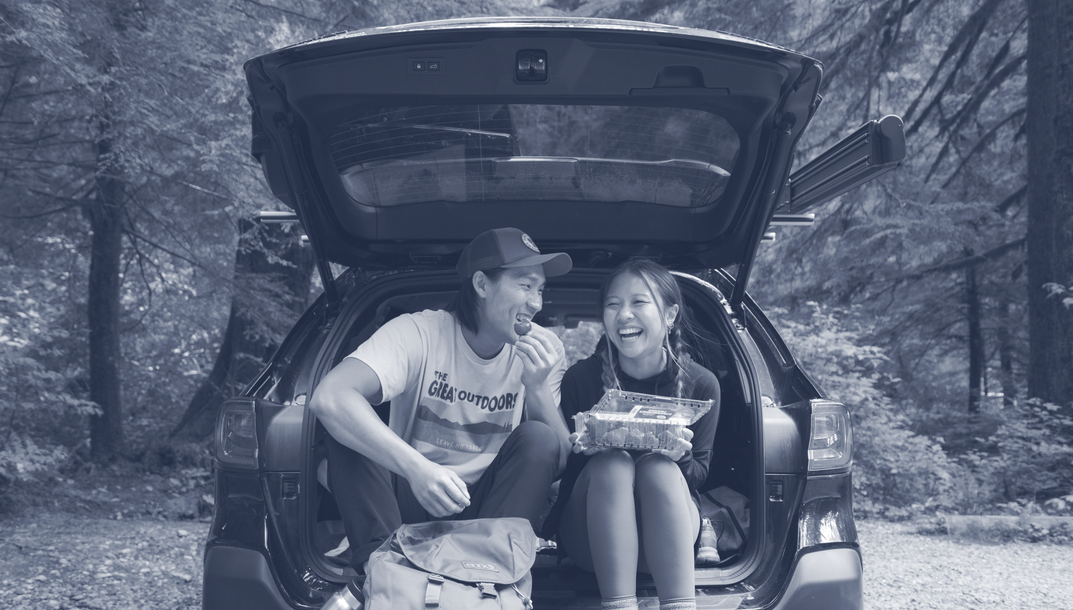
LEAVE NO TRACE
Notes:
Today: the organization reaches millions of people annually, extensive partner network and global reach. The program has also expanded into cities and local parks and Leave No Trace addresses how to bring Leave No Trace concepts from your home to the outdoors.

Slide 17
LAND MANAGEMENT AGENCY PARTNERS
ONSITE & ONLINE TRAINING
YOUTH PROGRAMS, CLUBS, CAMPS, & SCHOOLS
VOLUNTEERS & EDUCATORS TEACHING THE PROGRAM
OUTDOOR EVENTS & FESTIVALS
How does Leave No Trace
MEDIA
WEBSITE & EDUCATIONAL MATERIALS
PARTNERSHIPS WITH RETAILERS & MANUFACTURERS, NGOs, OUTFITTERS, CLUBS
TRAVELING TRAINERS
SIGNAGE & EDUCATION IN PARKS & PROTECTED AREAS
SOCIAL MEDIA
TOURISM
WRITERS, AUTHORS, OUTDOOR AUTHORS, MEDIA, BLOGGERS
Notes:
While Leave No Trace training is one of our strongest tools, Leave No Trace has a multitude of ways it reaches people. Instructors and volunteers sharing their knowledge is an excellent way to introduce people to Leave No Trace.

Slide 18
MEMBERS, INSTRUCTORS
VOLUNTEERS
Notes:
Members provide financial support for our mission of spreading Leave No Trace education.
Instructors teaching others how to practice Leave No Trace is crucial to reducing impacts to nature. One person trained in Leave No Trace goes on to educate 256 additional people, so the more folks educated the greater the our reach is.
Leave No Trace volunteer State Advocates who coordinate training and stewardship in each respective US states.
There are over 8,000 members and more than 72,000 trained educators who make up the base of on-the-ground advocacy for Leave No Trace. They support Leave No Trace by providing volunteer education, outreach, and training in their communities, and work to organize on the ground engagement and stewardship programs and events.

Slide 19
THE POWER OF
Notes:
Partners: Federal, state and local land management agencies, corporations, NGOs, schools and universities, outfitters guide services that carry the program millions of their visitors, constituents, customers and students.
Thousands of members and volunteers are key partners who carry Leave No Trace into their communities.
This vast array of partners domestically and internationally, are the on the ground network that supports Leave No Trace education, research and outreach.
Leave No Trace has hundreds of active Community, Corporate and Tourism Partners that are critical to overall Leave No Trace efforts:
Over 420 organizations, agencies and small businesses with the reach of 11.3 million people supported the Leave No Trace movement as Community Partners. These partners were from 29 countries and 45 US states and 97% of them actively engage their audiences in Leave No Trace.
Companies, largely within the outdoor industry, that support the Leave No Trace mission, also join as corporate partners to lend their support and voice to the movement. Corporate partnerships have been responsible for funding high impact programs like the Subaru/Leave No Trace Traveling Teams (3 teams of mobile educators who travel the country offering free education programs). That program alone has an average reach of 15 million annually.
7 new educational partnerships with tourism were established exposing more than 69.4 million annual visitors to Leave No Trace before, during and after their travels.

Slide 20
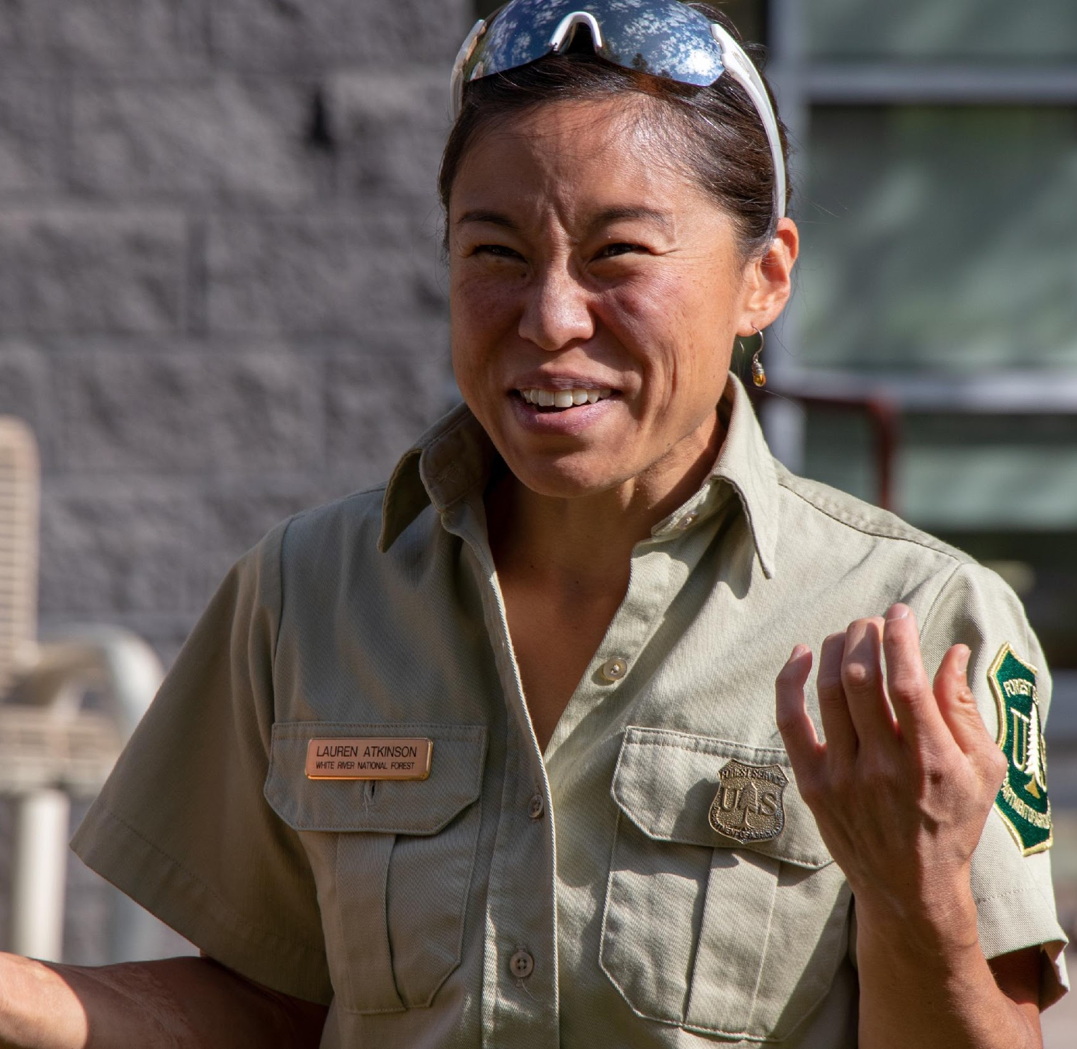
FEDERAL, STATE & LOCAL
Notes:
Federal agency land management partners play a critical role in providing Leave No Trace information to millions of people each year. Currently, the Leave No Trace organization has formal partnerships with the National Park Service, the United States Forest Service, the Bureau of Land Management, the United States Fish and Wildlife, and the Army Corps of Engineers to provide Leave No Trace education on public lands. Each of these agencies has staff trained in Leave No Trace who train other agency personnel and the general public. The federal agencies all have national Leave No Trace coordinators.
Leave No Trace also has formal partnerships with all of the country’s state parks through America’s State Parks. Local/County/Municipal agencies also partner with Leave No Trace to incorporate the program on the lands they manage.

Slide 21
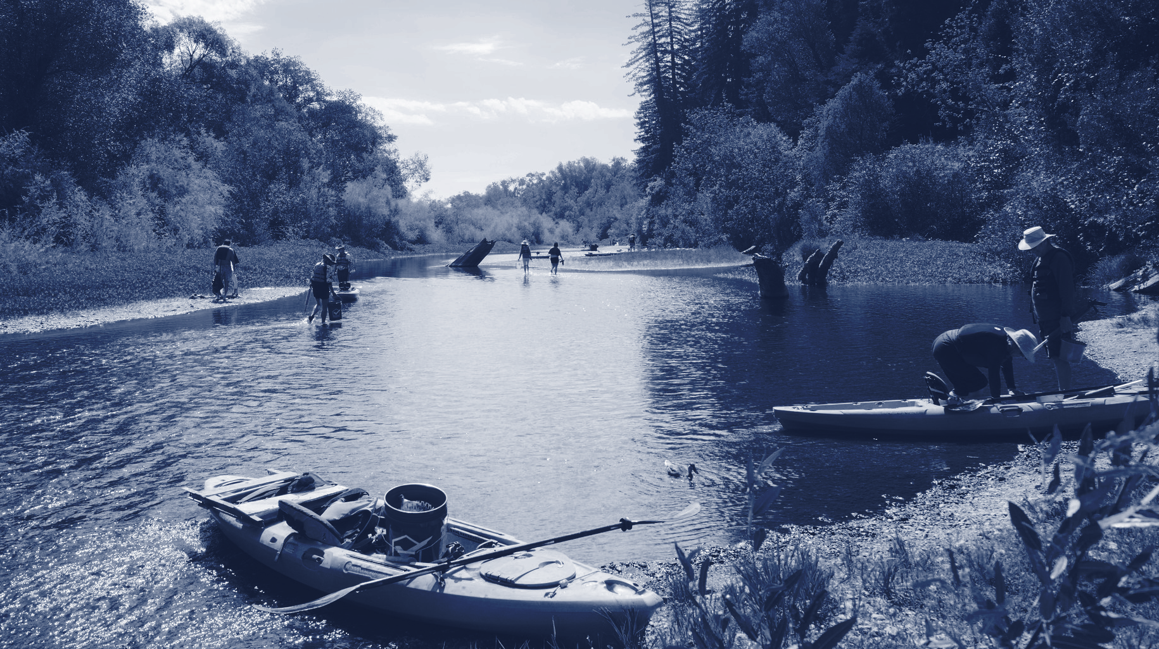
LEAVE NO TRACE IN PARK, FOREST & PROTECTED AREA
Notes:
LEAVE NO TRACE IN EVERY PARK
What if everyone who stepped into the natural world was provided with the tools to put Leave No Trace into action and develop an outdoor ethic? That’s the goal of this bold program that focuses on offering educational opportunities in the outdoors. We have several initiatives and programs that support this:
Leave No Trace in Every Park incorporates Leave No Trace programs and educational opportunities across the country. The initiative takes many forms including service work, research, interpretive materials, staff and volunteer training, public education initiatives, onsite signage, Leave No Trace Spotlights, Leave No Trace Hot Spots, Leave No Trace Gold Standard Sites, Citizen Science Projects, working with government agencies, state and local tourism entities and more.
In a typical year, the Leave No Trace organization conducts:
-Conducted over 600 education events in most of the lower 48 states, reaching over 15.5 million people
-Worked with partners and volunteers on in-person workshops to train over 500 advanced educators. The organizations online learning programs reach over 40 thousand people
-Works with parks and protected areas to achieve Leave No Trace Gold Standard Designation

Slide 22
GOVERNMENT ENGAGEMENT
LEAVE
NO TRACE
IN EVERY PARK AND PROTECTED PLACE
RESEARCH
Notes:
The organization uses various methods and programs to provide Leave No Trace in Every Park and Protected Place.
Spotlights: The new Spotlight program is a multi-day event to bring attention to community conservation, to spread education, and to build momentum and inspire involvement for the future. Our outdoor areas are facing many challenges, but with those challenges come people putting local stewardship into action. Leave No Trace wants to shine a spotlight on these challenges and the communities that are rising to meet them.
Hot Spots: Have conducted over 110 Hot Spots and are executing 11 new Hot Spots at areas in need across the country in 2022—The Hot Spots Program identifies areas suffering from severe impacts resulting from outdoor activities and implements Leave No Trace solutions to put them on the path to a healthy and sustainable future.
Gold Standard Site Designation: The Gold Standard designation recognizes specific parks and protected areas as beacons of excellence in instilling Leave No Trace. The ultimate goal is that all natural areas offer educational resources that inspire people to engage in caring for and protecting their natural qualities.

Slide 23
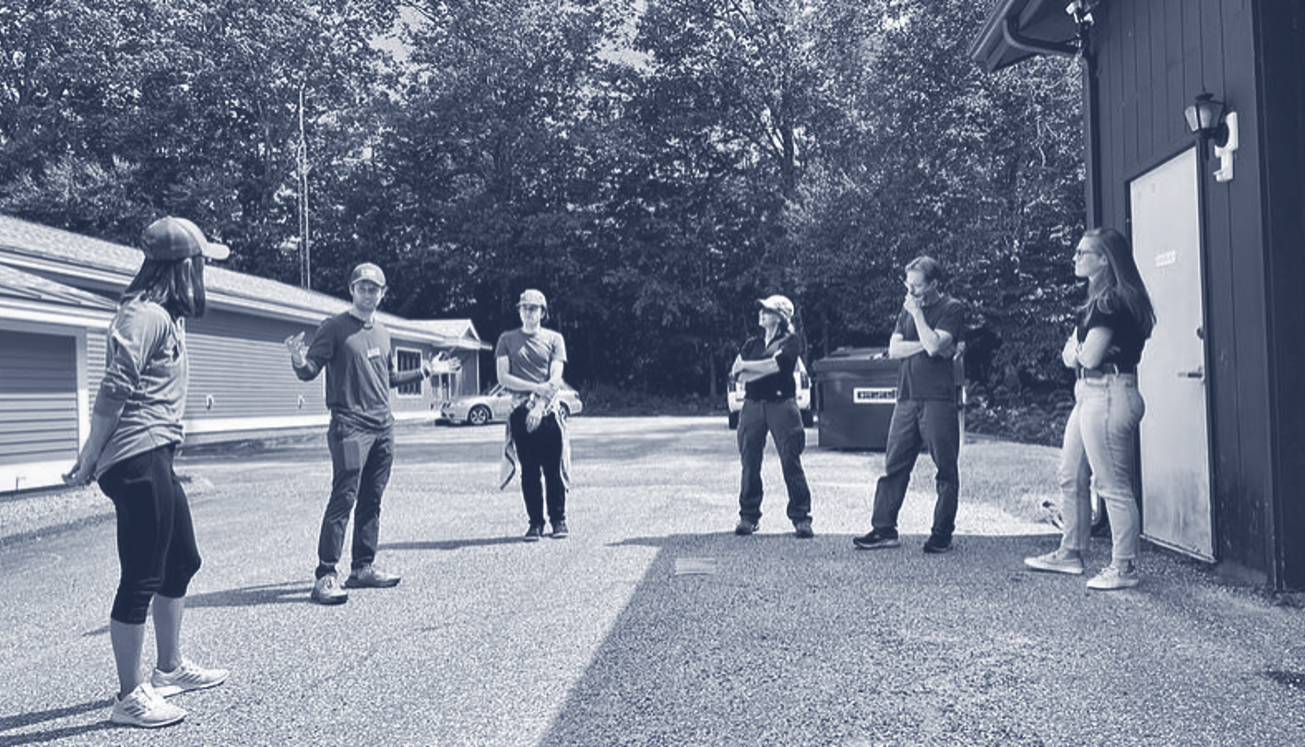
Notes:
Our outdoor areas are facing many challenges, but with those challenges come people putting local stewardship into action. Leave No Trace wants to shine a spotlight on these challenges and the communities that are rising to meet them. The new Spotlight program is a multi-day event to bring attention to community conservation, to spread education, and to build momentum and inspire involvement for the future. Sites will receive 3 days of activation put on by the Subaru/Leave No Trace Traveling Teams that can include service projects, staff and community training, community outreach, and youth programs.

Slide 24
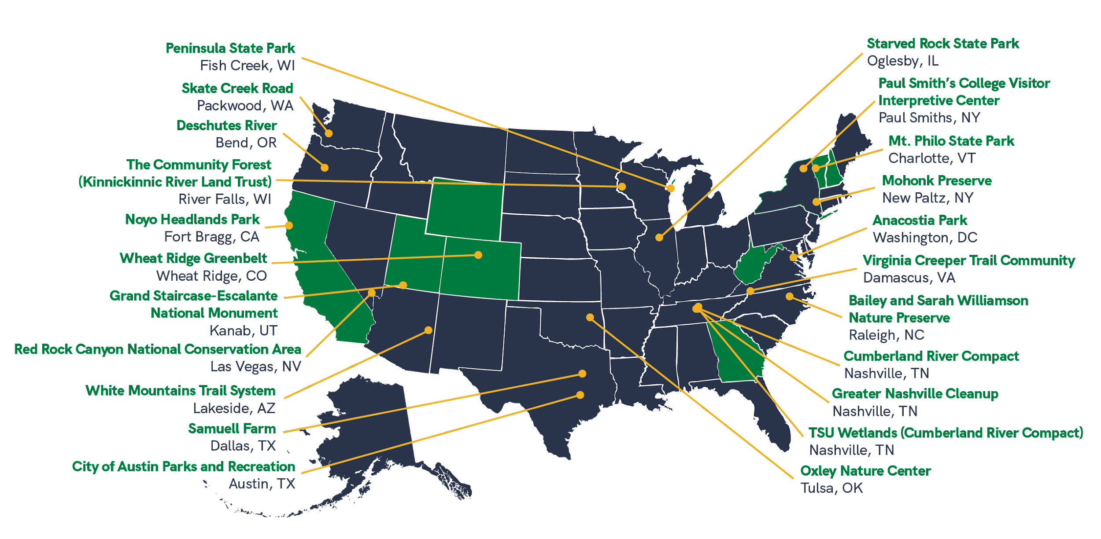
2023 SPOTLIGHT LOCATIONS
+ PAST LOCATIONS
Notes:
A map of the 2023 Spotlight locations

Slide 25
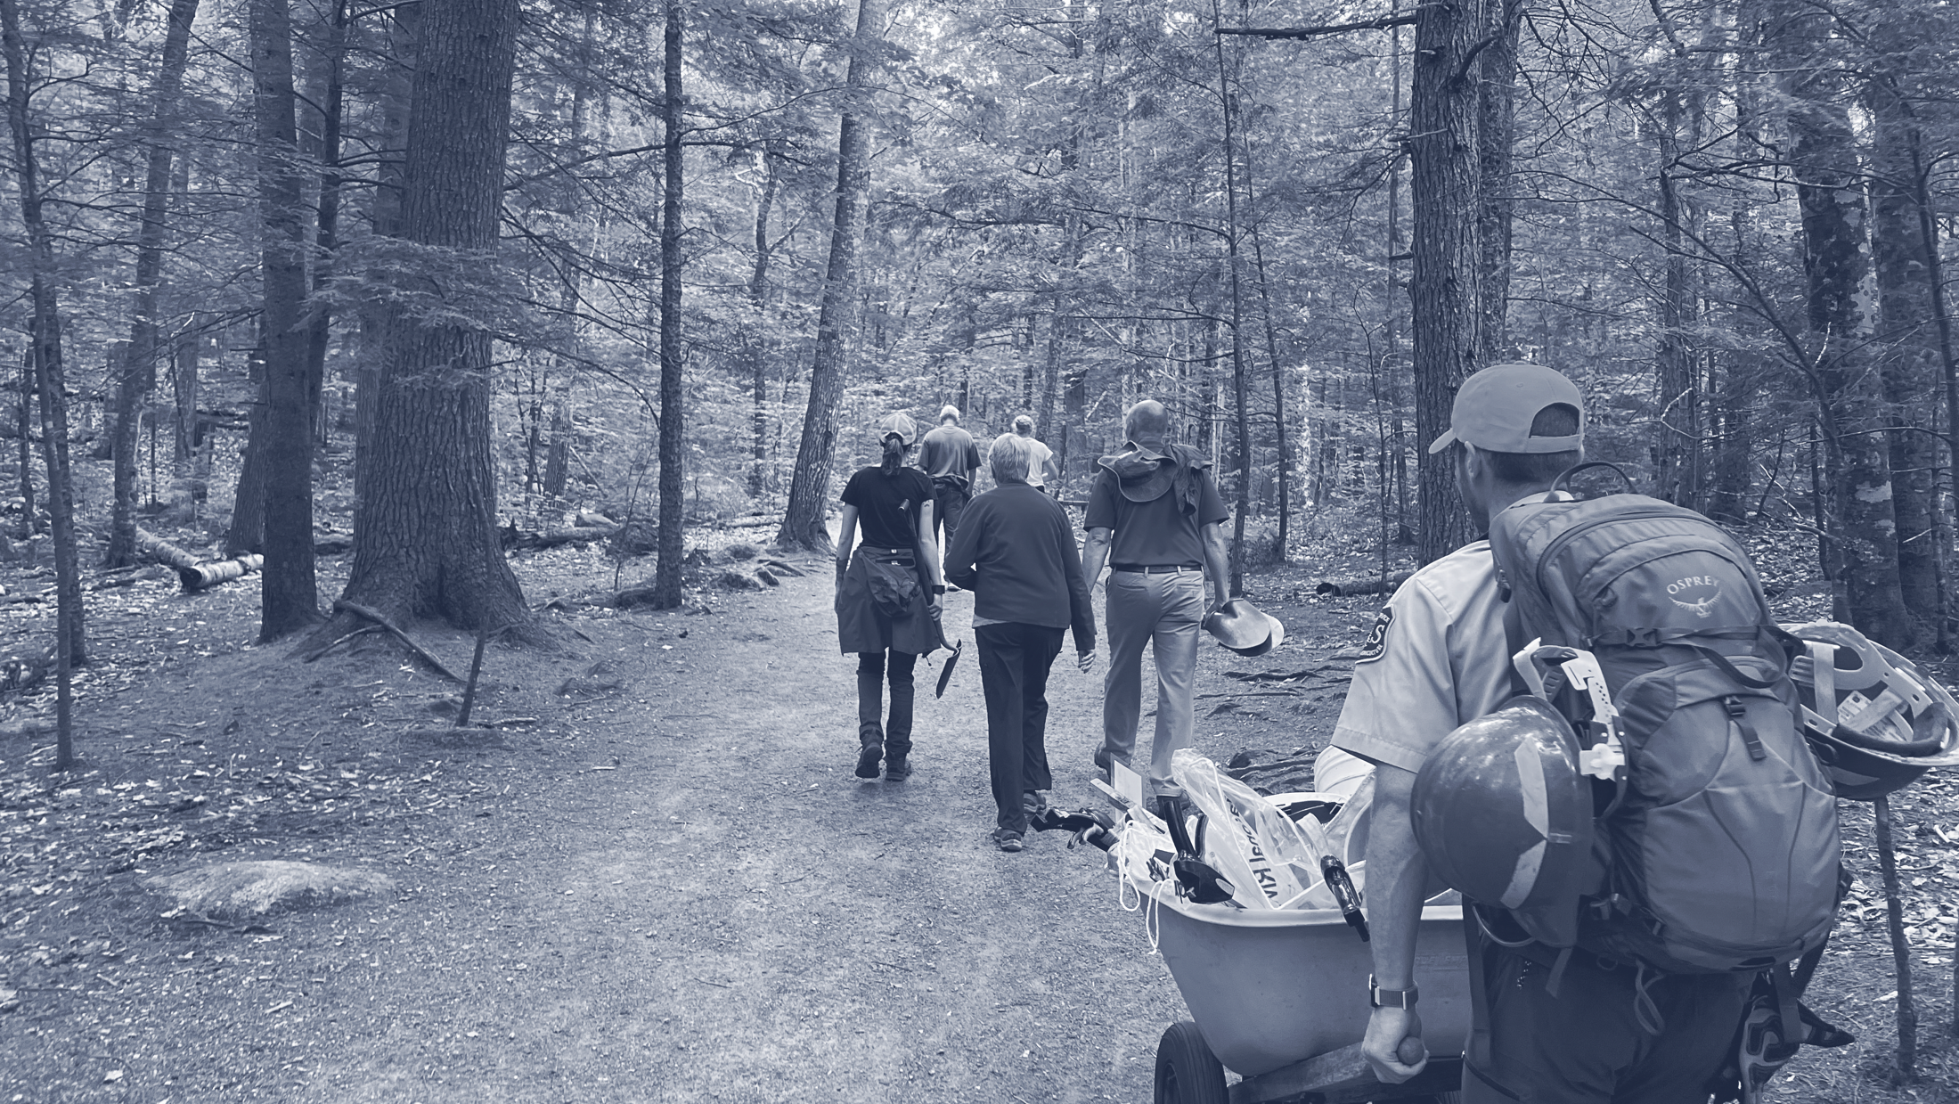
Notes:
Hot Spots are areas around the country facing the threat of irreversible impacts and sometimes closure that can recover and return to their healthy states through long-term and targeted Leave No Trace solutions. To date, Leave No Trace has conducted over 110 Hot Spots around the country–these 5-day site specific activations are a blend of educational programs, stewardship projects, community engagement, public lands workshops and more.

Slide 26
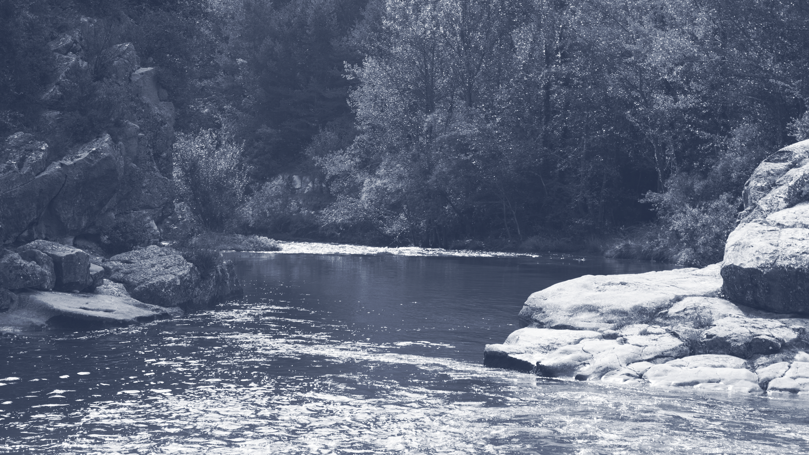
Notes:
The Gold Standard Site designation is part of the Leave No Trace in Every Park initiative designed to recognize outdoor areas that have the highest standard of onsite Leave No Trace programs.
What are the program’s ultimate goals?
Short-term: Recognize and publicize the strongest examples of agencies and land managers, nationwide, that are implementing effective Leave No Trace. Develop a national blueprint and pathway for areas to move towards Gold Standard Site status. Institute effective Leave No Trace training for park managers and other relevant parties (guides, outfitters, concessionaires).
Long-term: A critical mass of Gold Standard Sites among American public lands.Minimum-impact recreation education part of every public lands visitor experience.

Slide 27
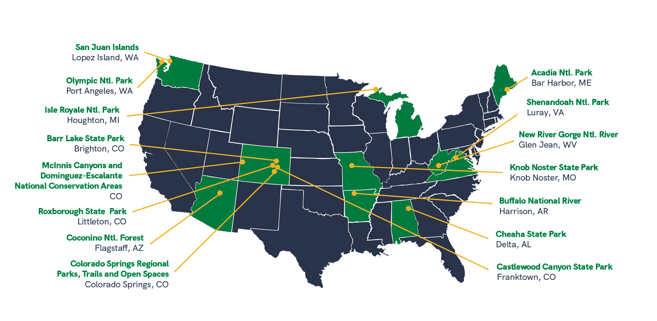
2023 GOLD STANDARD LOCATIONS
Notes:
A map of 2023 Gold Standard Sites

Slide 28
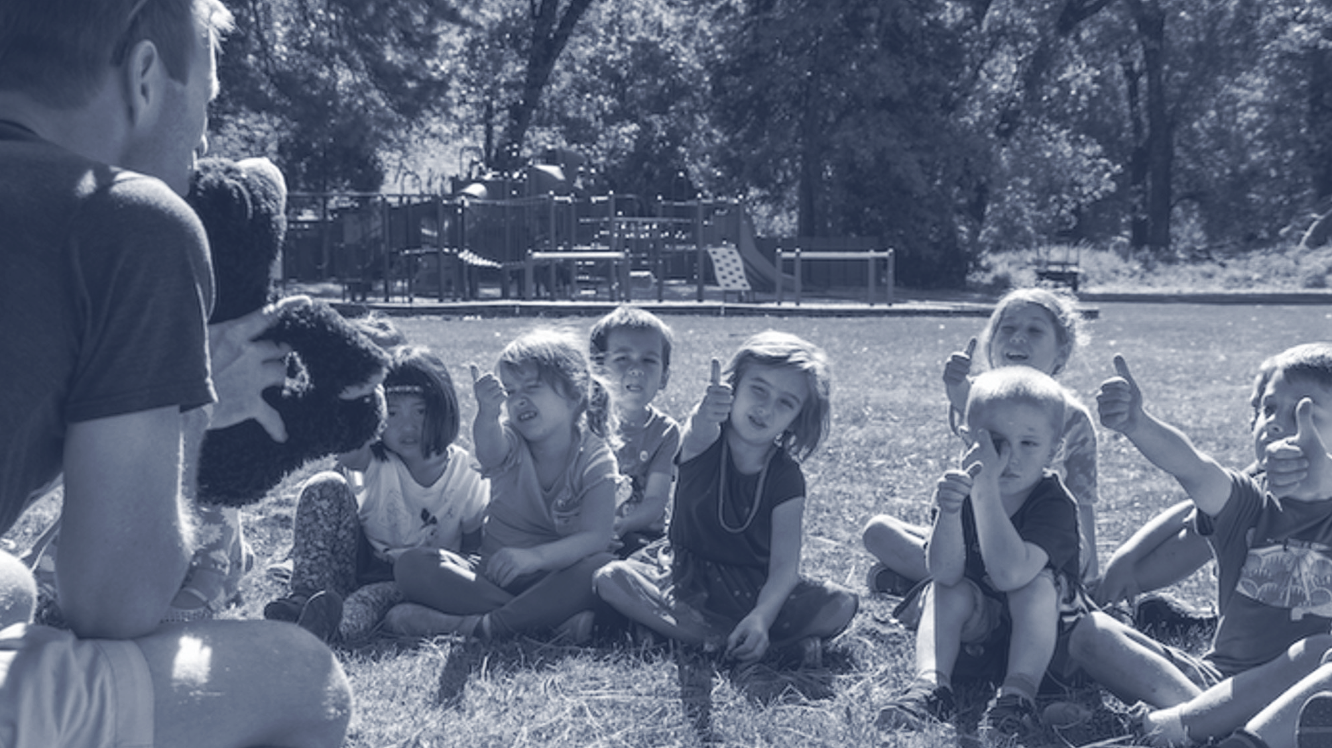
LEAVE NO TRACE FOR KID
Notes:
LEAVE NO TRACE FOR EVERY KID
Leave No Trace for Every Kid is a program that helps young people learn how responsible actions can help protect the outdoors. The initiative is shaped and inspired by the rich diversity of young people and their communities that have found joy, discovery and learning through the outdoors.

Slide 29
LEAVE
NO TRACE FOR EVERY KID
YOUTH EDUCATOR LIBRARY
BIGFOOT’S PLAYBOOK
YOUTH PROGRAMS STAFF TRAINING RESOURCES
Notes:
The organization has various resources to help engage youth in stewardship education, from activities for youth themselves to staff training resources to programmatic level tools for youth-serving organizations.
Bigfoot’s Playbook - Bigfoot’s Playbook is an experiential education curriculum which provides 38 activities specific to the Seven Principles that help kids understand what it means to Leave No Trace in their lives and their community.
PEAK (Promoting Environmental Awareness in Kids) - is presented as a “pack” of 30 minute to 1 hour Leave No Trace activities to do with kids of all ages. PEAK is available in Spanish as well. There is also a virtual version of the program called PEAK Online that is a collection of 5 fun, interactive activities to help kids learn about Leave No Trace.
Youth Program Accreditation - Provides youth program directors, managers, teachers and other youth program staff leaders with essential tools, guidelines, and best practices for teaching youth about environmental stewardship and incorporating Leave No Trace into all aspects of their program.

Slide 30
Notes:
The Leave No Trace organization funds, develops and undertakes research designed to inform new, effective ways to provide education about protecting our shared public lands. We create ground-breaking research projects, and utilize state-of-the-art methods to fuel the development of specific education, messaging, and innovative programming.
Some past Leave No Trace-focused studies used of minimum-impact practices as a measure of Leave No Trace effectiveness. In other words, the more you know about Leave No Trace, the more likely you are to put into action. While knowledge of Leave No Trace is important, there isn’t a perfect relationship between knowledge and behavior. Put another way, increasing knowledge about environmental impact does not necessarily guarantee a change in a person’s Leave No Trace behavior. The Leave No Trace organization is continually looking for new and effective ways to effective influence stewardship of our shared lands.

Slide 31
RESEARCH
Research Leave No Trace is working on today:
Leave No Trace Level 2 Instructor Course Providers and Hidden Curriculum – Advancing Equity in Outdoor Education
How close is too close: experimental study of wildlife viewing distance in Grand Teton National Park
Exploration of ”new” visitors to parks and protected areas: understanding attitudes, perceptions, expectations, and intentions
Experimental study of wildlife viewing distance, and the influence of emotions on safe distances in Yellowstone National Park
Notes:
This is a sampling of recent research. Leave No Trace partners with organizations like Penn State, Colorado State University, Virginia Tech, Old Dominion and more to conduct research.

Slide 32
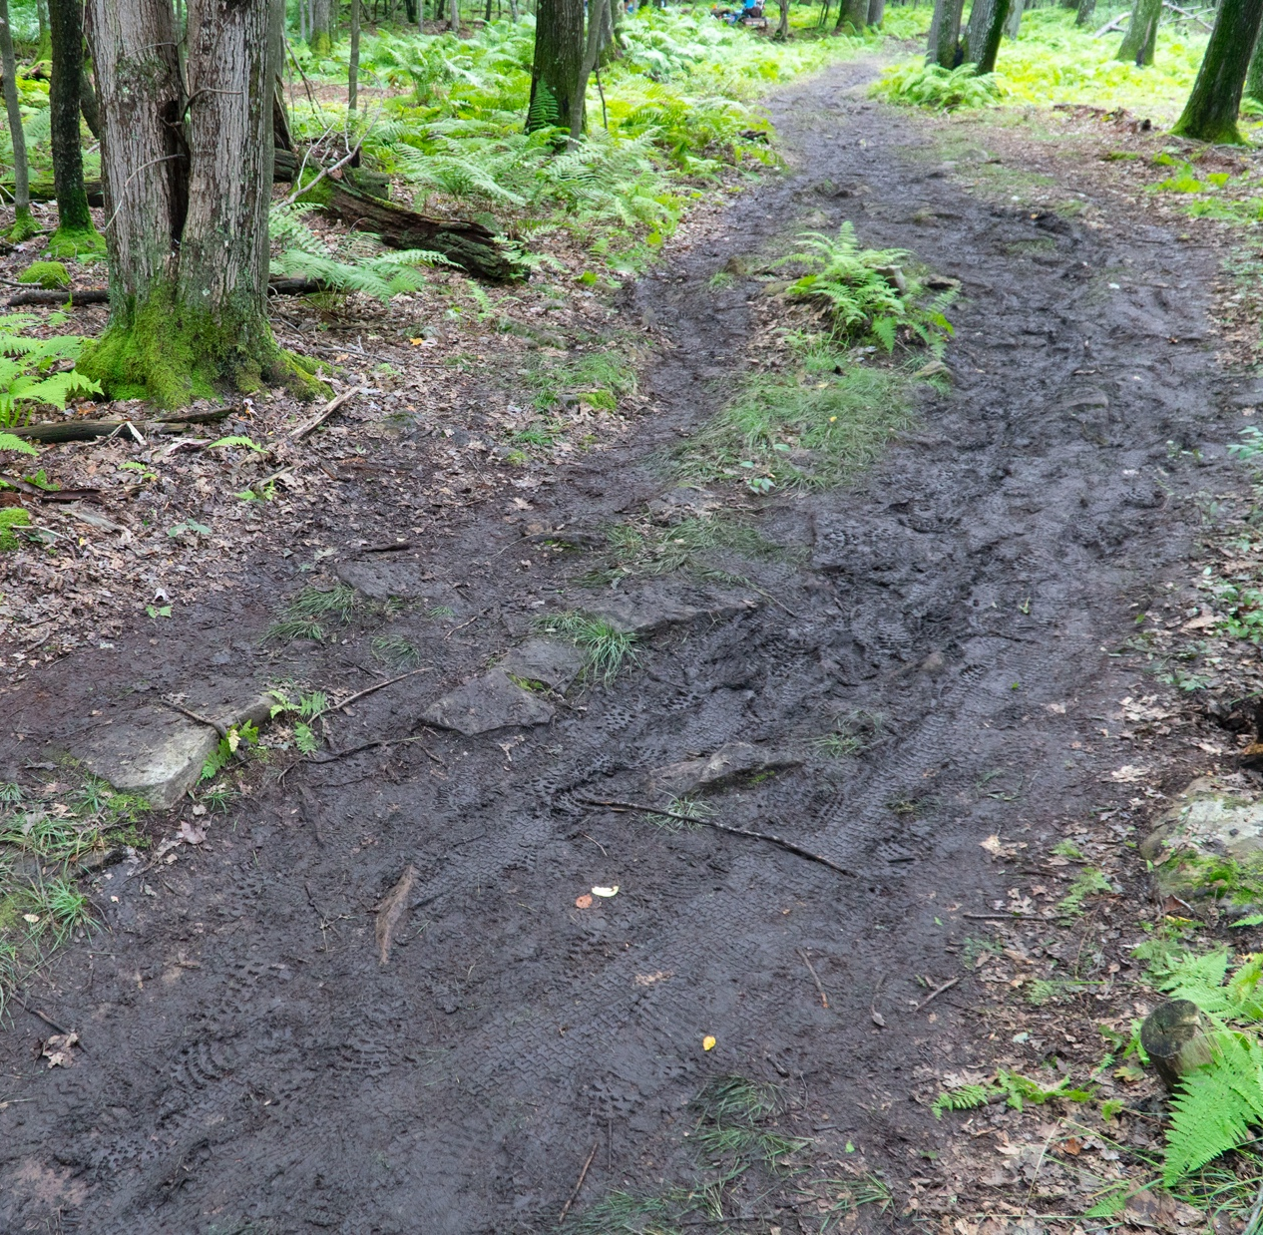
SCIENCE BASED DATA DRIVEN
Notes:
Leave No Trace is rooted in science and data-driven in its approach. Whether conducting its own studies, or drawing from the findings of research, Leave No Trace uses data to ensure strong education programs, high-quality training, and sound best practices.
Existing Leave No Trace scientific literature aligns with the disciplines of recreation ecology, and human dimensions of natural resources. Recreation ecology is a field of study that examines the impact of visitors to protected areas, and has provided the underpinning for Leave No Trace messaging because of its focus on recreation-related impacts.
Additional Information: One of most significant causes of recreation-related impacts is less than Leave No Trace behavior, which can be studied and addressed using the field of human dimensions of natural resources. Human dimensions of natural resources research seeks to interpret humans’ attitudes towards, perceptions of, and interactions with the ecosystem. Leave No Trace-focused research of this kind has increased significantly in the past 10 years, with broad and diverse research being conducted with each year.

Slide 33
SCIENCE
Notes:
Leave No Trace is currently building an extensive Citizen and Community Science program to engage adults and children in its Leave No Trace in Every Park initiative. Our Citizen and Community Science program allows volunteers the ability to contribute meaningfully to Leave No Trace in Every Park through data collection efforts.

Slide 34
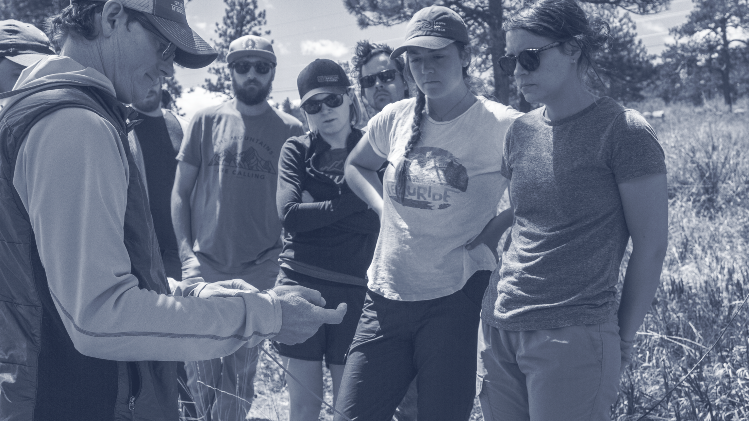
TRAINING EDUCATION
Notes:
We use training and education to support the Leave No Trace mission and ensure that all outdoor enthusiasts have the skills to leave places as good or better than they found them. Leave No Trace education comes in a variety of forms from 30 minute workshops to five day field courses, outreach at trailheads and festivals, as well as educational literature and guides.
In recent years, Leave No Trace was able to greatly expand virtual training opportunities. Regardless of where you are in the country, Leave No Trace can now offer virtual sessions to meet your group’s needs.

Slide 35
Notes:
There are currently three tiers of Leave No Trace training that provide differing education levels.
The first, and least intensive, is a workshop, which lasts 30 mins. to a full day and offers introductory Leave No Trace concepts designed for the general public. Millions have attended awareness workshops and they continue to be a popular way to get trained. Offerings exist in both virtual and in-person settings.
The next option is a 2-day Level 1 Instructor Course taught both in the field or online by Leave No Trace Level 2 Instructors across the country. The Level 1 Instructor Course results in a certification upon completion. Currently, there are over 50,000 Leave No Trace Level 1 Instructors worldwide.
The comprehensive Leave No Trace Level 2 Instructor Course is a 5-day, field-based training designed specifically for educators or those interested in teaching Leave No Trace.
Leave No Trace has 72 thousand Level 1 & Level 2 Instructors deployed around the globe. In 2021, an additional 253 Level 2 Instructors (through 31 courses) and 1,598 Level 1 Instructors (through 290 courses) were trained.
The Leave No Trace Skills Course is a 2-day course focusing on learning Leave No Trace practices. Skills Courses prepare you to discuss the Leave No Trace principles with others and to practice low-impact skills and techniques on future endeavors.

Slide 36
LEVEL 2 INSTRUCTOR COURSE PROVIDERS
Notes:
If relevant to your audience, please include this slide:
Partnerships with some of the country’s leading outdoor education institutions ensures that the Leave No Trace Level 2 Instructor Course is taught by and to a broad cross-section of people.

Slide 37
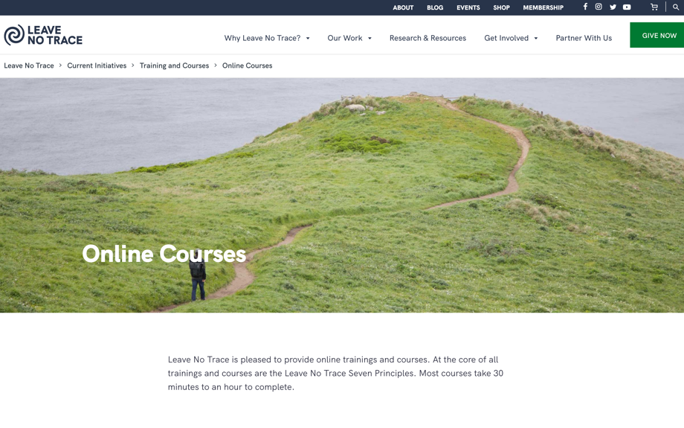
LEARNING
Notes:
A popular web-based option is taking our online 101 Course, which is designed to convey general Leave No Trace knowledge. Anyone age 12 or older can take the 101 Course, and those who complete it receive a certificate of completion.
Another opportunity for existing Level 2 Instructors is an Online Level 2 Instructor Refresher Course, which ensures that Leave No Trace Level 2 Instructors are current on their knowledge. This online refresher takes about 90 minutes to complete and is required once every two years for Level 2 Instructors who teach Leave No Trace Level 1 Instructor and Skills Courses.
Additional courses include the online PEAK course for kids, a course for Outdoor Elopement Photographers, and a Zero Landfill Course.

Slide 38
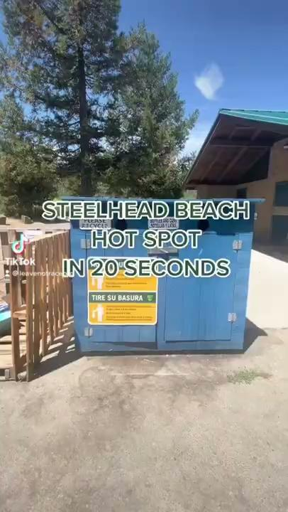
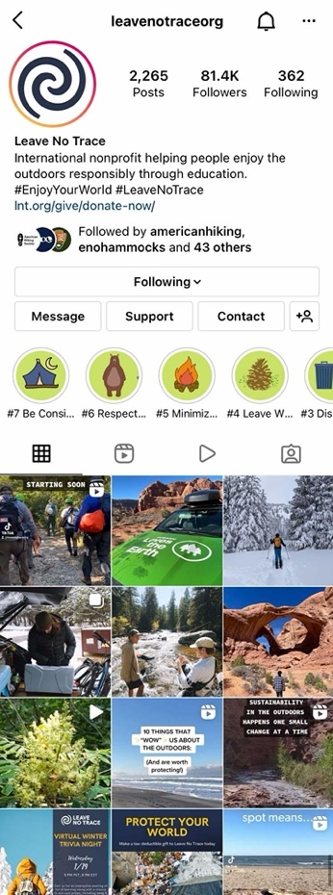
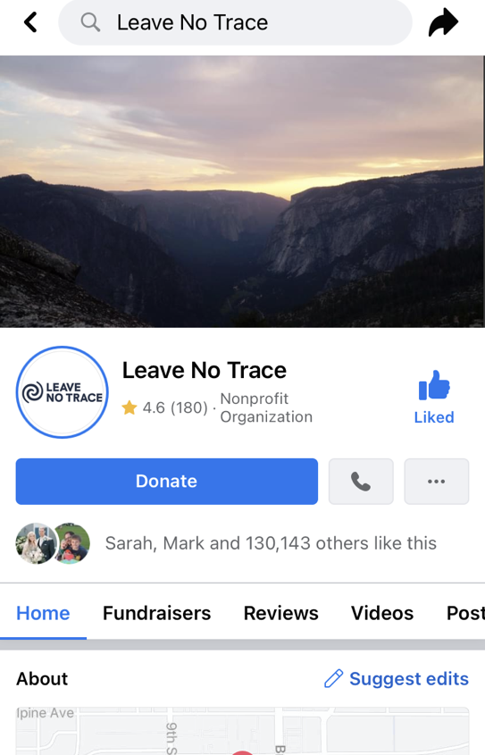
SOCIAL MEDIA & LEAVE NO TRACE
Be thoughtful about what your images portray.
When geotagging crowded tourist posts or delicate areas, include Leave No Trace and other environmental/safety information as tools for people reading your posts.
Research areas. Consider including a land acknowledgement.
Choose kindness not callouts. Share Leave No Trace information in the comments instead of shaming.
Give back to the places you love.
Notes:
Social media can excite and inspire people to get outside, and Leave No Trace sees social media as an opportunity to engage more people with Leave No Trace education.
Over recent years, social media and the outdoors has emerged as an important topic for Leave No Trace to provide guidance for. We have comprehensive guidance for Leave No Trace and social media that is available on the website. Specifically geotagging in the outdoors has gotten much attention recently.
The bullets in the slide provide key takeaways from the social media guidelines.

Slide 39
HOW TO GET INVOLVED:
Notes:
Learn Something:
Take advantage of the organization’s broad selection of skills videos on our YouTube Channel
Read the Leave No Trace Skills & Ethics Guide: a short booklet that takes you through Leave No Trace for various ecosystems and outdoor activities
Taking one of the instructor or recreational courses
Taking the online 101 Course

Slide 40
HOW TO GET INVOLVED:
Notes:
Share Leave No Trace, even a simple principle, with other people when you’re enjoying the outdoors.
Contact your Leave No Trace State Advocate to learn about opportunities to get involved with Leave No Trace efforts in your community!
Introduce a kid to Leave No Trace through PEAK online
Contact Leave No Trace and become a Citizen Scientist to get involved with Leave No Trace monitoring in your area
Forward Leave No Trace videos from YouTube, educational blogs and more.
Take, learn and share on social all of the great resources in our Free Social Media Toolkit which you can find on our website.
Organize a clean up at your favorite outdoor area and share Leave No Trace education on the way.
It’s so easy.

Slide 41
HOW TO GET INVOLVED:
Notes:
Easy ways to get involved where you are:
Join the movement as a member: supporting what you care about, and be in the know about the latest science, research, and skills.
Encourage your organization or company to become an official partner of Leave No Trace. Any group can get involved and play an important role in sharing the Leave No Trace message!
Join 330K+ strong, active, engaged social media family: Instagram, TikTok, Facebook, Twitter, LinkedIn

Slide 42
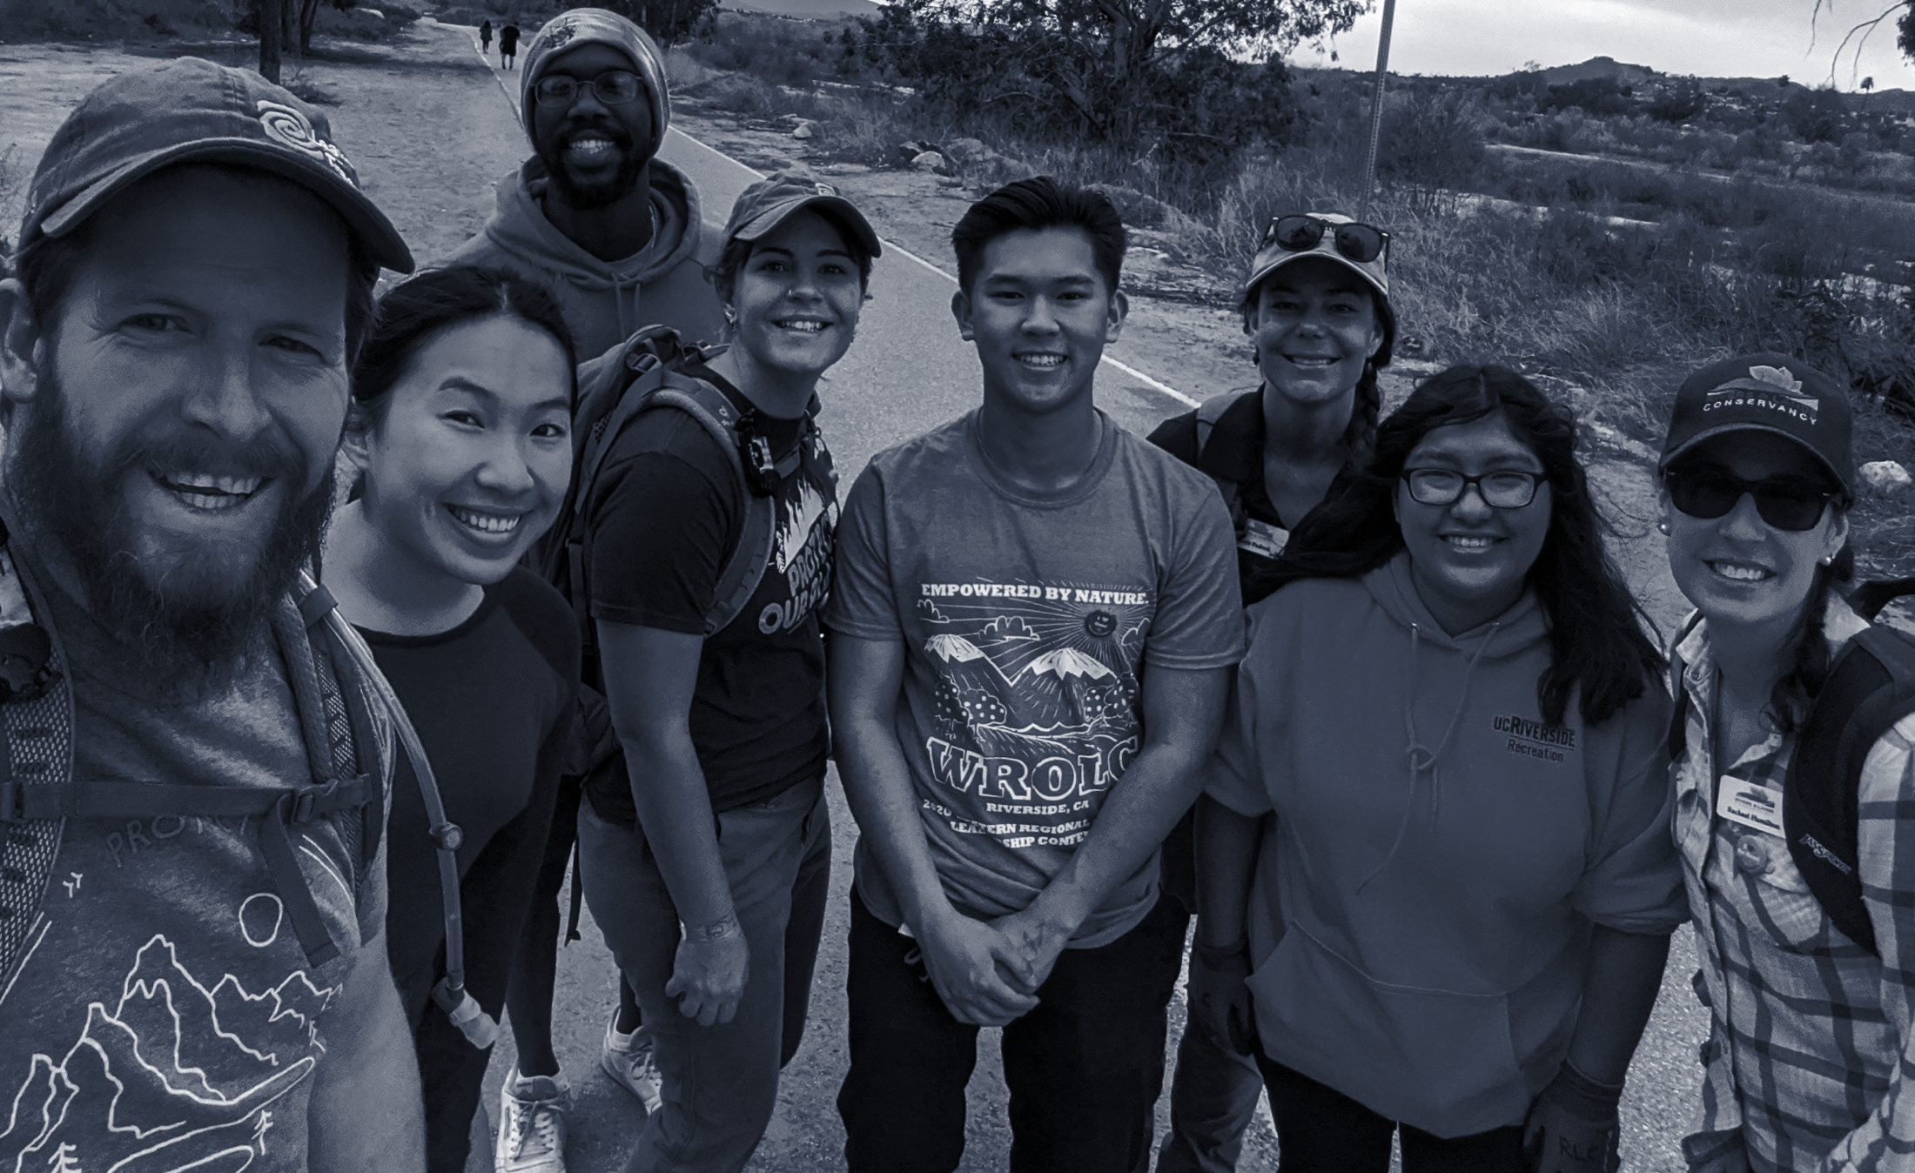
IT’S GOING TO TAKE
Notes:
Remember: It’s your nature so Leave No Trace.

