Slide 1
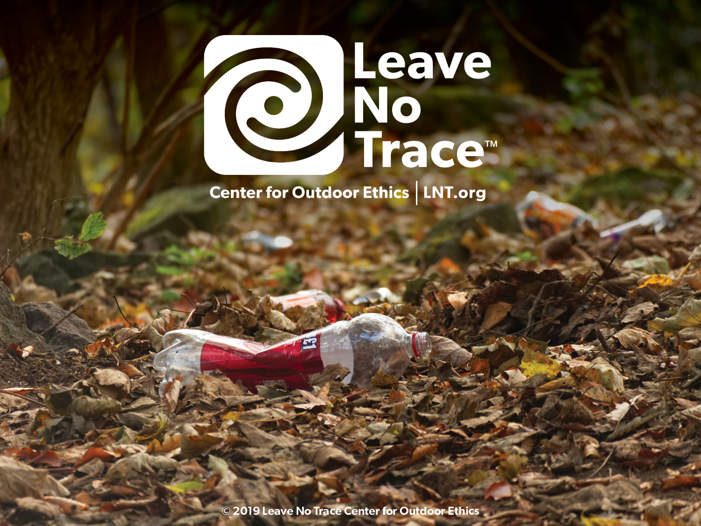

Slide 2
Notes:
How many of you have taken a hike? Been on a picnic? Gone camping with your family or friends? Show of hands. Getting outside renews our spirits, connects us with nature, amazing beauty, and the many natural wonders of our world.
National movement, run by a nonprofit organization (called the Leave No Trace Center for Outdoor Ethics) that is dedicated to protecting the outdoors by teaching and inspiring people to enjoy it responsibly.
Center accomplishes this mission by delivering cutting-edge education, and training programs to millions of people across the country every year.
Then introduce yourselves:
State Advocate/Volunteer/Educator: Introduce yourself and your role with the Leave No Trace Center for Outdoor Ethics.
Leave No Trace addresses impacts and provides people with techniques and skills to enjoy the outdoors sustainably—now and into the future.

Slide 3
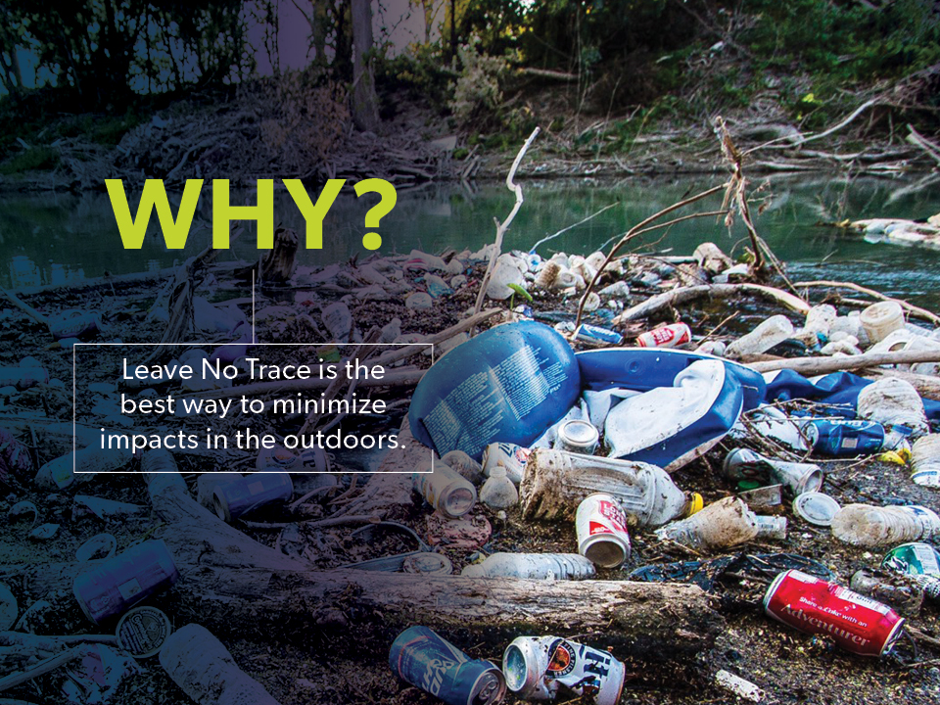
WHY?
Notes:
9 out of 10 people who visit the outdoors are not informed about Leave No Trace. With over 13 billion trips into the outdoors in the U.S. alone every year, people are causing much preventable damage, and that damage is adding up.
Have you ever seen a trashed area? Fire scars at a campground? Severely damaged trails? Other impacts? Would you believe (use any of stats that may resonate):
Americans pay $2.9 billion to fight fires in parks and forests, 80% of which are caused by campfires left unattended, the burning of debris, or negligently discarded cigarettes.
Wildlife in our parks are routinely relocated and, in some cases euthanized, due to conflicts with humans. The National Park Service cites human garbage as the origin of many of these unfortunate and unnecessary conflicts.
Grand Canyon National Park has $11 million in trail maintenance needs and more than $5 million in critical trail work is needed at Great Smoky Mountains National Park.
Each year, tons of petrified wood are removed illegally from Arizona’s Petrified Forest National Park.
Wildlife that obtain human food can lose their fear of humans and develop attraction behaviors to trails, picnic areas, campsites and visitors, turning wild animals into aggressive and potentially dangerous panhandlers. Such animals may ultimately euthanized by land managers because of the risks they present to people.
Invasive species are being spread nationwide due to moving firewood from one area to the next by campers. Many new infestations of non-native tree-killing insects and disease are often first found in campgrounds. The specific insects and diseases vary by region, but some have already killed millions of trees over thousands of acres.
Trash lasts a very long time: plastic grocery bags can last up to 20 years; aluminum cans up to 100 years; fishing line up to 600 years.
According to the U.S. Centers for Disease Control (CDC), one day’s pet waste can contain several billion fecal coliform bacteria, along with Giardia and the eggs of roundworms, hookworms, and tapeworms.
Studies have attributed pet wastes to instances of water pollution sufficient enough to exceed water quality standards, close beaches and harm wildlife.
Recovery rates for areas impacted by recreation are often very slow, with restoration to natural conditions often requiring a minimum of 10-30 years.
Leave No Trace is the best way to minimize these and other types of impacts we see in the outdoors today.
You can be on the forefront of changing that troubling trend—the trashed parks and damaged trails, the formidable impacts of fire, polluted waterways and serious wildlife issues. Now, more than ever, your role is critical.

Slide 4
Notes:
When venturing in the outdoors, humans generally impact the environment in seven broad areas:
Wildlife Impacts: disturbance, altered behavior, intentional or inadvertent feeding, or reduced health and reproduction of animals.
Soil Impacts: loss of organic litter, soil compaction, or soil erosion

Slide 5
Notes:
Vegetation Impacts: vegetation loss, the introduction of invasive species, and tree or plant damage
Cultural Resource Impacts through theft or damage to cultural and historic features and artifacts
Campfire Impacts: large damaging fires, depleting areas of all dead and downed wood, burned trash and food, wildfire risk

Slide 6
Notes:
Water Resource Impacts: siltation, sedimentation, trash, and soap or fecal waste
Social Impacts from Other Visitors: crowding, conflicts between various user groups, and diminished outdoor experience

Slide 7
Notes:
Consider the number of people our public lands see each year. While it’s great so many people spend time outside, it also means there are many opportunities to impact the outdoors. Recreation-related impacts to public lands are individual but they’re cumulative over time. It’s not the one time someone cuts a switchback or tosses an apple core off the trail, it’s when these actions are repeated hundreds, thousands, or millions of times.
The environmental implications of outdoor use can be staggering, especially given the popularity of outdoor recreation on federal and state lands. According to federal and state data (source – agency websites).

Slide 8
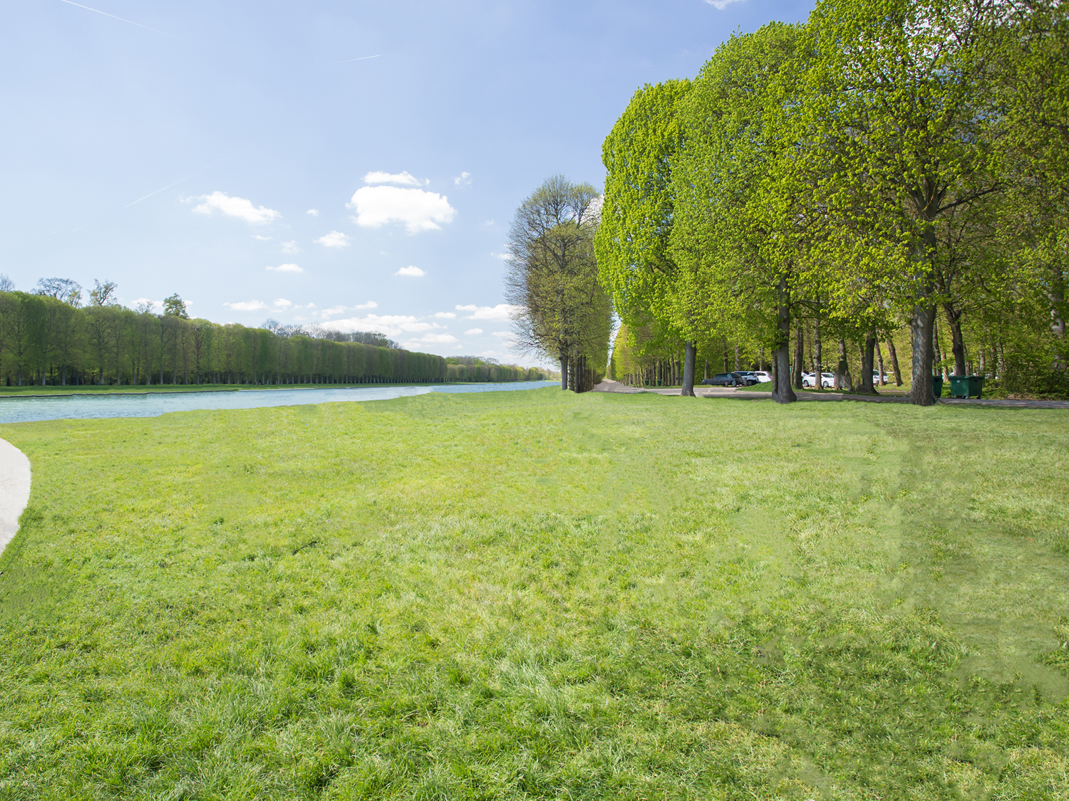
Notes:
Here is a typical park scene. A nice park with grassy fields, a hardened parking area, and easy access to the water.

Slide 9
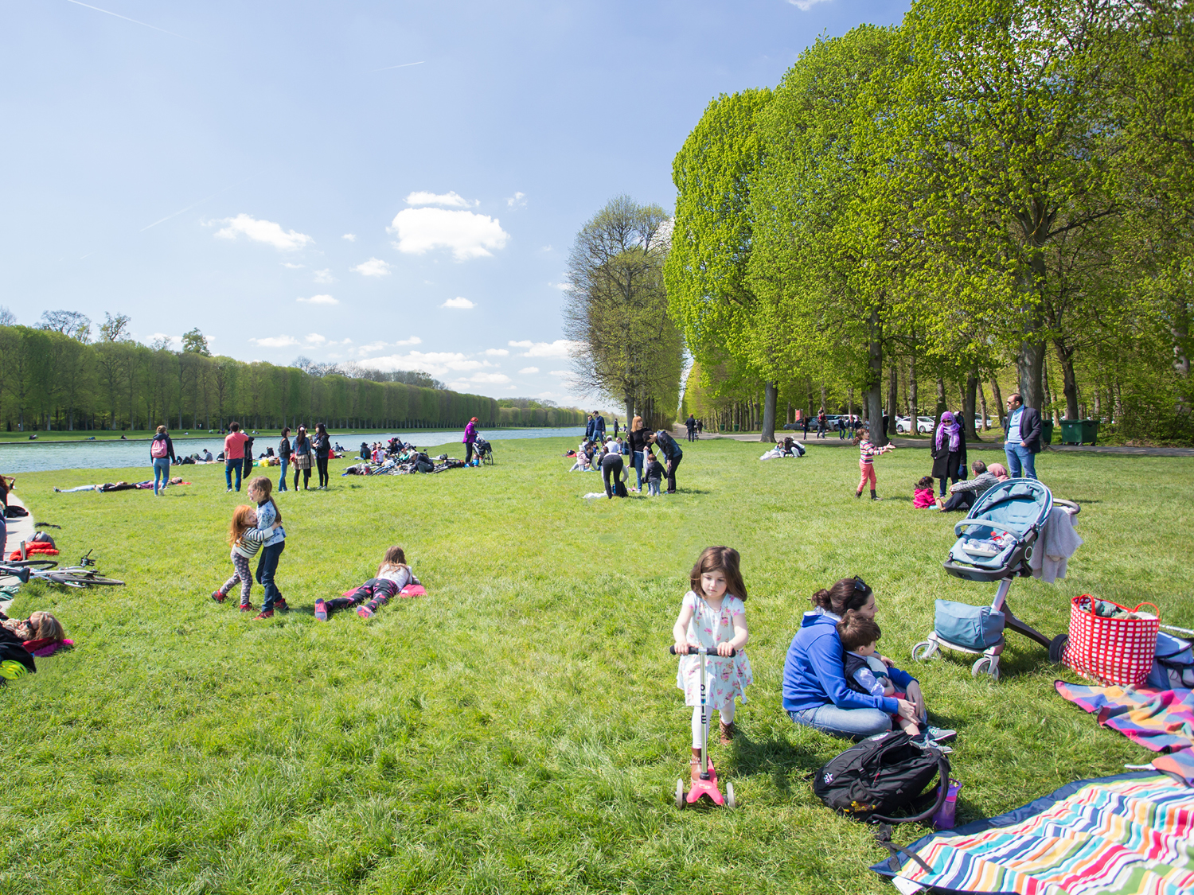
Notes:
What happens when people show up? What kinds of impacts can occur?

Slide 10
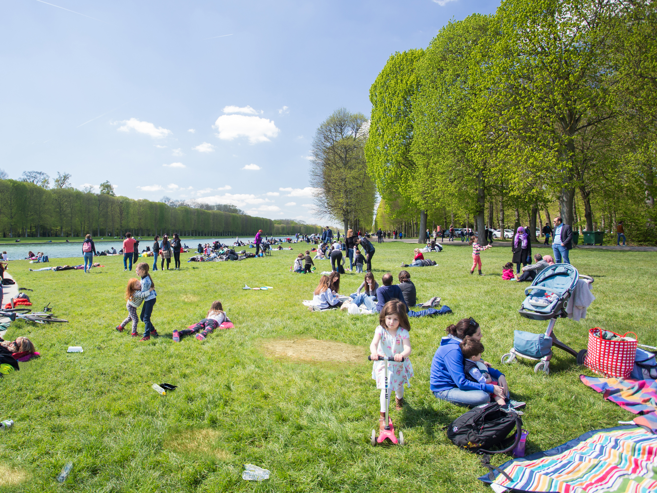
Notes:
Think what happens when even more people come to the park. The potential for recreation-related impacts can increase significantly.

Slide 11
Notes:
Think of Leave No Trace as a spectrum:
On one end: many impacts. On the other: few impacts
Many ways to Leave No Trace when spending time in the outdoors. Find your place on the spectrum.
Doing ANYTHING to minimize your impact is better than doing nothing at all. Leave No Trace isn’t rules, regulations, or black or white.
It’s about doing what we can to minimize our impact on the natural spaces where we choose to spend time.
If you pack out your trash, you’ve left no trace. If you’ve picked up after your pet, you’ve left no trace. If you’ve done both, even better. The cumulative effect of all those good stewardship actions is how we can collectively protect our shared lands.
Think of the difference for our public lands if every one put Leave No Trace into action!

Slide 12
Notes:
-Data-driven in its approach. Whether conducting its own studies, or drawing from the findings of recent research, the Center utilizes empirical data to ensure strong education programs, high-quality training, and sound best practices.
Existing Leave No Trace scientific literature aligns with the disciplines of recreation ecology, and human dimensions of natural resources. Recreation ecology is a field of study that examines the impact of visitors to protected areas, and has provided the underpinning for Leave No Trace messaging because of its focus on recreation-related impacts.
-One of most important causes of visitor-created impacts is impactful visitor behavior, which aligns with human dimensions. Human dimensions of natural resources research seeks to interpret humans’ attitudes towards, perceptions of, and interactions with the ecosystem. Leave No Trace-focused research of this kind has increased significantly in the past 10 years, with more research being done each year.

Slide 13
Notes:
Research shows that Leave No Trace education is successful in improving people’s knowledge about minimum-impact practices, fostering an outdoor ethic, and positively influencing responsible behavior in the outdoors. Research indicates education fosters:
Healthier, thriving wildlife and fewer negative interactions with humans.
Considerable litter reduction
Less degradation of native plants and animal species
Stronger human bonds to the outdoors and a greater sense of stewardship
The Center continues to study and test our principles, messaging, and training to ensure the best, most effective, relevant messaging and programs.
Is a simple, effective framework for making good decisions in nature, no matter how your choose to spend time outdoors.
Though developed for the backcountry, Leave No Trace today is relevant for anyone who spends time outdoors and is appropriate everywhere from deep Wilderness and the backcountry to your local city park.

Slide 14
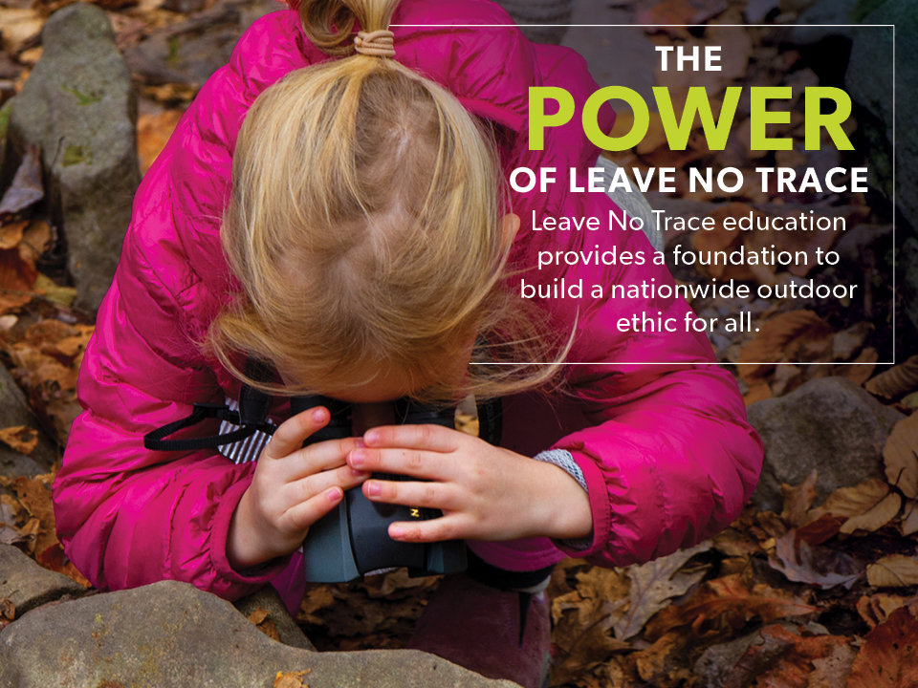
Notes:
Optional Narrative: What began as a call to preserve wilderness areas has evolved into a global, daily commitment for all people to embrace a Leave No Trace ethic.
A goal of Leave No Trace is to change the relationship between use and impacts. Ideally, use of our share lands could increase without the continued increase in impact due to everyone who spends time outdoors putting Leave No Trace into action.
The environmental stewardship promoted by the Leave No Trace Center extends beyond outdoor enthusiasts to include ANYONE who enjoys the outdoors and is concerned with people’s relationship with nature.

Slide 15
Notes:
To understand how the Leave No Trace Center for Outdoor Ethics operates today, understanding the extensive history is helpful.
60s: originated in backcountry and federally-designated Wilderness areas in the 1960’s, following the passage of the Wilderness Act in 1964.
70s: federal land management agencies developed and shared basic Leave No Trace concepts on lands they managed
Later, in the 1980’s, the “No Trace” program was developed by the USDA Forest Service wilderness managers as a humanistic approach for wilderness ethics and low impact hiking and camping practices.
ADDITIONAL INFORMATION AS NEEDED
Early names for the program included: Wilderness Manners, Wilderness Ethics, Minimum-Impact Camping and No-Trace Camping.
1970s: federal agencies began to develop educational brochures to teach the public about Leave No Trace. At the time, the program was slogan-based with little national leadership or inter-agency coordination.
Early 1990’s: “Leave No Trace” selected as the name for an expanded national program
Partnerships formed with four federal land management agencies and the National Outdoor Leadership School (NOLS)
The 1993 Outdoor Recreation Summit held in Washington D.C. (including feds, NGOs, outdoor companies) recommended new nonprofit to manage national program

Slide 16
Notes:
To understand how the Leave No Trace Center for Outdoor Ethics operates today, understanding the extensive history is helpful.
60s: originated in backcountry and federally-designated Wilderness areas in the 1960’s, following the passage of the Wilderness Act in 1964.
70s: federal land management agencies developed and shared basic Leave No Trace concepts on lands they managed
Later, in the 1980’s, the “No Trace” program was developed by the USDA Forest Service wilderness managers as a humanistic approach for wilderness ethics and low impact hiking and camping practices.
ADDITIONAL INFORMATION AS NEEDED
Early names for the program included: Wilderness Manners, Wilderness Ethics, Minimum-Impact Camping and No-Trace Camping.
1970s: federal agencies began to develop educational brochures to teach the public about Leave No Trace. At the time, the program was slogan-based with little national leadership or inter-agency coordination.
Early 1990’s: “Leave No Trace” selected as the name for an expanded national program
Partnerships formed with four federal land management agencies and the National Outdoor Leadership School (NOLS)
The 1993 Outdoor Recreation Summit held in Washington D.C. (including feds, NGOs, outdoor companies) recommended new nonprofit to manage national program

Slide 17
Notes:
Established in 1994 as an independent, national nonprofit to lead development, education, partnerships, research and expand public awareness.
Today:
partners with 700+ companies, land agencies, schools, universities, non-profits, outfitters and guides, and their constituents to promote Leave No Trace
35,000 trained volunteers, educators, and members across the country provide local Leave No Trace programs
What began as a wilderness education program is now relevant from deep backcountry to urban parks and protected areas—anywhere people live and enjoy the outdoors.

Slide 18
LEAVE NO TRACE
TODAY
Notes:
The ultimate goal of the Center, which is Leave No Trace education for everyone who loves the outdoors, is enormous. The fastest way to get there, we believe, is to focus on the sources—the lands themselves, as well as youth. The Center focuses on two major initiatives: Leave No Trace in Every Park and Leave No Trace for Every Kid:
Leave No Trace in Every Park focuses on public lands including local, state, and national parks, forests, and protected areas.
Leave No Trace for Every Kid focuses on introducing basic Leave No Trace concepts to kids while they are forming their personal ethic framework.
To ensure that to ensure that Leave No Trace is reaching communities across the country.
we’re also:
training the public
building a vast volunteer network
conducting critical research

Slide 19
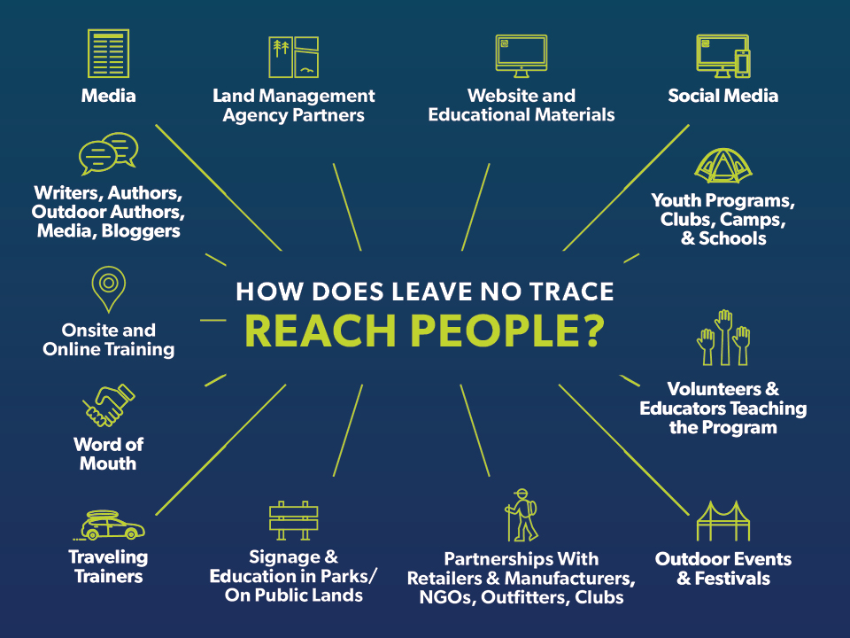
Notes:
Leave No Trace has multiple strategies to reach people.

Slide 20
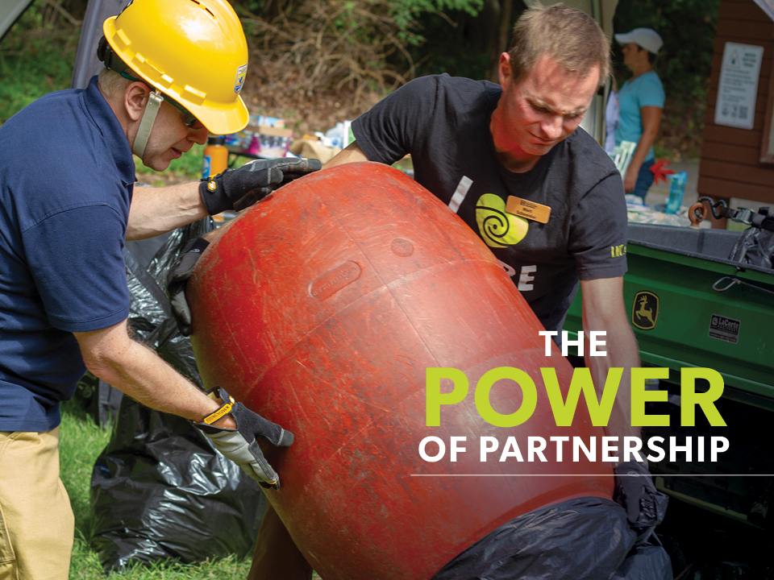
Notes:
Partners: Federal, state and local land management agencies, corporations, NGOs, schools and universities, outfitters guide services that carry the program millions of their their visitors, constituents, customers and students.
Thousands of members and volunteers are key partners who carry Leave No Trace into their communities.
This vast array of partners domestically and internationally, are the ground troops to support Leave No Trace education, research and outreach.
Let’s take a look at how these partners play a role with Leave No Trace:

Slide 21
Notes:
The Center has over 700+ active Community and Corporate Partners that are critical to overall Leave No Trace efforts.
Corporate and Community partners are dues-paying
On average, a single community partner reaches 1100 people each year with formal Leave No Trace training. Community partnership is the best way for non-profits, colleges, universities, small businesses, municipalities, clubs, outfitters and guides to publically demonstrate their support of the Leave No Trace movement.
Companies, largely within the outdoor industry, that support the Leave No Trace mission, also join as corporate partners to lend their support and voice to the movement.
Corporate partnerships have been responsible for funding high impact programs like the Subaru/Leave No Trace Traveling Trainers (4 teams of mobile educators who travel the country offering free education programs) and State Advocates (ensuring that every state has a volunteer coordinator and educator).

Slide 22
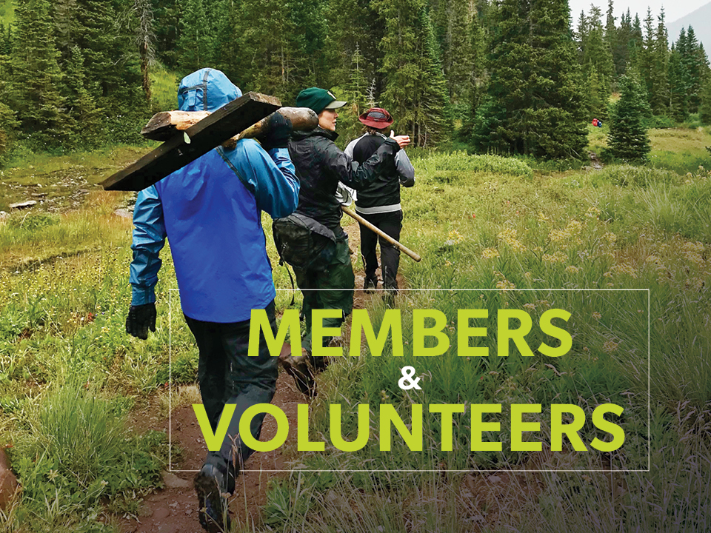
Notes:
7,500 members and 35,000 volunteers make up the base of on-the-ground advocacy for Leave No Trace. They support Leave No Trace by providing volunteer education, outreach, and training in their communities, making financial contributions to the organization’s work, and rallying the on-the-ground troops.

Slide 23
Notes:
Federal agency land management partners play a critical role in providing Leave No Trace information to millions of people each year. Currently, the Center for Outdoor has formal partnerships with the five largest land management agencies in the U.S. to provide Leave No Trace education on public lands. Each these agencies has staff trained in Leave No Trace who train other agency personnel and the general public. The federal agencies have national Leave No Trace coordinators who collaborate with the Center.
The Center has formal partnerships with all of the country’s state parks through the National Association of State Park Directors.
Local/County/Municipal agencies also partner with Leave No Trace to incorporate the program on the lands they manage.

Slide 24
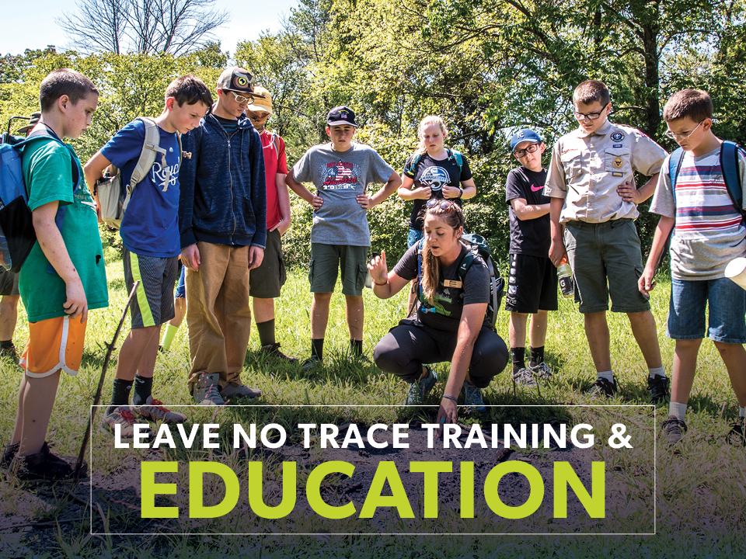
Notes:
We use the training and education to support the Leave No Trace mission and ensure that all outdoor enthusiasts have the skills to leave places as good or better than they found them.
Multitude of options from courses, workshops, online training, outreach and Leave No Trace literature and guides.

Slide 25
Notes:
There are three tiers of Leave No Trace training that provide differing education levels.
The first, and least intensive, is an awareness workshop, which lasts 30 min to a full day and offers introductory Leave No Trace concepts designed for the general public. Millions have attended awareness workshops and they continue to be a popular way to get trained.
The next option is a 2-day trainer course taught in the field by Leave No Trace Master Educators across the country. The trainer course results in a certificate of completion. Currently, there are over 50,000 Leave No Trace trainers, worldwide.
The comprehensive Leave No Trace Master Educator course is a 5-day, field-based training designed specifically for educators or those interested in teaching Leave No Trace. There are nearly 11,000 Master Educators in the US and abroad.

Slide 26
Notes:
A popular web-based option is taking an online awareness workshop, which is designed to convey general Leave No Trace knowledge. Anyone age 12 or older can participate in an online awareness workshop, and those who complete it receive a certificate of completion.
Another opportunity for existing Master Educators is an Online Master Educator Refresher Course, which ensures that Leave No Trace Master Educators are current on their knowledge. This online refresher takes about 90 minutes to complete and is required once every two years for Master’s who teach Leave No Trace Trainer Courses.

Slide 27
Notes:
Learn Something:
Take advantage of the organization’s broad selection of Skills videos on our YouTube Channel
Reading a Leave No Trace Skills & Ethics booklet: a short booklet that takes you through Leave No Trace for various ecosystems and outdoor activities
Choosing from one of the course options
Take the online awareness course

Slide 28
Notes:
Easy ways to get involved where you are:
Introduce a kid to Leave No Trace through PEAK online
Contact the Center and become a Citizen Scientist to get involved with Leave No Trace monitoring in your area
Join the movement as a member: supporting what you care about, and be in the know about the latest science, research and skills.
Encourage your organization or company to become an official partner of Leave No Trace. Any group can get involved.
Join 180K+ strong, active, engaged social media family: Facebook, Twitter, Instagram and SnapChat

Slide 29
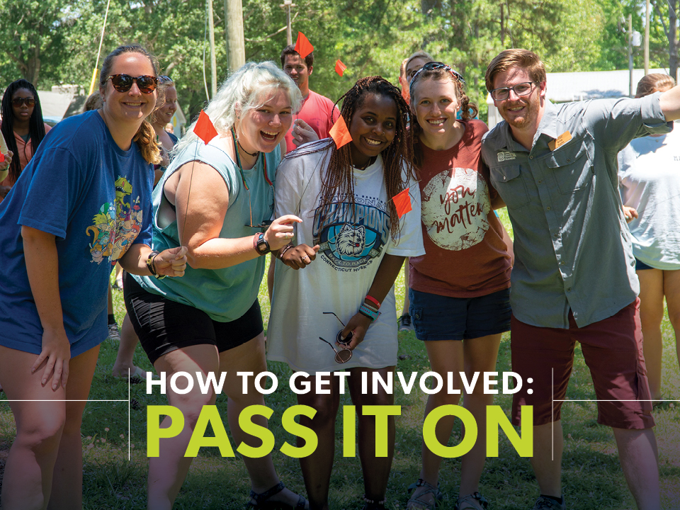
Notes:
Share Leave No Trace, even a simple principle, with other people when you’re enjoying the outdoors.
Contact your Leave No Trace State Advocate to learn about opportunities to teach others in your community.
Forward Leave No Trace videos from YouTube, educational blogs and more.
It’s so easy.

Slide 30
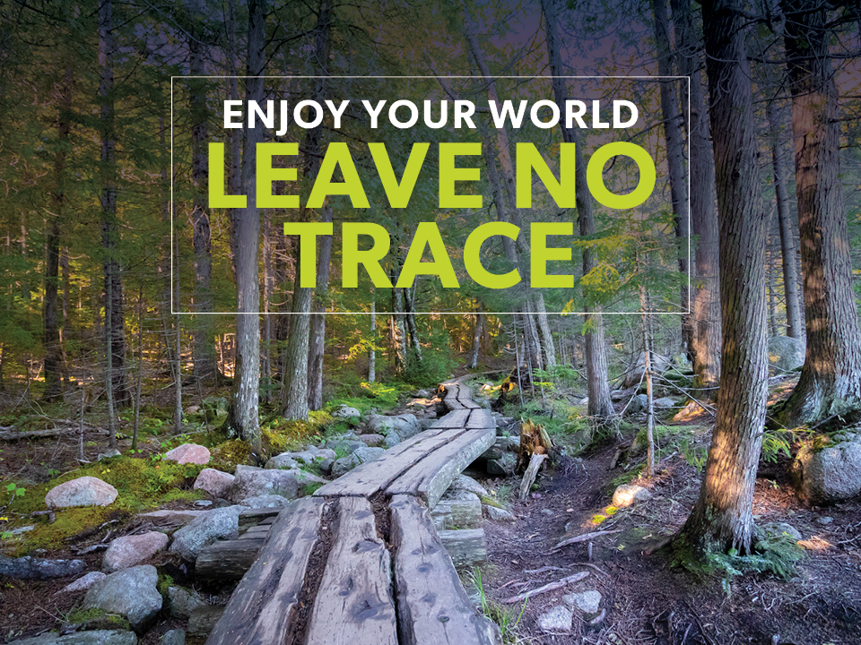

Slide 31
THIS IS A TEMPLATE
& LEAVE NO TRACE
The Center Released…
Tag Thoughtfully….
Tag Thoughtfully….
Tag Thoughtfully….
Tag Thoughtfully….
Tag Thoughtfully….
Tag Thoughtfully….
Tag Thoughtfully….
PLACE PHOTO HERE & CROP TO SIZE

