Slide 1
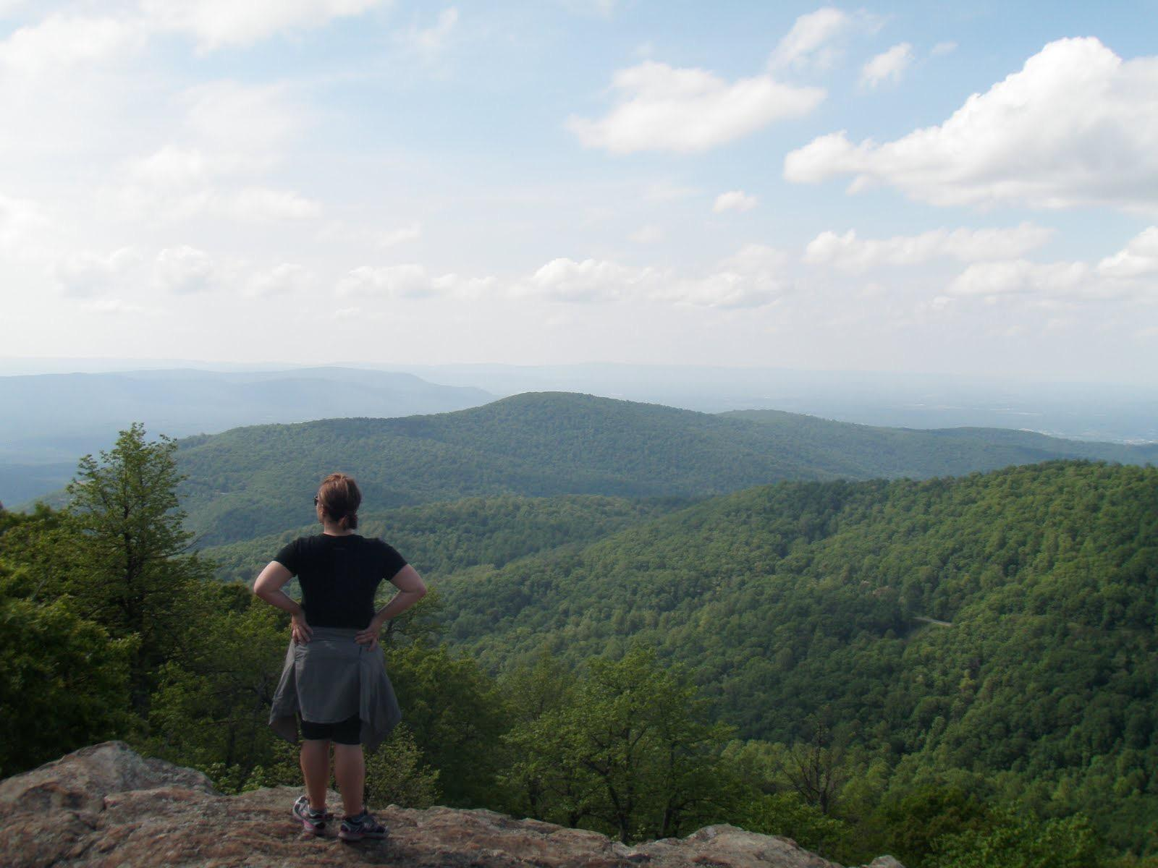
© 2017 Leave No Trace Center for Outdoor Ethics

Slide 2
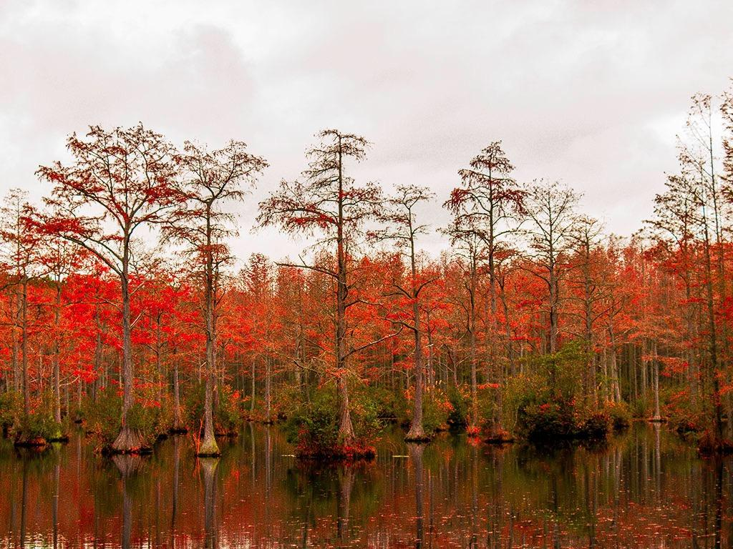
WHAT IS
LEAVE NO TRACE?
Mission: Protecting the outdoors by teaching and inspiring people to enjoy it responsibly.
Notes:
How many of you have taken a hike? Been on a picnic? Gone camping with your family? Show of hands. Getting outside renews our spirits, connects us with nature, amazing beauty, and the many natural wonders of our world.
9 out of 10 people who visit the outdoors are not armed with Leave No Trace education. With over 13 billion trips into the outdoors in the U.S. alone every year, people are causing too much preventable damage, and that damage is adding up. You can be on the forefront of changing that troubling trend—the trashed parks and damaged trails, the formidable impacts of fire, polluted waterways and serious wildlife issues. Now, more than ever, your role is critical.
Now, have you ever seen trash on your hike? Fire scars at a campground? Other impacts? Would you believe (use any of stats that may resonate):
Americans pay $2.1 billion to fight fires in parks and forests, 90% of which are caused by campfires left unattended, the burning of debris, or negligently discarded cigarettes.
Wildlife in our parks are routinely relocated or euthanized due to conflicts with humans.
The National Park Service cites human garbage as the origin of many of these unfortunate and unnecessary conflicts.
Grand Canyon National Park has $11 million in trail maintenance needs and more than $5 million in critical trail work is needed at Great Smoky Mountains National Park.
Each year, tons of petrified wood are removed illegally from Arizona’s Petrified Forest National Park.
Wildlife that obtain human food develop strong attraction behaviors to trails, picnic areas, campsites and visitors, turning wild animals into aggressive and potentially dangerous panhandlers. Such animals are ultimately euthanized by land managers because of the risks they present to people.
Invasive species are being spread nationwide due to moving firewood from one area to the next by campers. Many new infestations of non-native tree-killing insects and disease are often first found in campgrounds. The specific insects and diseases vary by region, but some have already killed millions of trees over thousands of acres.
Trash lasts a very long time: plastic grocery bags can last up to 20 years; aluminum cans up to 200 years; fishing line up to 600 years.
According to the U.S. Centers for Disease Control (CDC), one day’s pet waste can contain several billion fecal coliform bacteria, along with Giardia and the eggs of roundworms, hookworms, and tapeworms.
Studies have attributed pet wastes to instances of water pollution sufficient enough to exceed water quality standards, close beaches and harm wildlife.
Recovery rates for areas impacted by recreation are very slow, with restoration to natural conditions often requiring a minimum of 10-30 years.

Slide 3
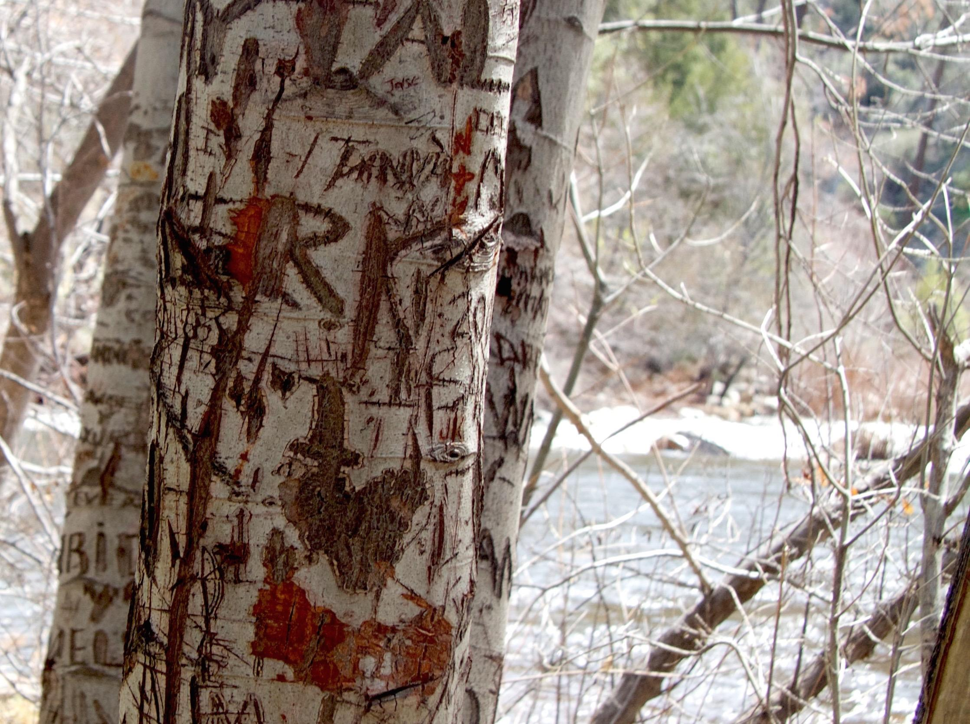
WHY?
Impacts occur when we spend time outdoors, but we can do something about them.
Impacts occur when we spend time outdoors, but we can do something about them.
WHY?
Notes:
Leave No Trace is the best way to minimize these and other types of impacts we see in the outdoors today.
-National movement, run by a nonprofit organization (called the Leave No Trace Center for Outdoor Ethics) that is dedicated to protecting the outdoors by teaching and inspiring people to enjoy it responsibly.
-Accomplish this mission by delivering cutting-edge education, and training programs to millions of people across the country every year.
Then introduce yourselves:
If Traveling Trainers—we are the Subaru/Leave No Trace Traveling Trainers, a mobile education and training team that is part of the Leave No Trace Center for Outdoor Ethics.
If Staff/State Advocate/Volunteer: Introduce yourself and your role with the Leave No Trace Center for Outdoor Ethics.
Leave No Trace addresses impacts and provides people with techniques and skills to enjoy the outdoors sustainably—now and into the future.

Slide 4
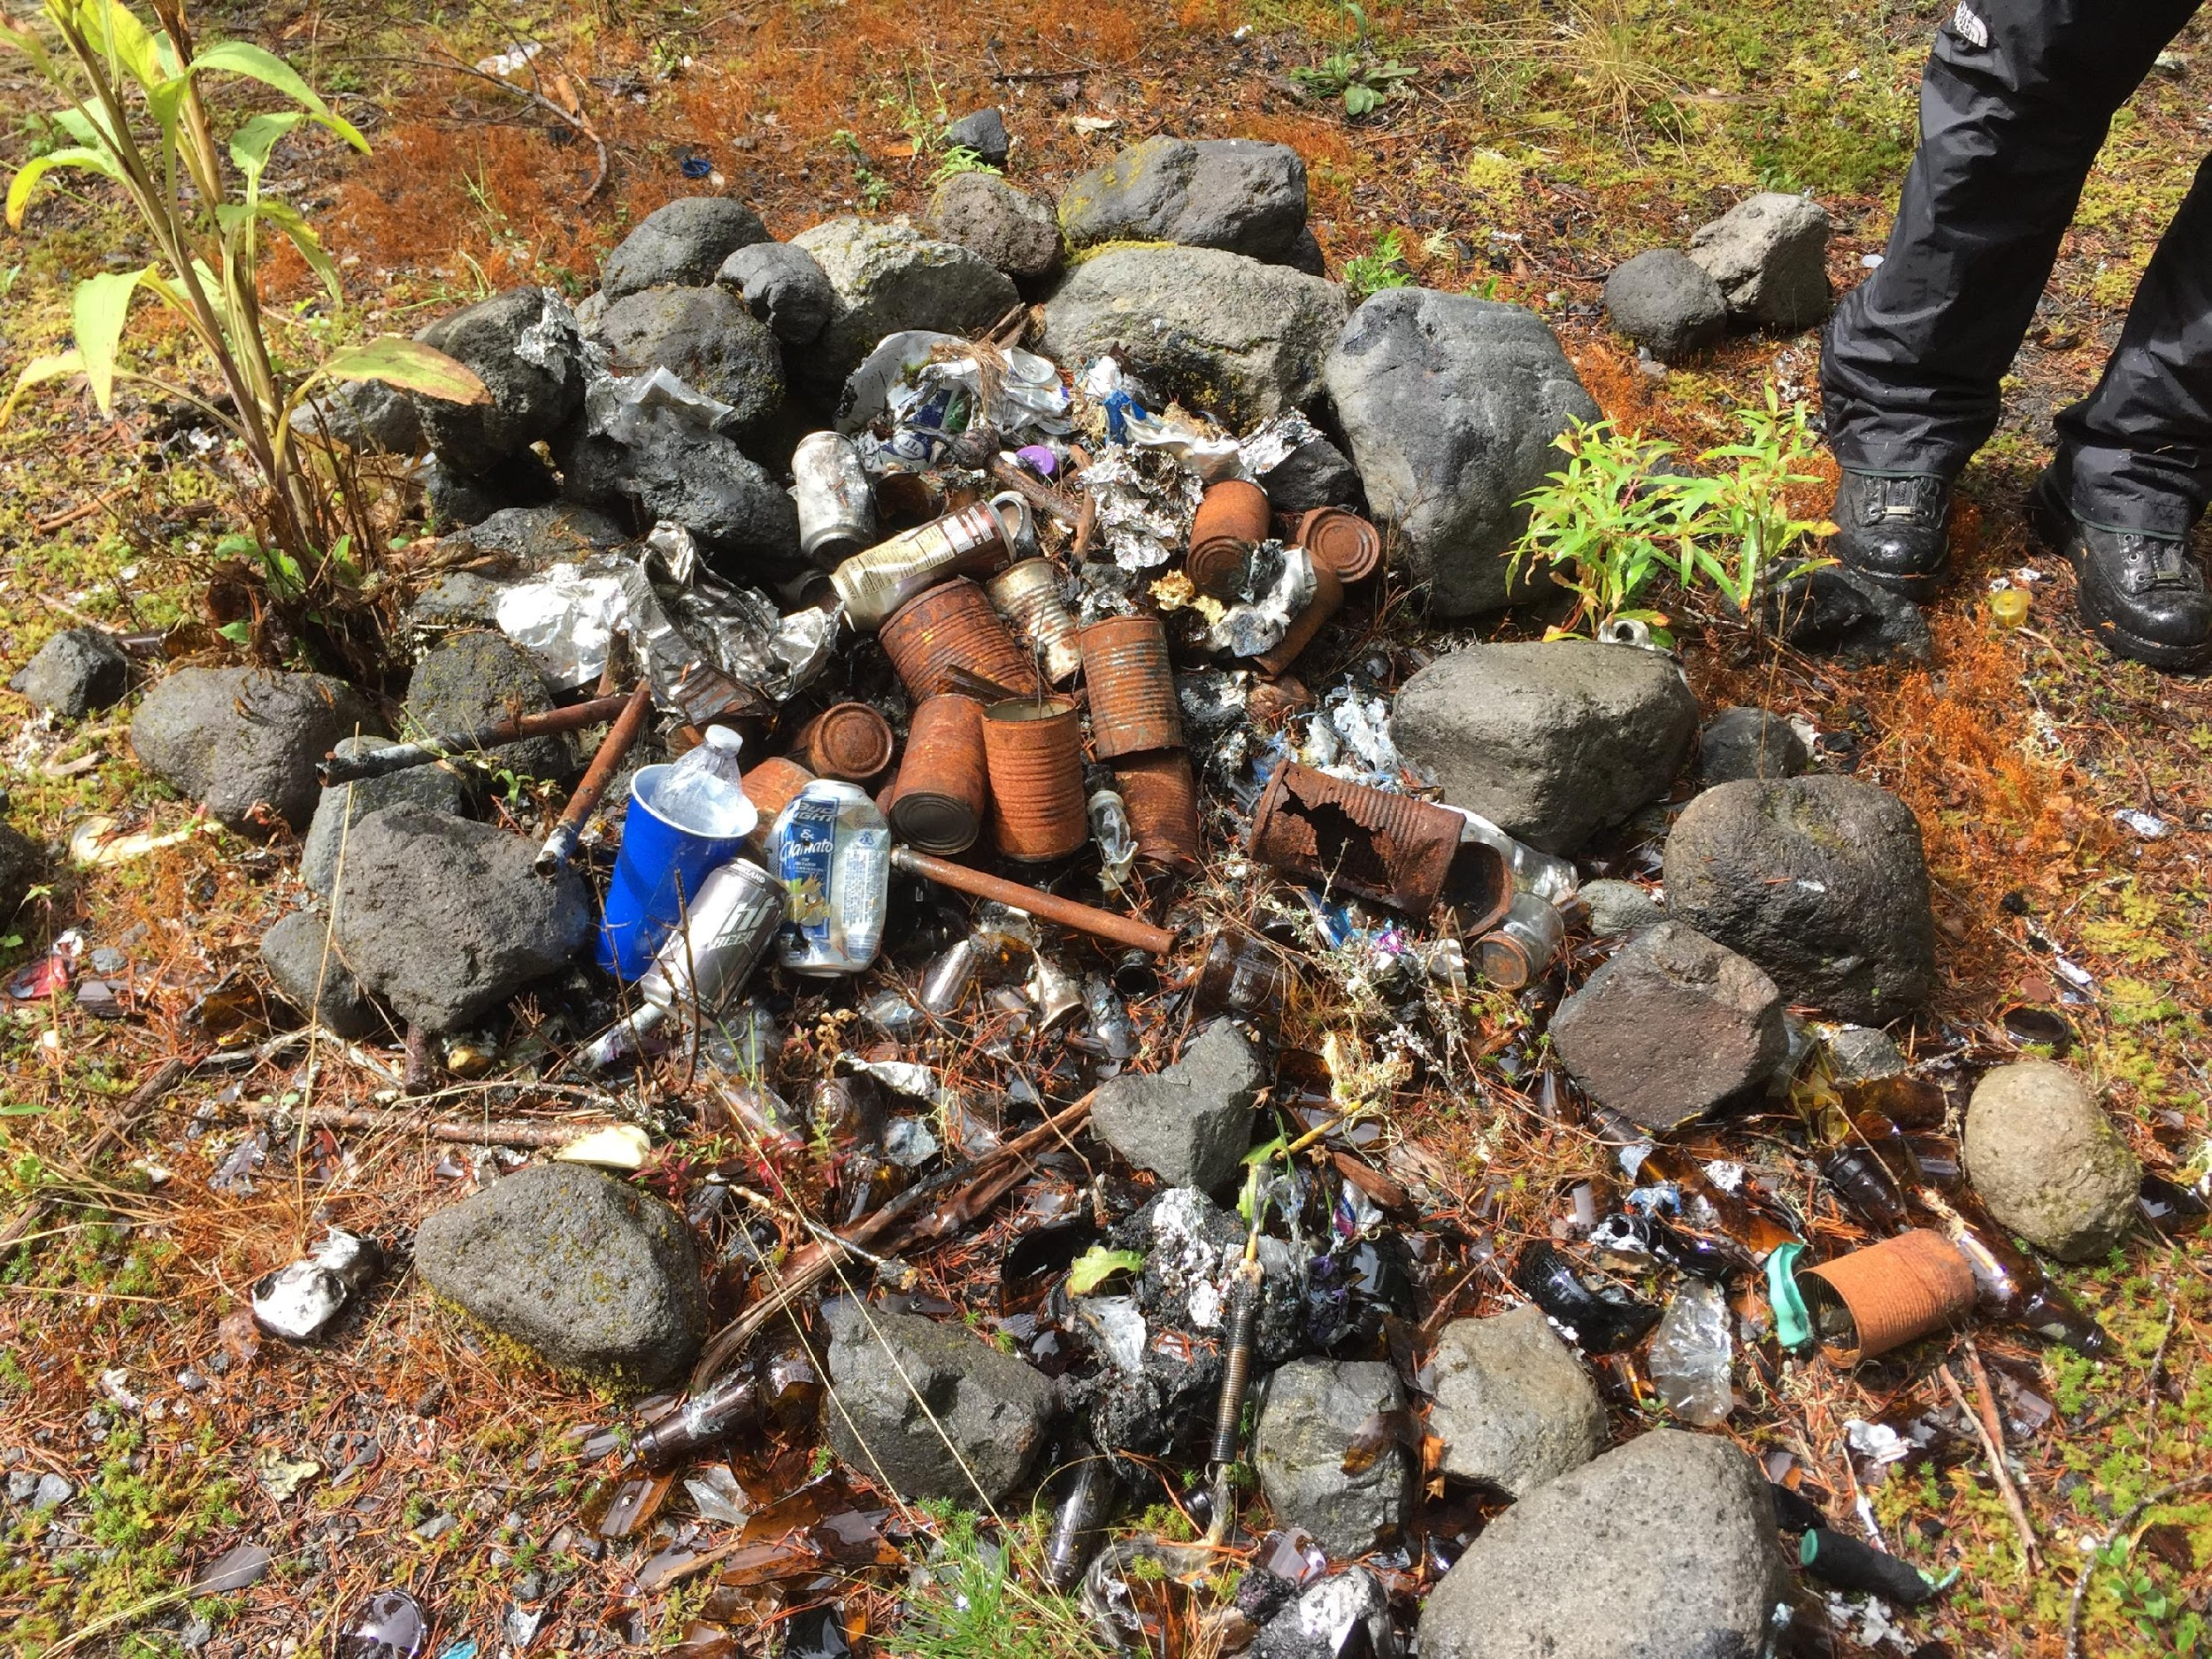
IMPACTS
FROM OUTDOOR USE
Impacts include wildlife, vegetation, water resource, soil, cultural resource, social.
IMPACTS
From Outdoor Use
Wildlife
Vegetation
Water Resource
Soil
Cultural Resource
Social
Notes:
When venturing in the outdoors, humans generally impact the environment in six broad areas:
Wildlife Impacts: disturbance, altered behavior, or reduced health and reproduction of animals.
Vegetation Impacts: vegetation loss, the introduction of invasive species, and tree or plant damage
Water Resource Impacts: siltation, sedimentation, and soap or fecal waste
Soil Impacts: loss of organic litter, soil compaction, or soil erosion
Cultural Resource Impacts through theft or damage to cultural and historic features and artifacts
Social Impacts: crowding, conflicts between various user groups, and diminished outdoor experience

Slide 5
Notes:
Consider the number of people our public lands see each year.
The environmental implications of outdoor use can be staggering, especially given the popularity of outdoor recreation on federal and state lands. According to federal and state data (source – agency websites).

Slide 6
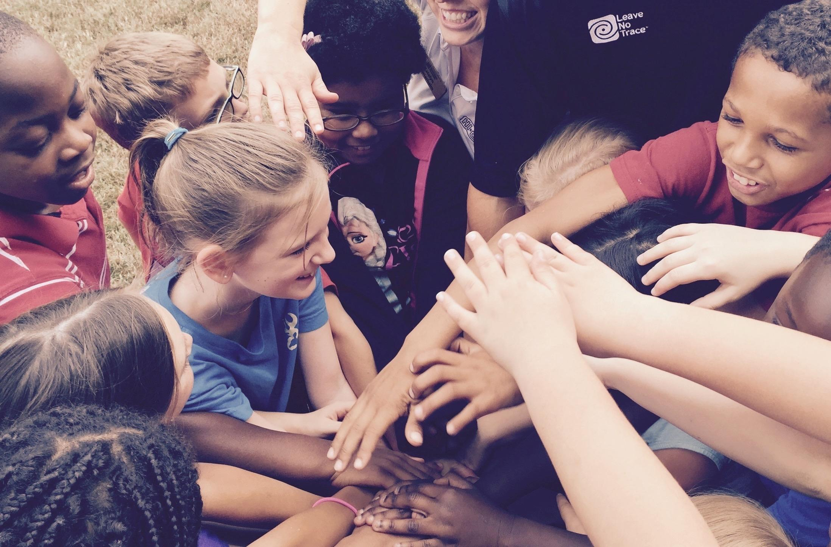
THE POWER
OF LEAVE NO TRACE
Leave No Trace education provides a foundation to build a nationwide outdoor ethic for all.
THE POWER
OF LEAVE NO TRACE
Leave No Trace education provides a foundation to
build a nationwide outdoor ethic for all.
Notes:
Optional Narrative: What began as a call to preserve wilderness areas has evolved into a global, daily commitment for all people to embrace a Leave No Trace ethic.
The environmental stewardship promoted by the Leave No Trace Center extends beyond outdoor enthusiasts to include ANYONE who enjoys the outdoors and is concerned with people’s relationship with nature.

Slide 7
LEAVE NO TRACE
Science-based, simple & effective, relevant for everyone, and for your backcountry to city parks.
LEAVE NO TRACE IS
Science-based
Simple & effective
Relevant for everyone
For your backcountry to your city parks
Notes:
Research shows that Leave No Trace education is successful in significantly improving people’s knowledge, ethics and behavior in the outdoors. Our research indicates education fosters:
Healthier, thriving wildlife and fewer negative interactions with humans.
Considerable litter reduction
Less degradation of native plants and animal species
Stronger human bonds to the outdoors and a greater sense of stewardship
The Center continues to study and test our principles and training to ensure the best, most effective, relevant messaging and programs.
Is a simple, effective framework for making good decisions in nature, no matter how your choose to spend time outdoors.
Though developed for the backcountry, Leave No Trace today is relevant for anyone who spends time outdoors and is appropriate everywhere from deep Wilderness and the backcountry to your local city park.

Slide 8
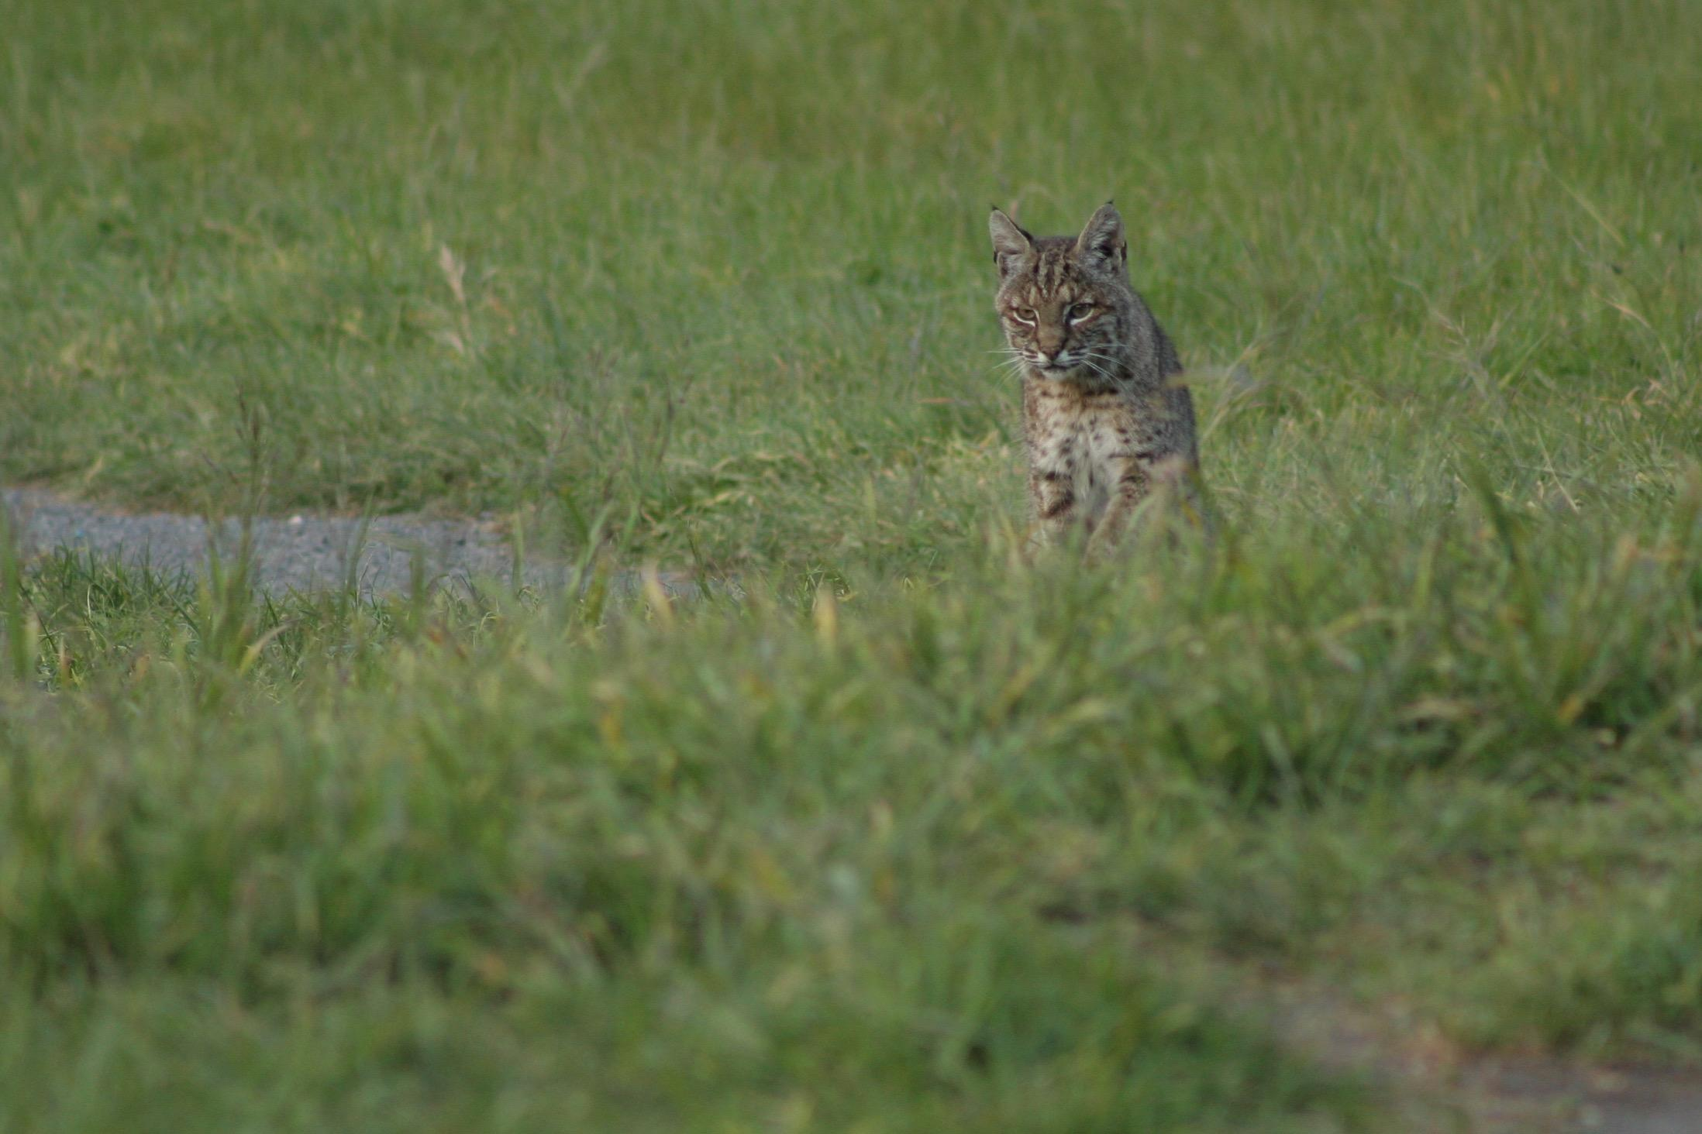
THE SEVEN
LEAVE NO TRACE PRINCIPLES
Plan Ahead & Prepare
Travel and Camp on Durable Surfaces
Dispose of Waste Properly
Leave What You Find
Minimize Campfire Impacts
Respect Wildlife
Be Considerate of Other Visitors
THE SEVEN
LEAVE NO TRACE
PRINCIPLES
Notes:
We use the foundation of seven core principles to communicate the best available guidance for enjoying the outdoors responsibly. The Seven Principles of Leave No Trace help educate and guide people in sustainable, minimum impact practices that mitigate or avoid recreation-related impacts. These principles are the most robust and widely utilized minimum impact, outdoor practices on public lands across the country. The seven principles are:
Plan Ahead and Prepare
Travel and Camp on Durable Surfaces
Dispose of Waste Properly
Leave What You Find
Minimize Campfire Impacts
Respect Wildlife
Be Considerate of Other Visitors
Principles are available in many forms: for kids, frontcountry, activity-specific (climbing, mountain biking, fishing, hunting, cultural heritage, international, etc.).

Slide 9
THE LEAVE NO TRACE
SPECTRUM
FEW
IMPACTS
SIGNIFICANT
IMPACTS
Notes:
Think of Leave No Trace as a spectrum:
On one end: many impacts. On the other: few impacts
Many ways to Leave No Trace. Find your place on the spectrum.
Doing ANYTHING to minimize your impact is better than doing nothing at all.
If you pack out your trash, you’ve left no trace. If you’ve picked up after your pet, you’ve left no trace. If you’ve done both, even better.
Think of the difference for our shared lands if every one put Leave No Trace into action!

Slide 10
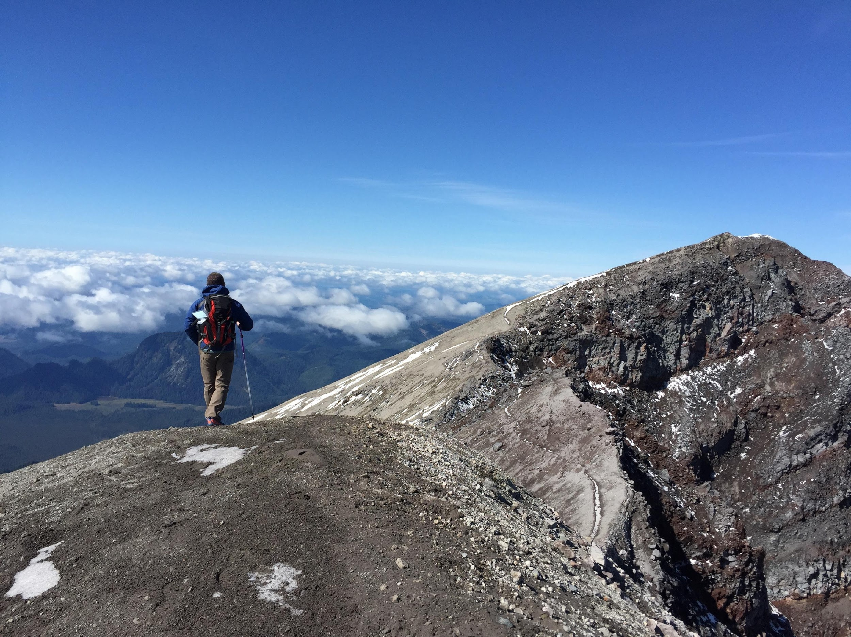
HISTORY
OF LEAVE NO TRACE
Roots in the backcountry
Notes:
To understand how the Leave No Trace Center for Outdoor Ethics operates today, understanding the extensive history is helpful.
60s: originated in backcountry and federally-designated Wilderness areas in the 1960’s, following the passage of the Wilderness Act in 1964.
70s: federal land management agencies developed and shared basic Leave No Trace concepts on lands they managed
Later, in the 1980’s, the “No Trace” program was developed by the USDA Forest Service wilderness managers as a humanistic approach for wilderness ethics and low impact hiking and camping practices.
ADDITIONAL INFORMATION AS NEEDED
Early names for the program included: Wilderness Manners, Wilderness Ethics, Minimum-Impact Camping and No-Trace Camping.
1970s: federal agencies began to develop educational brochures to teach the public about Leave No Trace. At the time, the program was slogan-based with little national leadership or inter-agency coordination.
Early 1990’s: “Leave No Trace” selected as the name for an expanded national program
Partnerships formed with four federal land management agencies and the National Outdoor Leadership School (NOLS)
The 1993 Outdoor Recreation Summit held in Washington D.C. (including feds, NGOs, outdoor companies) recommended new nonprofit to manage national program

Slide 11
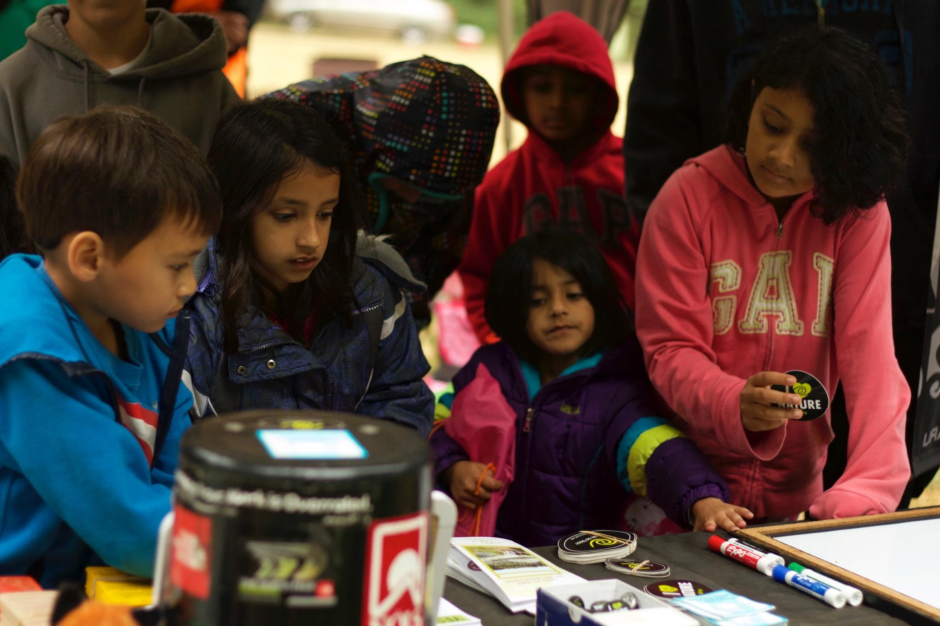
HISTORY
OF LEAVE NO TRACE
The Leave No Trace Organization
Notes:
Established in 1994 as an independent, national nonprofit to lead development, education, research and expand public awareness.
2003: Fun Fact: added Center for Outdoor ethics to name reducing misconception that we were a detective agency or witness protection program.
Today:
partners with 600+ companies, land agencies, schools, universities, non-profits, outfitters and guides, and their constituents to promote Leave No Trace
35,000 trained volunteers across the country provide local Leave No Trace programs
What began as a wilderness education program is now relevant from deep backcountry to urban parks and protected areas - anywhere people live and enjoy the outdoors.

Slide 12
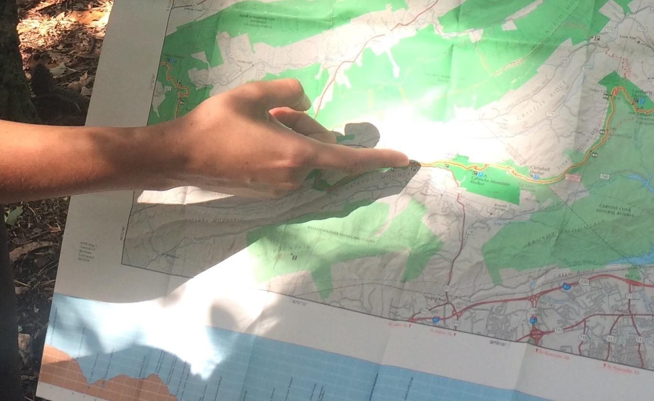
TODAY
LEAVE NO TRACE
TODAY
LEAVE NO TRACE
Notes:
The ultimate goal of the Center, which is Leave No Trace education for everyone who loves the outdoors, is enormous. The fastest way to get there, we believe, is to focus on the sources—the lands themselves, as well as youth. The Center focuses on two major initiatives: Leave No Trace in Every Park and Leave No Trace for Every Kid:
Leave No Trace in Every Park focuses on public lands including local, state, and national parks, forests, and protected areas.
Leave No Trace for Every Kid focuses on introducing basic Leave No Trace concepts to kids while they are forming their personal ethic framework.
To ensure that to ensure that Leave No Trace is reaching communities across the country.
we’re also:
Training the public
building a vast volunteer network
and conducting critical research

Slide 13
EVERY PARK
LEAVE NO TRACE IN
Notes:
LEAVE NO TRACE FOR EVERY PARK
What if everyone who stepped into the natural world was provided with the tools to develop an outdoor ethic? That’s the goal of this bold, multi-year initiative that focuses on offering educational opportunities in the settings where it matters most—our shared public lands.
Leave No Trace in Every Park incorporates Leave No Trace programs and educational opportunities across the country. The campaign takes many forms from research, interpretive materials, staff and volunteer training, public education initiatives, onsite signs, junior ranger programs, Leave No Trace Hot Spots, Leave No Trace Gold Standard Sites and more.
Will conduct 16 Hot Spots—week-long rehabilitation programs—at areas across the country this year.
Gold Standard Sites exemplify the successful integration of Leave No Trace outdoor skills and ethics into management, programming and education efforts on public lands. These locations prominently feature Leave No Trace educational components. 10 current sites with expansion of program sites in 2017.
The Center expanded the Citizen Science program to increase community involvement and collect data for the multi-year, Every Park initiative. The Center has received over 100 submissions describing Leave No Trace programs in parks and protected areas across 32 states.
Last year, the Center:
-Conducted 601 events in 48 states, reaching over 15.5 million people with Leave No Trace education.
-Partnered with the Bureau of Land Management to conduct 112 training events, exposing 38,270 visitors to Leave No Trace education.
-Worked with partners and volunteers on in-person workshops to train 4,873 advanced educators. The Center’s online learning programs also expanded, with a total 48,590 people completing an online course.

Slide 14
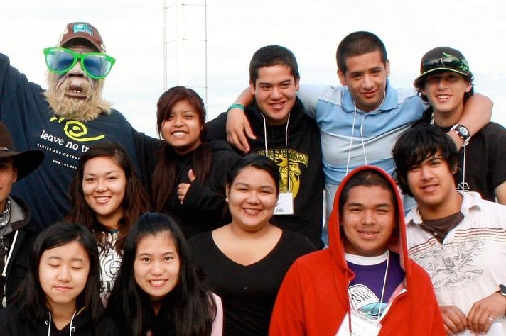
EVERY KID
LEAVE NO TRACE FOR
Notes:
2. LEAVE NO TRACE FOR EVERY KID
The goal: ensuring that our natural world is left in able hands for generations to come.
Leave No Trace for Every Kid provides education for any kid who spends time outside including:
Comprehensive, new, standardized curriculum for outdoor youth programs (camps, YMCA, Boys and Girls Clubs, Girl Scouts and Boy Scouts).
Leave No Trace Youth Program Accreditation that increases the collective, positive environmental footprint through program-wide minimum impact practices.
Ongoing research: Recently partnered with Penn State University, the Center completed a youth-focused study to gain understanding of youth perceptions and attitudes about Leave No Trace and to further develop effective ways to teach Leave No Trace to children.

Slide 15
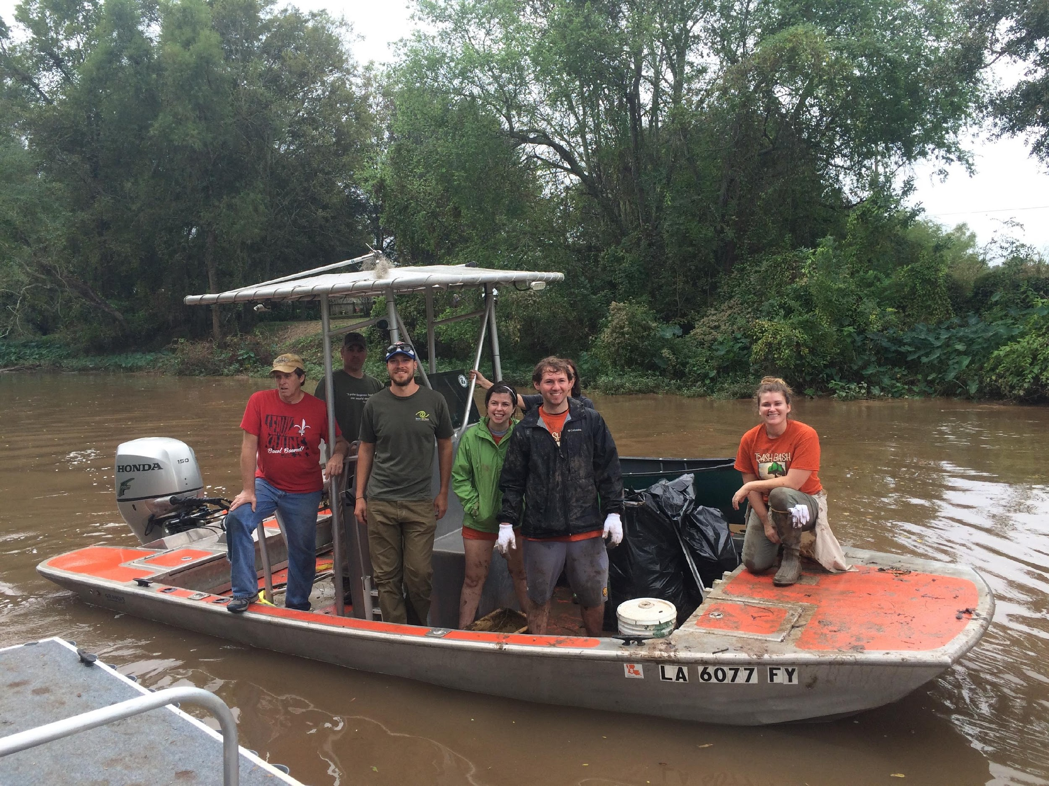
PARTNERSHIP
POWER OF
Notes:
Partners: Federal, state and local land management agencies, corporations, NGOs, schools and universities, outfitters guide services that carry the program millions of their their visitors, constituents, customers and students.
Thousands of members and volunteers are key partners who carry Leave No Trace into their communities.
This vast array of partners domestically and internationally, are the ground troops to support Leave No Trace education, research and outreach.
Let’s take a look at how these partners play a role with Leave No Trace:

Slide 16
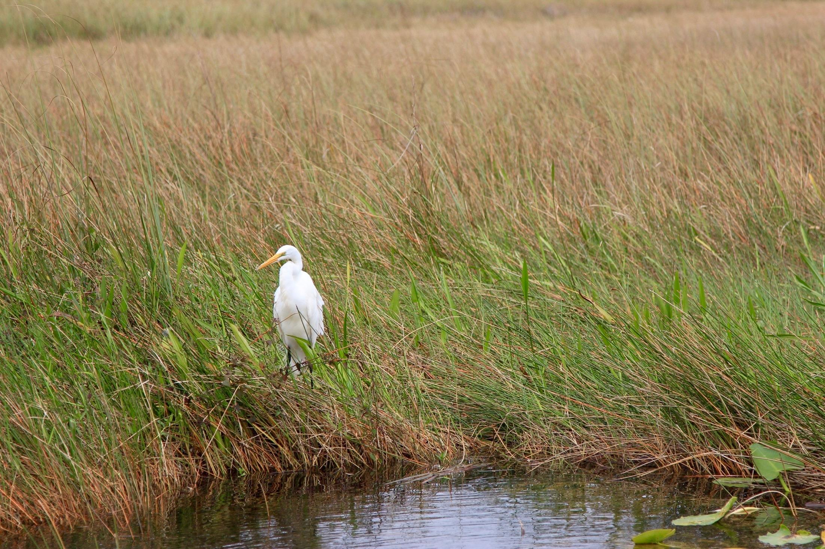
PARTNERS
FEDERAL, STATE & LOCAL
PARTNERS
Federal, State & Local
Land Management Agencies
Notes:
Federal agency partners play a critical role in providing Leave No Trace information to millions of people each year. Currently, the Center for Outdoor has formal partnerships with the five largest land management agencies in the U.S. to provide Leave No Trace education on public lands. Each these agencies has staff trained in Leave No Trace who train other agency personnel and the general public. The federal agencies have national Leave No Trace coordinators who collaborate with the Center.
The Center has formal partnerships with all of the country’s state parks through the National Association of State Park Directors.
Local/County/Municipal agencies also partner with Leave No Trace to incorporate the program on the lands they manage.

Slide 17
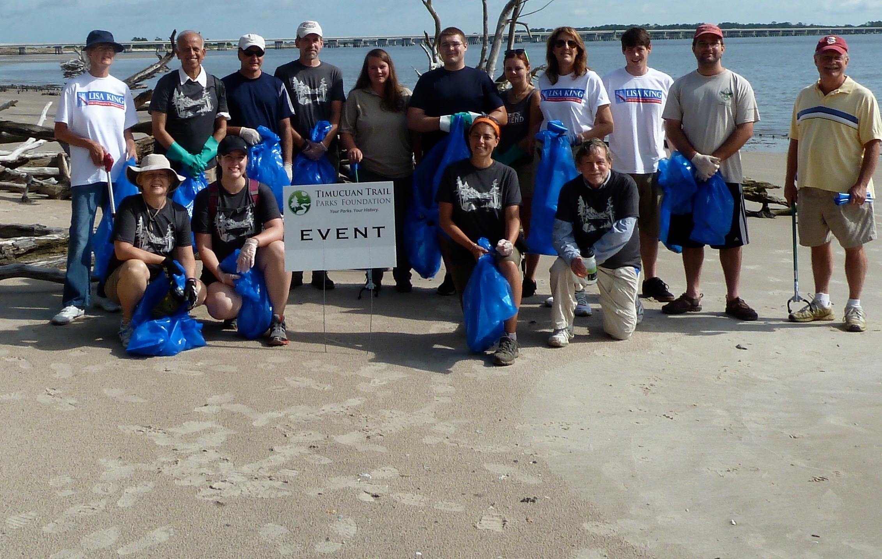
PARTNERS
CORPORATE & COMMUNITY
Notes:
The Center has over 600 active Community and Corporate Partners that are critical to overall Leave No Trace efforts.
Corporate and Community partners are dues-paying
On average, a single community partner reaches 1000 people each year with formal Leave No Trace training. Community partnership is the best way for non-profits, colleges, universities, small businesses, municipalities, clubs, outfitters and guides to publically demonstrate their support of the Leave No Trace movement.
Companies, who support the Leave No Trace mission, also join as corporate partners to lend their support and voice to the movement.
Corporate partnerships have been responsible for funding high impact programs like the Subaru/Leave No Trace Traveling Trainers (4 teams of mobile educators who travel the country offering free education programs) and State Advocates (ensuring that every state has a volunteer coordinator and educator).

Slide 18
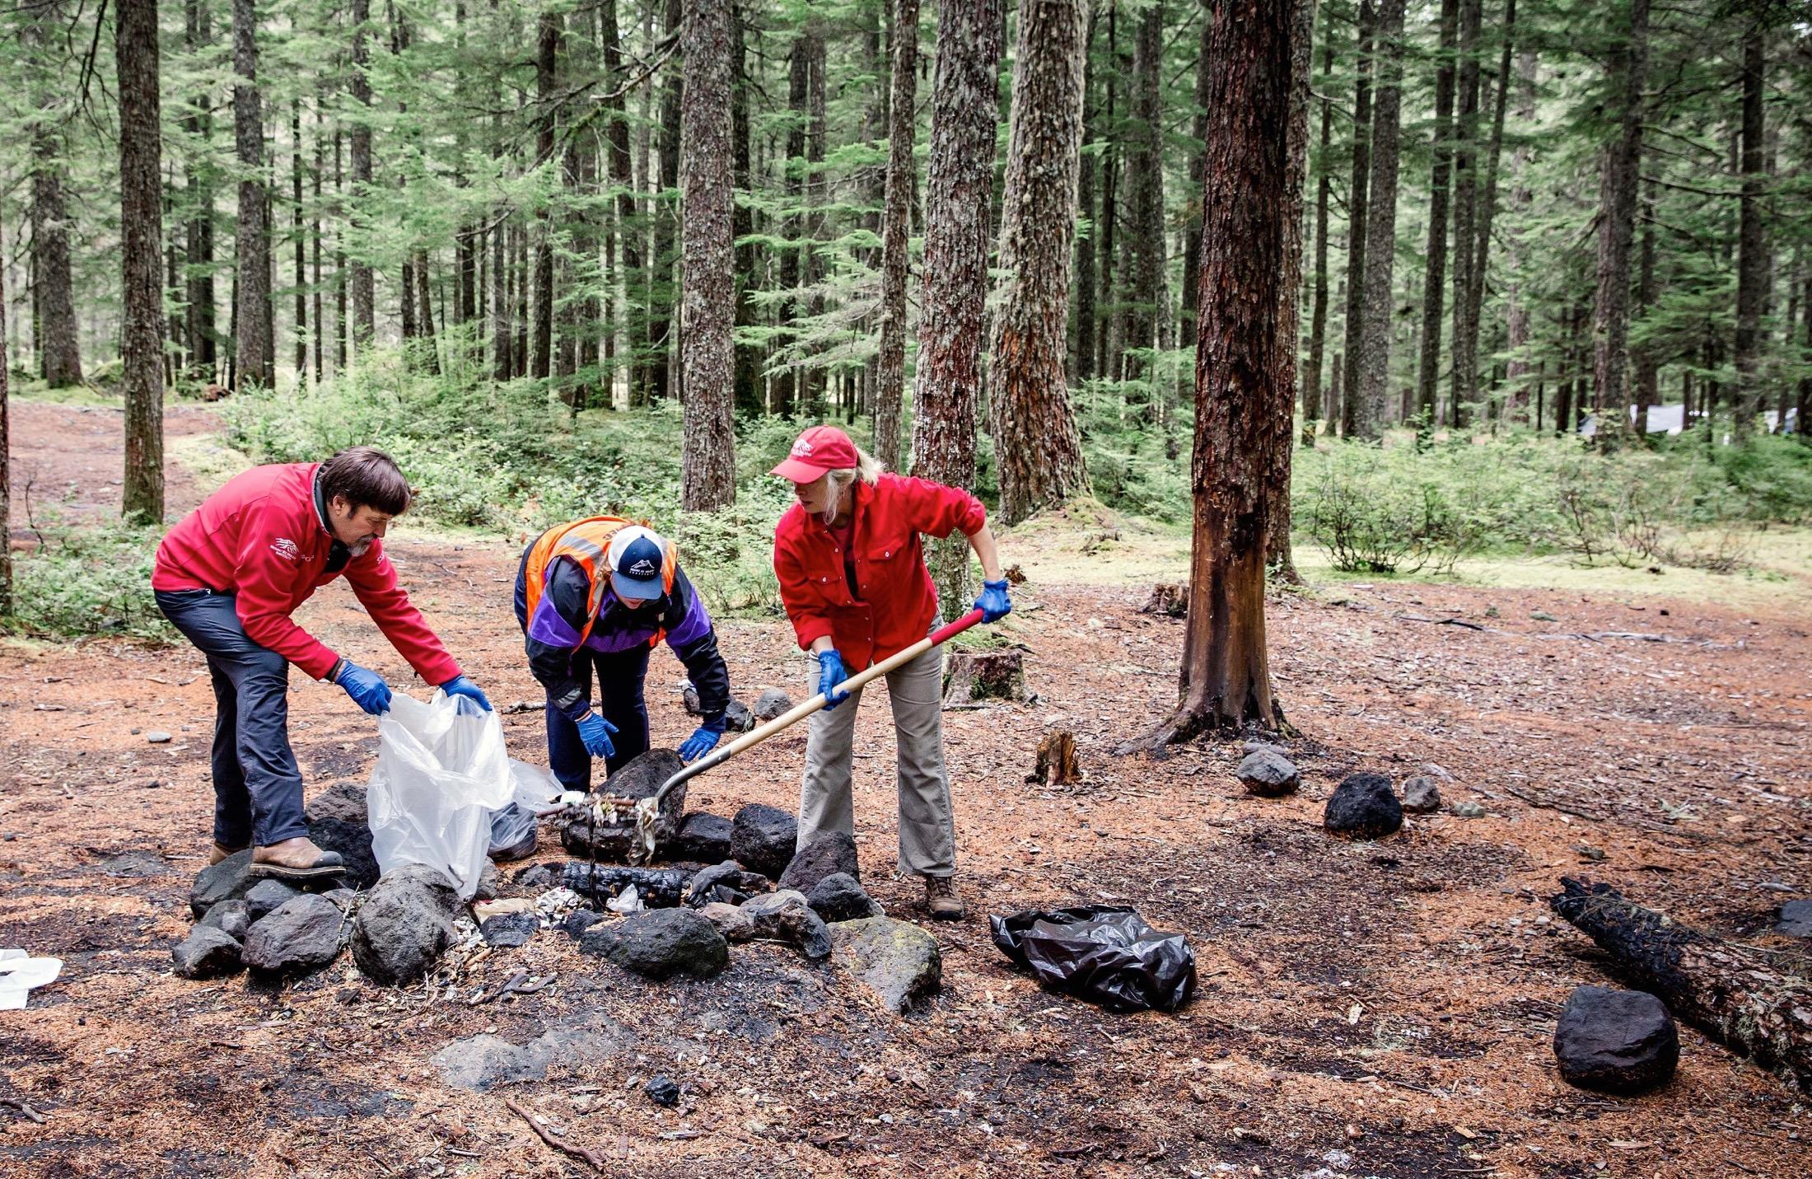
MEMBERS &
VOLUNTEERS
Notes:
7,000 members and 35,000 volunteers make up the base of on-the-ground advocacy for Leave No Trace. They support Leave No Trace by providing volunteer training in their communities, making financial contributions to the organization’s work and rallying the on-the-ground troops.

Slide 19
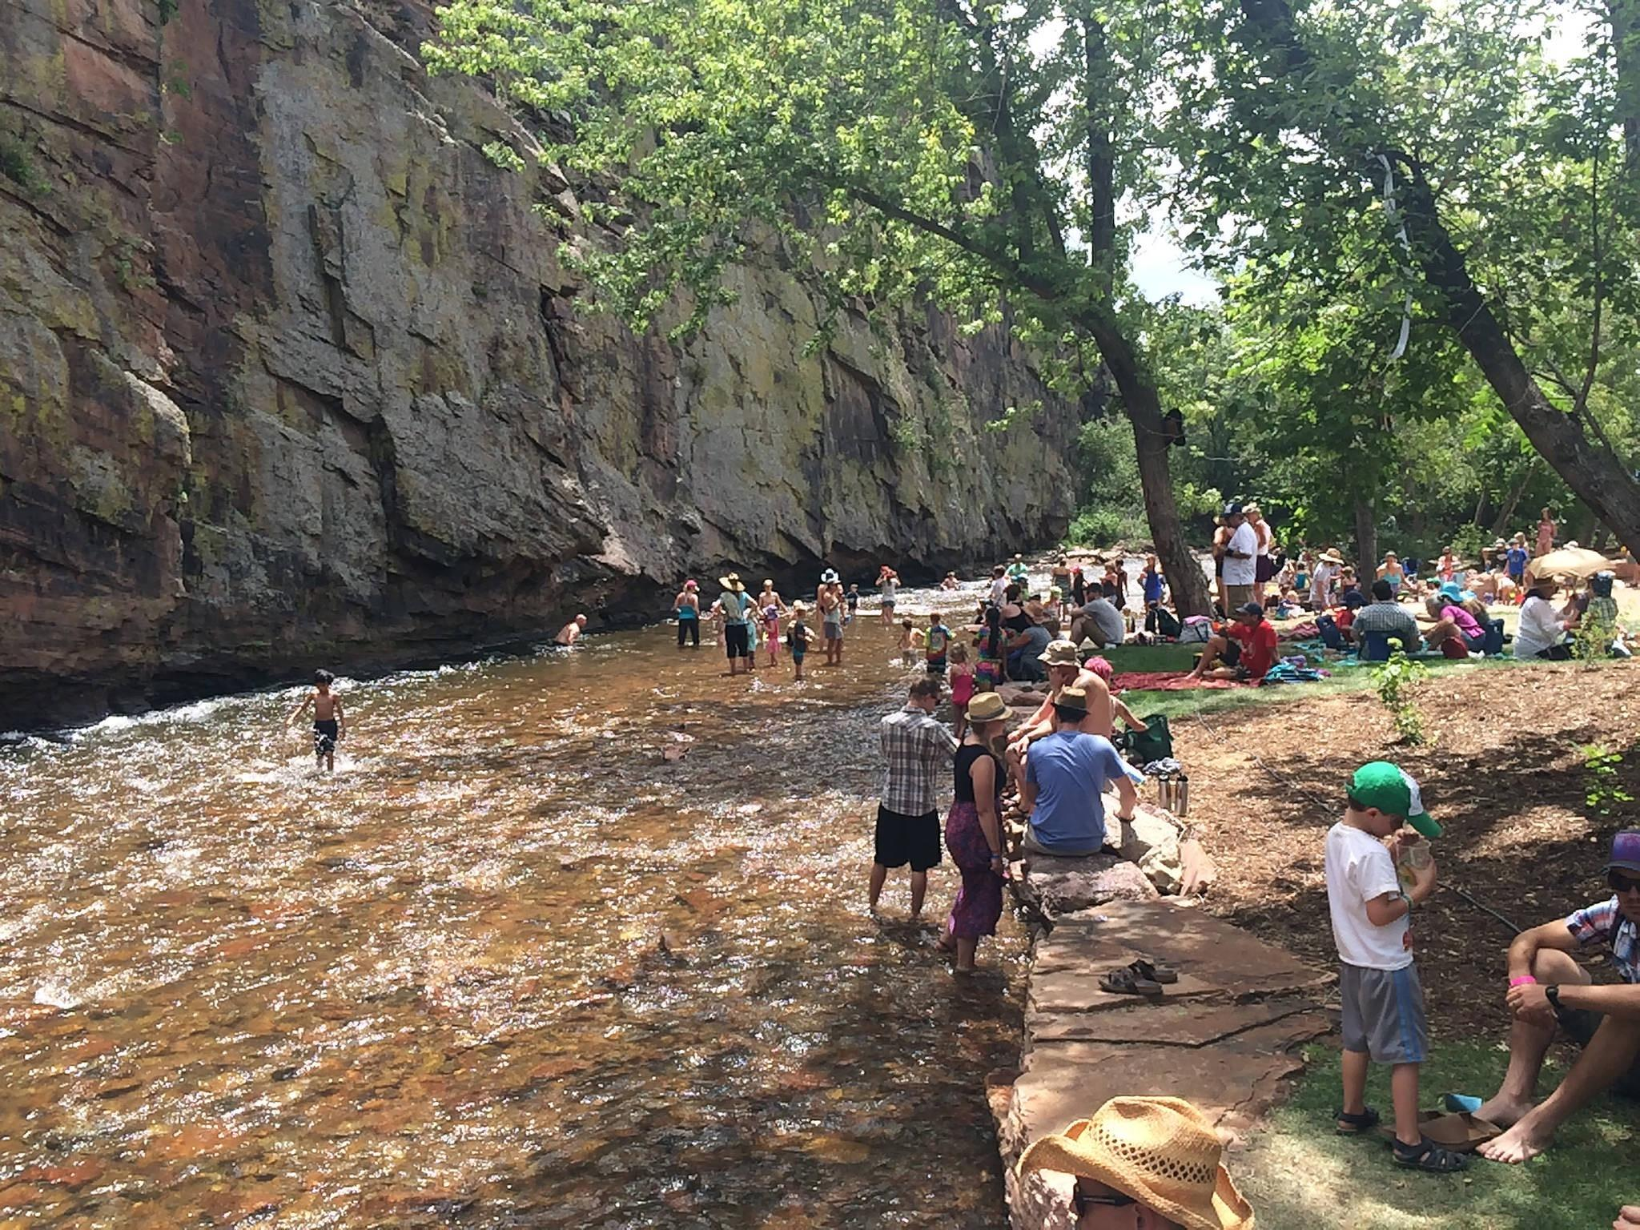
SCIENCE
Notes:
-Data-driven in its approach. Whether conducting its own studies, or drawing from the findings of recent research, the Center utilizes empirical data to ensure strong education programs, high-quality training, and sound best practices.
Existing Leave No Trace scientific literature aligns with the disciplines of recreation ecology, and human dimensions of natural resources. Recreation ecology is a field of study that examines the impact of visitors to protected areas, and has provided the underpinning for Leave No Trace messaging because of its focus on recreation-related impacts.
-One of most important causes of visitor-created impacts is impactful visitor behavior, which aligns with human dimensions. Human dimensions of natural resources research seeks to interpret humans’ attitudes towards, perceptions of, and interactions with the ecosystem. Leave No Trace-focused research of this kind is limited but increasing.
Recently the Center has usedan approach to explore Leave No Trace-related behaviors of interest which has primarily consisted of visitor observation coupled with paired survey data. This methodology provides the opportunity to ask study participants what they would do while also observing what they actually do in a park or protected area context.
Through multi-method, experimental designs including unobtrusive observation, and paired visitor survey data collection, these kinds of studies allow for the examination of attitudes and motivations that lead to a reduction of recreation-related impact.

Slide 20
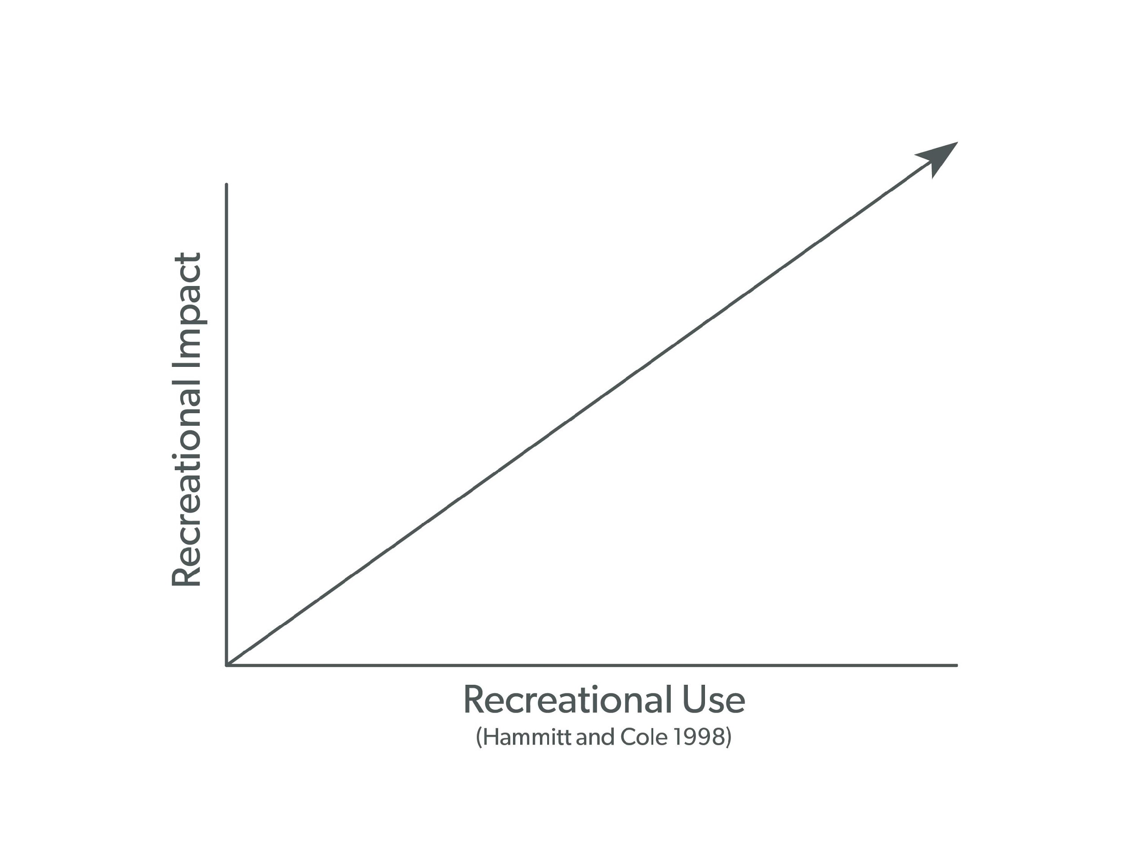
HYPOTHETICAL RELATIONSHIP:
Use & Impact
Notes:
Scientists have proposed a hypothetical relationship between recreational use and recreational impact. The thinking is that as use increases, so does overall impact. In some areas this is definitely the case. In other areas, not as much.

Slide 21
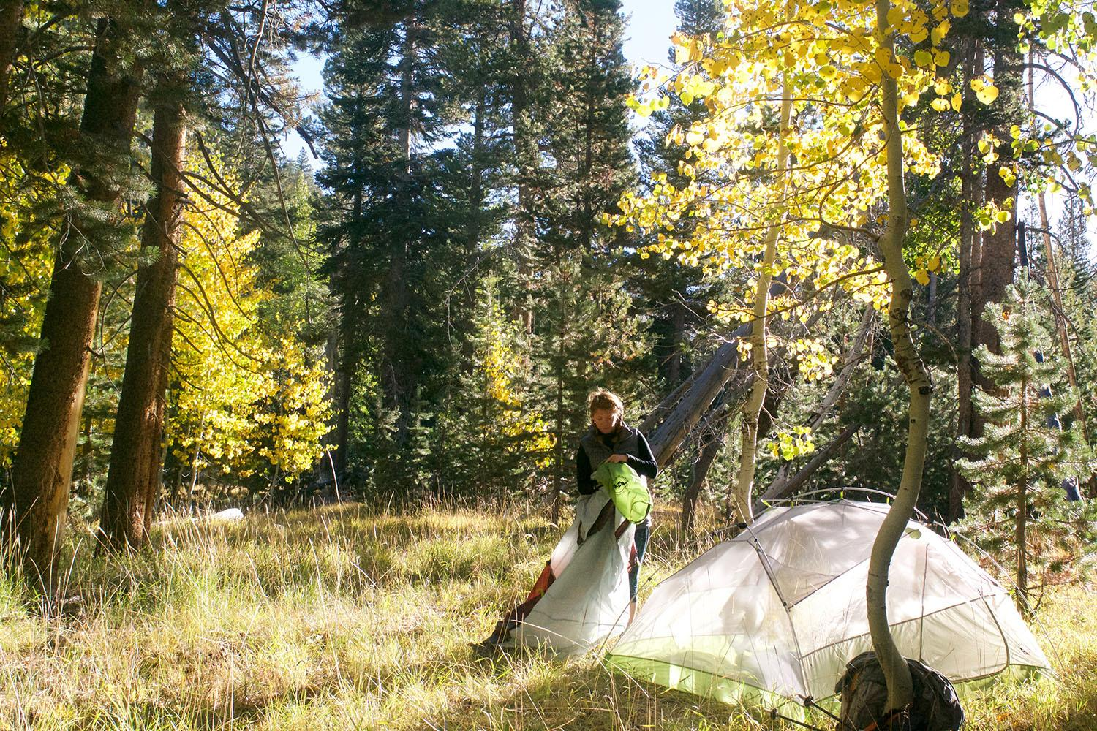
SOLUTION
LEAVE NO TRACE IS THE
Limiting impacts that come with increased use.
Notes:
Yet the goal of Leave No Trace is to change the relationship between use and impacts. Ideally, use could increase without the continued increase in impact due to everyone spending time outdoors putting Leave No Trace into action.
Leave No Trace provides the foundation and framework necessary for making good decisions for sustainable enjoyment of the outdoors now and well into the future.

Slide 22
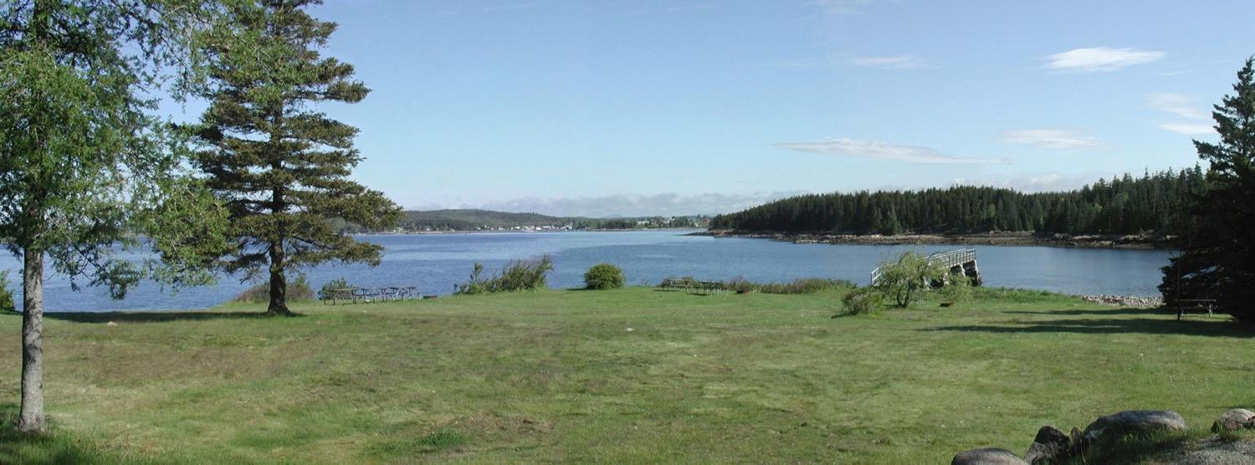
Notes:
Here is a typical park or protected area scene – grass, trees, water, fishing pier, picnic tables, etc.

Slide 23
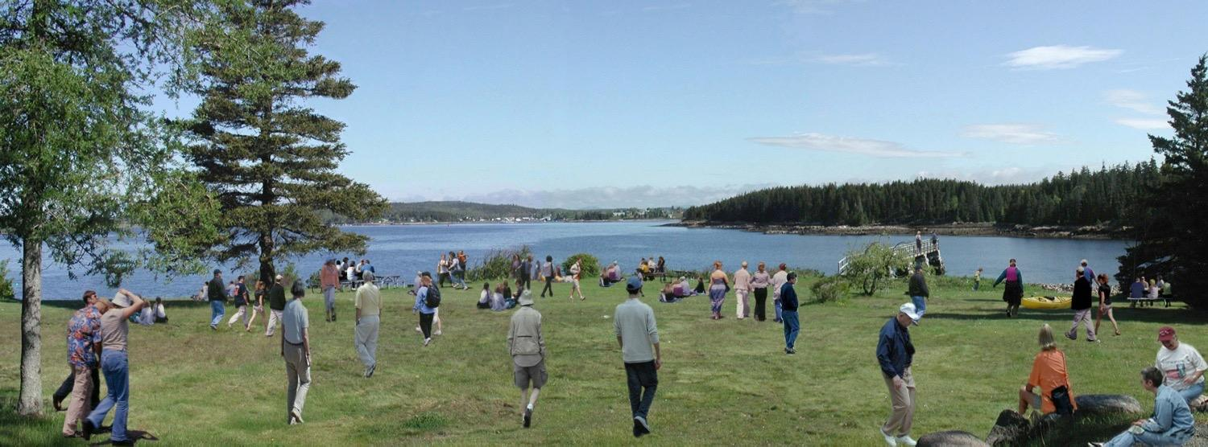
Notes:
Now come the people, and potentially the impacts. Given how many of us are spending time outside, the question is how much impact is being created?

Slide 24
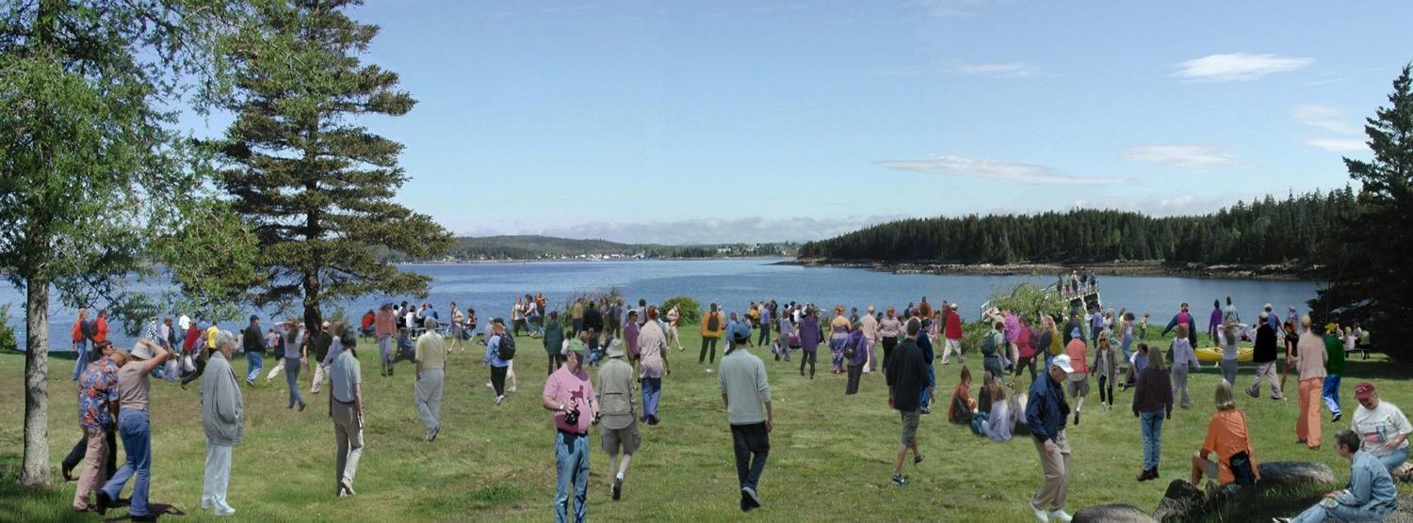
Notes:
Add more people to the mix and the potential for increased impact rises. This is where Leave No Trace comes in.
By teaching all people how to enjoy the outdoors responsibly we can collectively ensure the continued protection of our share lands for current and future generations.
It’s not necessarily about tomorrow but the day after tomorrow. It’s about the legacy we leave behind.

Slide 25
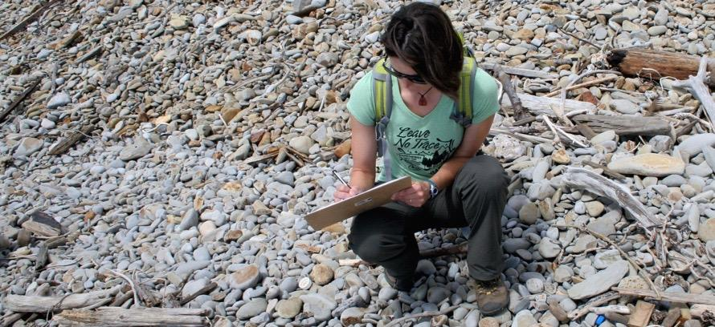
RESEARCH
Notes:
We conduct research to help Leave No Trace hone new, effective ways to educate the public about sustainable recreation and enjoyment in the outdoors, and how to most effectively protect public lands.
Current studies include:
Exploration of Social and Ecological Impacts of Pet Waste on Open Space Lands – City of Boulder Open Space and Mountain Parks
Exploring Visitor Attitudes, Values, and Behaviors Regarding Waste in National Parks – Subaru of America/National Park Service
Meta-analysis of Existing Leave No Trace Datasets – Center, Penn State Univ., Colorado State Univ., Northland College, National Park Service

Slide 26
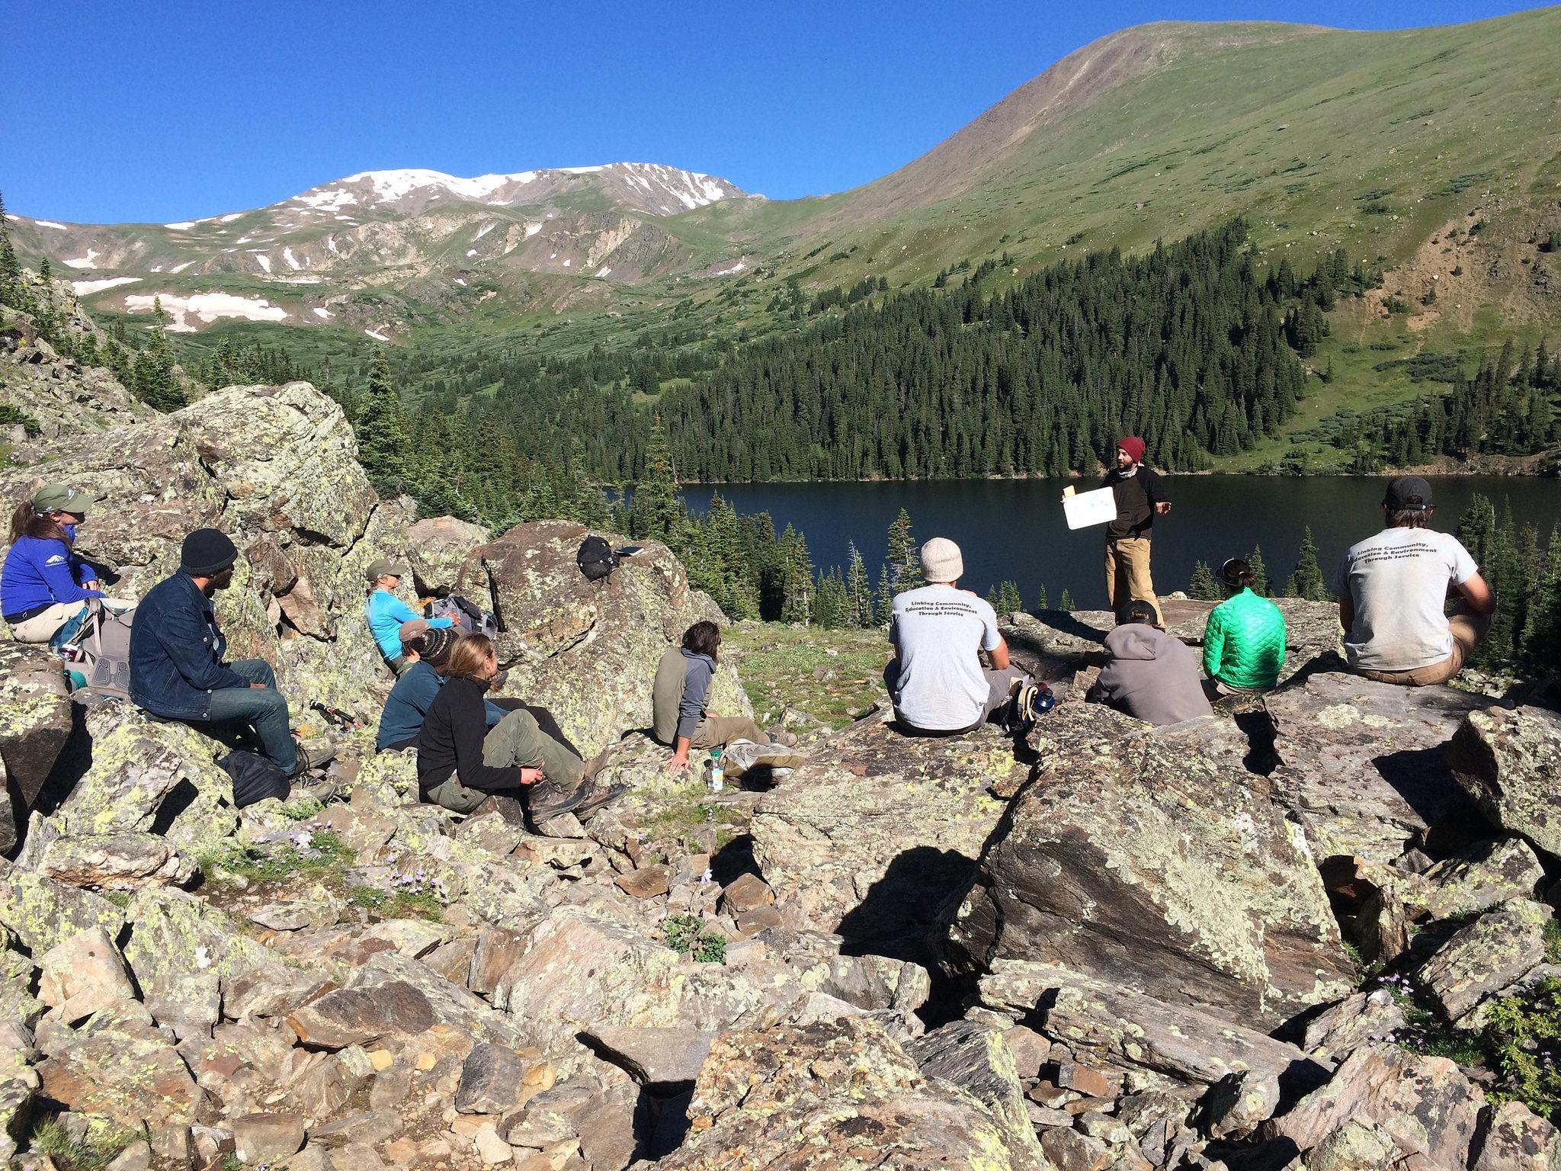
TRAINING & EDUCATION
LEAVE NO TRACE
Notes:
We use the training and education to support the Leave No Trace mission and ensure that all outdoor enthusiasts have the skills to leave places as good or better than they found them.
Multitude of options from courses, workshops, online training, outreach and Leave No Trace literature and guides.

Slide 27
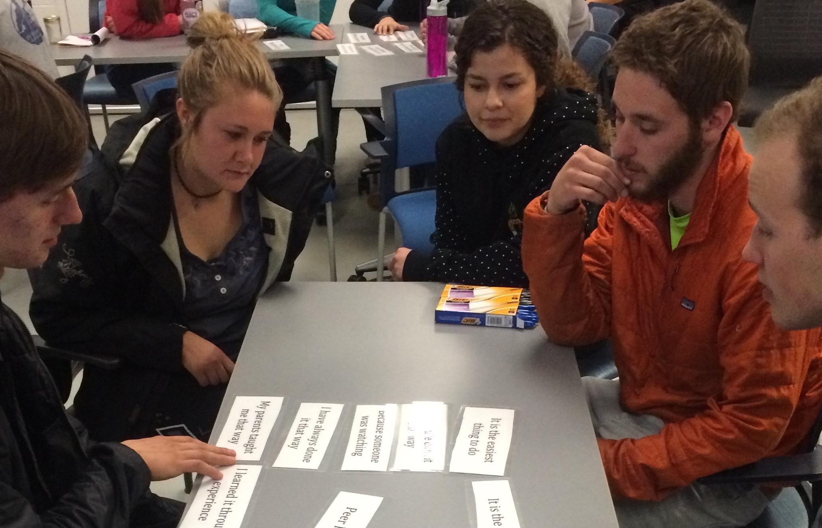
TRAINING
The Center offers training options across the country
Notes:
There are three tiers of Leave No Trace training that provide differing education levels.
The first, and least intensive, is an awareness workshop, which lasts 30 min to a full day and offers introductory Leave No Trace concepts designed for the general public. Millions have attended awareness workshops and they continue to be a popular way to get trained.
The next option is a 2-day trainer course taught in the field by Leave No Trace Master Educators across the country. The trainer course results in a certificate of completion. Currently, there are over 40,000 Leave No Trace trainers, worldwide.
The comprehensive Leave No Trace Master Educator course is a 5-day, field-based training designed specifically for educators or those interested in teaching Leave No Trace. There are nearly 7,500 Master Educators in the US and abroad.

Slide 28
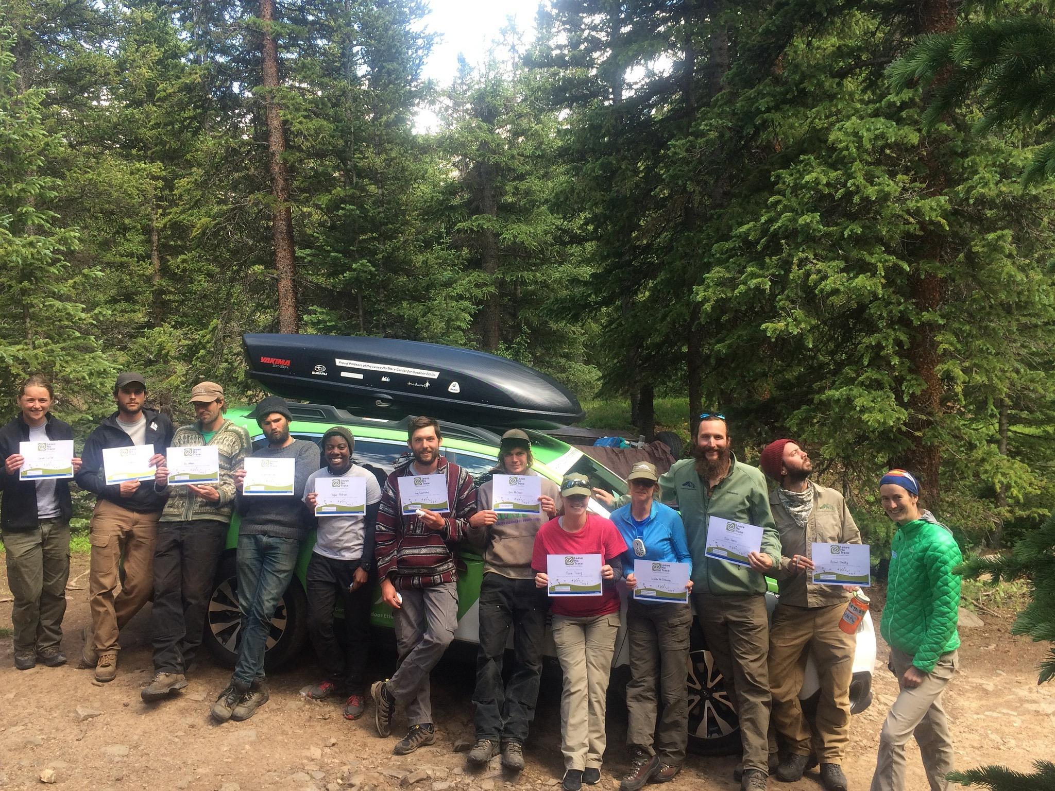
MASTER
EDUCATOR
COURSE PROVIDERS
Notes:
Today there are more than 7,500 Master Educators around the globe.
The Center’s partnerships with some of the country’s leading outdoor education institutions ensures that the Leave No Trace Master Educator Course is taught to a broad cross-section of people.

Slide 29
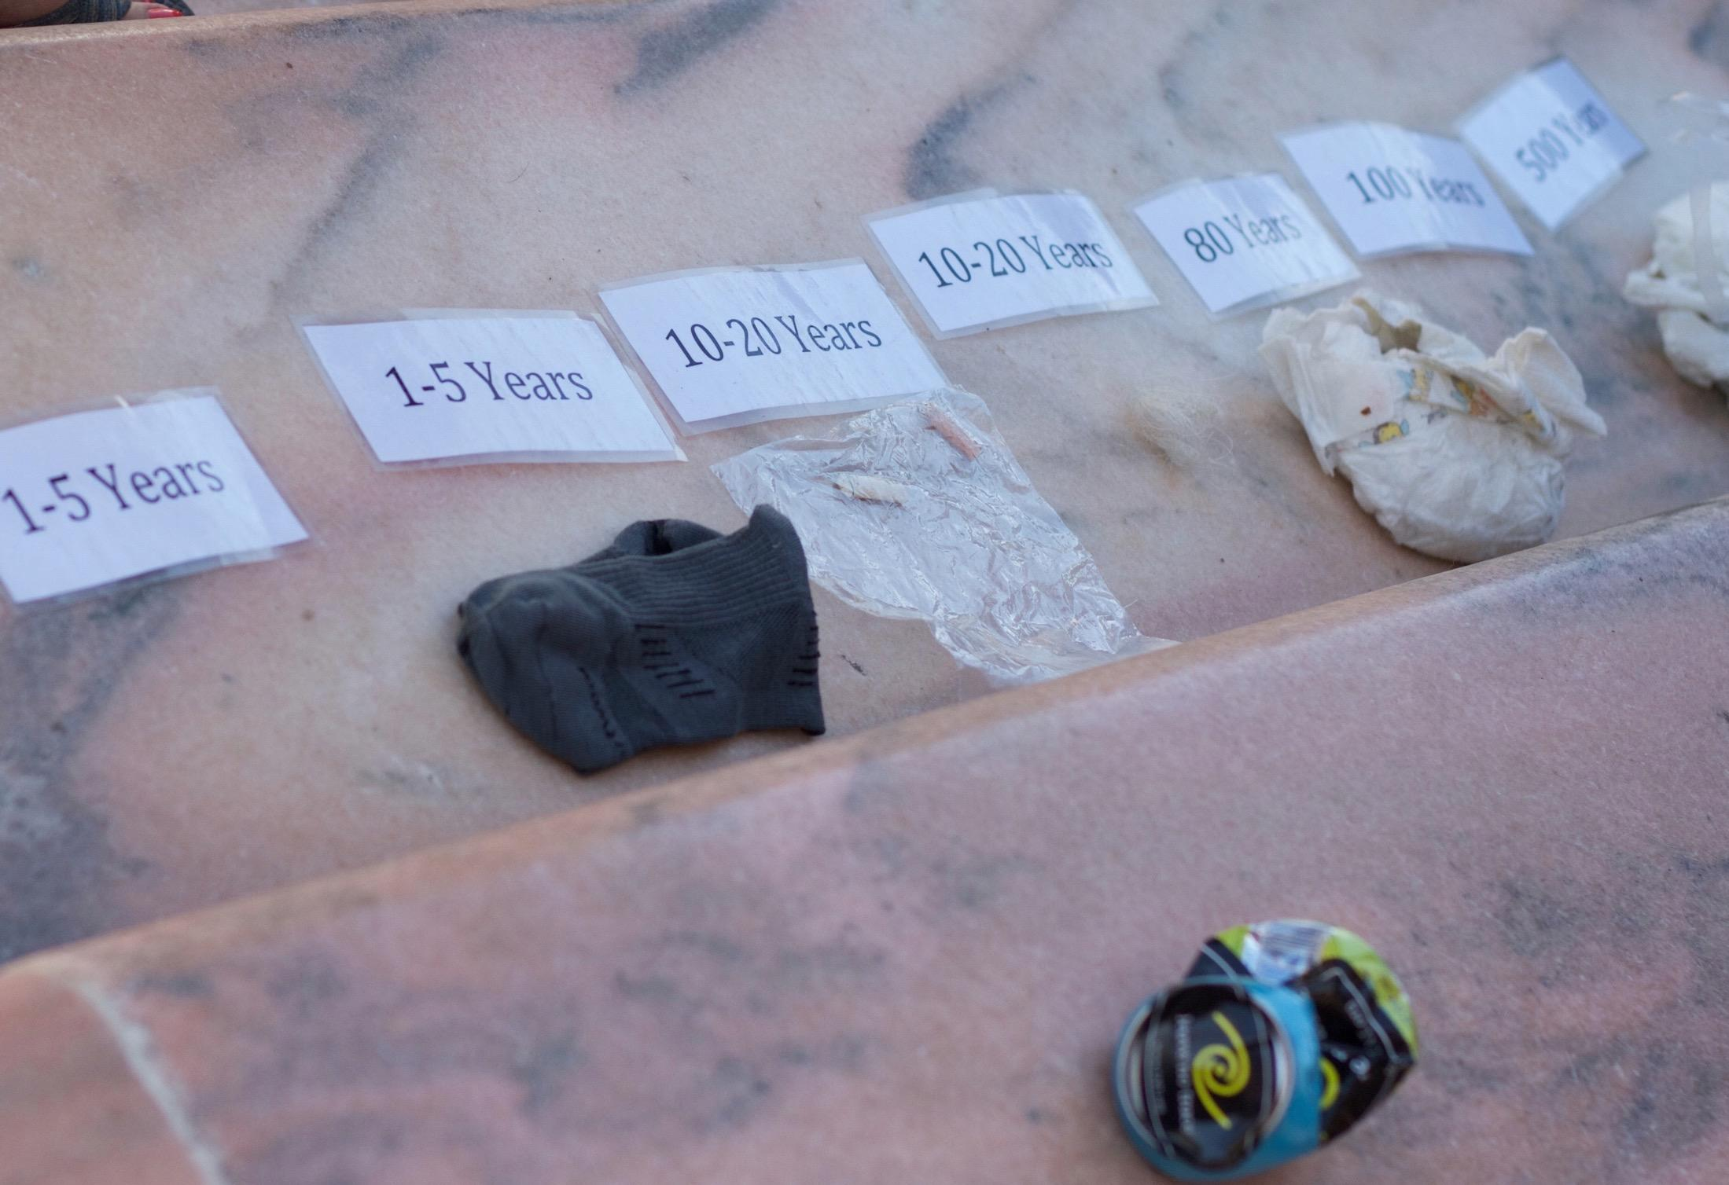
LEARNING
ONLINE
Notes:
A popular web-based option is taking an online awareness workshop, which is designed to convey general Leave No Trace knowledge. Anyone age 12 or older can participate in an online awareness workshop, and those who complete it receive a certificate of completion.
Another opportunity for existing Master Educators is an Online Master Educator Refresher Course, which ensures that Leave No Trace Master Educators are current on their knowledge. This online refresher takes about 90 minutes to complete and is required once every two years for Master’s who teach Leave No Trace Trainer Courses.

Slide 30
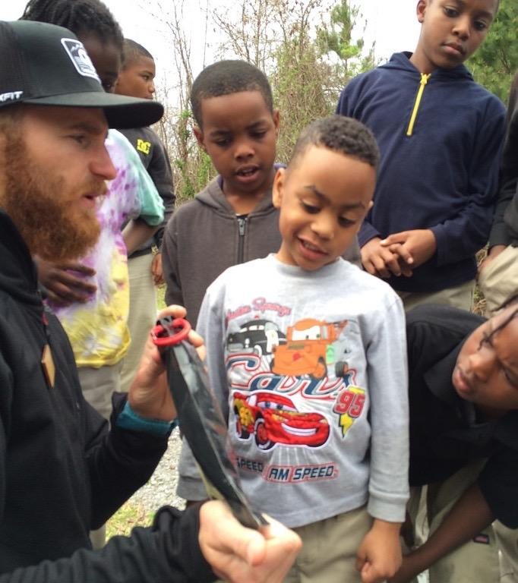
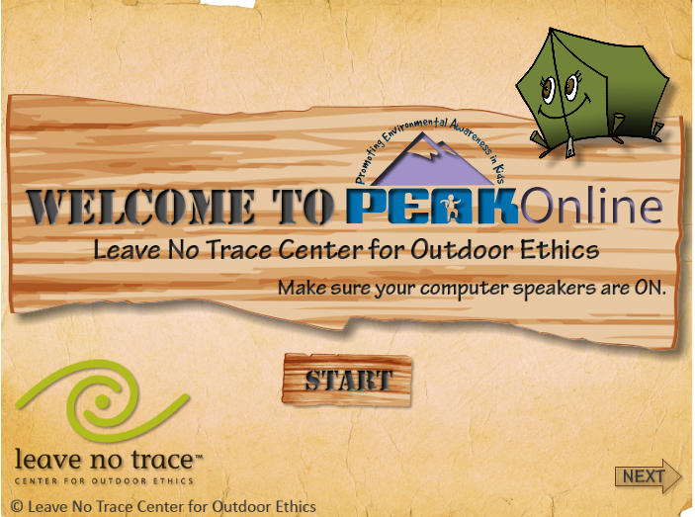
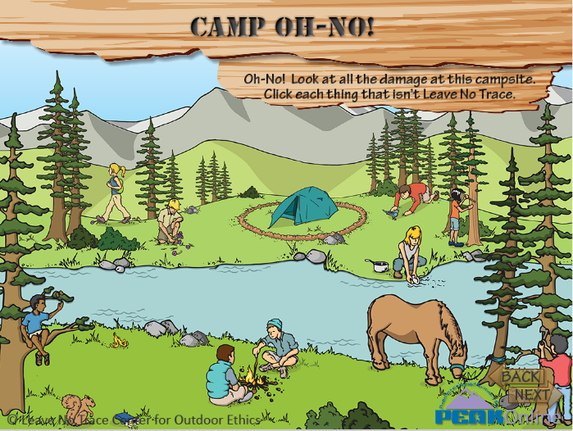
YOUTH
EDUCATION
Notes:
The Center has a broad variety of tools to teach children. Along with new Youth-program curriculum, also turnkey PEAK and TEEN programs.
PEAK (Promoting Environmental Awareness in Kids), and TEEN are presented as a “pack” of 30-1 hour Leave No Trace experiential activities to do with kids of all ages. The program is fee-based, with free downloads on the Leave No Trace website.
PEAK is available in Spanish.
Web-based version of the program called PEAK Online that is a collection of 5 fun, interactive activities to help kids learn about Leave No Trace.

Slide 31
LEARN
learn
HOW TO GET INVOLVED
Notes:
Educate yourself by:
Take advantage of the organization’s broad selection of books and other educational materials
Reading a Leave No Trace Skills & Ethics booklet: a short booklet that takes you through Leave No Trace for various ecosystems and outdoor activities
Choosing from one of the course options
Join Leave No Trace’s YouTube channel and watch the many Leave No Trace skills videos

Slide 32
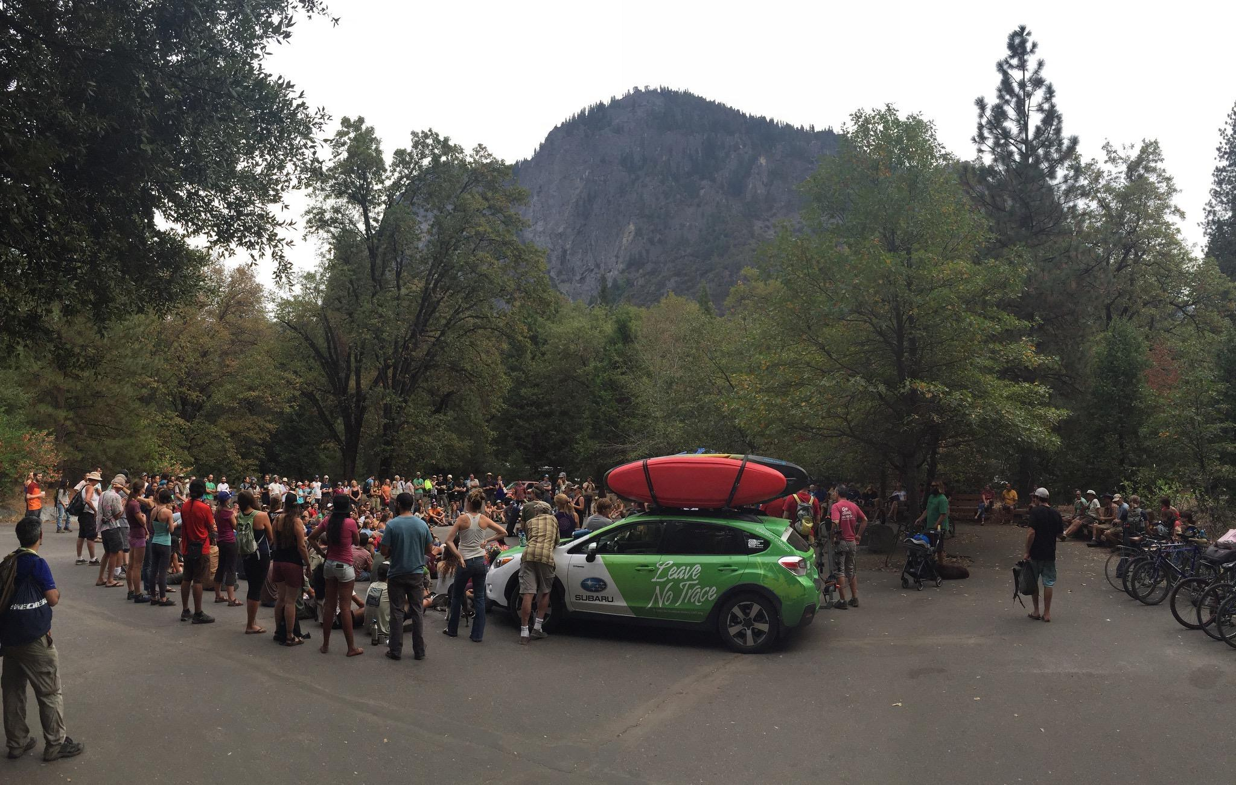
JOIN US
HOW TO GET INVOLVED
Notes:
Easy ways to get involved where you are:
Introduce a kid to Leave No Trace through PEAK online
Contact the Center and become a Citizen Scientist to get involved with Leave No Trace monitoring in your area
Join the movement as a member: supporting what you care about, and be in the know about the latest science, research and skills.
Encourage your organization or company to become an official partner of Leave No Trace. Any group can get involved.
Join 170K+ strong, active, engaged social media family: Facebook, Twitter, Instagram and SnapChat

Slide 33
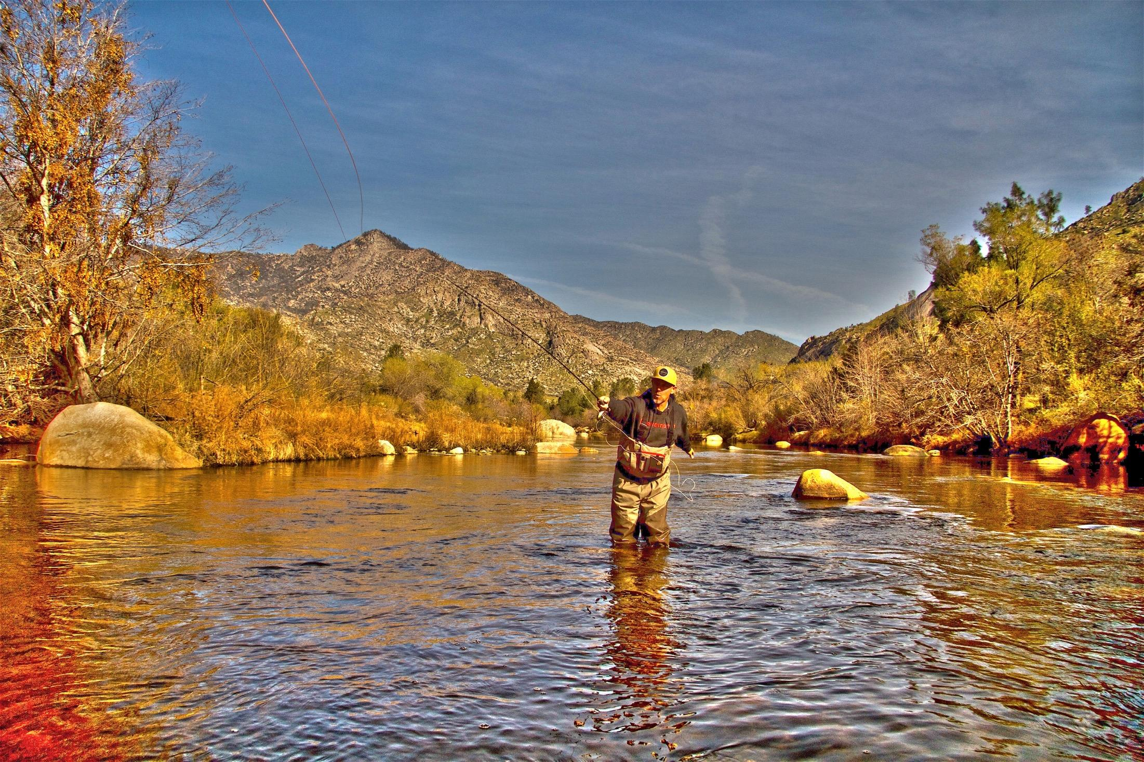
PASS IT ON
HOW TO GET INVOLVED
Notes:
Share Leave No Trace, even a simple principle, with other people when you’re enjoying the outdoors.
Contact your Leave No Trace State Advocate to learn about opportunities to teach others in your community.
Forward Leave No Trace videos from YouTube, educational blogs and more.
It’s so easy.

Slide 34
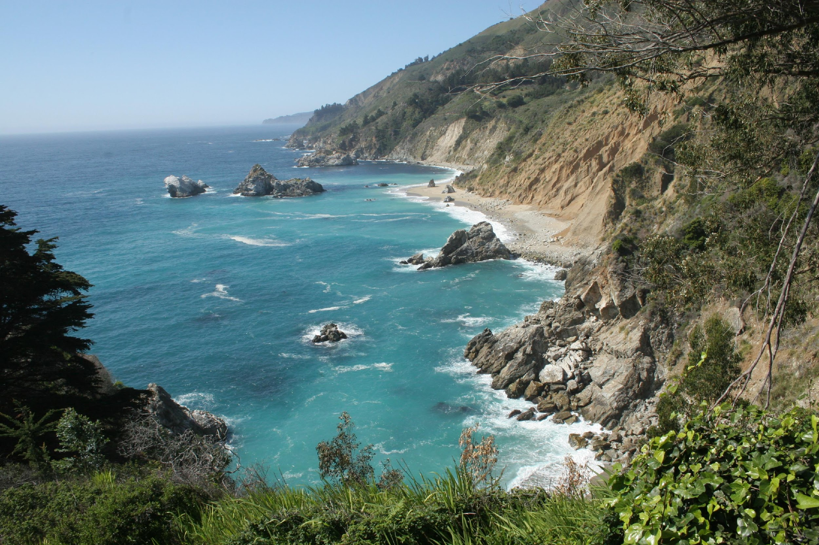
ENJOY YOUR WORLD.
LEAVE NO TRACE.
© 2017 Leave No Trace Center for Outdoor Ethics

