Slide 1
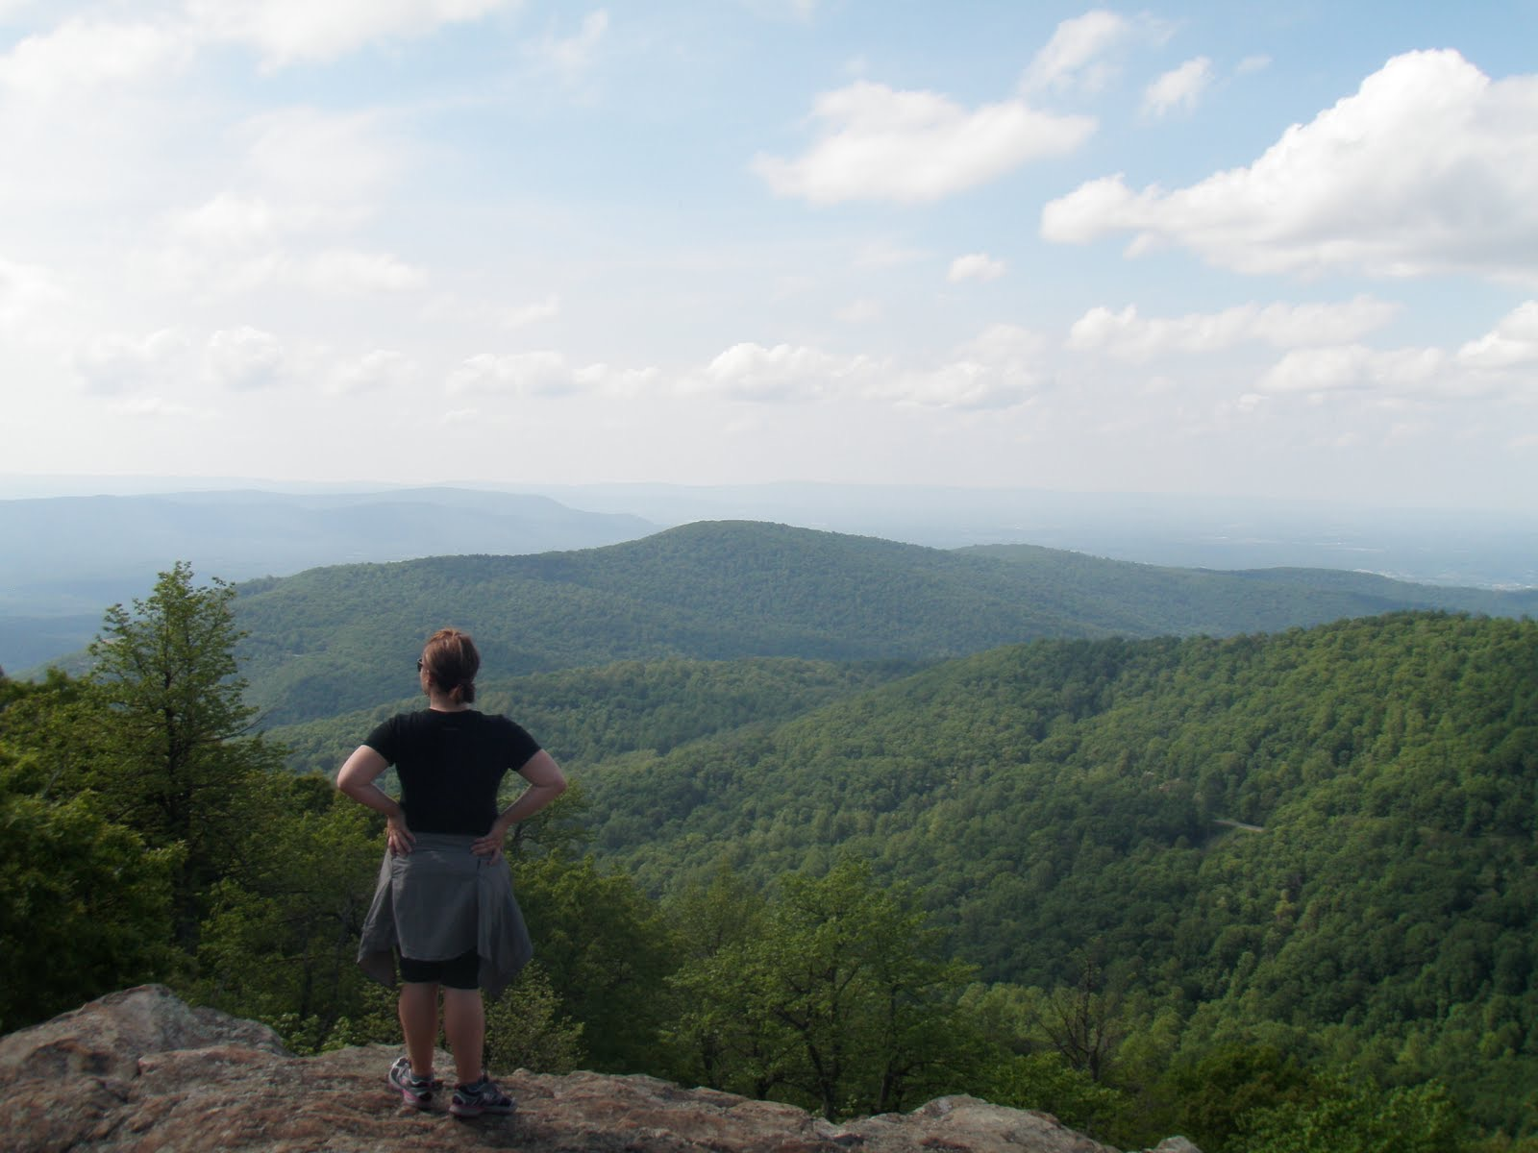

© 2016 Leave No Trace Center for Outdoor Ethics

Slide 2
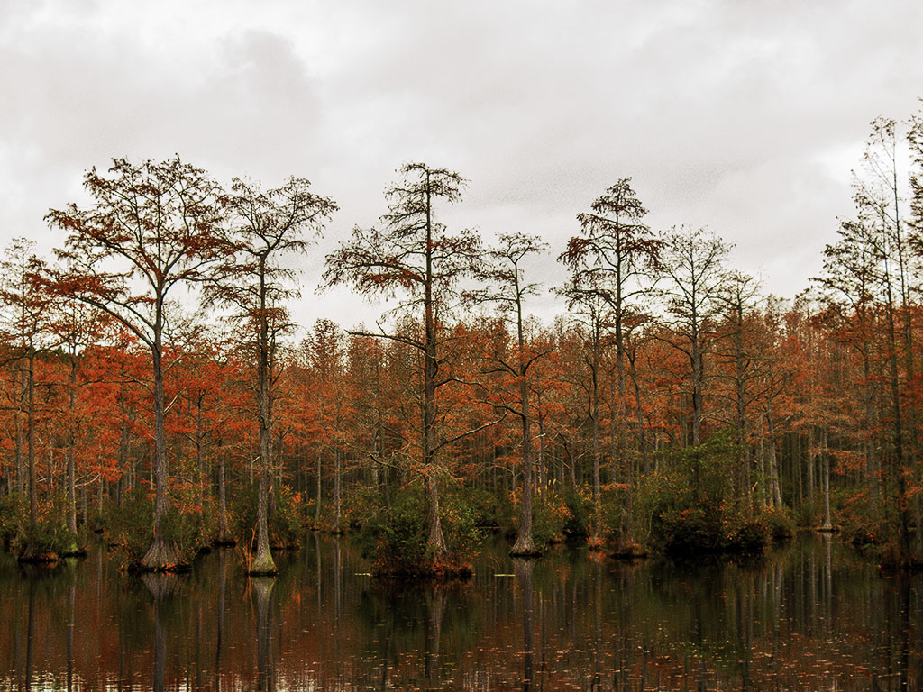
WHAT IS
LEAVE NO TRACE?
Mission: Protecting the outdoors by teaching and inspiring people to enjoy it responsibly.
Notes:
How many of you have taken a hike? Been on a picnic? Gone camping with your family? Show of hands. Getting outside renews our spirits, connects us with nature, amazing beauty, and the many natural wonders of our world.
Now, have you ever seen trash on your hike? Fire scars at a campground? Other impacts? Would you believe (use any of stats that may resonate):
Each year, tons of petrified wood are removed illegally from Arizona’s Petrified Forest National Park.
Wildlife that obtain human food develop strong attraction behaviors to trails, picnic areas, campsites and visitors, turning wild animals into aggressive and potentially dangerous panhandlers. Such animals are ultimately euthanized by land managers because of the risks they present to people.
Invasive species are being spread nationwide due to moving firewood from one area to the next by campers. Many new infestations of non-native tree-killing insects and disease are often first found in campgrounds. The specific insects and diseases vary by region, but some have already killed millions of trees over thousands of acres.
Trash last a very long time: plastic grocery bags can last up to 20 years; aluminum cans up to 200 years; fishing line up to 600 years.
According to the U.S. Centers for Disease Control (CDC), one day’s pet waste can contain several billion fecal coliform bacteria, along with Giardia and the eggs of roundworms, hookworms, and tapeworms.
Studies have attributed pet wastes to instances of water pollution sufficient enough to exceed water quality standards, close beaches and harm wildlife.
Recovery rates for areas impacted by recreation are very slow, with restoration to natural conditions often requiring a minimum of 10-30 years.

Slide 3
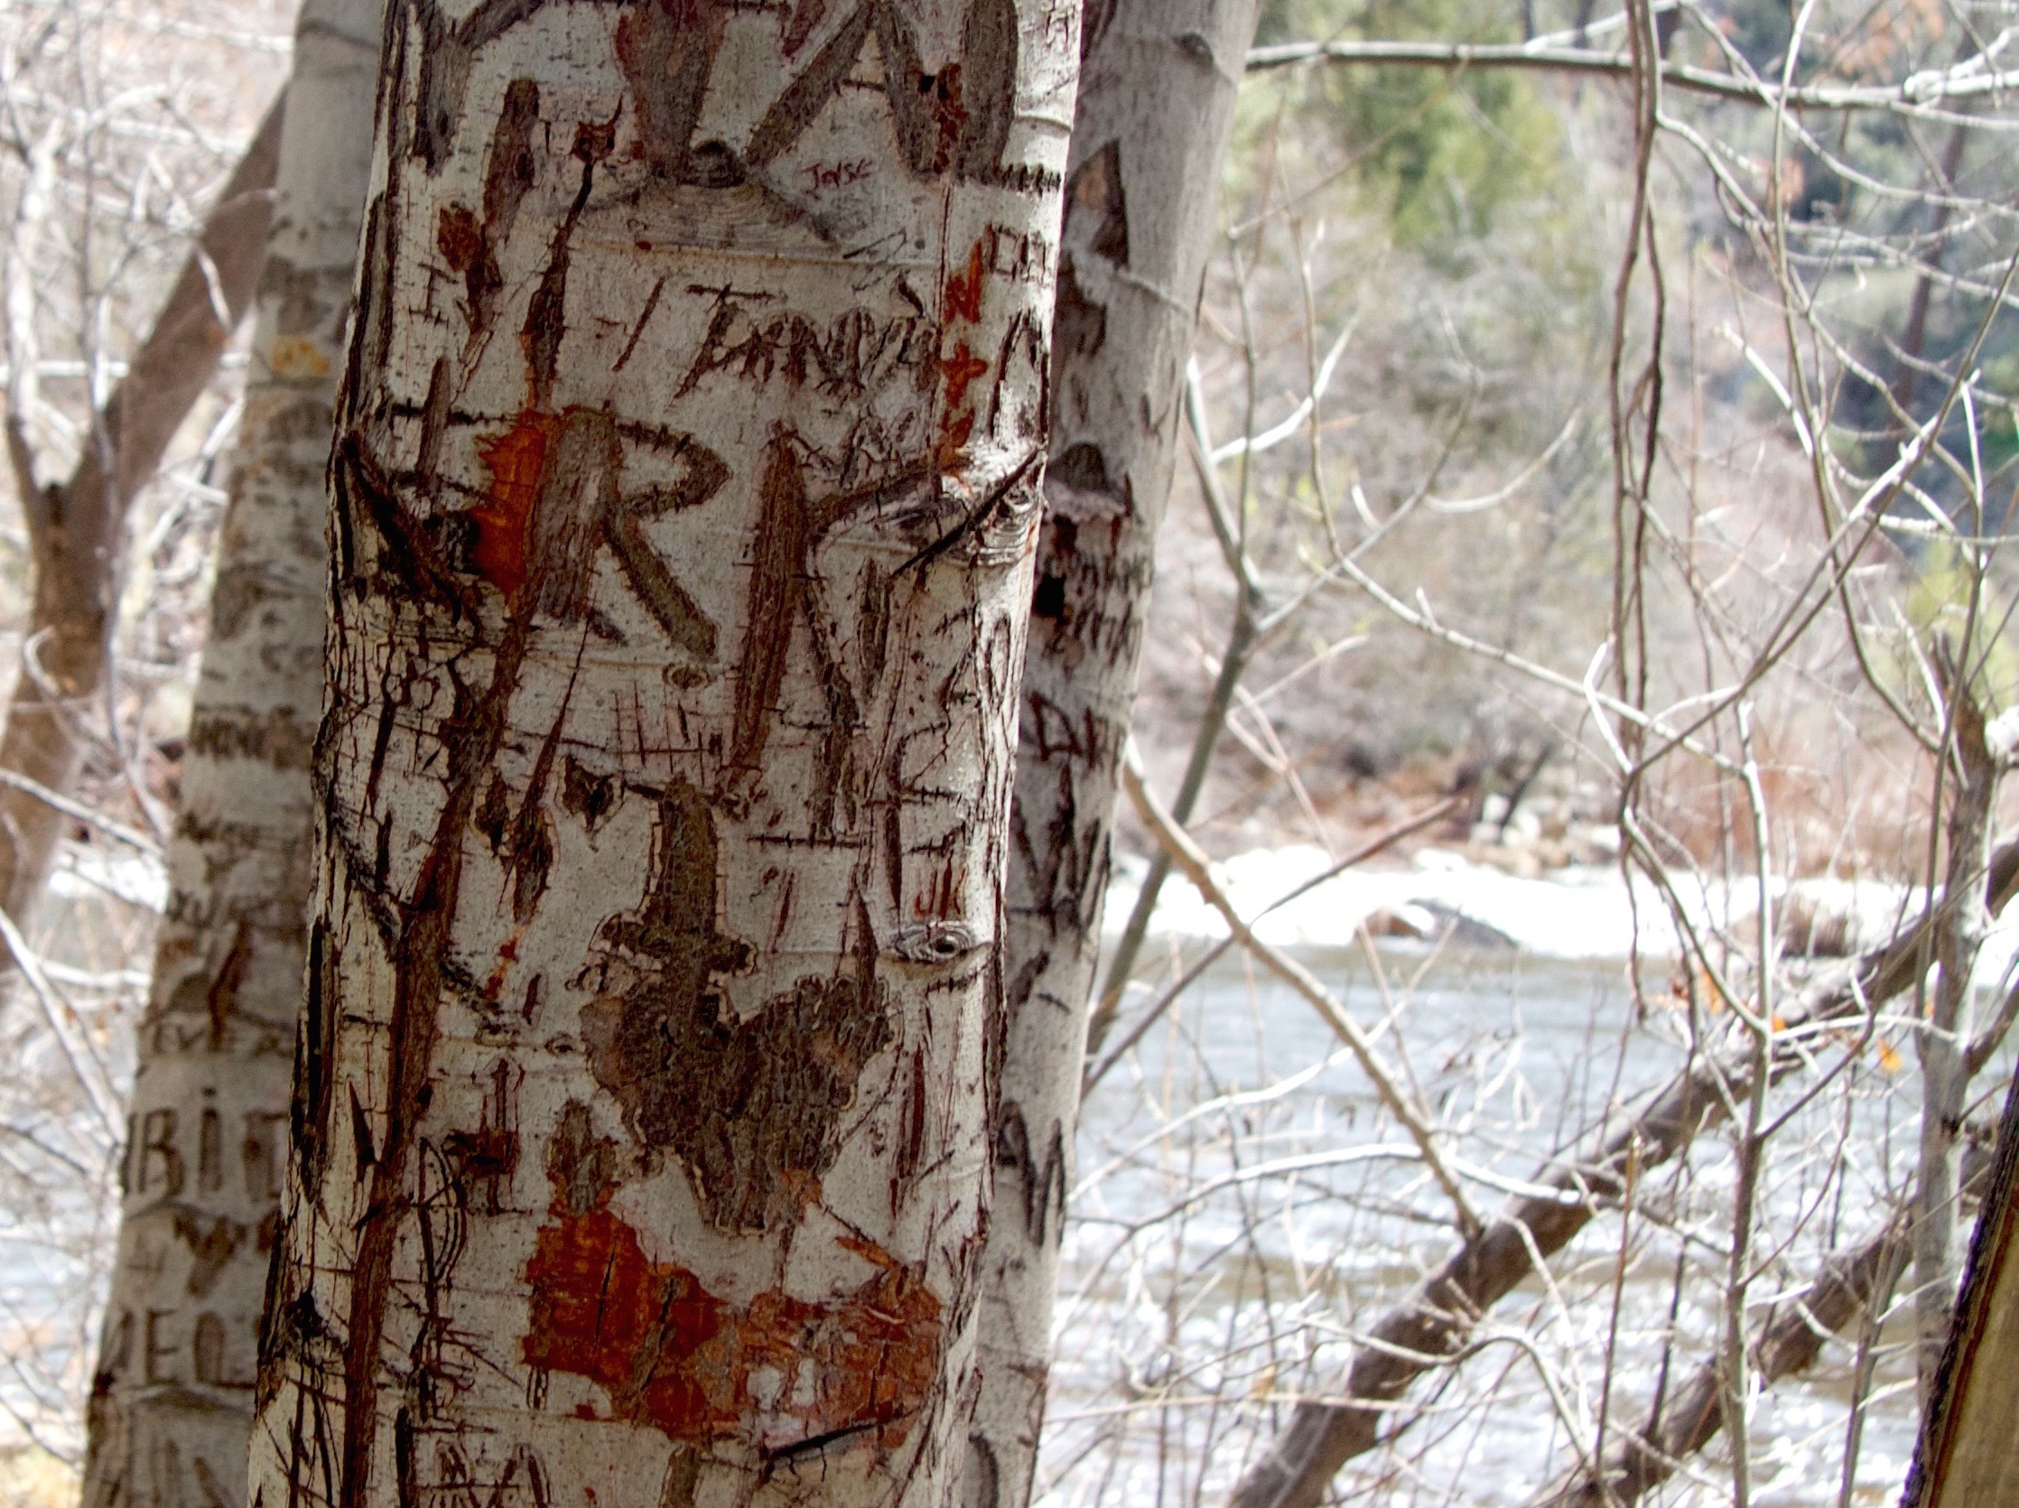
WHY
Impacts occur when we spend
time outdoors, but we can do
something about them.
Notes:
Leave No Trace is the best way to minimize these and other types of impacts we see in the outdoors today.
-National movement, run by a nonprofit organization (called the Leave No Trace Center for Outdoor Ethics) that is dedicated to protecting the outdoors by teaching and inspiring people to enjoy it responsibly.
-Accomplish this mission by delivering cutting-edge education, and training programs to millions of people across the country every year.
Then introduce yourselves:
If Traveling Trainers—we are the Subaru/Leave No Trace Traveling Trainers, a mobile education and training team that is part of the Leave No Trace Center for Outdoor Ethics.
If Staff/State Advocate/Volunteer: Introduce yourself and your role with the Leave No Trace Center for Outdoor Ethics.
Leave No Trace addresses impacts and provides people with techniques and skills to enjoy the outdoors sustainably—now and into the future.

Slide 4
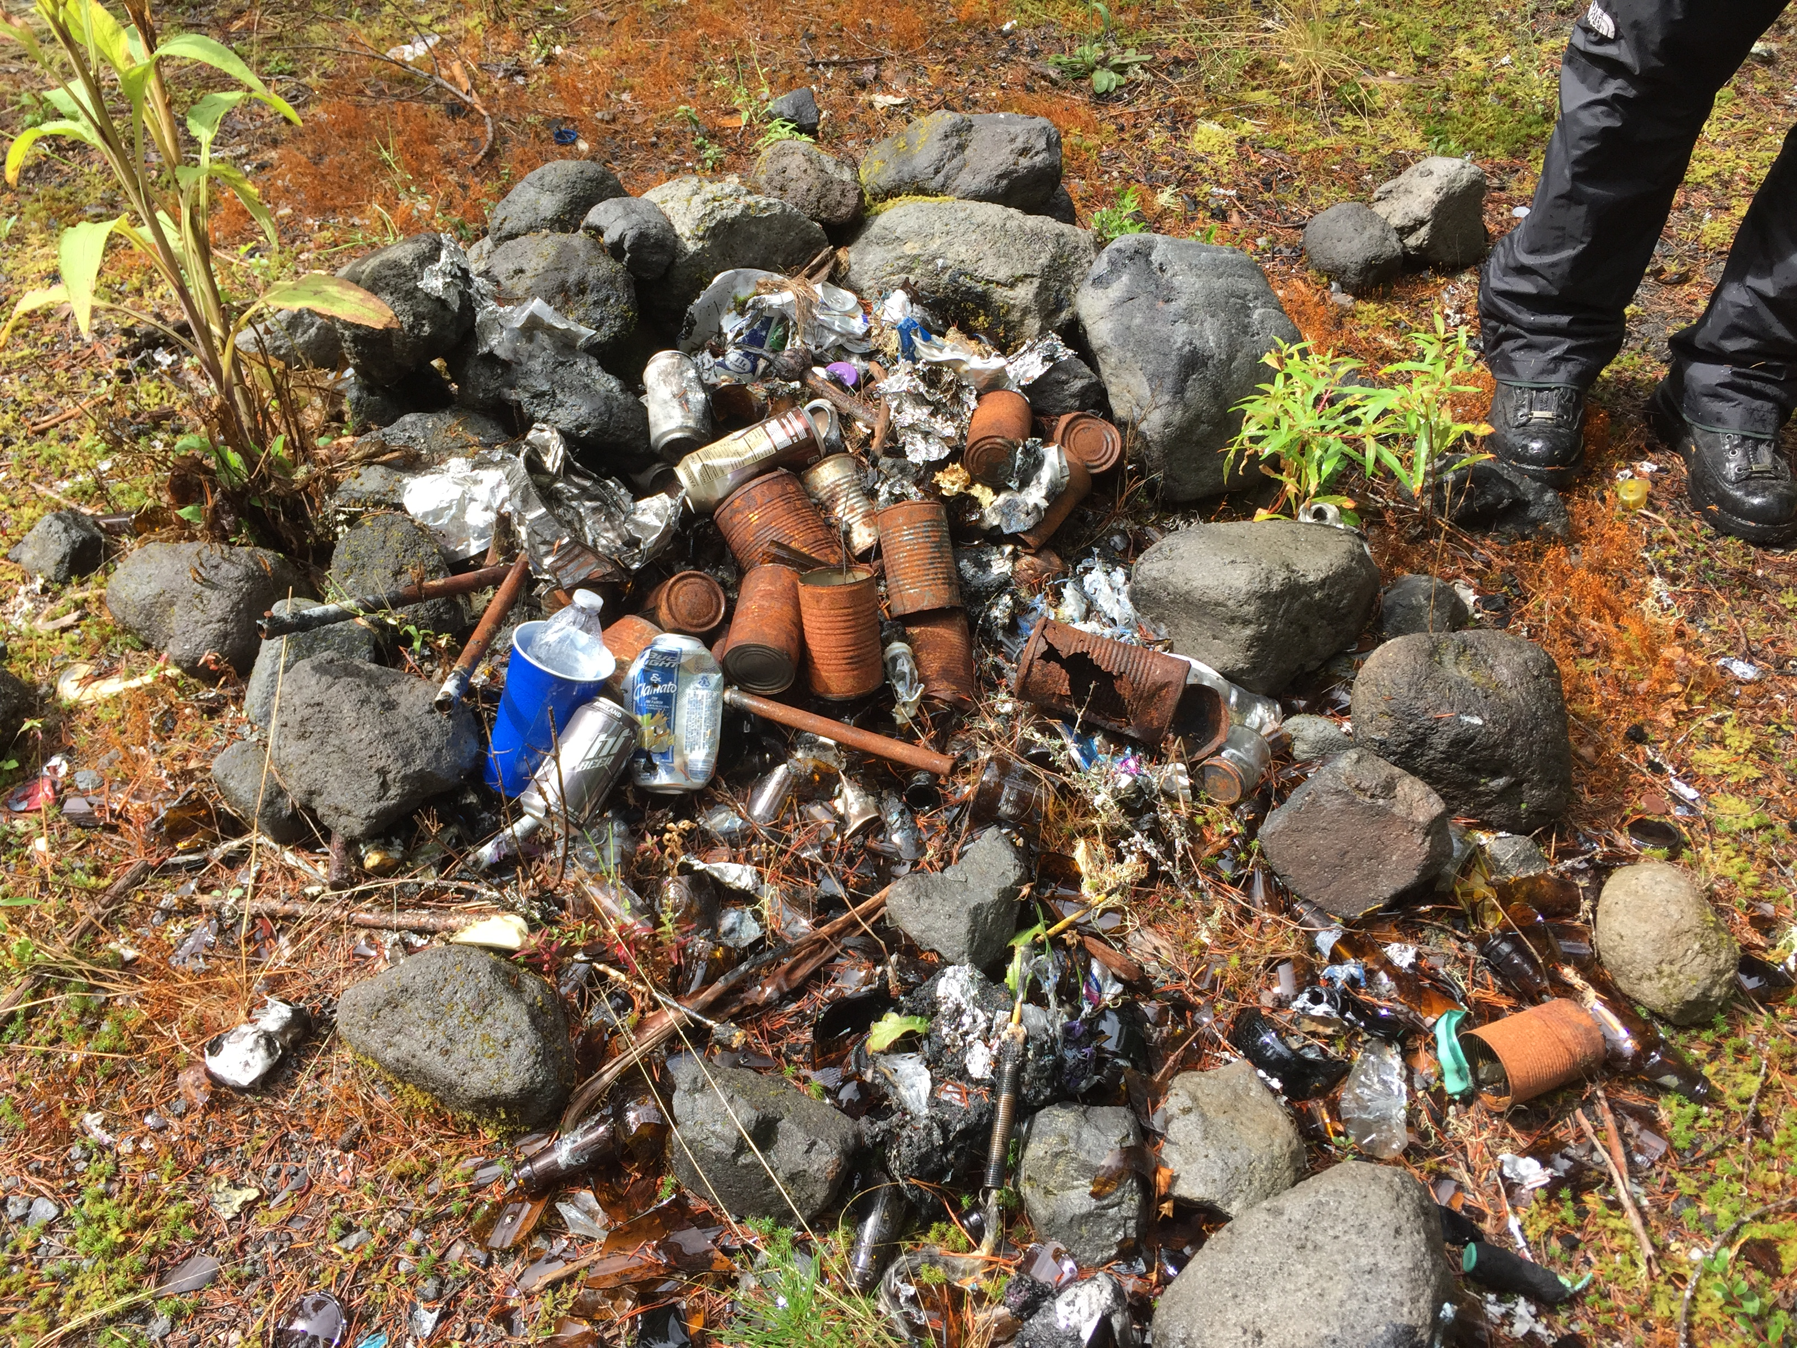
IMPACTS
  From Outdoor Use
  Wildlife
  Vegetation
  Water Resource
  Soil
  Cultural Resource
  Social
Notes:
When venturing in the outdoors, humans generally impact the environment in six broad areas:
Wildlife Impacts: disturbance, altered behavior, or reduced health and reproduction of animals.
Vegetation Impacts: vegetation loss, the introduction of invasive species, and tree or plant damage
Water Resource Impacts: siltation, sedimentation, and soap or fecal waste
Soil Impacts: loss of organic litter, soil compaction, or soil erosion
Cultural Resource Impacts through theft or damage to cultural and historic features and artifacts
Social Impacts: crowding, conflicts between various user groups, and diminished outdoor experience

Slide 5
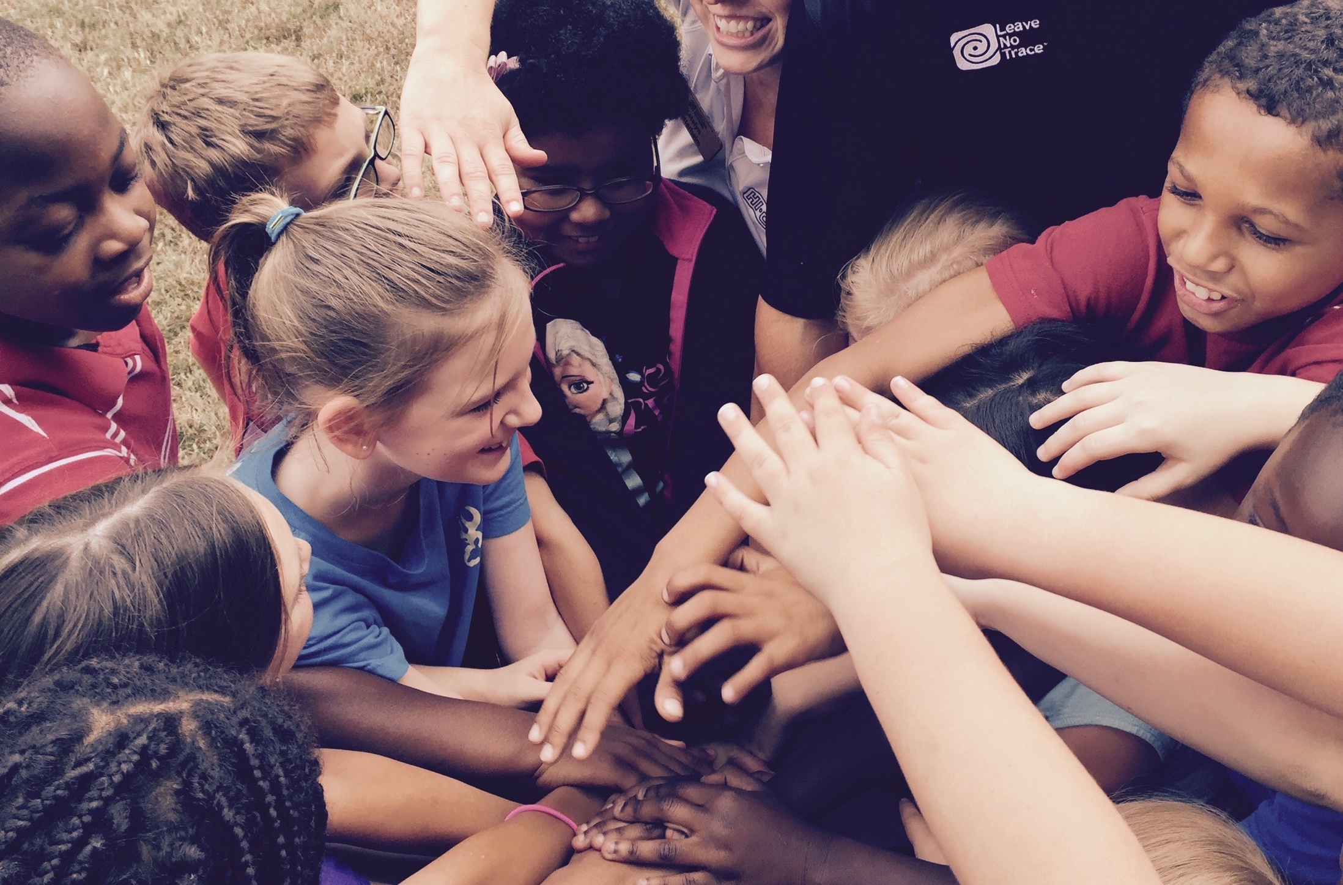
THE POWER
OF LEAVE NO TRACE
Leave No Trace education provides a foundation to
build a nationwide outdoor ethic for all.
Notes:
Optional Narrative: What began as a call to preserve wilderness areas has evolved into a global, daily commitment for all people to embrace a Leave No Trace ethic.
The environmental stewardship promoted by the Leave No Trace Center extends beyond outdoor enthusiasts to include ANYONE who enjoys the outdoors and is concerned with people’s relationship with nature.

Slide 6
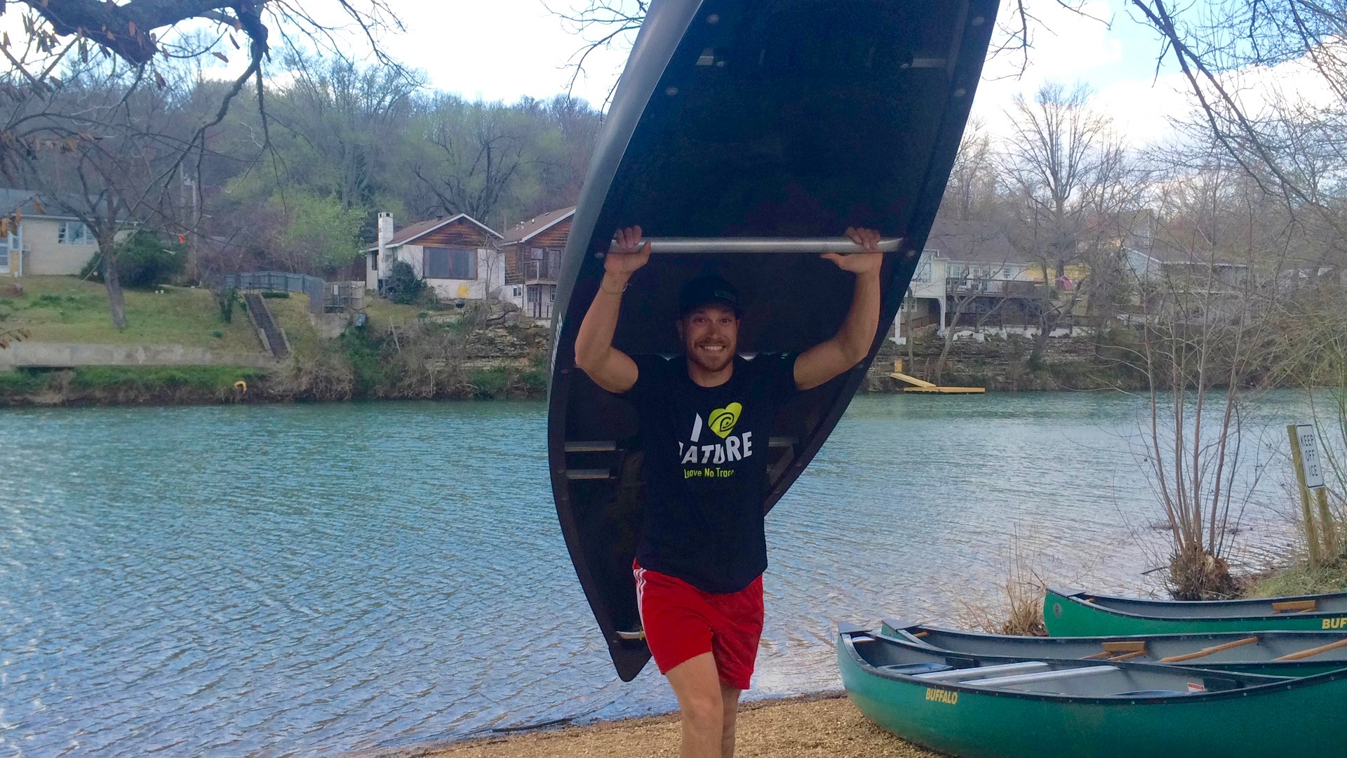
LEAVE NO TRACE IS
  Science-based
  Simple & effective
  Relevant for everyone
  For your backcountry to your city parks
Notes:
Research shows that Leave No Trace education is successful in significantly improving people’s knowledge, ethics and behavior in the outdoors. Our research indicates education fosters:
Healthier, thriving wildlife and fewer negative interactions with humans.
Considerable litter reduction
Less degradation of native plants and animal species
Stronger human bonds to the outdoors and a greater sense of stewardship
The Center continues to study and test our principles and training to ensure the best, most effective, relevant messaging and programs.
Is a simple, effective framework for making good decisions in nature, no matter how your choose to spend time outdoors.
Though developed for the backcountry, Leave No Trace today is relevant for anyone who spends time outdoors and is appropriate everywhere from deep Wilderness and the backcountry to your local city park.

Slide 7
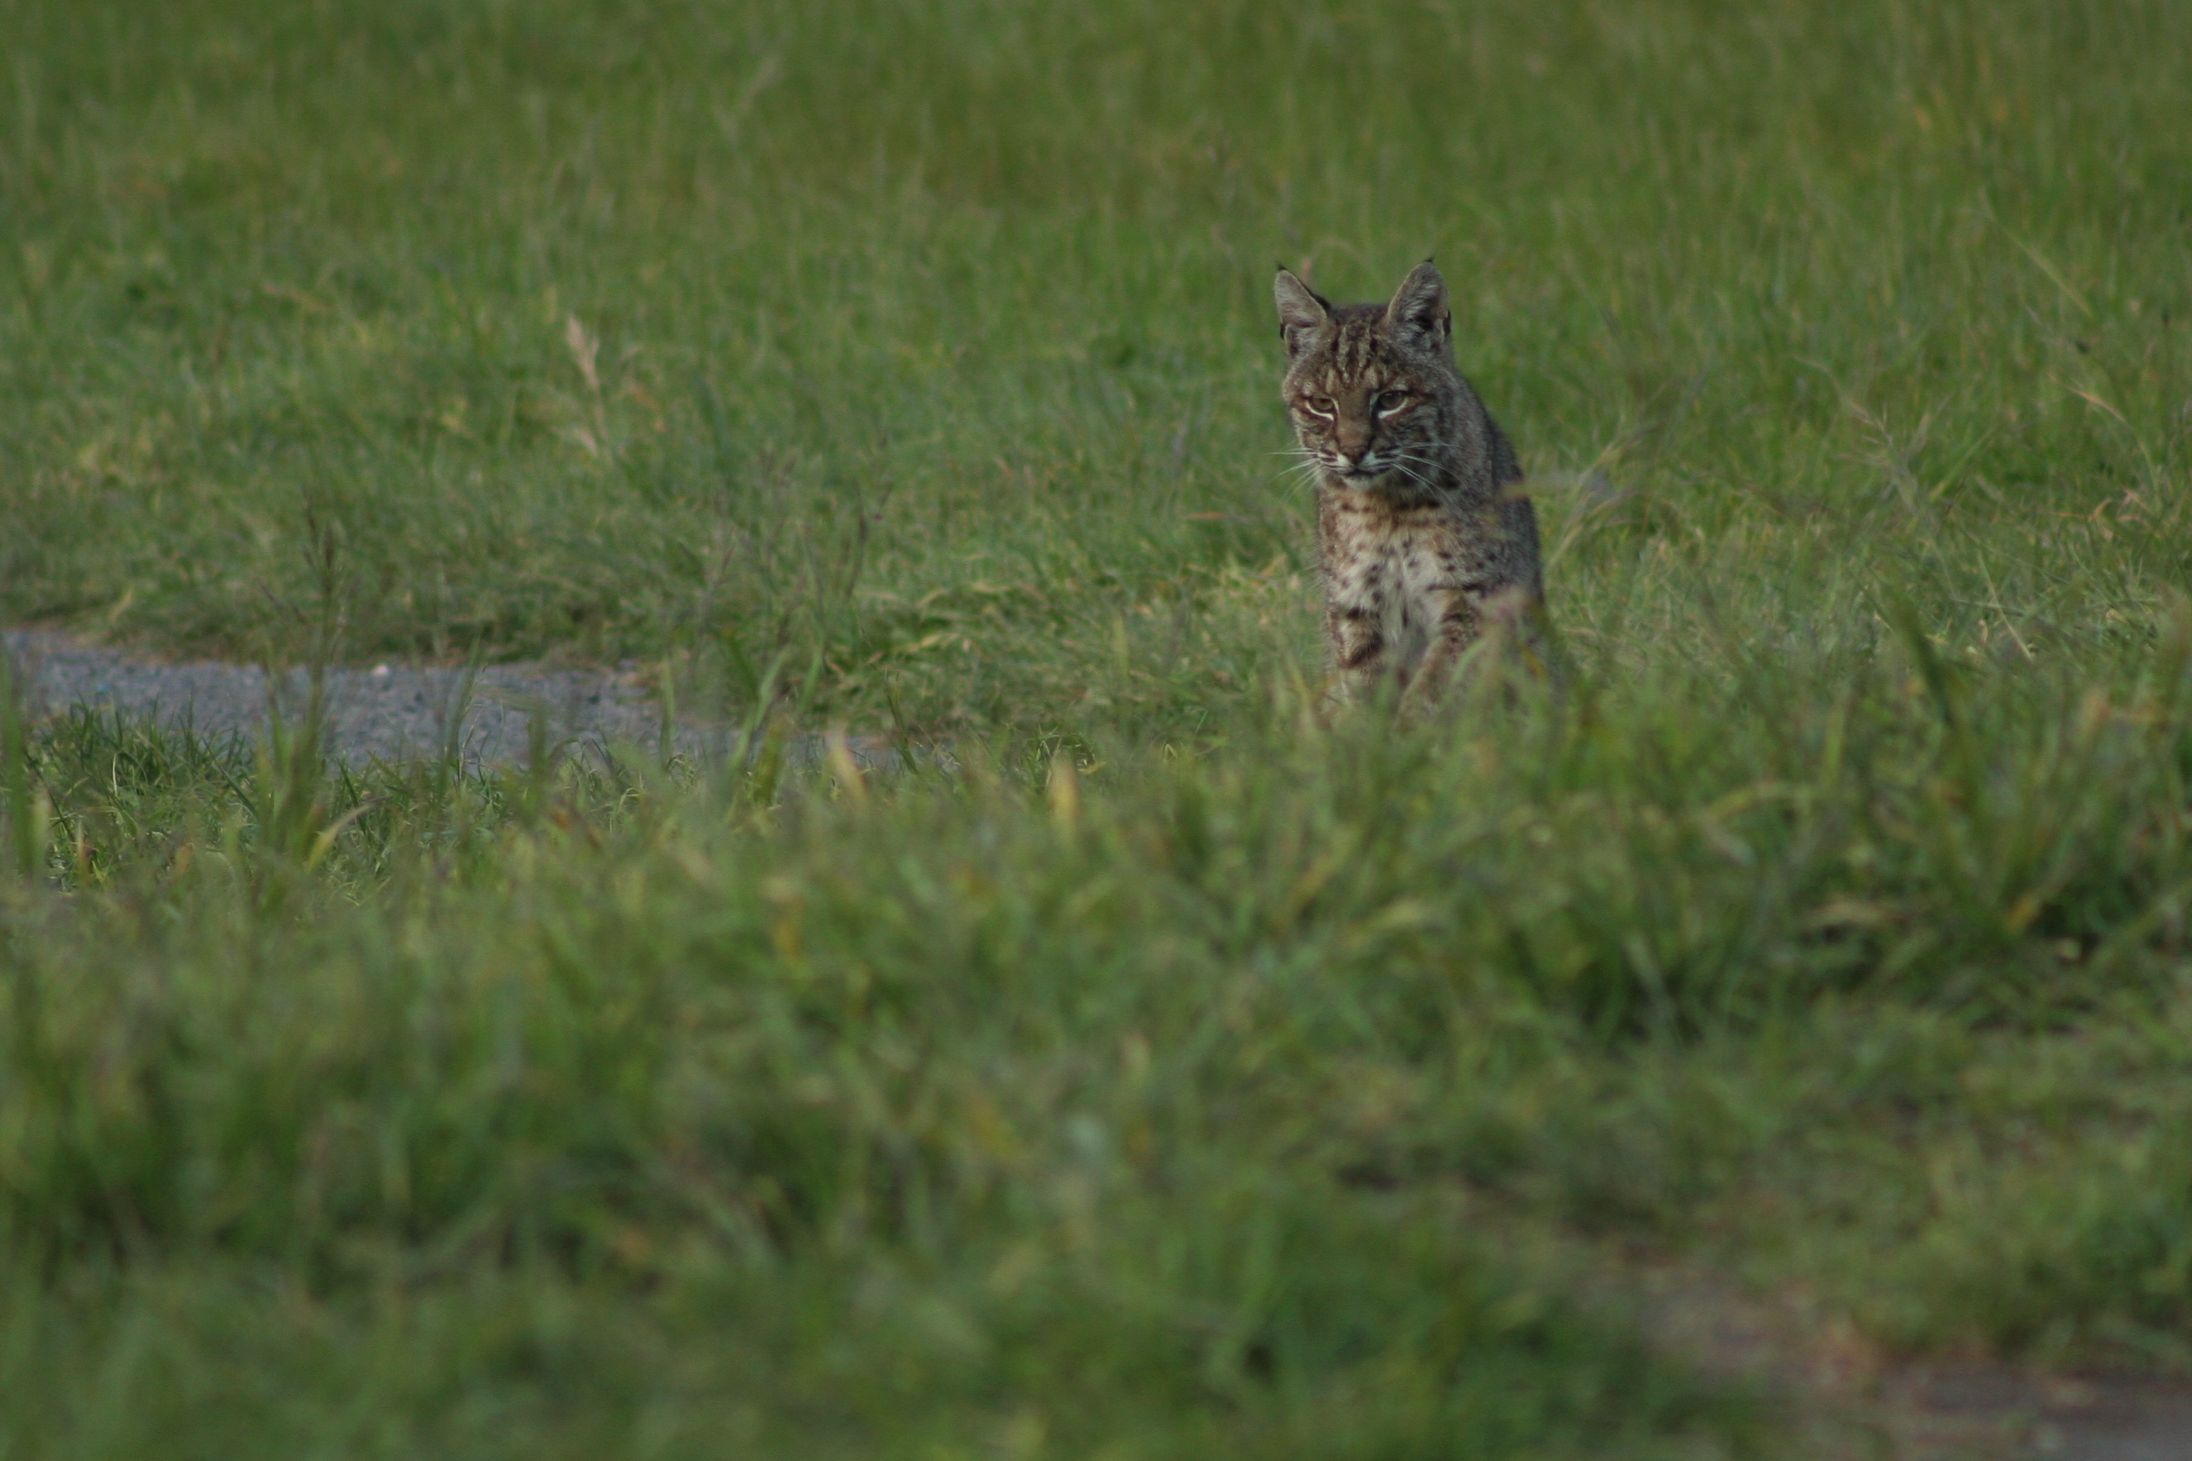
THE SEVEN
LEAVE NO TRACE
PRINCIPLES
Plan Ahead & Prepare
Travel and Camp on Durable Surfaces
Dispose of Waste Properly
Leave What You Find
Minimize Campfire Impacts
Respect Wildlife
Be Considerate of Other Visitors
Notes:
We use the foundation of seven core principles to communicate the best available guidance for enjoying the outdoors responsibly. The Seven Principles of Leave No Trace help educate and guide people in sustainable, minimum impact practices that mitigate or avoid recreation-related impacts. These principles are the most robust and widely utilized minimum impact outdoor practices on public lands across the country. The seven principles are:
Plan Ahead and Prepare
Travel and Camp on Durable Surfaces
Dispose of Waste Properly
Leave What You Find
Minimize Campfire Impacts
Respect Wildlife
Be Considerate of Other Visitors
Principles are available in many form: for kids, frontcountry, activity-specific (climbing, mountain biking, fishing, hunting, cultural heritage, international, etc.).

Slide 8

THE LEAVE NO TRACE
SPECTRUM
FEW
IMPACTS
SIGNIFICANT
IMPACTS
Notes:
Think of Leave No Trace as a spectrum:
On one end: many impacts. On the other: few impacts
Many ways to Leave No Trace. Find your place on the spectrum.
Doing ANYTHING to minimize your impact is better than doing nothing at all.
If you pack out your trash, you’ve left no trace. If you’ve picked up after your pet, you’ve left no trace. If you’ve done both, even better.
Think of the difference for our shared lands if every one put Leave No Trace into action!

Slide 9
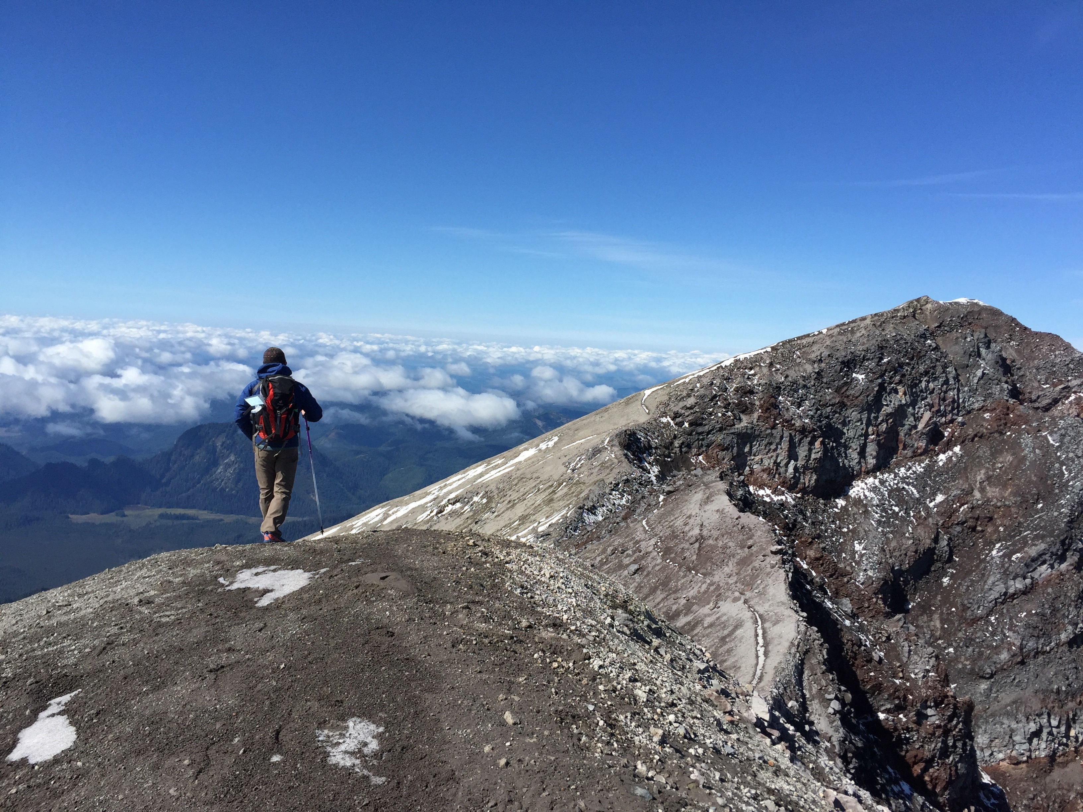
HISTORY
  Roots In The Backcountry
Notes:
To understand how the Leave No Trace Center for Outdoor Ethics operates today, understanding the extensive history is helpful.
60s: originated in backcountry and federally-designated Wilderness areas in the 1960’s, following the passage of the Wilderness Act in 1964.
70s: federal land management agencies developed and shared basic Leave No Trace concepts on lands they managed
Later, in the 1980’s, the “No Trace” program was developed by the USDA Forest Service wilderness managers as a humanistic approach for wilderness ethics and low impact hiking and camping practices.
ADDITIONAL INFORMATION AS NEEDED
Early names for the program included: Wilderness Manners, Wilderness Ethics, Minimum-Impact Camping and No-Trace Camping.
1970s: federal agencies began to develop educational brochures to teach the public about Leave No Trace. At the time, the program was slogan-based with little national leadership or inter-agency coordination.
Early 1990’s: “Leave No Trace” selected as the name for an expanded national program
Partnerships formed with four federal land management agencies and the National Outdoor Leadership School (NOLS)
The 1993 Outdoor Recreation Summit held in Washington D.C. (including feds, NGOs, outdoor companies) recommended new nonprofit to manage national program

Slide 10
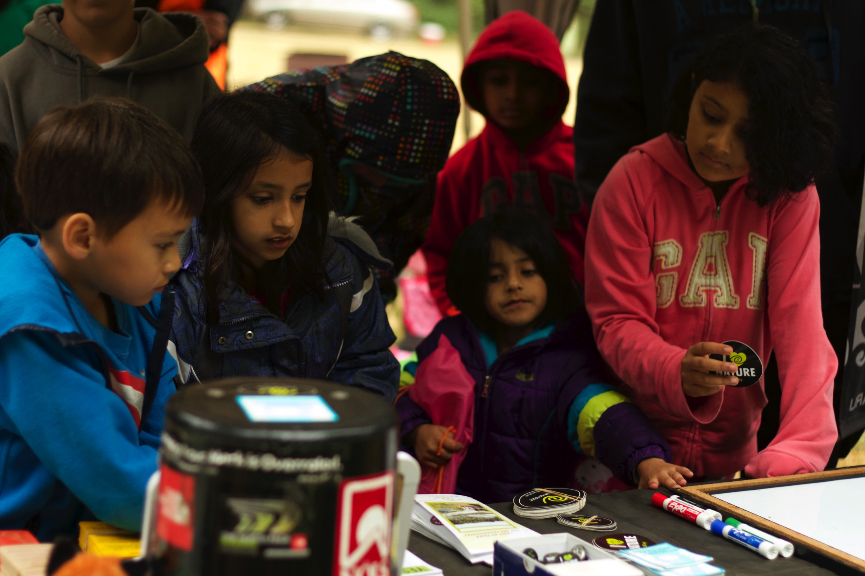
HISTORY
  The Leave No Trace Organization
Notes:
Established in 1994 as independent, national nonprofit to lead development, education, research and expand public awareness.
2003: Fun Fact: added Center for Outdoor ethics to name reducing misconception that we were a detective agency or witness protection program.
Today:
partners with 500+ companies, land agencies, schools, universities, non-profits, outfitters and guides, and their constituents to promote Leave No Trace
Staff of 20+ in Boulder, CO and national board of directors provide leadership
30,000 trained volunteers across the country provide local Leave No Trace programs
What began as a backcountry wilderness education program has now expanded to the frontcoutnry - where people live and enjoy the outdoors in their home towns.

Slide 11
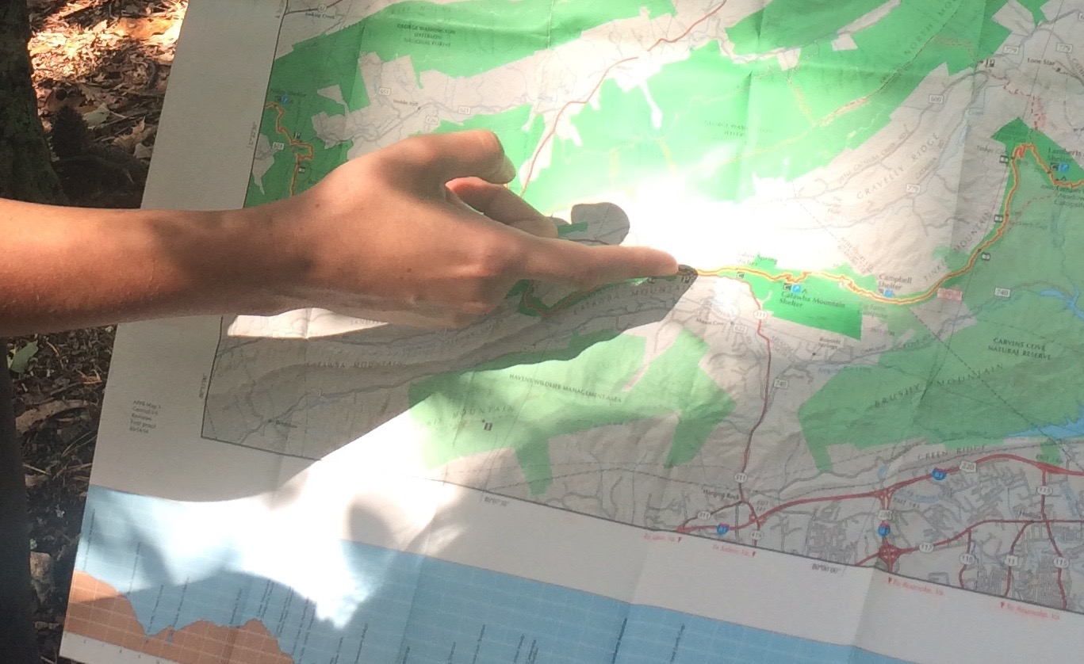
LEAVE NO TRACE
TODAY
Notes:
The ultimate goal of the Center, which is Leave No Trace education for everyone who loves the outdoors, is enormous. The fastest way to get there, we believe, is to focus on the sources—the lands themselves, as well as youth. Due to this, we decided to introduce two new campaigns: Leave No Trace in Every Park and Leave No Trace for Every Kid (as earlier described in this presentation:
Leave No Trace in Every Park focuses on public lands including local, state, and national parks, forests, and protected areas.
Leave No Trace for Every Kid focuses on introducing basic Leave No Trace concepts to kids while they are forming their personal ethic framework.
To ensure that to ensure that Leave No Trace is reaching communities across the country.
we’re also:
Training the public
building a vast volunteer network
and conduct critical research

Slide 12

LEAVE NO TRACE IN
EVERY
PARK
Notes:
Leave No Trace in Every Park
The goal: that every person who visits a park has the opportunity to learn about and put Leave No Trace into action. Leave No Trace in Every Park ensures that parks continue to thrive because people understand what it means to take care of them.
MORE INFO AS NEEDED
What if everyone who stepped into the natural world had an outdoor ethic? What if all children learned just a few Leave No Trace skills to carry them into adulthood? The collective positive impact would be giant.
The fastest way to get there, we believe, is to focus on the source—the lands themselves. We are concentrating on a new, multi-year initiative: Leave No Trace in Every Park. The campaign focuses on public lands: local to national parks, forests and protected areas.
Our new, multi-year initiative incorporates Leave No Trace programs and educational opportunities across the country. Leave No Trace in Every Park takes many forms from research, interpretive materials, staff and volunteer training, public education initiatives, onsite signs, junior ranger programs, Leave No Trace Hot Spots, Leave No Trace Demonstration Sites and more.

Slide 13
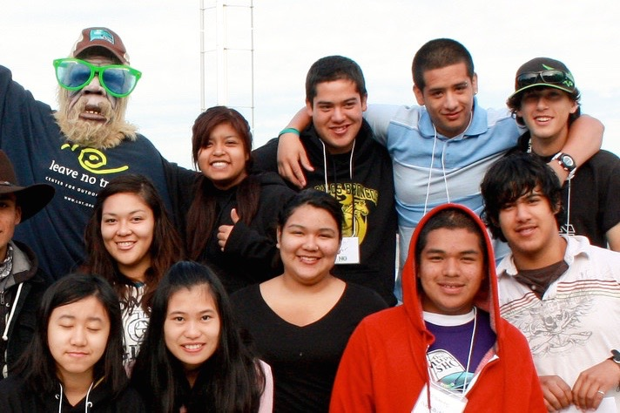
LEAVE NO TRACE FOR
EVERY
KID
Notes:
The Leave No Trace Center for Outdoor Ethics is committed to ensuring that our natural world is left in able hands for generations to come.
Leave No Trace for Every Kid
Leave No Trace for Every Kid is a multiyear initiative to provide Leave No Trace education for every kid who spends time outside. The first step is The National Youth Initiative consisting of:
Developing and delivering comprehensive, standardized curriculum for outdoor youth programs delivered to youth programs (camps, YMCA, Boys and Girls Clubs, Girl Scouts and Boy Scouts) to integrate principles into camp and other programs’ cultures;
Creating and delivering a Leave No Trace Youth Program Endorsement that increases the collective, positive environmental footprint through program-wide minimum impact practices. Formal Leave No Trace education among this important demographic will increase the number of children and adults that learn vital Leave No Trace skills and principles, ultimately improving the care and quality of our natural world.
Additionally, the Center visits schools and camps to provide education: More American kids now practice Leave No Trace because of 740 school and camp visits from the Center last year.
MORE INFO AS NEEDED:
The Center launched a National Youth Initiative focused on providing comprehensive Leave No Trace programs for camps and outdoor youth-serving programs. 2015 included the development of youth-based camp curriculum, the selection of 20 camps for participation in the pilot, and the development of a Nature Keepers program for kids.
In partnership with Penn State University, the Center designed a youth-focused study to gain understanding of youth perceptions and attitudes about Leave No Trace. The 2016 study is being conducted in conjunction with Shavers Creek Environmental Learning Center in Pennsylvania.

Slide 14
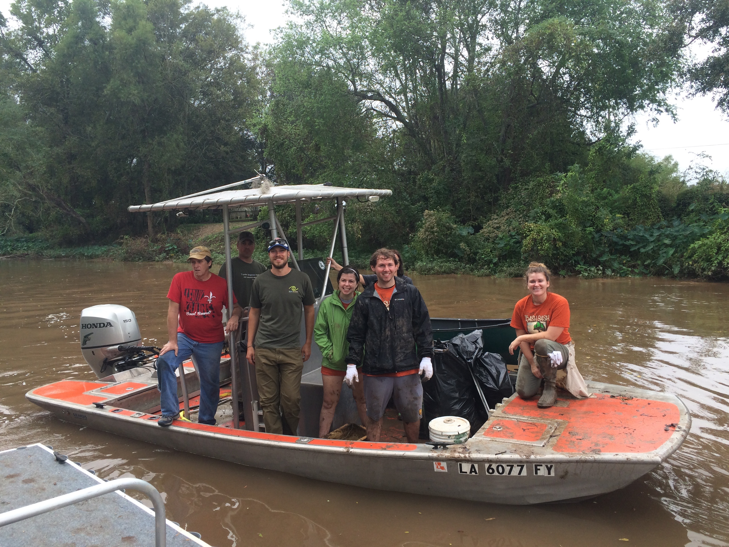
POWER OF
PARTNERSHIP
Notes:
Partners: Federal, state and local land management agencies, corporations, NGOs, schools and universities, outfitters guide services that carry the program millions of their their visitors, constituents, customers and students.
Thousands of members and volunteers are key partners who carry Leave No Trace into their communities.
This vast array of partners domestically and internationally, are the ground troops to support Leave No Trace education, research and outreach.
Let’s take a look at how these partners play a role with Leave No Trace:

Slide 15
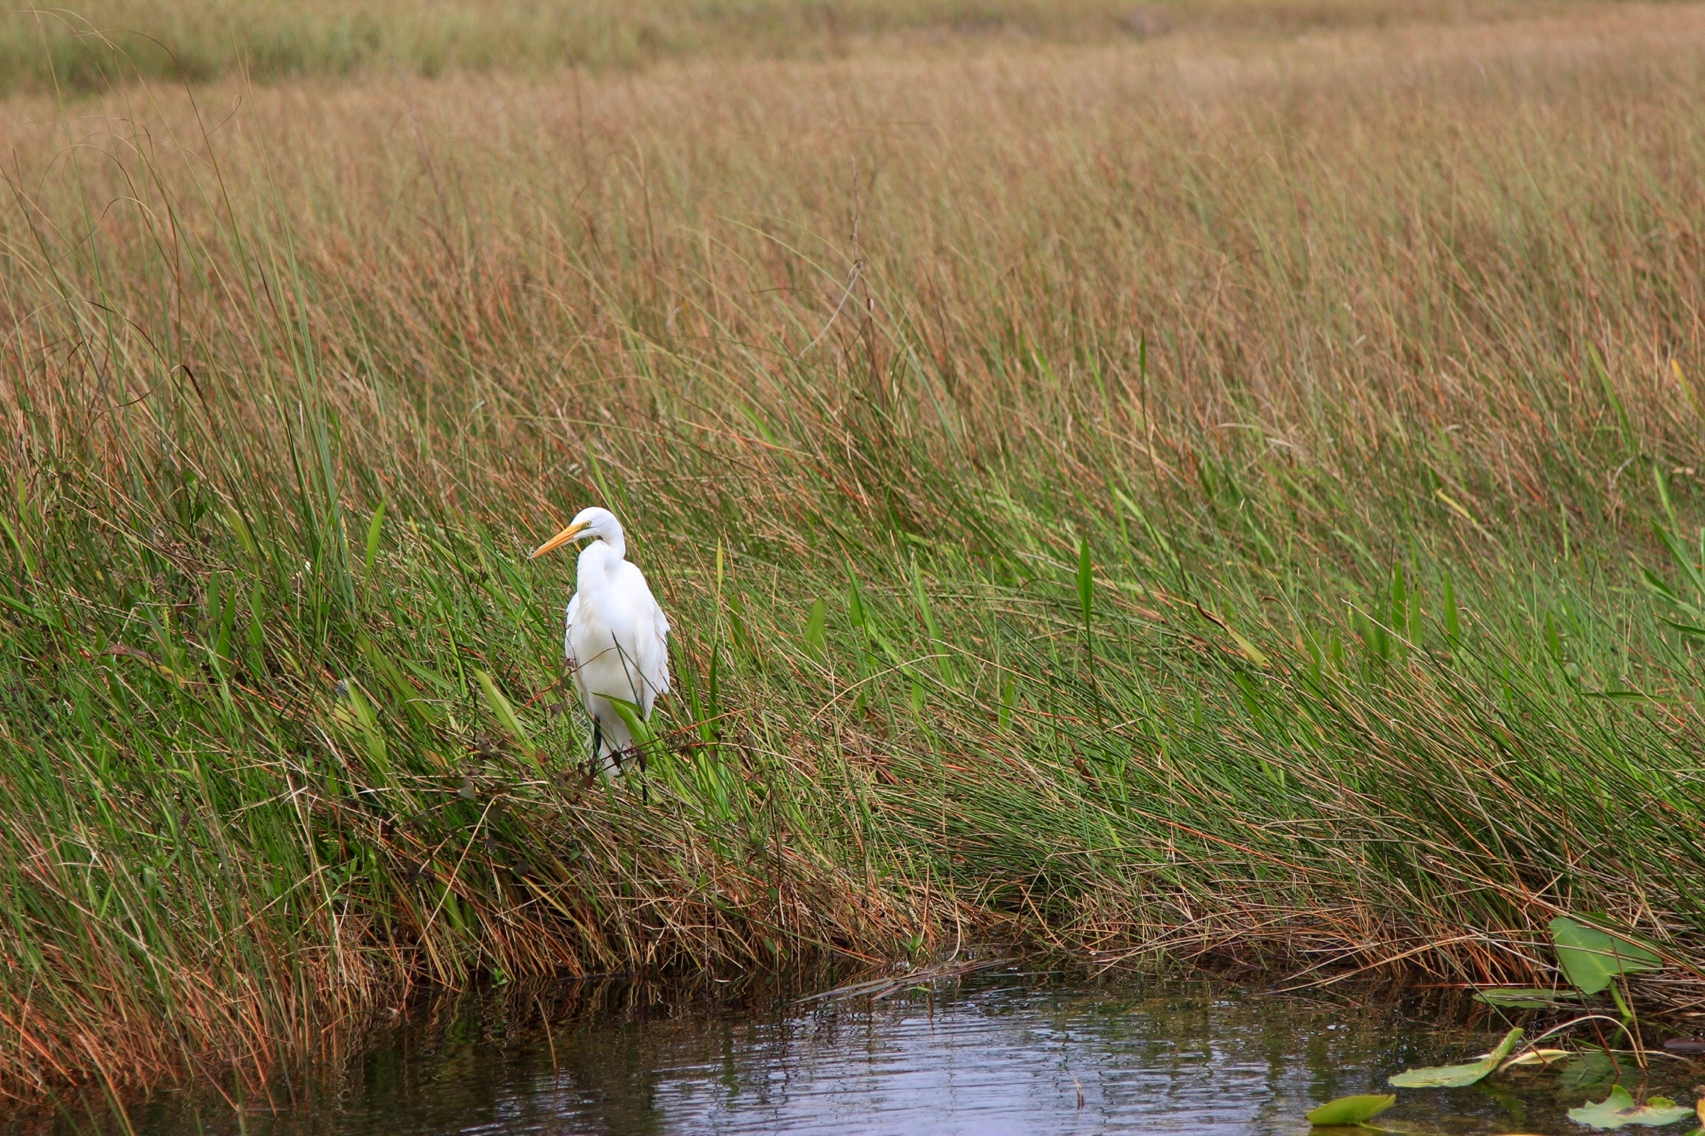






PARTNERS
Federal, State & Local
Land Management Agencies
Notes:
Federal agency partners play a critical role in providing Leave No Trace information to millions of people each year. Currently, the Center for Outdoor has formal partnerships with the five largest land management agencies in the U.S. to provide Leave No Trace education on public lands. Each these agencies has staff trained in Leave No Trace who train other agency personnel and the general public. The federal agencies have national Leave No Trace coordinators who collaborate with the Center.
The Center has formal partnerships with all of the country’s state parks through the National Association of State Park Directors.
Local/County/Municipal agencies also partner with Leave No Trace to incorporate the program on the lands they manage.

Slide 16
Notes:
Consider the number of people our public lands see each year.
The environmental implications of outdoor use can be staggering, especially given the popularity of outdoor recreation on federal and state lands. According to federal and state data (source – agency websites):

Slide 17
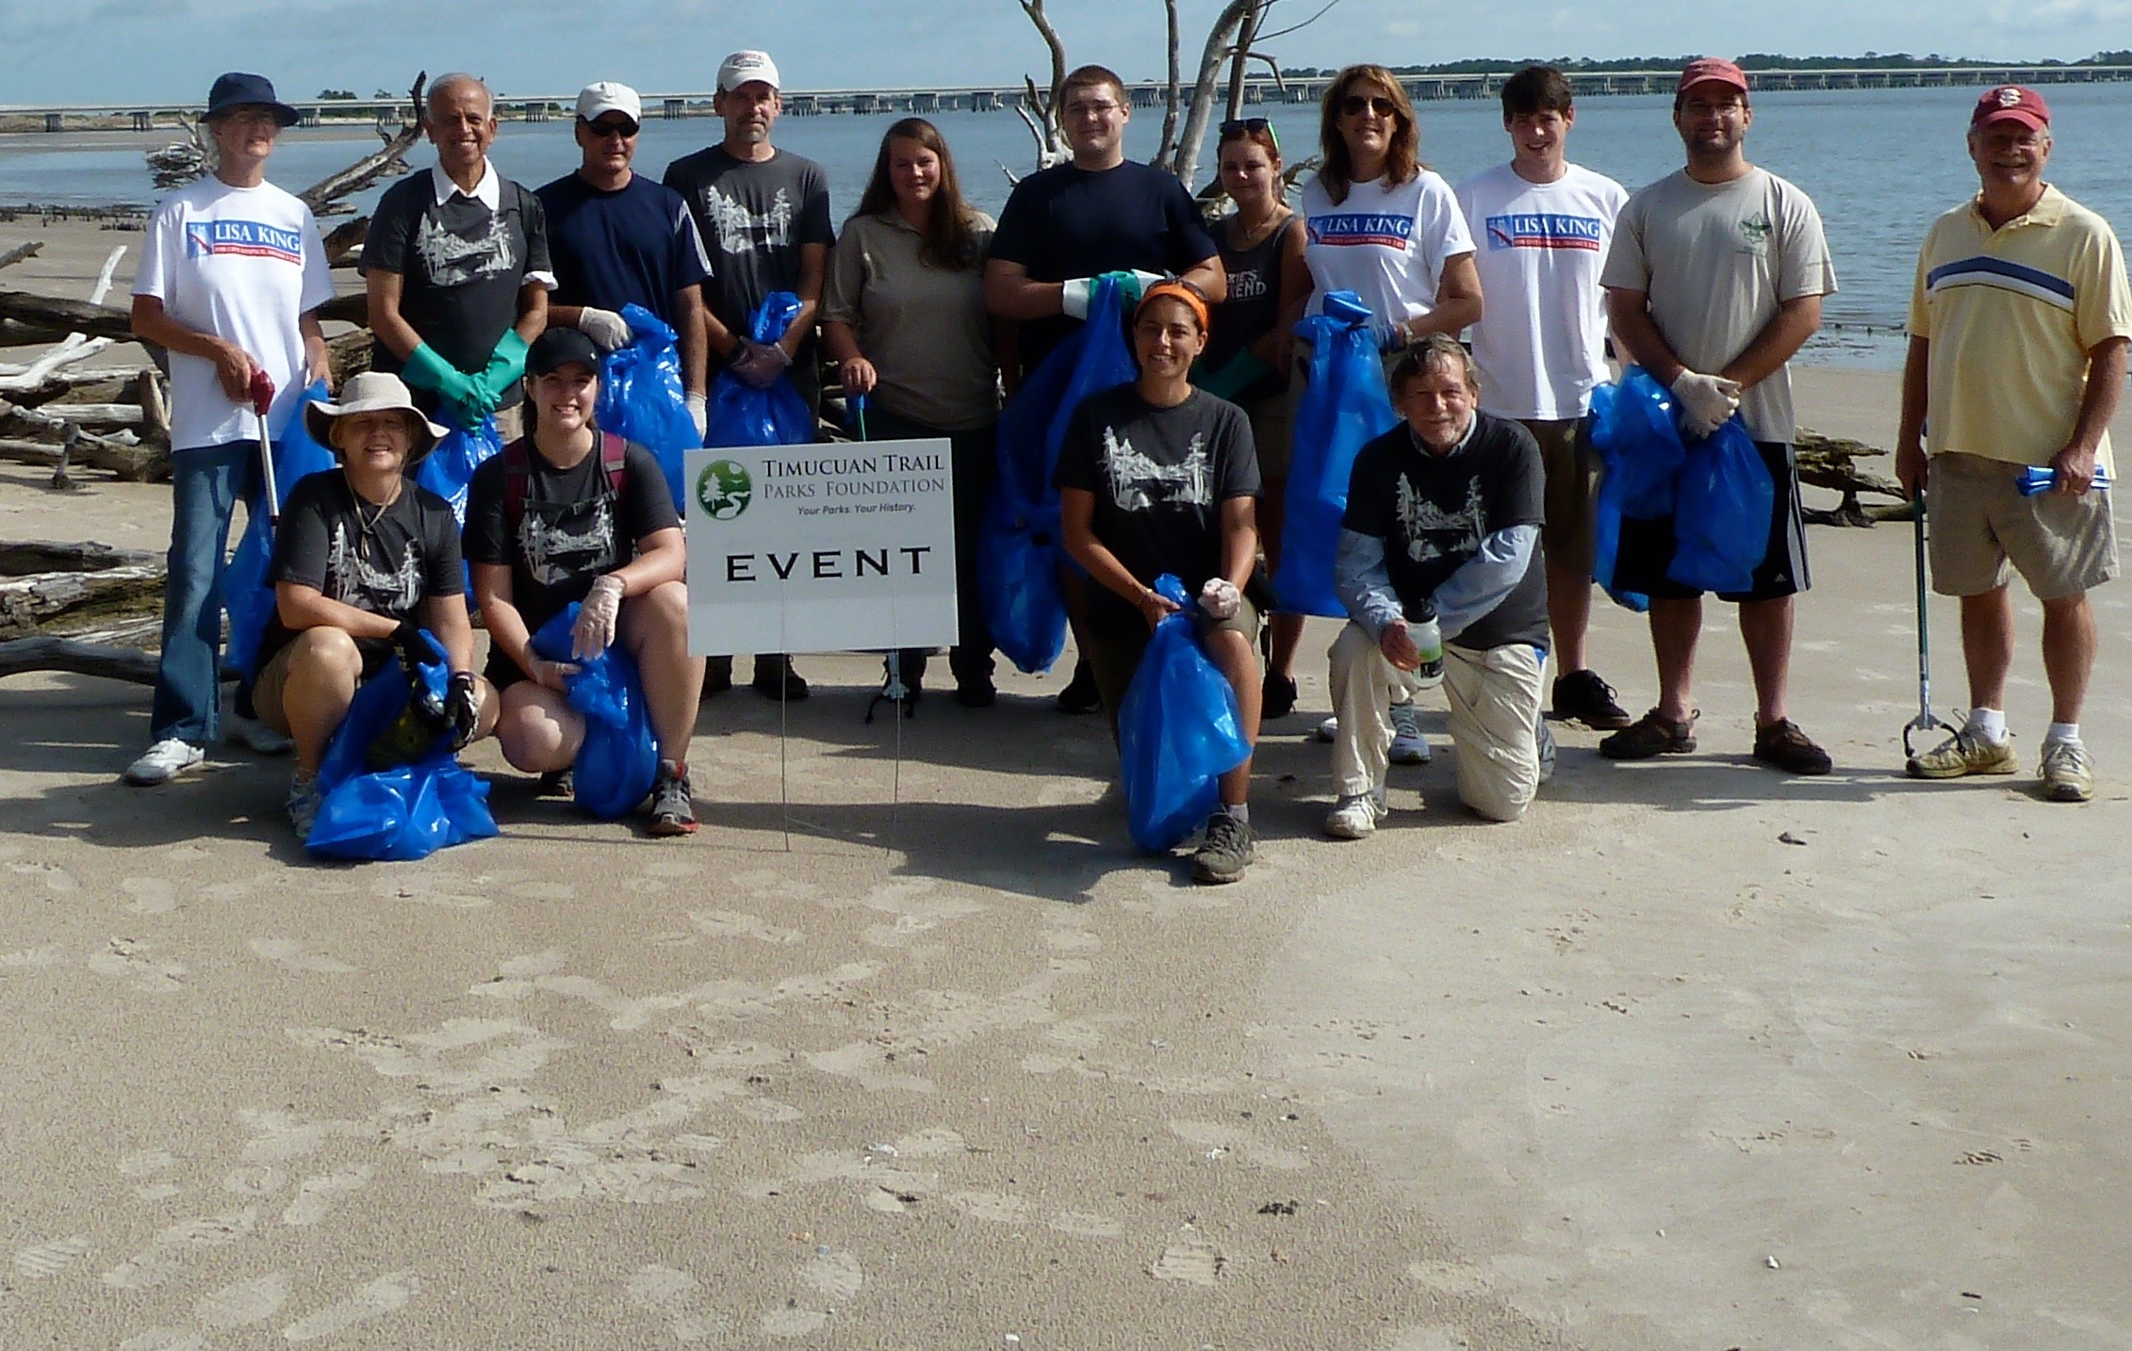
PARTNERS
Corporate &
Community Partners
Notes:
The Center has over 500 active Community and Corporate Partners that are critical to overall Leave No Trace efforts.
Corporate and Community partners are dues-paying
On average, a single community partner reaches 1000 people each year with formal Leave No Trace training. Community partnership is the best way for non-profits, colleges, universities, small businesses, municipalities, clubs, outfitters and guides to publically demonstrate their support of the Leave No Trace movement.
Companies, who support the Leave No Trace mission, also join as corporate partners to lend their support and voice to the movement.
Corporate partnerships have been responsible for funding high impact programs like the Subaru/Leave No Trace Traveling Trainers (4 teams of mobile educators who travel the country offering free education programs) and State Advocates (ensuring that every state has a volunteer coordinator and educator).

Slide 18
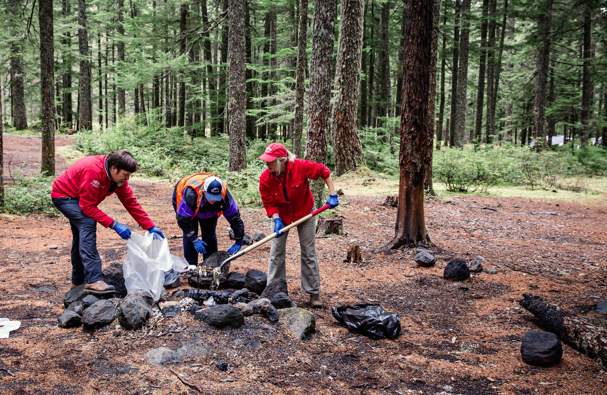
MEMBERS &
VOLUNTEERS
Notes:
7,000 members and 30,000 volunteers make up the base of on-the-ground advocacy for Leave No Trace. They support Leave No Trace by providing volunteer training in their communities, making financial contributions to the organization’s work and rallying the on-the-ground troops.

Slide 19
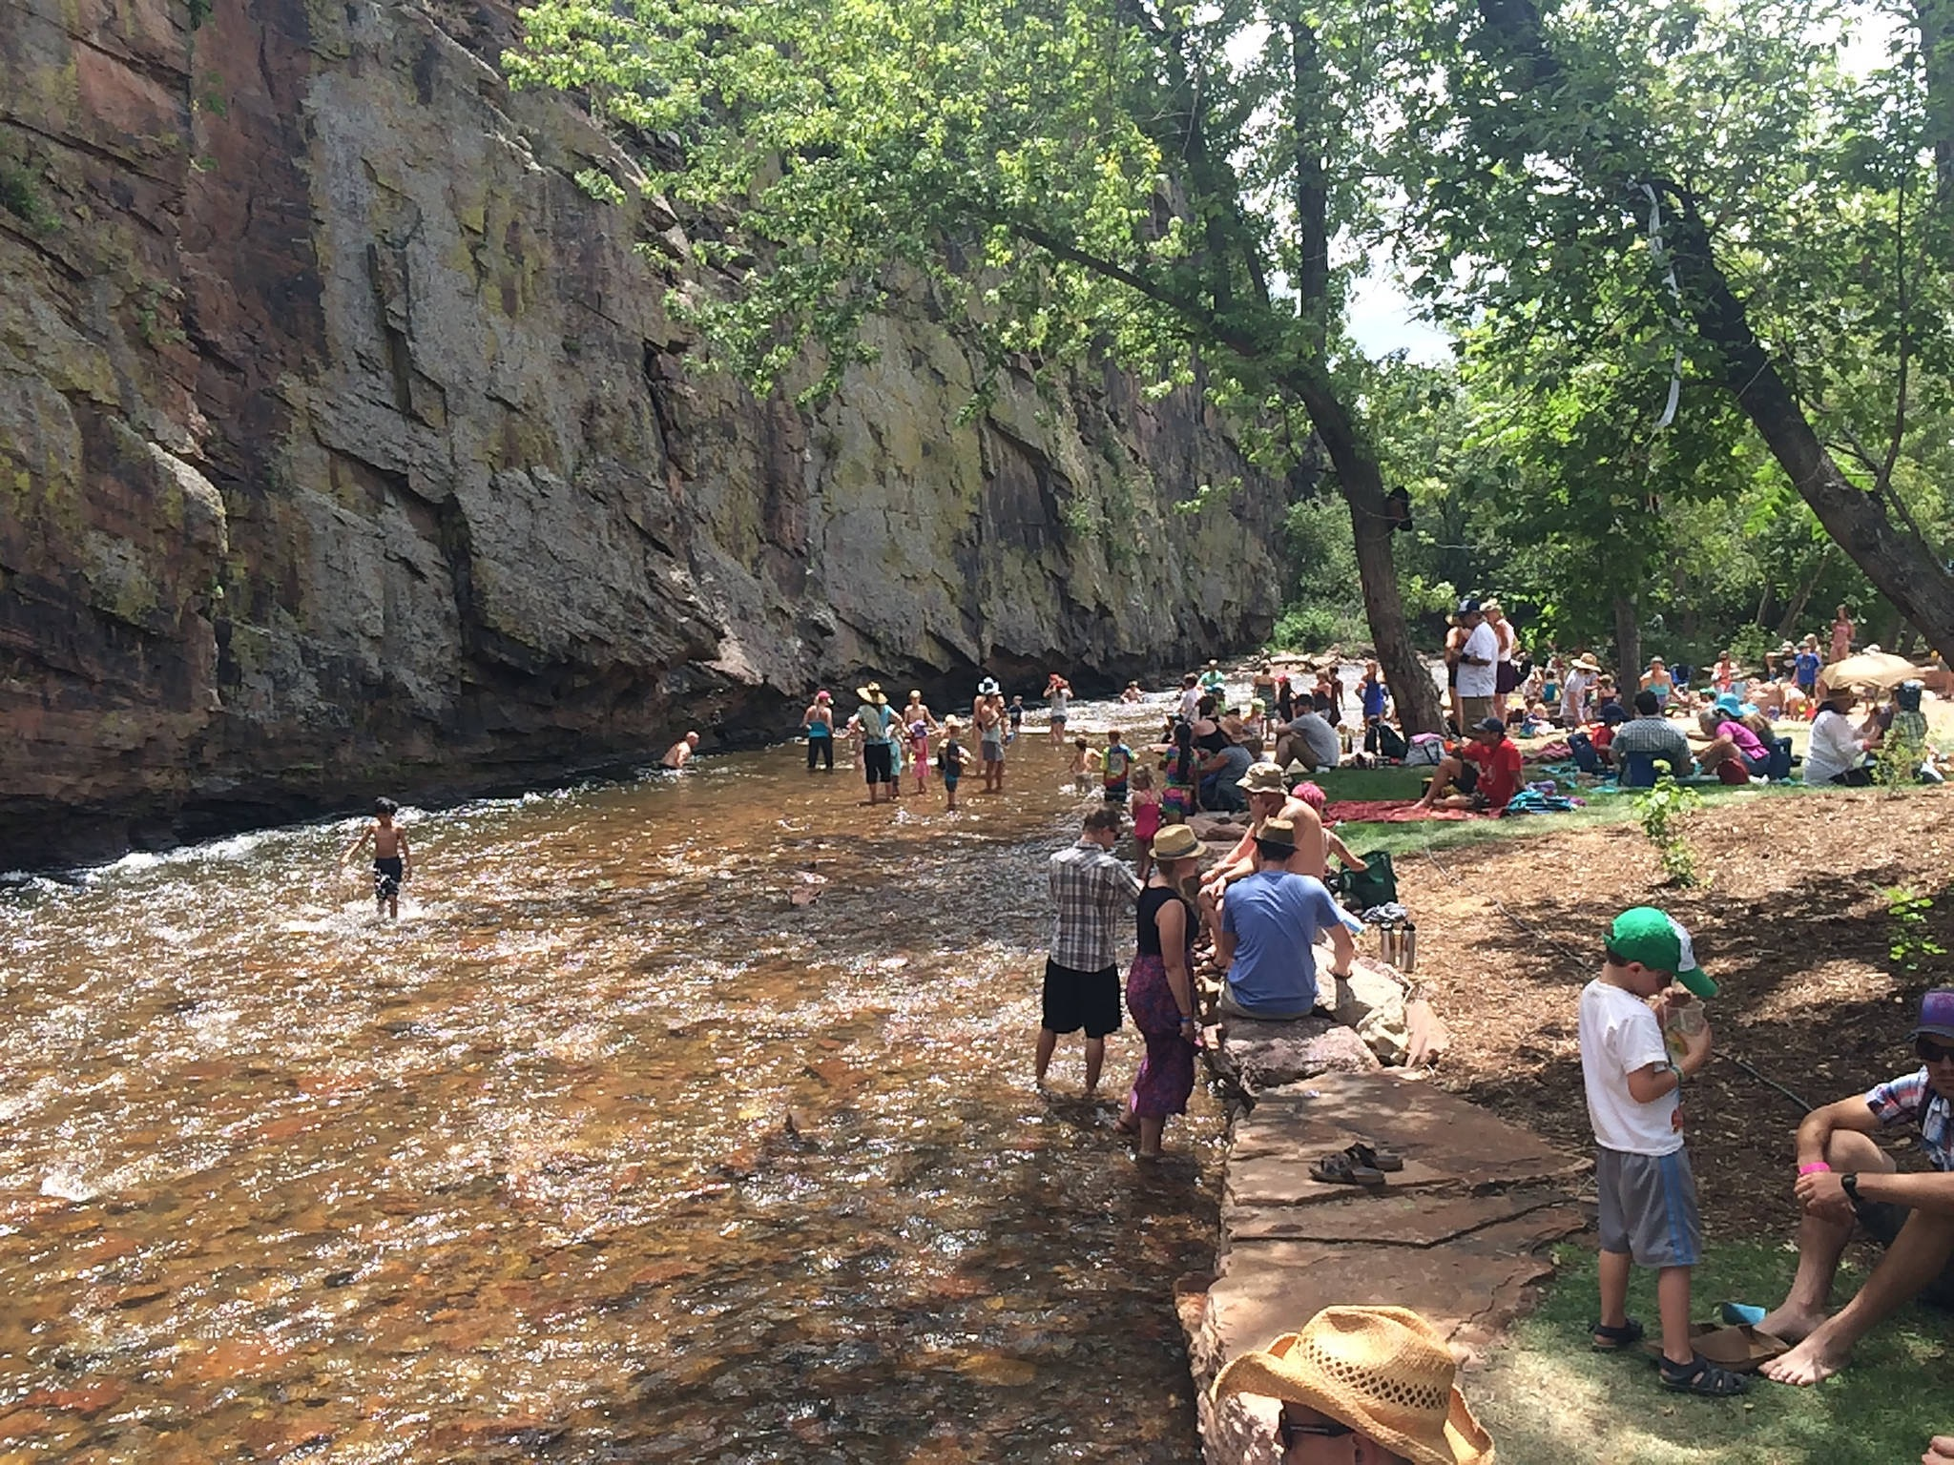
SCIENCE
Notes:
-Data-driven in its approach. Whether conducting its own studies, or drawing from the findings of recent research, the Center utilizes empirical data to ensure strong education programs, high-quality training, and sound best practices.
Existing Leave No Trace scientific literature aligns with the disciplines of recreation ecology, and human dimensions of natural resources. Recreation ecology is a field of study that examines the impact of visitors to protected areas, and has provided the underpinning for Leave No Trace messaging because of its focus on recreation-related impacts.
-One of most important causes of visitor-created impacts is impactful visitor behavior, which aligns with human dimensions. Human dimensions of natural resources research seeks to interpret humans’ attitudes towards, perceptions of, and interactions with the ecosystem. Leave No Trace-focused research of this kind is limited but increasing.
Recently the Center has usedan approach to explore Leave No Trace-related behaviors of interest which has primarily consisted of visitor observation coupled with paired survey data. This methodology provides the opportunity to ask study participants what they would do while also observing what they actually do in a park or protected area context.
Through multi-method, experimental designs including unobtrusive observation, and paired visitor survey data collection, these kinds of studies allow for the examination of attitudes and motivations that lead to a reduction of recreation-related impact.

Slide 20
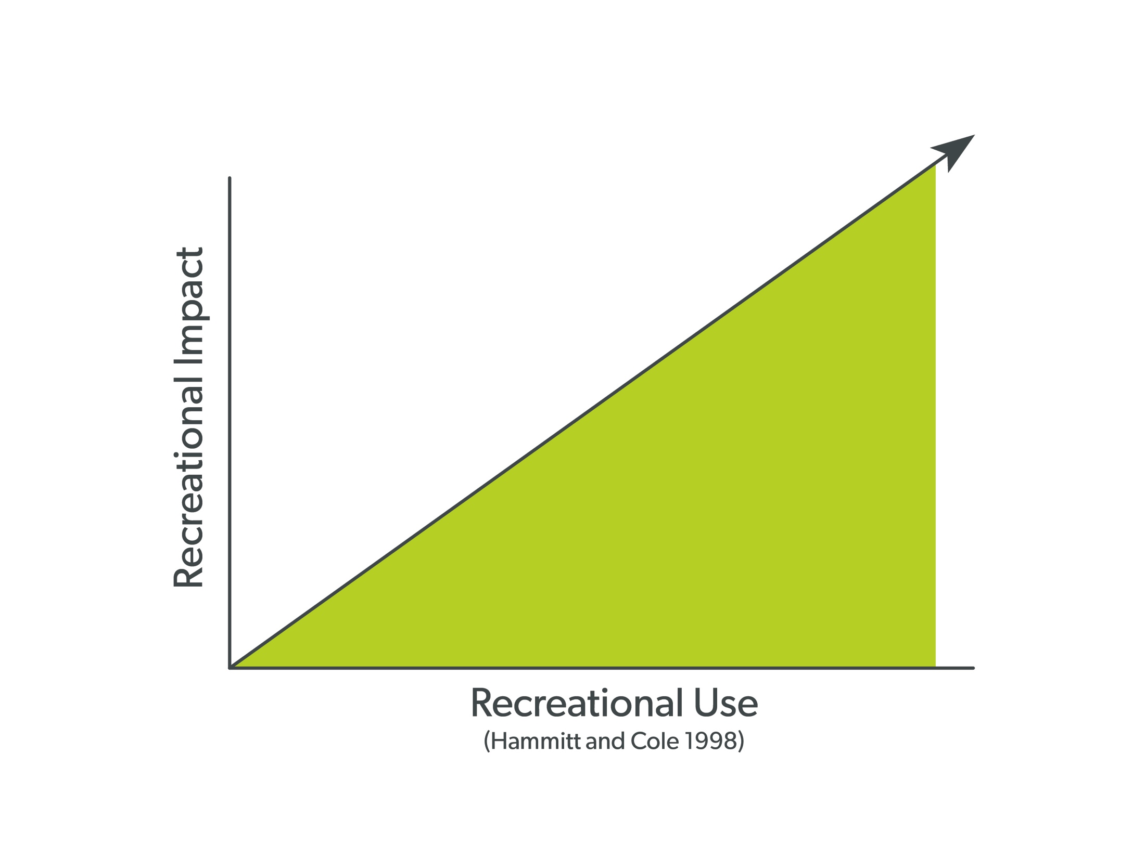
HYPOTHETICAL RELATIONSHIP:
Use & Impact
Notes:
Scientists have proposed a hypothetical relationship between recreational use and recreational impact. The thinking is that as use increases, so does overall impact. In some areas this is definitely the case. In other areas, not as much.

Slide 21
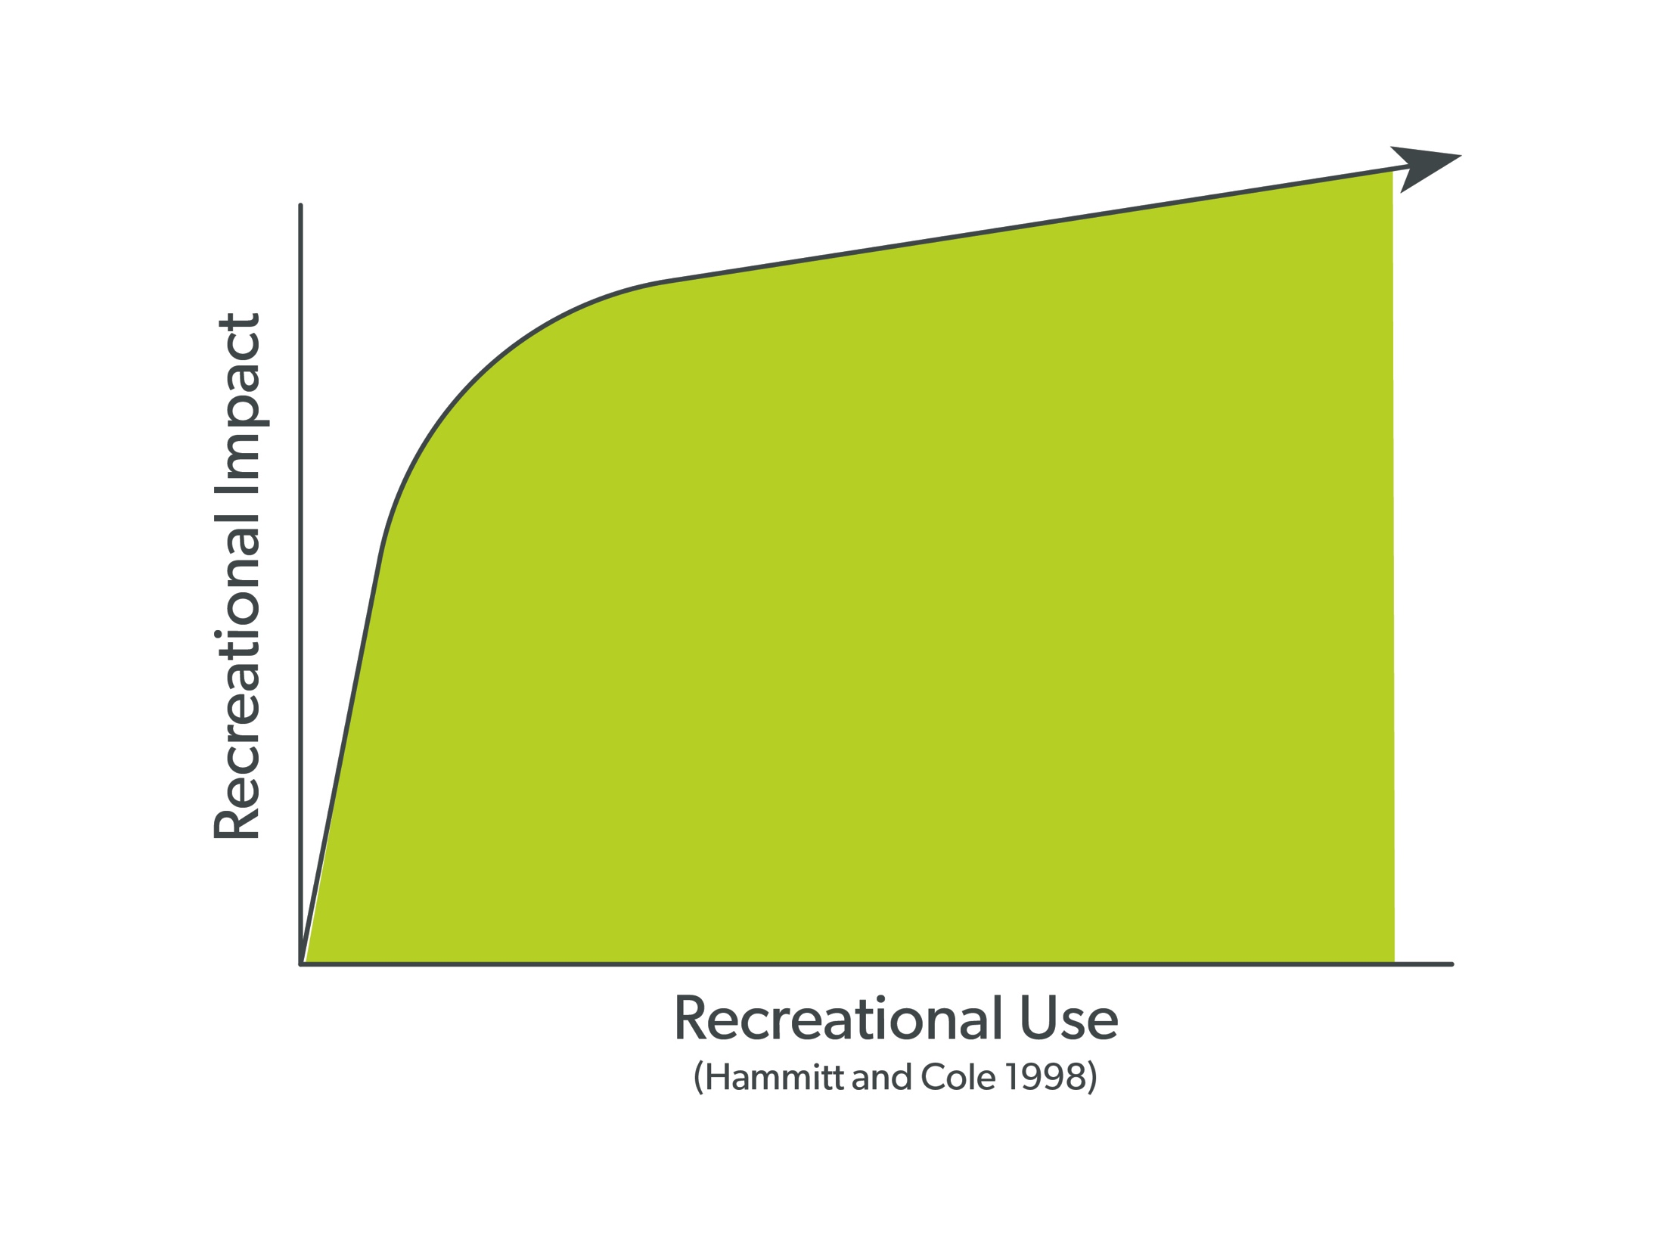
HYPOTHETICAL RELATIONSHIP:
Use & Impact
Notes:
Yet the goal of Leave No Trace is to change the relationship between use and impacts. Ideally, use could increase without the continued increase in impact due to everyone spending time outdoors putting Leave No Trace into action.
Leave No Trace provides the foundation and framework necessary for sustainable enjoyment of the outdoors now and well into the future.

Slide 22
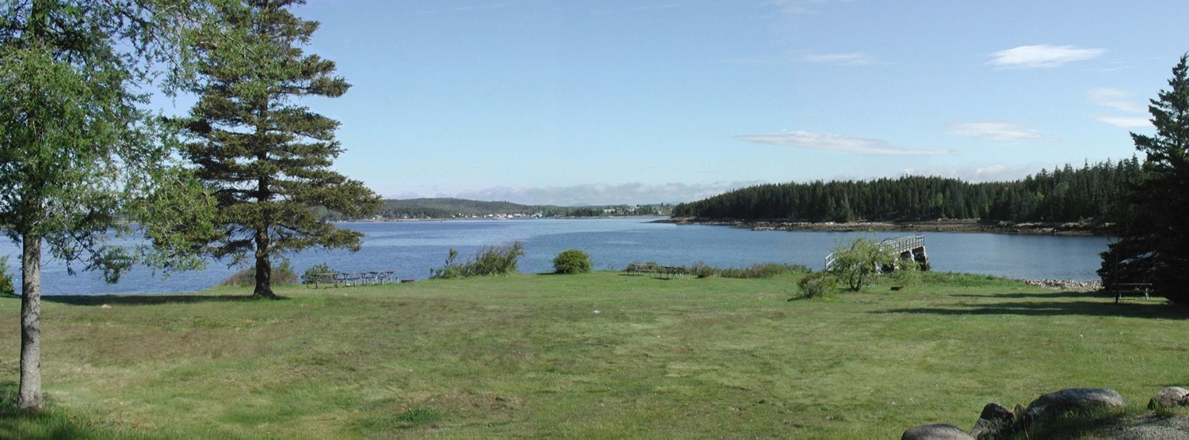
Notes:
Here is a typical park or protected area scene – grass, trees, water, etc.

Slide 23
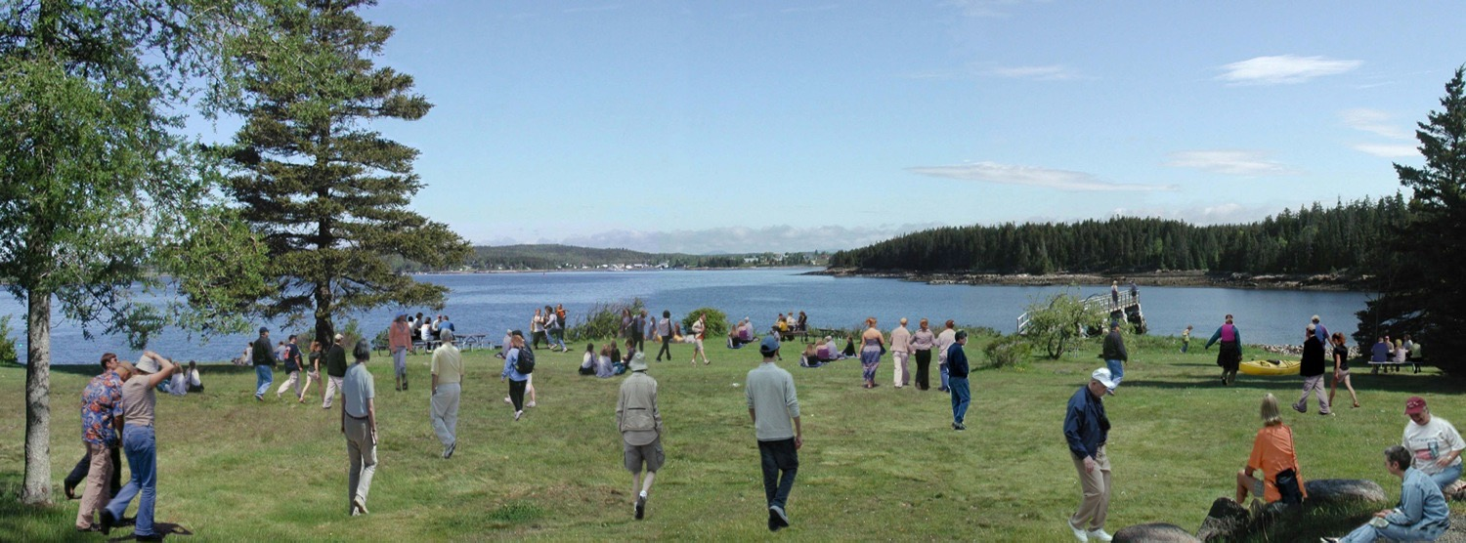
Notes:
Now come the people, and potentially the impacts. Given how many of us are spending time outside, the question is how much impact is being created?

Slide 24
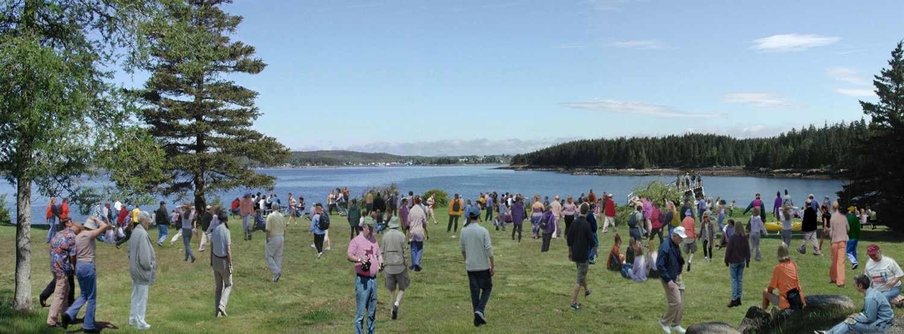
Notes:
Add more people to the mix and the potential for increased impact rises. This is where Leave No Trace comes in.
By teaching all people how to enjoy the outdoors responsibly we can collectively ensure the continued protection of our share lands for current and future generations.
It’s not necessarily about tomorrow but the day after tomorrow. It’s about the legacy we leave behind.

Slide 25
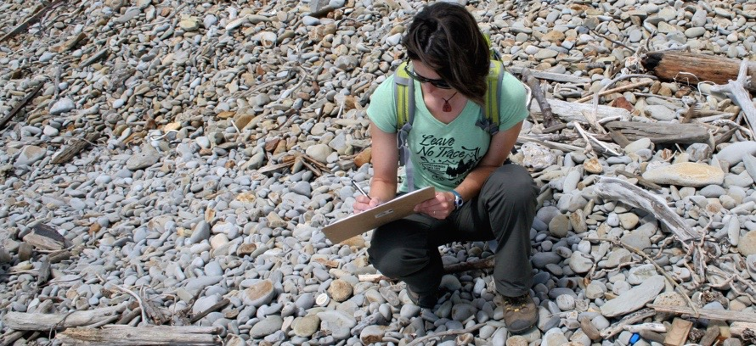
2016
RESEARCH
Notes:
We conduct research to help Leave No Trace hone new, effective ways to educate the public about sustainable recreation and enjoyment in the outdoors, and how to most effectively protect public lands:
2016:
Finalizing two Colorado-based studies related to trail use and climbing (bouldering) related issues.
Publishing results from a Wyoming-based study of state park visitors.
Conduct new Pennsylvania-bases study to further understand effective ways to teach Leave No Trace to children.
Planning for studies in 2017 focusing on pet waste, rock climbing and trash in parks and protected areas.

Slide 26
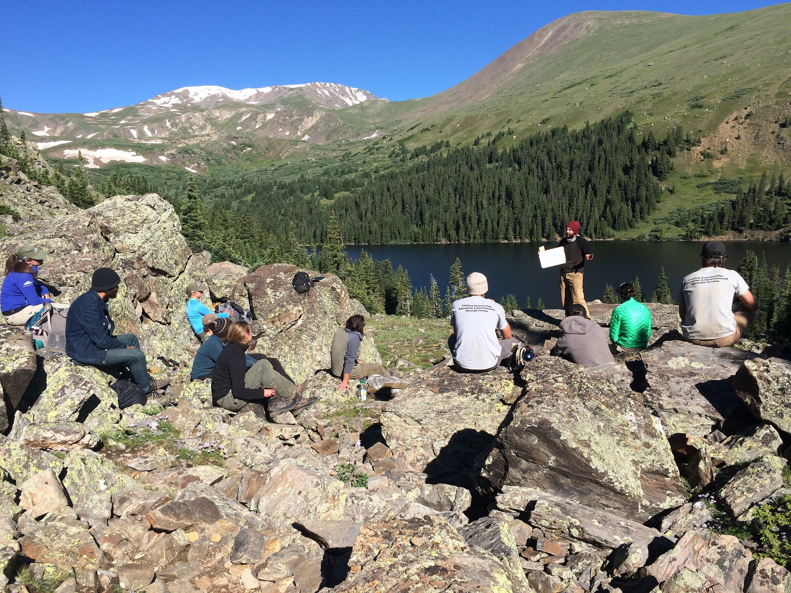
LEAVE NO TRACE
TRAINING &
EDUCATION
Notes:
We use the training and education to support the Leave No Trace mission and ensure that all outdoor enthusiasts have the skills to leave places as good or better than they found them.
Multitude of options from courses, workshops, online training, outreach and Leave No Trace literature and guides.

Slide 27
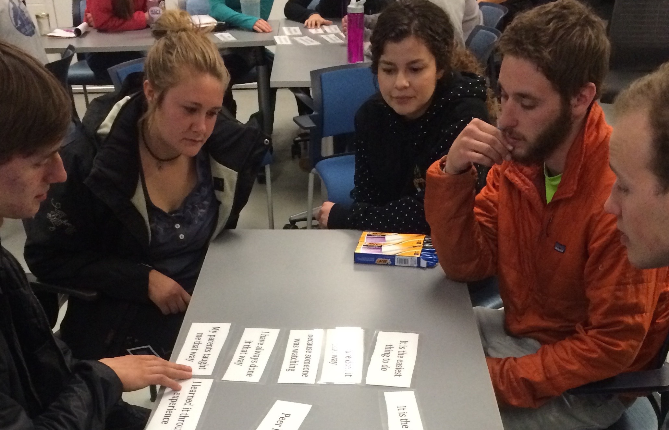
TRAINING
The Center offers training options across the country
Notes:
There are three tiers of Leave No Trace training that provide differing education levels.
The first, and least intensive, is an awareness workshop, which lasts 30 min to a full day and offers introductory Leave No Trace concepts designed for the general public. Millions have attended awareness workshops and they continue to be a popular way to get trained.
The next option is a 2-day trainer course taught in the field by Leave No Trace Master Educators across the country. The trainer course results in a certificate of completion. Currently, there are over 40,000 Leave No Trace trainers, worldwide.
The comprehensive Leave No Trace Master Educator course is a 5-day, field-based training designed specifically for educators or those interested in teaching Leave No Trace. There are nearly 7500 Master Educators in the US and abroad.

Slide 28
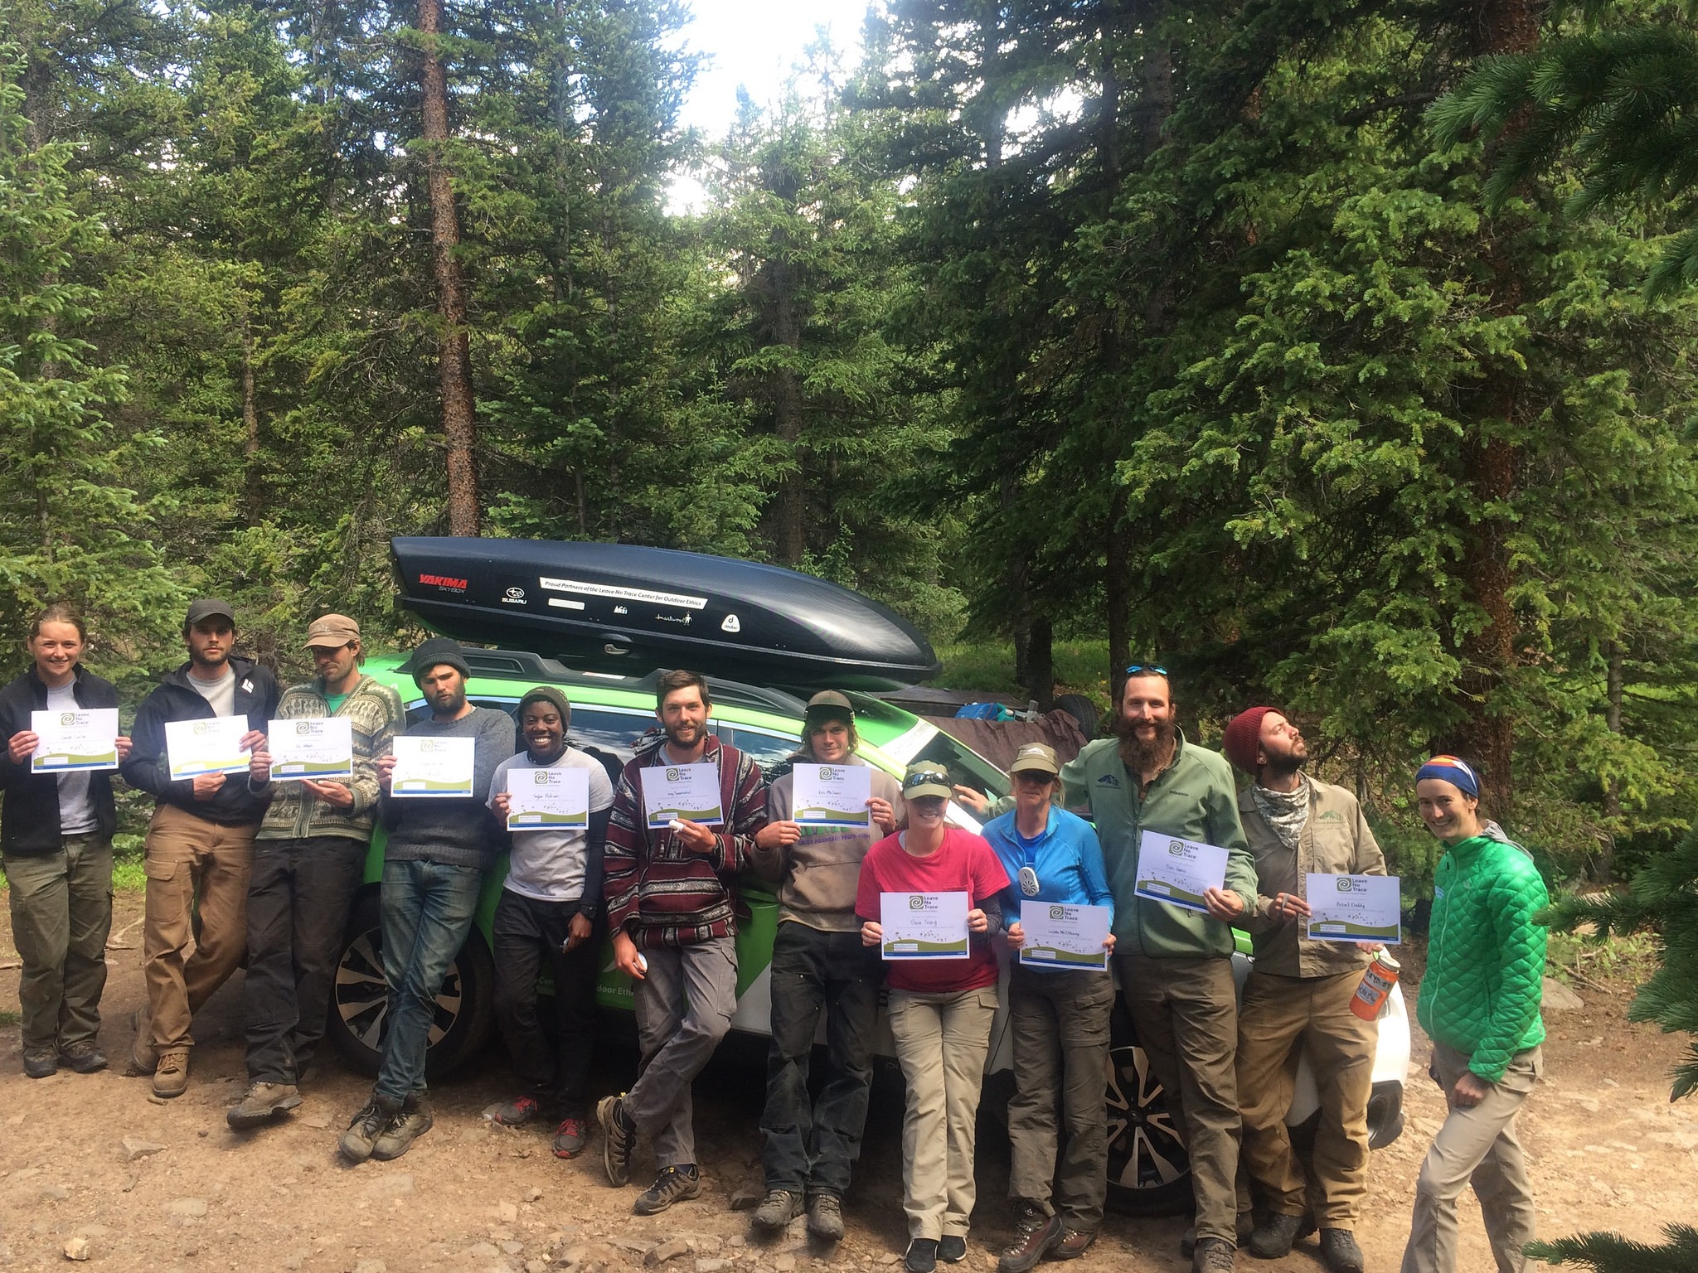











2015-2019
MASTER
EDUCATOR
COURSE PROVIDERS
Notes:
Today there are more than 7,000 Master Educators around the globe.
The Center’s partnerships with some of the country’s leading outdoor education institutions ensures that the Leave No Trace Master Educator Course is taught to a broad cross-section of people.

Slide 29
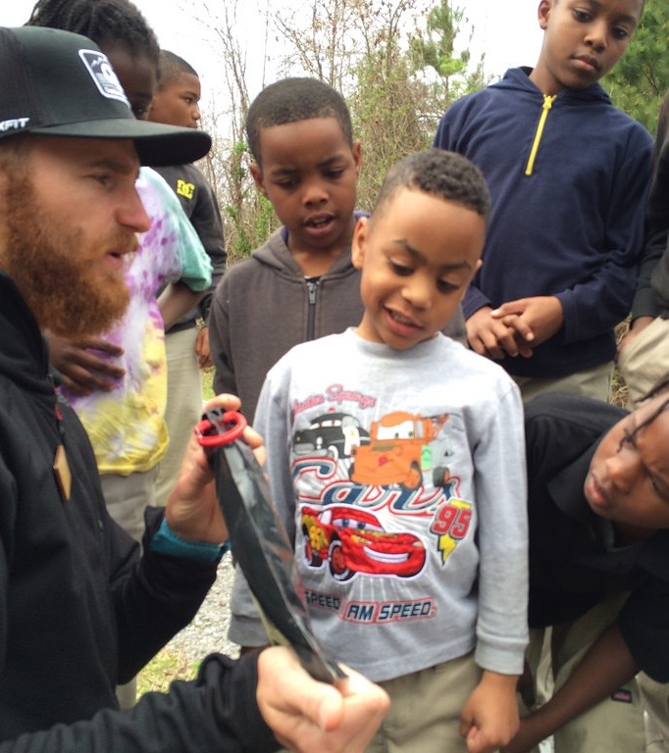
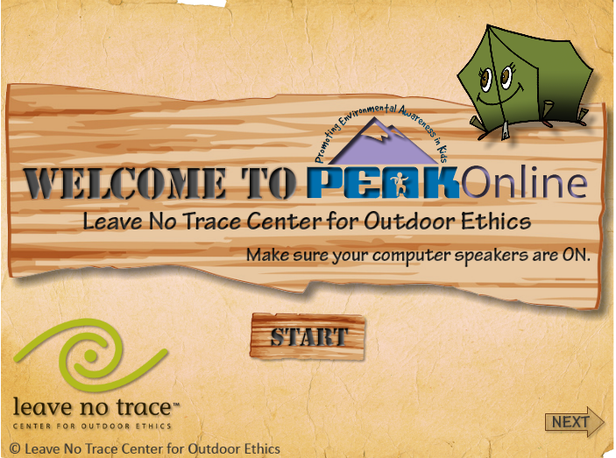
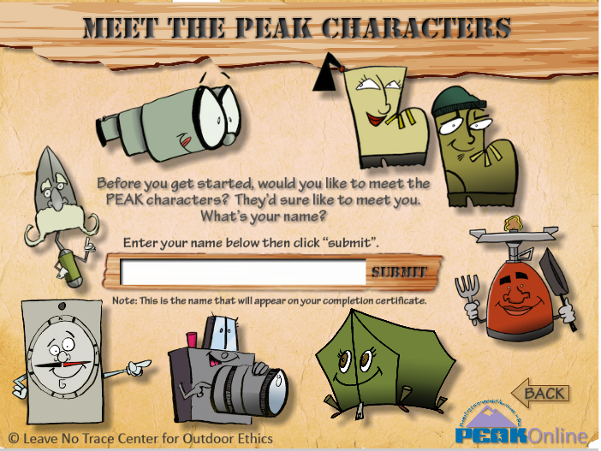
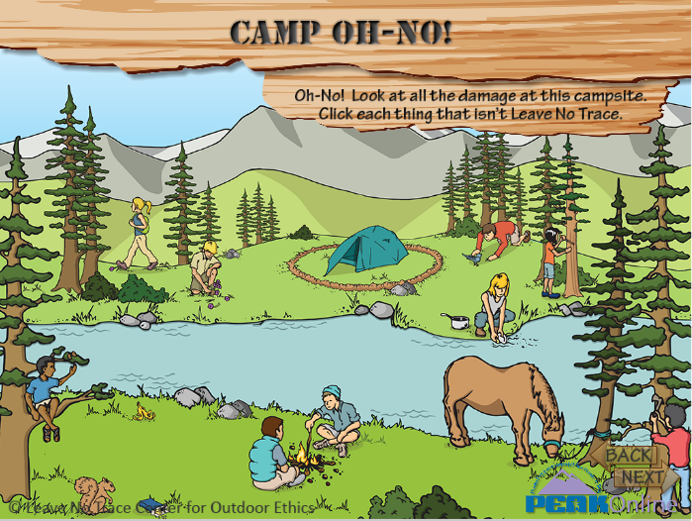
YOUTH
TRAINING
Notes:
The Center has a broad variety of tools to teach children. The most prominent are PEAK and TEEN.
PEAK (Promoting Environmental Awareness in Kids), and TEEN are presented as a “pack” of 30-1 hour Leave No Trace experiential activities to do with kids of all ages. The program is fee-based, with free downloads on the Leave No Trace website.
PEAK is available in Spanish.
Web-based version of the program called PEAK Online that is a collection of 5 fun, interactive activities to help kids learn about Leave No Trace.

Slide 30
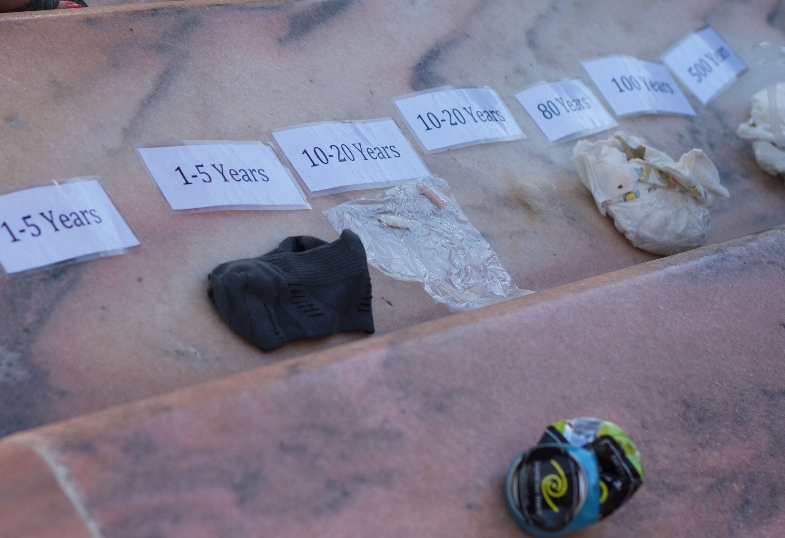
ONLINE
LEARNING
Notes:
In addition to our PEAK online program, our website serves as great resource for learning about Leave No Trace, and provides other ways to get involved.
A popular web-based option is taking an online awareness workshop, which is designed to convey general Leave No Trace knowledge. Anyone age 12 or older can participate in an online awareness workshop, and those who complete it receive a certificate of completion.
Another opportunity for existing Master Educators is an Online Master Educator Refresher Course, which ensures that Leave No Trace Master Educators are current on their knowledge. This online refresher takes about 90 minutes to complete and is required once every two years for Master’s who teach Leave No Trace Trainer Courses.

Slide 31
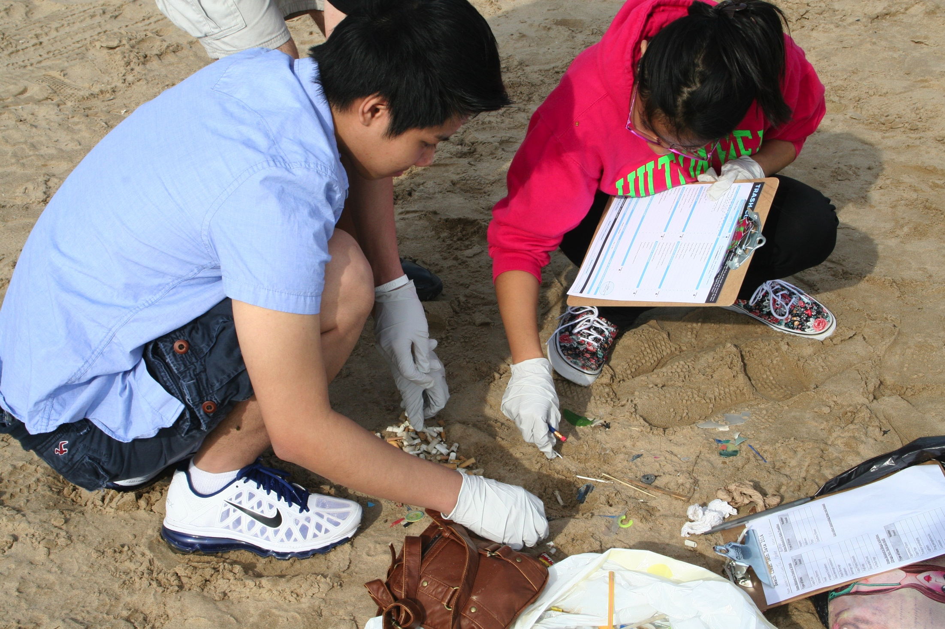
learn
HOW TO GET INVOLVED
LEARN
Notes:
Educate yourself by:
Take advantage of the organization’s broad selection of books and other educational materials
Reading a Leave No Trace Skills & Ethics booklet: a short booklet that takes you through Leave No Trace for various ecosystems and outdoor activities
Choosing from one of the course options
Join Leave No Trace’s YouTube channel and watch the many Leave No Trace skills videos

Slide 32
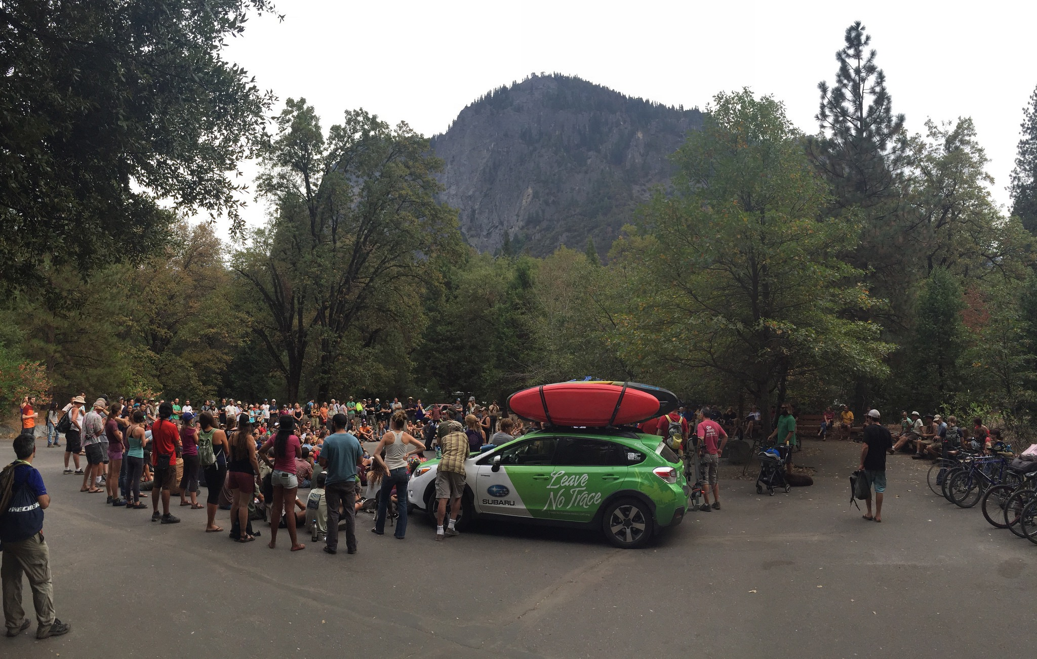
HOW TO GET INVOLVED
JOIN US
Notes:
Easy ways to get involved where you are:
Introduce a kid to Leave No Trace through PEAK online
Contact the Center and become a Citizen Scientist to get involved with Leave No Trace monitoring in your area
Join the movement as a member: supporting what you care about, and be in the know about the latest science, research and skills.
Encourage your organization or company to become an official partner of Leave No Trace. Any group can get involved.
Join 150K+ strong, active, engaged social media family: Facebook, Twitter, Instagram and SnapChat

Slide 33
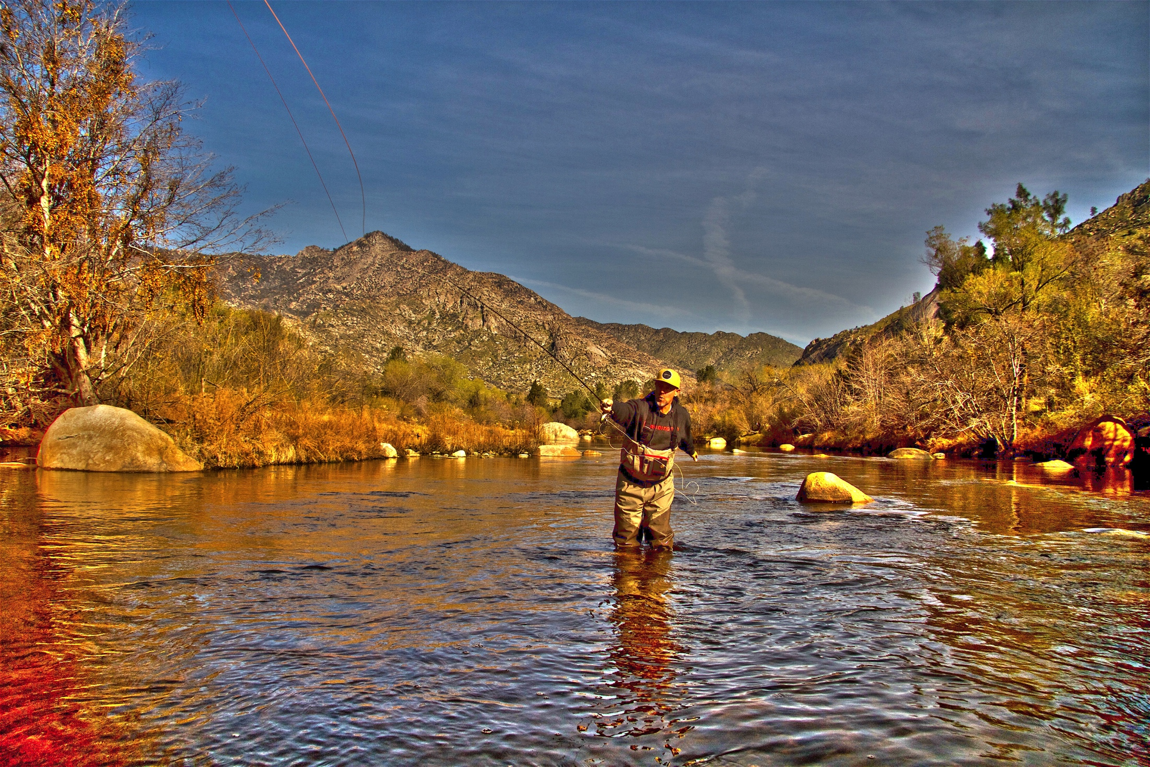
HOW TO GET INVOLVED
PASS IT ON
Notes:
Share Leave No Trace, even a simple principle, with other people when you’re enjoying the outdoors.
Contact your Leave No Trace State Advocate to learn about opportunities to teach others in your community.
Forward Leave No Trace videos from YouTube, educational blogs and more.
It’s so easy.

Slide 34




SPECIAL THANKS TO OUR PARTNERS

Slide 35
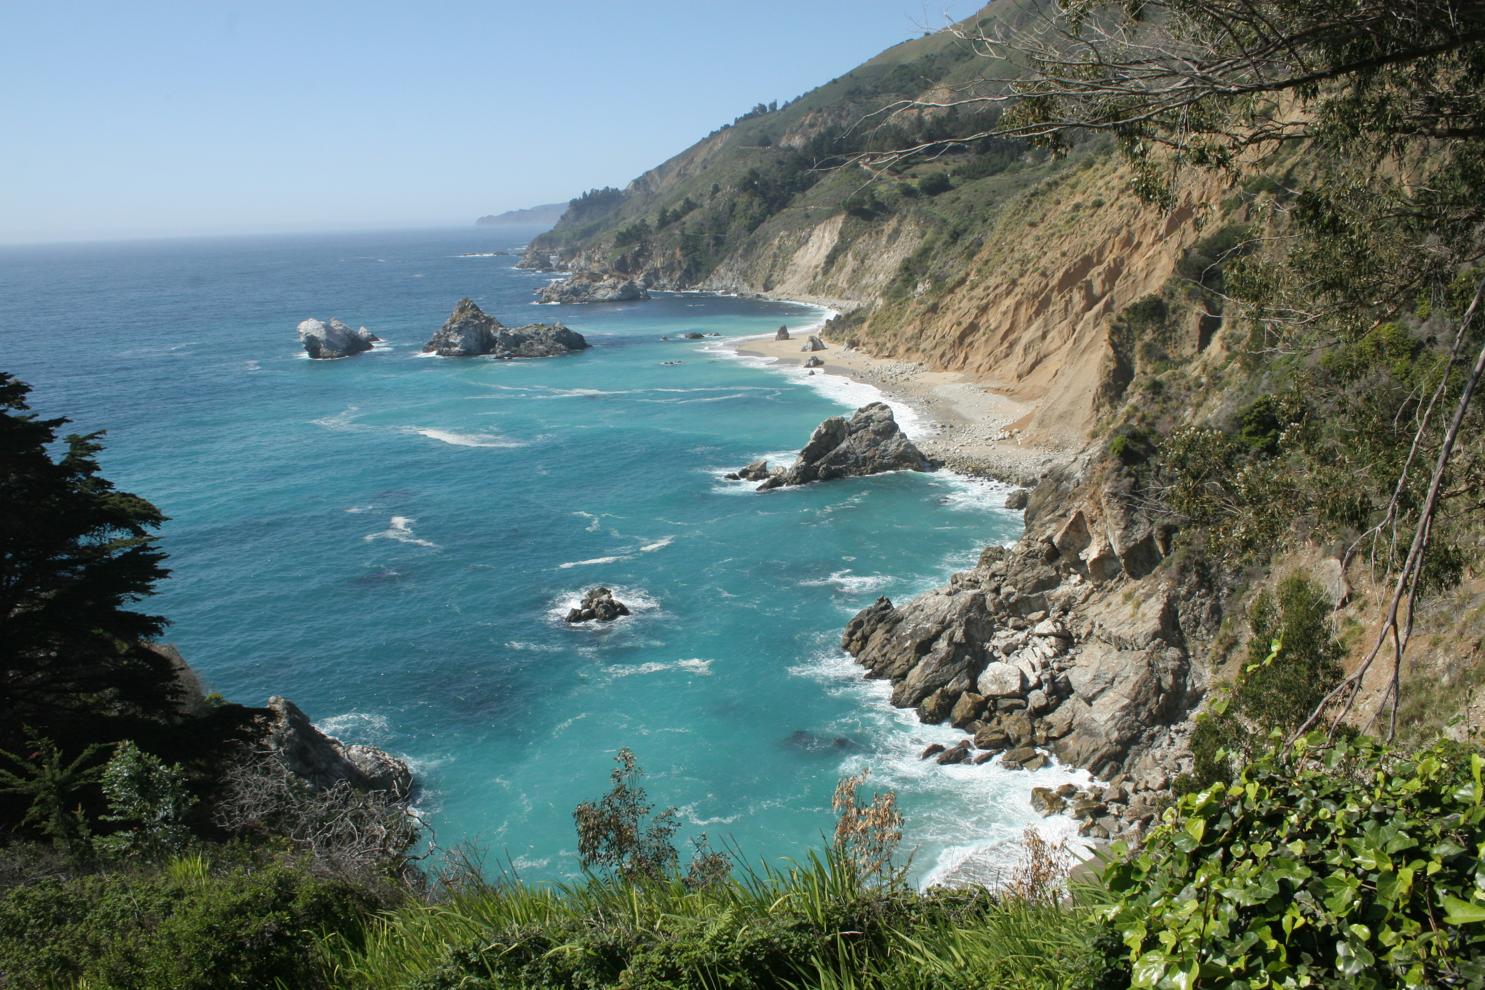

ENJOY YOUR WORLD.
LEAVE NO TRACE.
© 2016 Leave No Trace Center for Outdoor Ethics

